Slide 1
Tangent linear and adjoint models
for variational data assimilation
Angela Benedetti
with contributions from:
Marta Janisková, Philippe Lopez, Lars Isaksen, Gabor Radnoti and
Yannick Tremolet

Slide 2
Introduction
4D-Var is based on minimization of a cost function which measures the distance between the model with respect to the observations and with respect to the background state
The cost function and its gradient are needed in the minimization.
The tangent linear model provides a computationally efficient (although approximate) way to calculate the model trajectory, and from it the cost function. The adjoint model is a very efficient tool to compute the gradient of the cost function.
Overview:
  Brief introduction to 4D-Var with focus on TL/AD aspects
  General definitions of Tangent Linear and Adjoint models and why they are extremely useful in variational assimilation
  Writing TL and AD models and testing them
  Brief mention of automatic differentiation software

Slide 3
4D-Var
In 4D-Var the cost function can be expressed as follows:
B background error covariance matrix,
R observation error covariance matrix (instrumental + interpolation +
observation operator error),
y_i observations
x_o initial model state
x_b background state
M forward nonlinear forecast model (time evolution of the model state, index i),
H observation operator (model space → observation space).
H’^{T} = adjoint of observation operator and M’^{T} = adjoint of forecast model.

Slide 4
Incremental 4D-Var at ECMWF
In incremental 4D-Var, the cost function is minimized in terms of increments:
with the model state defined at any time t_{i} as:
is the trajectory around which the linearization is performed (
at t=0)
4D-Var cost function can then be approximated to the first order by:
where
is the so-called departure computed using the nonlinear model and observational operator.
The gradient of the cost function to be minimized is:
and are the tangent linear models which are used in the computations of incremental updates during the minimization (iterative procedure).
and are the adjoint models which are used to obtain the gradient of the cost function with respect to the initial condition.

Slide 5
Details on linearisation
In the first order approximation, a perturbation of the control variable (initial condition) evolves according to the tangent linear model:
where i is the time-step index.
The perturbation of the cost function around the initial state is:
where is the linearised version of about and
are the departures from observations.

Slide 6
Details of the linearisation (cnt.)
The gradient of the cost function with respect to is given by:
remembering that
The optimal initial perturbation is obtained by finding the value
of for which:
The gradient of the cost function with respect to the initial condition is provided by the adjoint solution at time t=0. Let’s see how…

Slide 7
Definition of adjoint operator
For any linear operator there exist an adjoint operator
such as:
where is an inner scalar product and x, y are vectors
(or functions) of the space where this product is defined.
It can be shown that for the inner product defined in the
Euclidean space :
We will now show that the gradient of the cost function at time
t=0 is provided by the solution of the adjoint equations at the
same time:

Slide 8
Adjoint solution
Usually the initial guess is chosen to be equal to the
background so that the initial perturbation
The gradient of the cost function is hence simplified as:
We choose the solution of the adjoint system as follows:
(arbitrary “final” condition)
(iterative solution)
We then substitute progressively the solution into the
expression for

Slide 9
Adjoint solution (cnt.)
Finally, regrouping and remembering that and that
and we obtain the following equality:
The gradient of the cost function with respect to the control variable (initial condition) is obtained by a backward integration of the adjoint model.

Slide 10
Iterative steps in the 4D-Var Algorithm
Integrate forward model gives .
Integrate adjoint model backwards gives .
If then stop.
Compute descent direction (Newton, CG, …).
Compute step size :
Update initial condition:

Slide 11
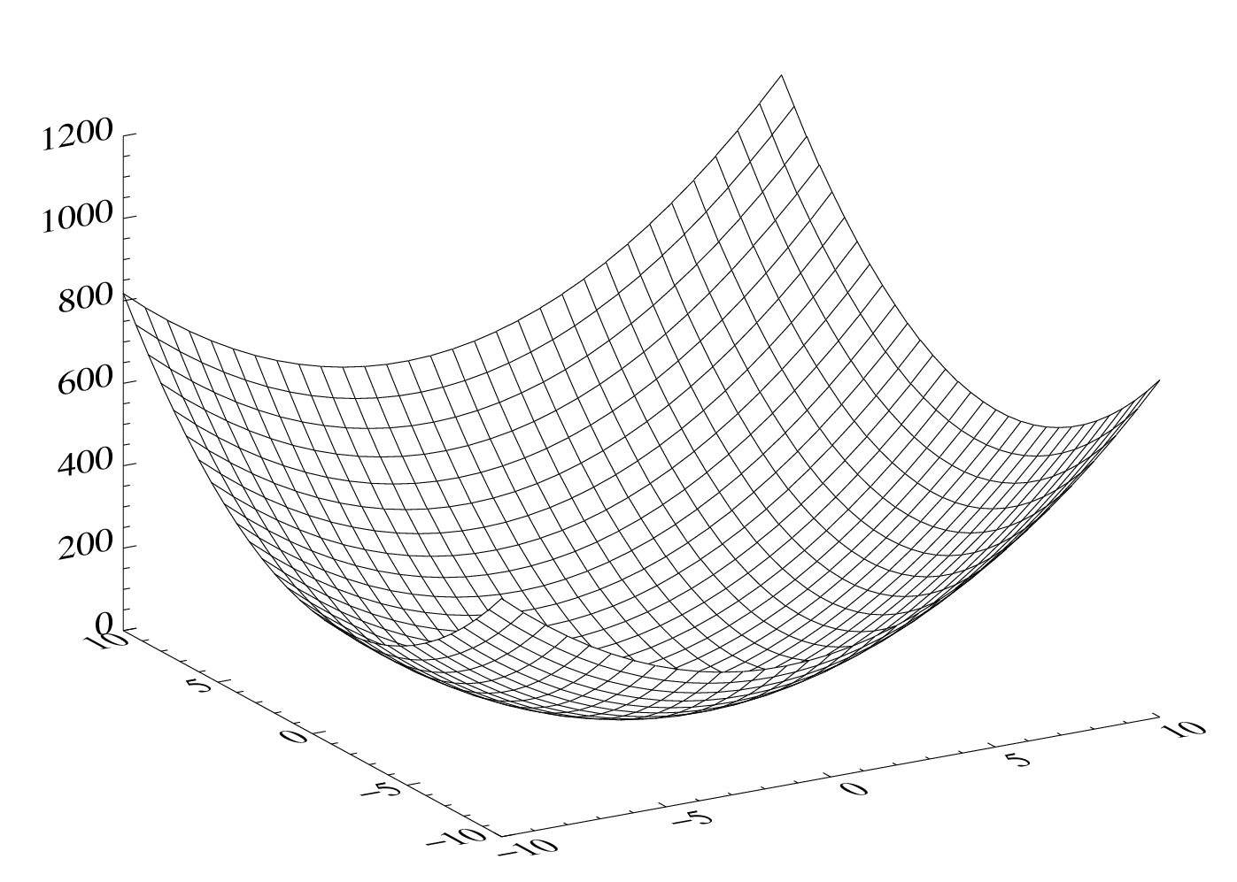
Finding the minimum of cost function J is an
iterative minimization procedure
cost function J
J(x_{b})
J_{mini}
model variable x₂
model variable x₁

Slide 12
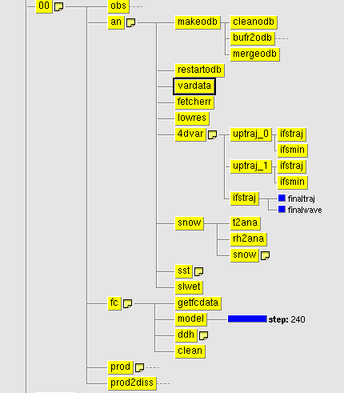
An analysis cycle in 4D-Var
1st ifstraj:
Non-linear model is used to compute the high-res
trajectory (T1279 operational, 12-h forecast)
High-res departures are computed at exact obs
time and location
Trajectory is interpolated at low res (T159)
1st ifsmin (70 iterations):
Iterative minimization at T159 resolution
Tangent linear with simplified physics to calculate
the increments
The Adjoint is used to compute the gradient of the
cost function with respect to the departure in
initial condition
Analysis increment at initial time is interpolated
back linearly from low-res to high-res and it provides
a new initial state for the 2nd trajectory run
2nd ifstraj:
repeat 1st ifstraj and interpolates at T255 resolution
2nd ifsmin (30 iterations):
repeat 1st ifsmin at T255
Last ifstraj:
Uses updated initial condition to run another 12-h
forecast and stores analysis departures in the
Observational Data Base (ODB)
2 minimizations in the old
configuration
Now 3 minimizations
are operational!

Slide 13
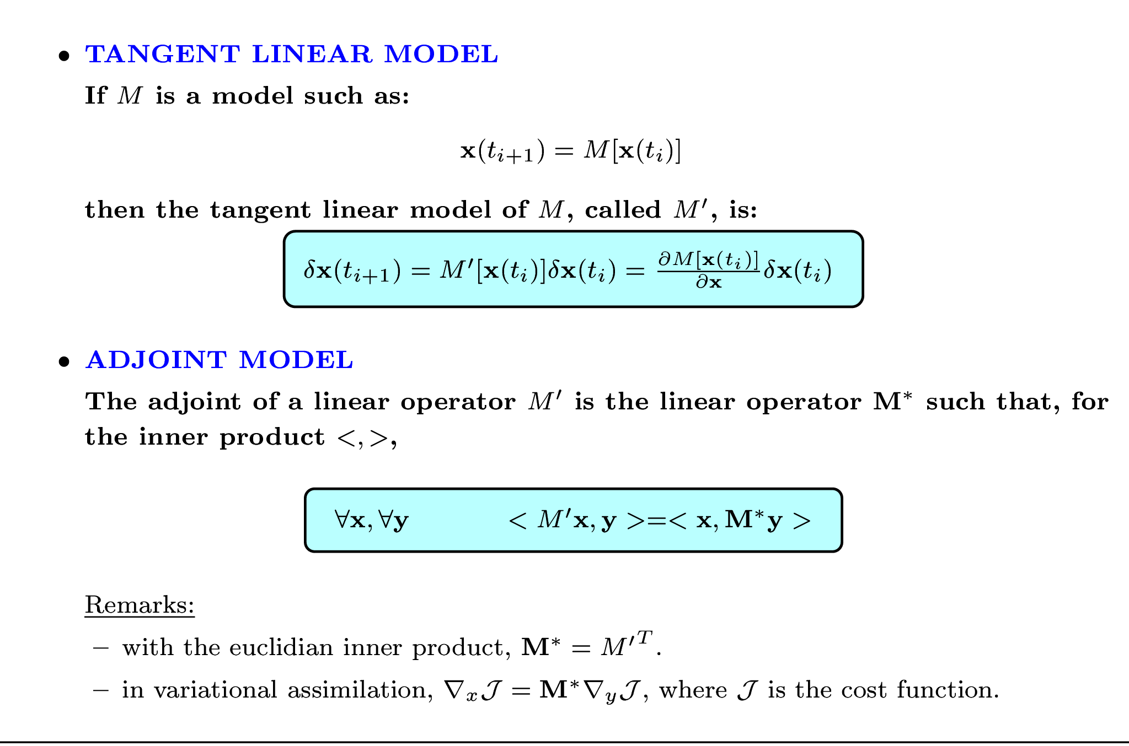
Recap on TL and AD models

Slide 14
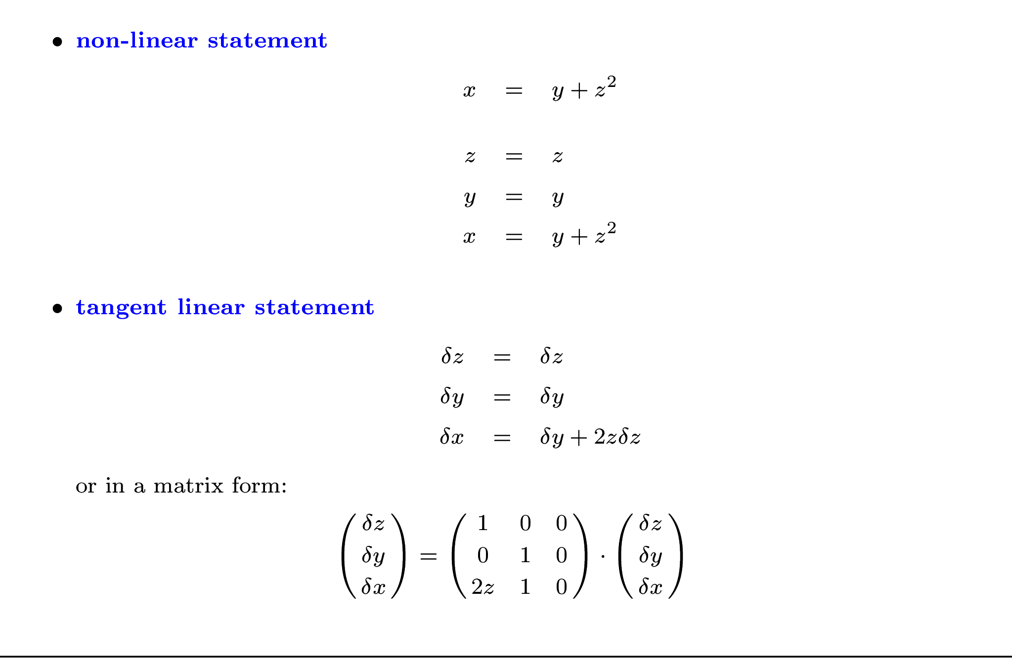
Simple example of adjoint writing

Slide 15
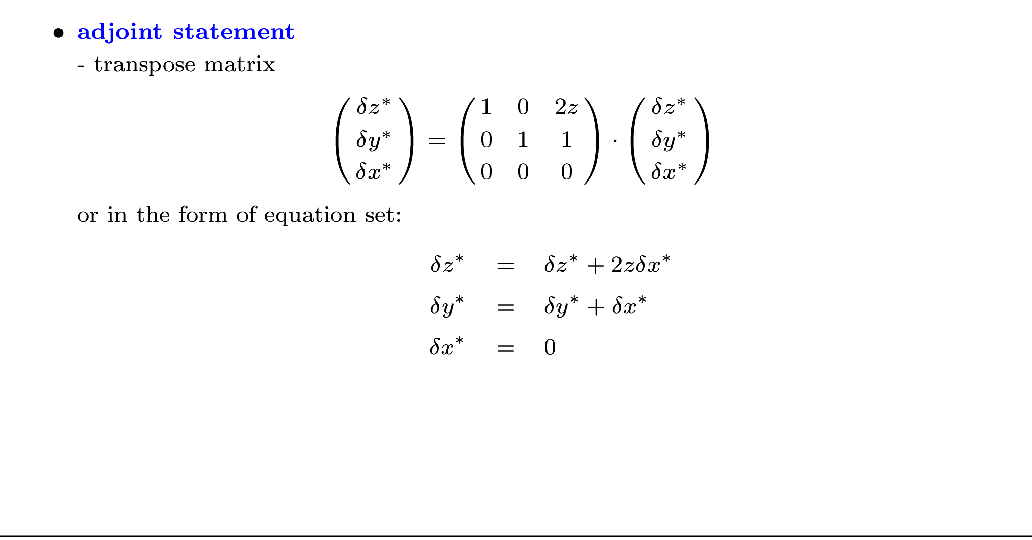
Simple example of adjoint writing (cnt.)
Often the adjoint variables in mathematical formulations are indicated with an asterisk
Do not forget the last equation!!! That too is part of the adjoint!
As an alternative to the matrix method, adjoint coding can be carried out using a line-by-line approach.

Slide 16
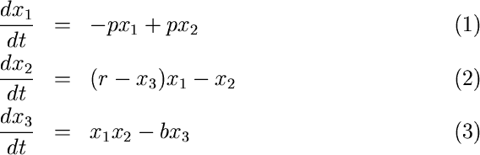
More practical examples on adjont coding: the Lorenz model
where is the Prandtl number, the Rayleigh number, and
the aspect ratio.
is the intensity of convection,
is the maximum temperature difference
is the stratification change due to convection.
Details on the Lorenz model can be found in the references.

Slide 17
The linear code in Fortran
Linearize each line of the code one by one, and set dx/dt=y for simplicity
(and do not focus on the fact that y is a time derivative, just consider it a dependent variable):
y(1) = -p*x(1) +p*x(2) :Nonlinear statement
(1)yd(1) = -p*xd(1) +p*xd(2) :Tangent linear
y(2) = x(1)*(r-x(3)) -x(2) :Nonlinear statement
(2)yd(2) = xd(1)*(r-x(3))
-x(1)*xd(3) -xd(2) :Tangent linear
…etc
Remember that p, r, b are constants;
x(1), x(2) and x(3) are the independent variables;
y(1), y(2) and y(3) are the dependent variables.
We chose the suffix “d” for the tangent linear variable for consistency with the automatic differentation software TAPENADE (see optional practical exercise). Adjoint variables are indicated with the suffix “b”. This is just a convention.
Note that in the ECMWF Integrated Forecast System (IFS) the tangent linear and adjoint variables are indicated without any subscripts and the nonlinear trajectory (x) is indicated with the suffix “5” (x5).

Slide 18
Adjoint of one instruction
We start from the tangent linear code:
yd(1)=-p*xd(1)+p*xd(2)
In matrix form, it can be written as:
which can easily be transposed (asterisk indicates adjoint variables):
The corresponding adjoint code in FORTRAN is:
xb(1)=xb(1)-p*yb(1)
xb(2)=xb(2)+p*yb(1)
yb(1)=0

Slide 19
Adjoint of one instruction (II)
We start again from the tangent linear code:
yd(2)= xd(1)*(r-x(3))-xd(2)- x(1)*xd(3)
In matrix form, it can be written as:
These terms come from the
trajectory! Needs to be stored
in memory or recomputed
which can easily be transposed (asterisk indicates transposition):
The corresponding adjoint code in FORTRAN is:
xb(1)=xb(1)+(r-x(3))*yb(2)
xb(2)=xb(2)- yb(2)
xb(3)=xb(3)- x(1)*yb(2)
yb(2)=0

Slide 20
Trajectory
The trajectory has to be available. It can be:
saved which costs memory,
recomputed which costs CPU time.
Depending on the complexity of the code, one
option or the other is adopted (or both options
at the same time).

Slide 21
The Adjoint Code
Property of adjoints (transposition):
Application: where represents the line of the tangent linear model.
The adjoint code is made of the transpose of each line of the tangent linear code in reverse order.

Slide 22
Adjoint of loops
In the TL code for the Lorenz model we have:
DO i=1,3
xd(i)=xd(i)+dt*yd(i)
ENDDO
dt is a constant for our purposes. This loop can be written explicitly:
xd(1)=xd(1)+dt*yd(1)
xd(2)=xd(2)+dt*yd(2)
xd(3)=xd(3)+dt*yd(3)
We can now transpose and reverse the lines to get the adjoint:
yb(3)=yb(3)+dt*xb(3)
yb(2)=yb(2)+dt*xb(2)
yb(1)=yb(1)+dt*xb(1)
which is equivalent to
DO i=3,1,-1 !Reverse order of indeces!
yb(i)=yb(i)+dt*xb(i)
ENDDO

Slide 23
Conditional statements (“IF” statements)
What we want is the adjoint of the statements which were actually executed in the direct model.
We need to know which “branch” of the IF statement was executed
The result of the conditional statement has to be stored: it is part of the trajectory !!!

Slide 24
Summary of basic rules for line-by-line adjoint coding (1)
Adjoint statements are derived from tangent linear ones in a reversed order
Tangent linear code | Adjoint code
δx = 0 | δx* = 0
δx = A δy + B δz | δy* = δy* + A δx* δz* = δz* + B δx* δx* = 0
δx = A δx + B δz | δz* = δz* + B δx* δx* = A δx*
do k = 1, N δx(k) = A δx(k−1) + B δy(k) end do | do k = N, 1, − 1 (Reverse the loop!) δx*(k −1) = δx*(k−1) + A δx*(k) δy*(k ) = δy*(k) + B δx*(k) δx*(k) = 0 end do
if (condition) tangent linear code | if (condition) adjoint code
Order of operations is important
when variable is updated!
And do not forget to initialize local adjoint variables to zero !

Slide 25
Summary of basic rules for line-by-line adjoint coding (2)
To save memory, the trajectory can be recomputed just before the adjoint calculations (again it depends on the complexity of the model).
Tangent linear code | Trajectory and adjoint code
if (x > x0) then δx = A δx / x x = A Log(x) end if | ------------- Trajectory ---------------- x_{store} = x (storage for use in adjoint) if (x > x0) then x = A Log(x) end if --------------- Adjoint ------------------ if (x_{store} > x0) then δx* = A δx* / x_{store} end if
The most common sources of error in adjoint coding are:
Pure coding errors
Forgotten initialization of local adjoint variables to zero
Mismatching trajectories in tangent linear and adjoint (even slightly)
Bad identification of trajectory updates

Slide 26
More facts about adjoints
The adjoint always exists and it is unique, assuming spaces of finite dimension. Hence, coding the adjoint does not raise questions about its existence, only questions related to the technical implementation.
In the meteorological literature, the term adjoint is often improperly used to denote the adjoint of the tangent linear of a non-linear operator. In reality, the adjoint can be defined for any linear operator. One must be aware that discussions about the existence of the adjoint usually should address the existence of the tangent linear model.
Without re-computation, the cost of the TL is usually about 1.5 times that of the non-linear code, the cost of the adjoint between 2 and 3 times.
The tangent linear model is not strictly necessary to run a 4D-Var system (but it is needed in the incremental 4D-Var formulation in use operationally at ECMWF). It is also needed as an intermediate step to write and test the adjoint.

Slide 27
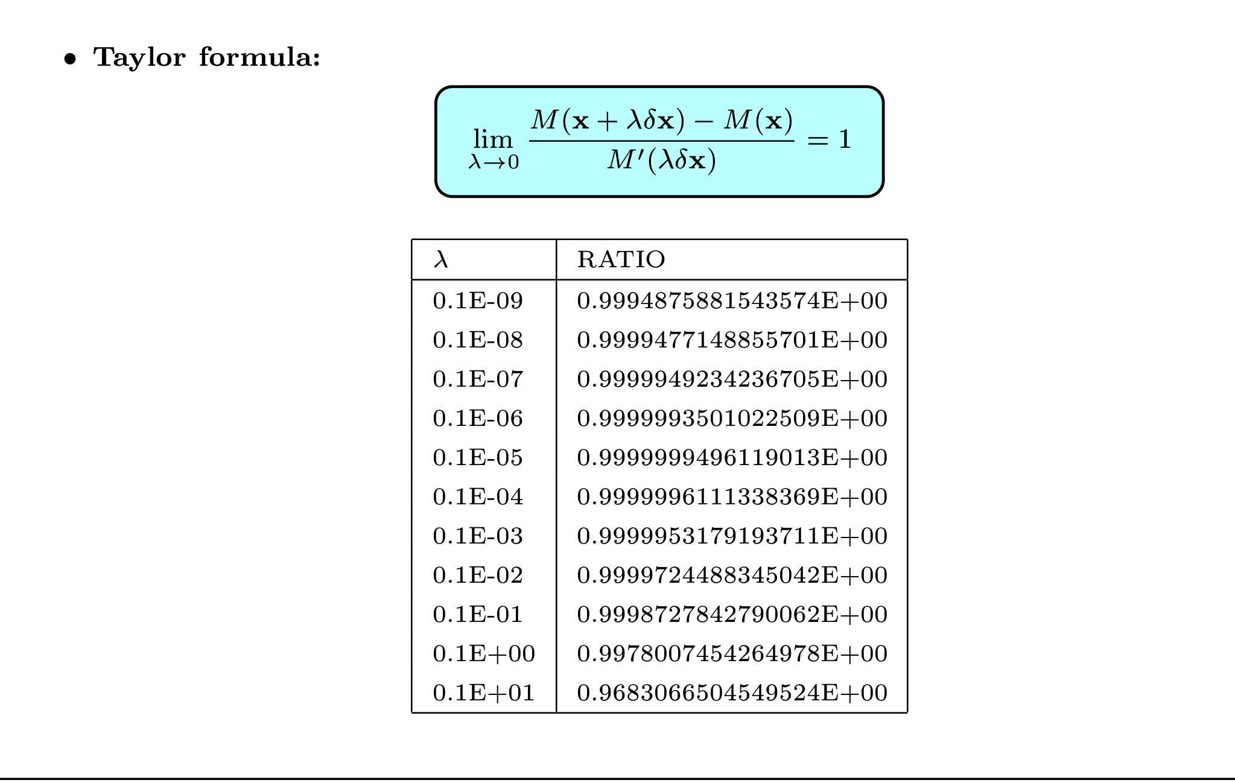
Test for tangent linear model
machine precision reached
Perturbation scaling factor

Slide 28
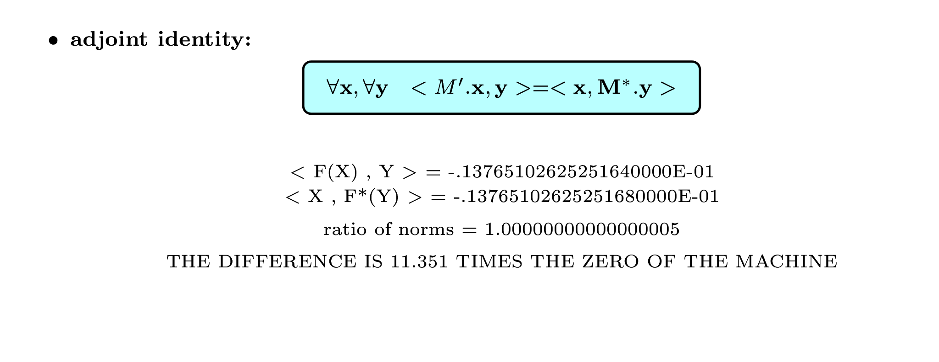
Test for adjoint model
The adjoint test is truly unforgiving. If you do not have a ratio of the norm close to 1
within the precision of the machine, you know there is a bug in your adjoint.
At the end of your debugging you will have a perfect adjoint. If properly tested,
the adjoint is the only piece of code on Earth to be entirely bug-free (although you
may still have an imperfect tangent linear)!

Slide 29
Test of adjoint in practice…
Compute perturbed variable (y) using perturbation in input variables (x,z) with the tangent linear code
Compute TL norm:
Call adjoint routine to obtain gradients in x and z with respect to initial perturbation in x and z from perturbation in y.
Compute the norm from the adjoint calculation, using unperturbed state and gradients:
According to the test of adjoint NORM_TL must be equal to NORM_AD to the machine precision!

Slide 30
Automatic differentiation
Because of the strict rules of tangent linear and adjoint coding,
automatic differentiation is possible.
Existing tools: TAF (TAMC), TAPENADE (Odyssée), ...
  Reverse the order of instructions,
  Transpose instructions instantly without typos !!!
  Especially good in deriving tangent linear codes!
There are still unresolved issues:
  It is NOT a black box tool,
  Cannot handle non-differentiable instructions (TL is wrong),
  Can create huge arrays to store the trajectory,
  The codes often need to be cleaned-up and optimised.
  Look in the “Supplementary material” for more information!

Slide 31
Useful References
Variational data assimilation:
Lorenc, A., 1986, Quarterly Journal of the Royal Meteorological Society, 112, 1177-1194.
Courtier, P. et al., 1994, Quarterly Journal of the Royal Meteorological Society, 120, 1367-1387.
Rabier, F. et al., 2000, Quarterly Journal of the Royal Meteorological Society, 126, 1143-1170.
The adjoint technique:
Errico, R.M., 1997, Bulletin of the American Meteorological Society, 78, 2577-2591.
Tangent-linear approximation:
Errico, R.M. et al., 1993, Tellus, 45A, 462-477.
Errico, R.M., and K. Reader, 1999, Quarterly Journal of the Royal Meteorological Society, 125, 169-195.
Janisková, M. et al., 1999, Monthly Weather Review, 127, 26-45.
Mahfouf, J.-F., 1999, Tellus, 51A, 147-166.
Lorenz model:
X. Y. Huang and X. Yang. Variational data assimilation with the Lorenz model. Technical Report 26, HIRLAM,
April 1996. Available on ftp site (see notes for practical session).
E. Lorenz. Deterministic nonperiodic flow. J. Atmos. Sci., 20:130-141, 1963.
Automatic differentiation:
Giering R., Tangent Linear and Adjoint Model Compiler, Users Manual Center for Global Change
Sciences, Department of Earth, Atmospheric, and PlanetaryScience,MIT,1997
Giering R. and T. Kaminski, Recipes for Adjoint Code Construction, ACM Transactions on
Mathematical Software, 1998
TAMC: http://www.autodiff.org/
TAPENADE: http://www-sop.inria.fr/tropics/tapenade.html
Sensitivity studies using the adjoint technique
Janiskova, M. and J.-J. Morcrette., 2005. Investigation of the sensitivity of the ECMWF radiation scheme to input parameters using adjoint technique. Quart. J. Roy. Meteor. Soc., 131,1975-1996.

