Slide 1

Highlights of the data assimilation practical session
Patrick Laloyaux, Massimo Bonavita, Sebastien Massart, Marcin Chrust, Elias Holm

Slide 2
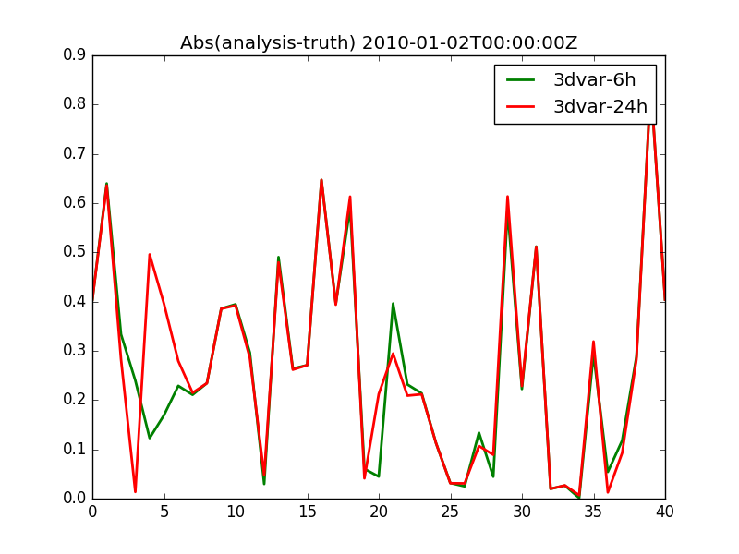
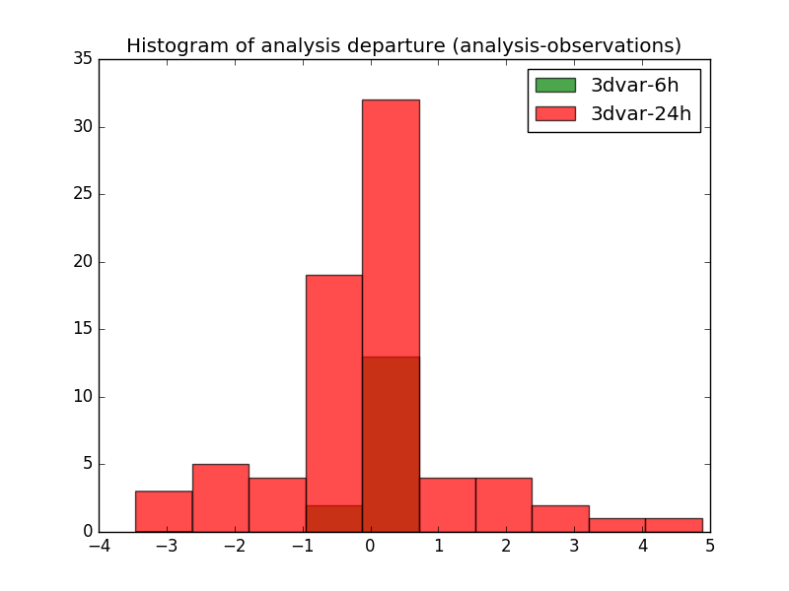
Lorentz 95 model – 3DVar
The size of the state vector is 40 and observations are available every 90 minutes at 5 different locations
If a 3D-Var assimilation system is available, is it better to assimilate observations using a window of 6 hours or 24 hours?
Assimilate 5 times more observations over a longer window with 3D-Var does not produce a better analysis because
3D-Var assumes that all observations are available at the middle of the window
when the window is increasing, the dynamical model has to be taken into account to assimilate observations at the correct time
departure statistics gives a lot of information about the assimilation performance

Slide 3
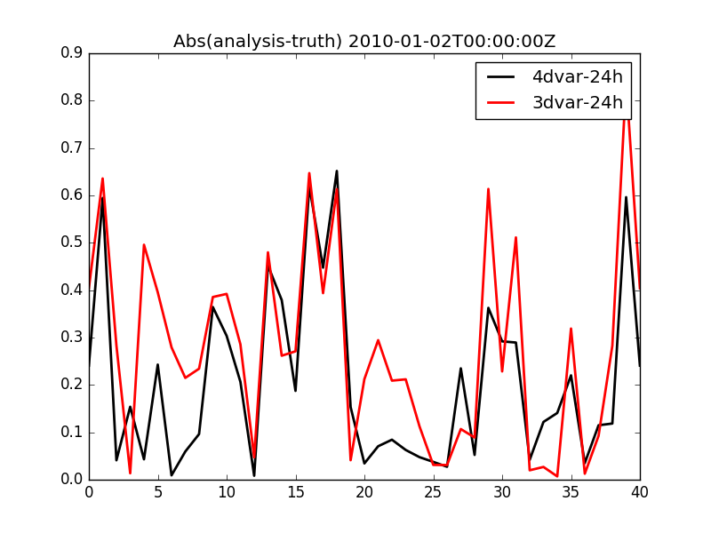
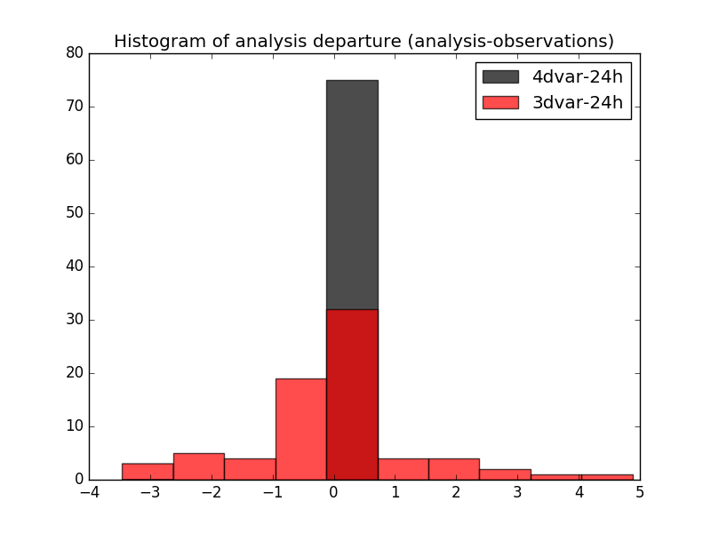
Lorentz 95 model – 4DVar
Is the 4D-Var better than the 3D-Var with a 24 hour window?
Using the dynamic of the model in the assimilation process to assimilate the observations at the correct time produces a better analysis (smaller error, better fit)
You need to know the dynamical properties of your system and the type of observations you assimilate to choose the best method and the best window

Slide 4
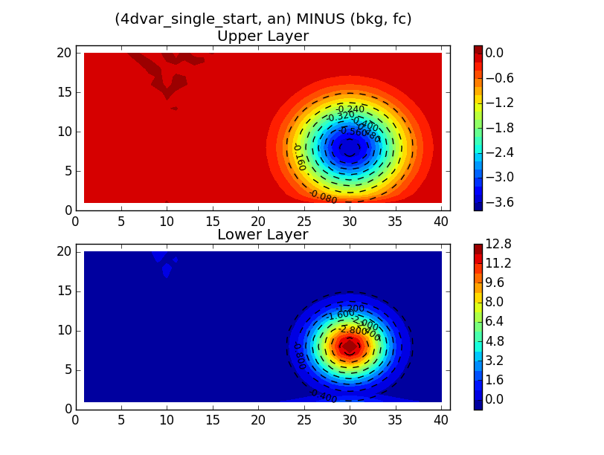
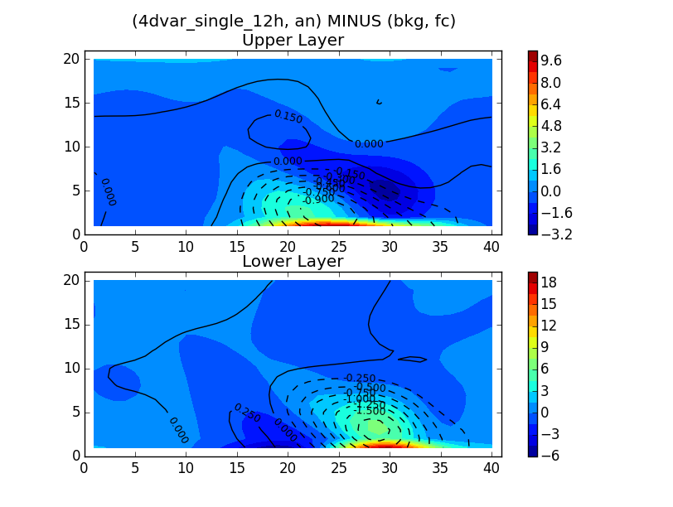
The quasi-geostrophic Model
Why the impact of a single observation in 4D-Var depends on the observation time?
4D-Var produces an increment at the beginning of the window
→ If the observation is at the beginning of the window, the model is not used and the information from the observation is simply spread in space by B
→ If the observation is available later on, the TL/AD models are used to propagate the information forward and backward in time. The increment shows some dynamical structure from the model physics

