Slide 1
ECMWF/EUMETSAT NWP-SAF Satellite data assimilation Training Course
3-7 April 2017

Slide 2
Practical Exercises with 1DVAR

Slide 3
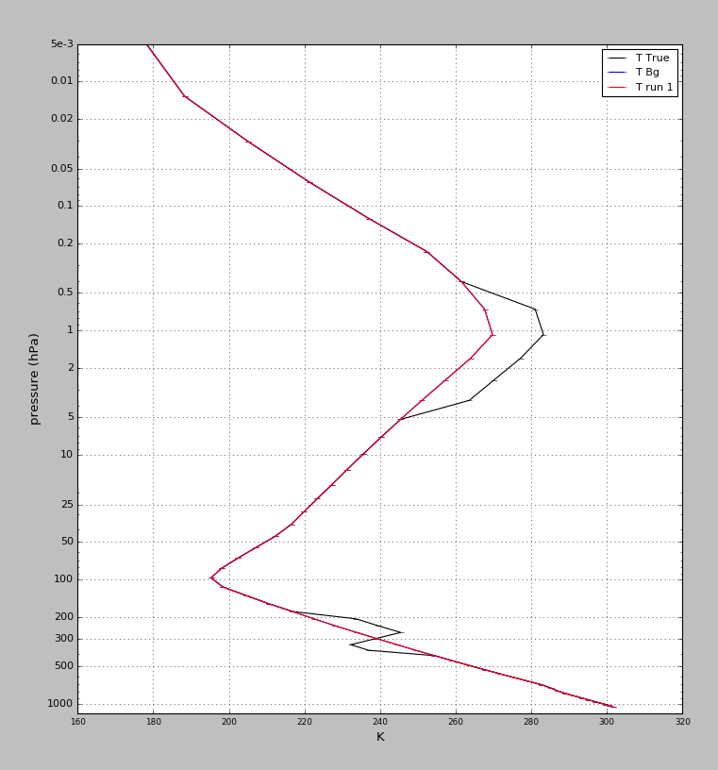
The Background and True profile
Can we push the background profile towards the truth using radiances ?

Slide 4
Practical Exercises with 1DVAR
Can we push the background profile towards the truth using radiances…
from a single AMSU-A channel
from 15 AMSU-A channels
from 800 IASI channels

Slide 5
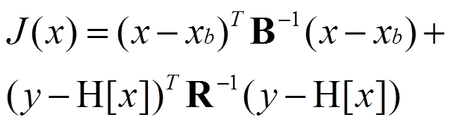
…when we minimise J(x) …
background error
covariance
model state
observations
observation* error
covariance
observation operator
(maps the model state to the observation space)

Slide 6
...we correct background errors
The state that minimizes the cost function is equivalent to a linear correction of the background using the observations:
…where the correction is the Kalman Gain Matrix multiplied by the innovation vector (observation minus radiances simulated from the background)
correction term =
Kalman gain x
innovation

Slide 7
How does the 1DVAR simulator work ?
Define a background profile Xb
Define a background error covariance B
Define a set of observations (channels) Y
Define an observation error covariance R
Define a true profile Xt
Simulate observed radiances Y from Xt (adding noise consistent with assumed R)
Compute H (RT model) applied to Xb

Slide 8
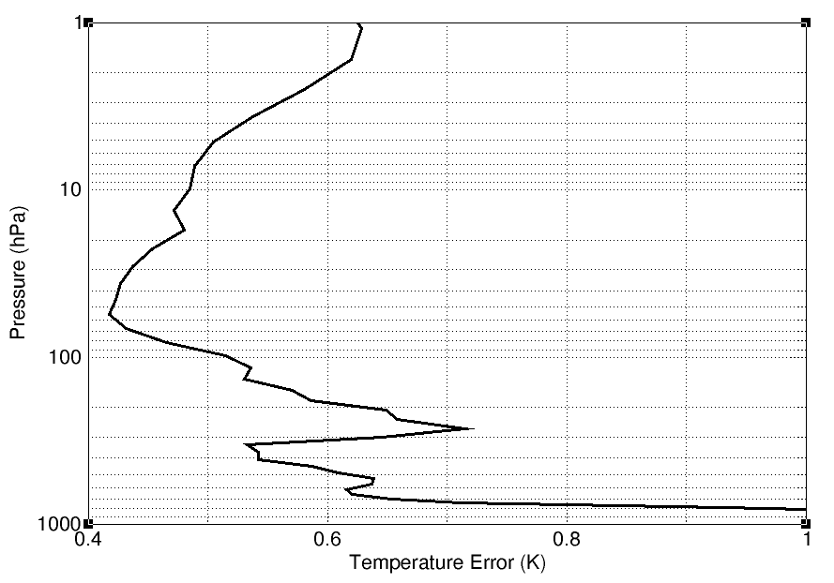
Assumed Background Errors (T)

Slide 9
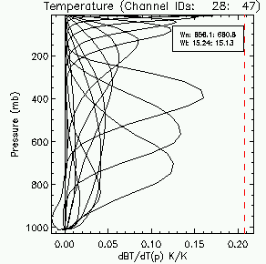
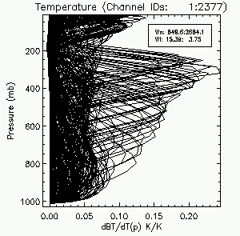
Weighting functions for AMSUA and IASI channels

Slide 10
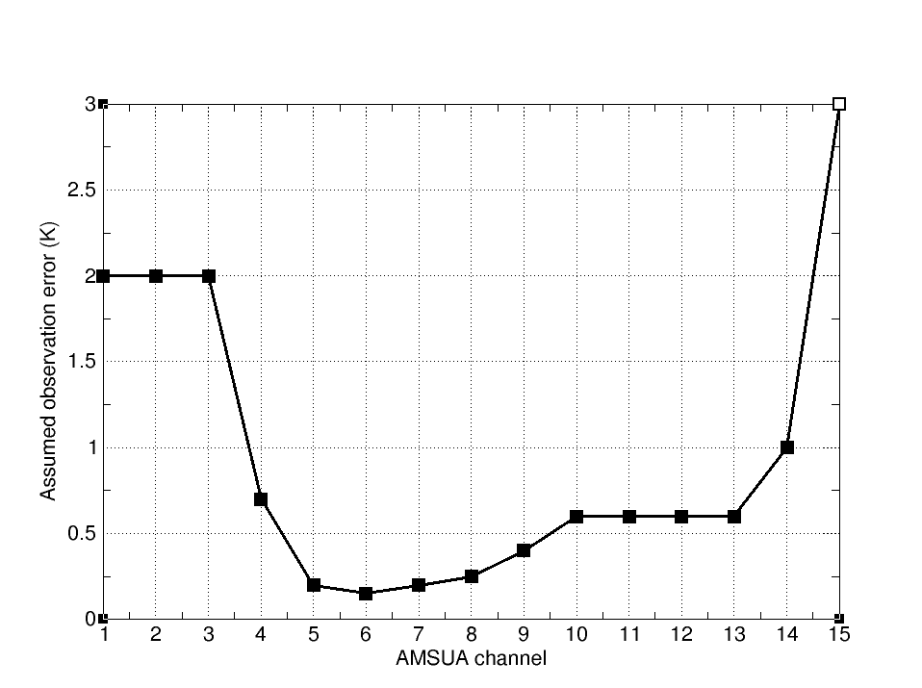
Assumed Observation error for AMSUA channels

Slide 11
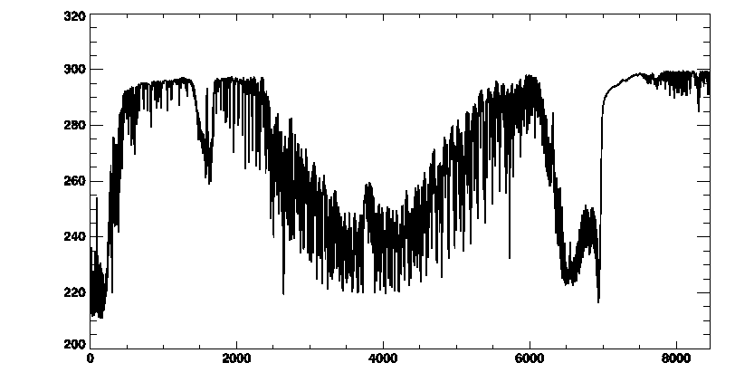
Assumed Observation error for IASI
1.0 K
2.0K
0.4K
15 um
6.4 um
4.2um
3.7 um

Slide 12
Start up the RTTOV GUI with
type:
module load rttov/12.1
type:
rttovgui
Class01,trd00, 2tDQohR,

Slide 13
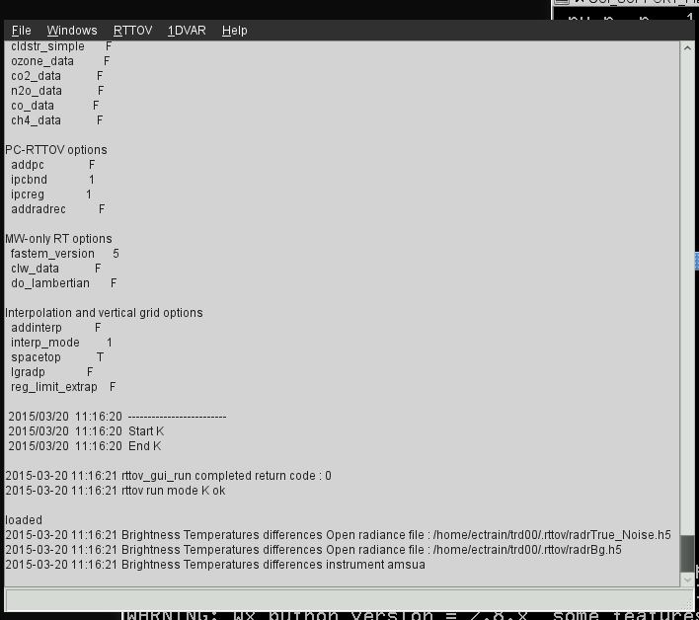
GUI main control window

Slide 14
GUI pull down menus

Slide 15
Open a background profile

Slide 16
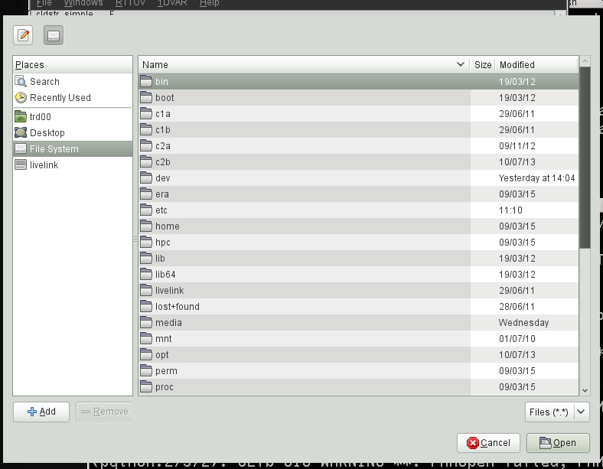
Open a background profile

Slide 17
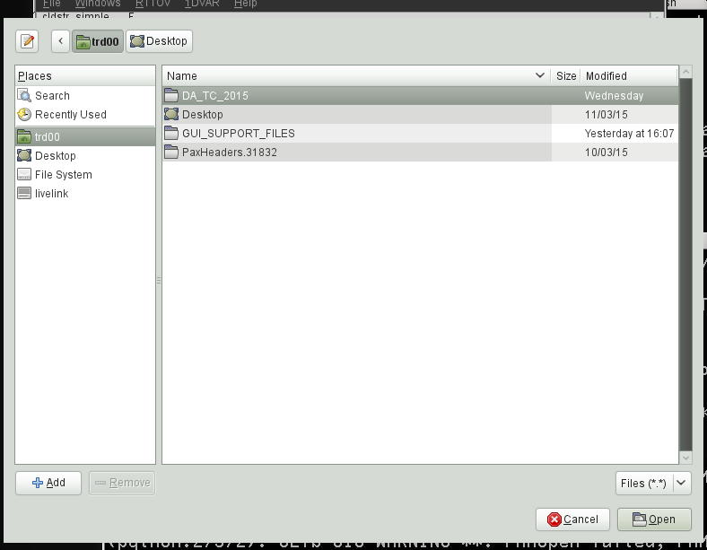
Open a background profile

Slide 18
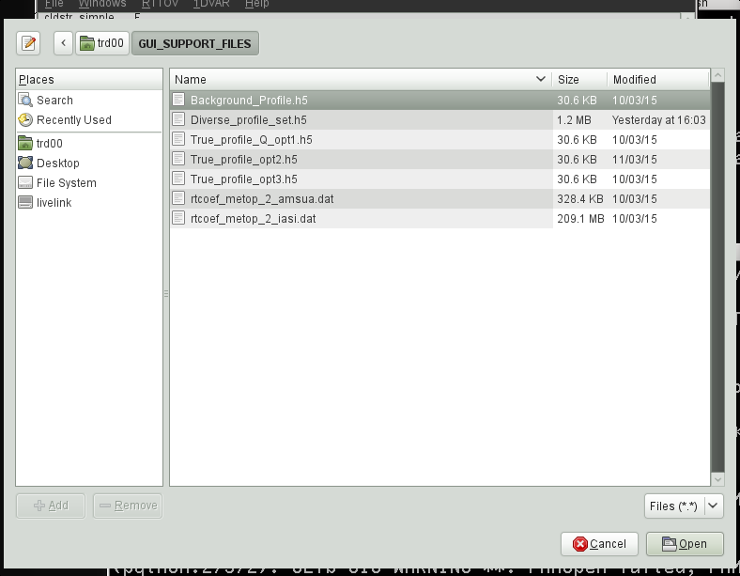
Open a background profile

Slide 19
Open a background profile

Slide 20
Have a quick look at the profile

Slide 21
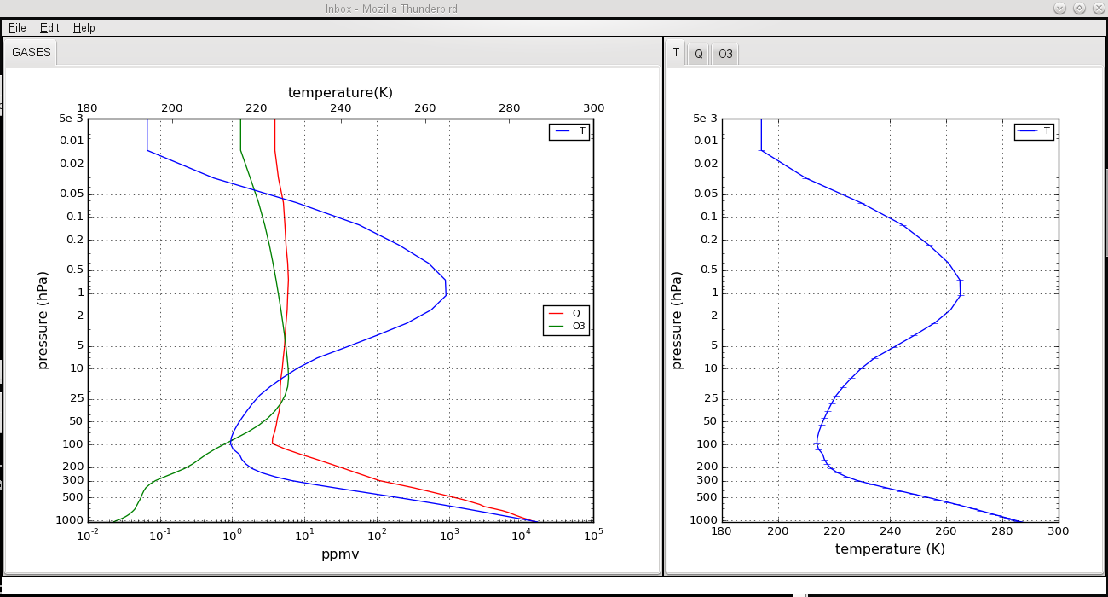
Have a quick look at the profile

Slide 22
Exercise #1 – Using a single AMSUA channel
File/Open Profile to select and Open Background_Profile.h5 from profiles directory (have a quick look at the profile in the Windows/Profile Editor Window)
RTTOV/Load Coefficients to Choose and Open and Load AMSUA RT coefficients rtcoef_metop_2_amsua.dat from coefficients directory
RTTOV/Run RTTOV K to look at weighting functions (use the KP button to look at channel 14)
RTTOV/Select Channels to select channel 14 (peaks ~ 2hPa)
1DVAR/Configure 1DVAR/Open a True Profile to select and Open True_profile_opt1.h5
In 1DVAR algorithm window click RUN 1DVAR retrieval (drag left mouse button to zoom in Retrieved Profile Window, right click to un-zoom)
Play with assumed background error and re-run 1DVAR

Slide 23
Choose and Load AMSUA (RT) coefficients

Slide 24
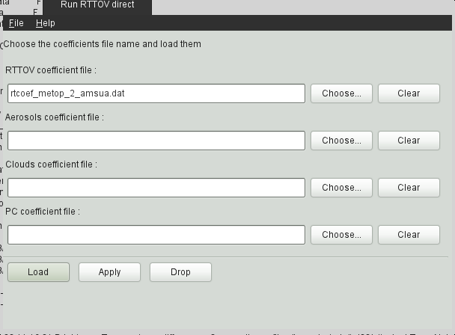
Choosing (RT) coefficients

Slide 25
Choosing (RT) coefficients

Slide 26
Choosing (RT) coefficients

Slide 27
Choosing (RT) coefficients

Slide 28
Choosing (RT) coefficients

Slide 29
Loading (RT) coefficients

Slide 30
Configure the 1DVAR

Slide 31
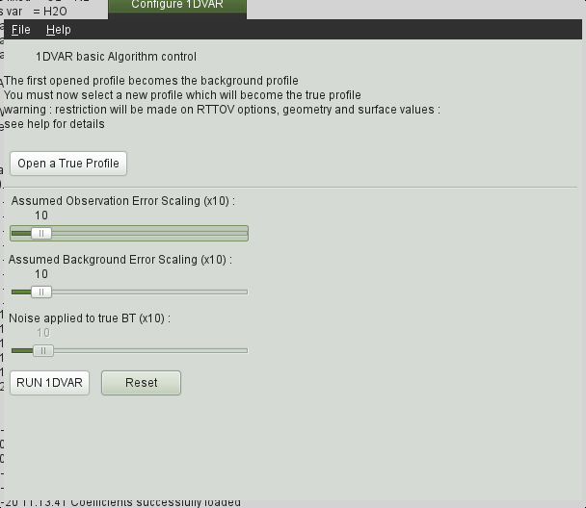
Open a true profile

Slide 32
Open a true profile

Slide 33
Open a true profile

Slide 34
Open a true profile

Slide 35
Open a true profile

Slide 36
Select Channels

Slide 37
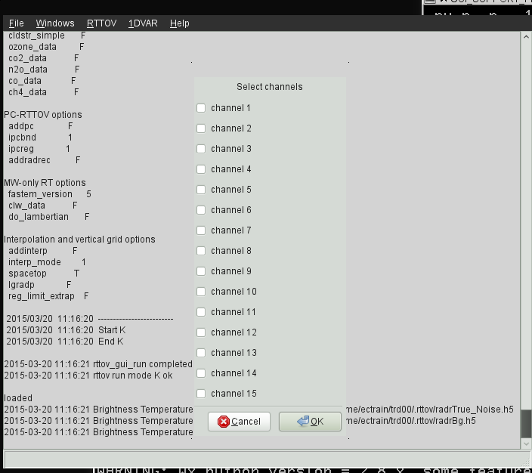
Select Channels (AMSUA-14)

Slide 38
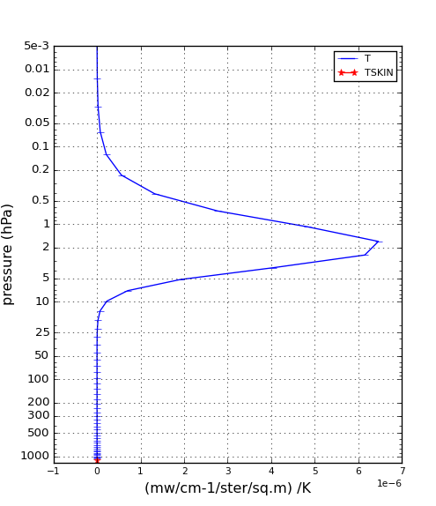
Select Channels (AMSUA-14)
Weighting function for AMSUA channel 14
We expect this channel to give information at this altitude

Slide 39
Run the 1DVAR

Slide 40
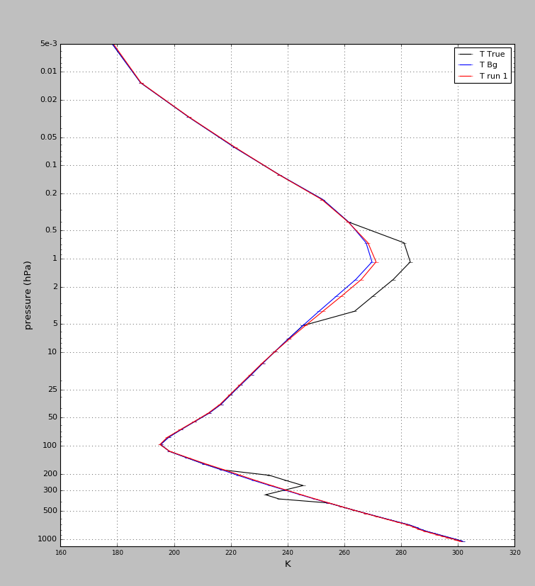
Run the 1DVAR
Why is the change so small ?

Slide 41
Try inflating background errors (x10)
…and run the 1DVAR again…

Slide 42
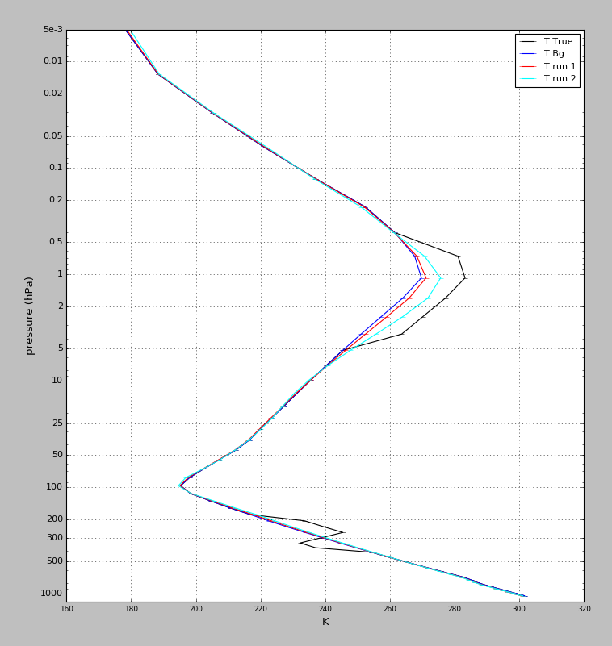
Result of the 1DVAR using 1 channels from AMSUA (ch 14)
We now have a much better change here
But why is there no change
to the background here?

Slide 43
Exercise #2 –Using multiple AMSUA channels
File/Open Profile to select and Open Background_Profile.h5 from profiles directory
RTTOV/Load Coefficients to Choose and Open and Load AMSUA RT coefficients rtcoef_metop_2_amsua.dat from coefficients directory
RTTOV/Run RTTOV K to look at weighting functions (note the use of all channels gives good vertical coverage through the profile column)
1DVAR/Configure 1DVAR/Open a True Profile to select and Open True_profile_opt1.h5
RUN 1DVAR retrieval (play with the background errors to tune)

Slide 44
Select Channels (AMSUA)

Slide 45
Run the 1DVAR

Slide 46
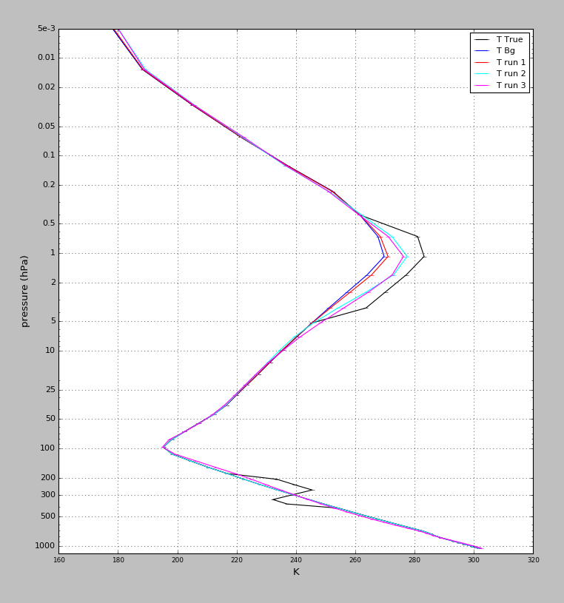
Result of the 1DVAR using 15 channels from AMSUA
Why is the performance still so bad here?

Slide 47
Exercise #3 – A multi-channel IASI retrieval
File/Open Profile to select and Open Background_Profile.h5 from profiles directory
RTTOV/Load Coefficients to Choose and Open and Load IASI RT coefficients rtcoef_metop_2_iasi.dat from coefficients directory
RTTOV/Run RTTOV K to look at weighting functions (note the use of all channels gives good vertical coverage through the profile column)
RTTOV/Select Channels to select a channel thinning factor (e.g. 10)
1DVAR/Configure 1DVAR/Open a True Profile to select and Open True_profile_opt2.h5
RUN 1DVAR retrieval (play with the background errors to tune…does this work ?? Try using just different parts of the IASI spectrum)

Slide 48
Choose and Load (RT) coefficients

Slide 49
Choosing (RT) coefficients

Slide 50
Choosing (RT) coefficients

Slide 51
Choosing (RT) coefficients

Slide 52
Choosing IASI (RT) coefficients

Slide 53
Choosing (RT) coefficients

Slide 54
Loading (RT) coefficients

Slide 55
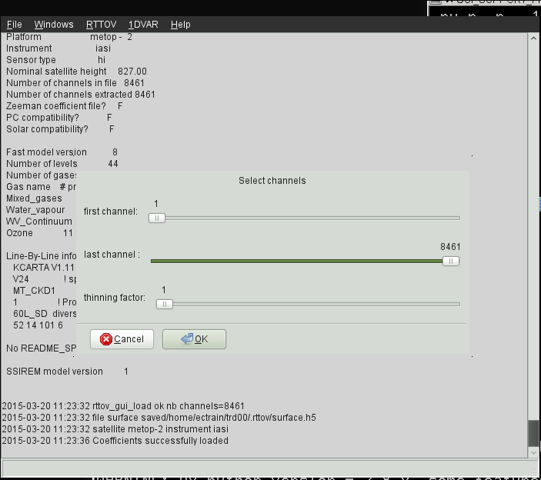
Select Channels (IASI) x10 !!!

Slide 56
Run the 1DVAR

Slide 57
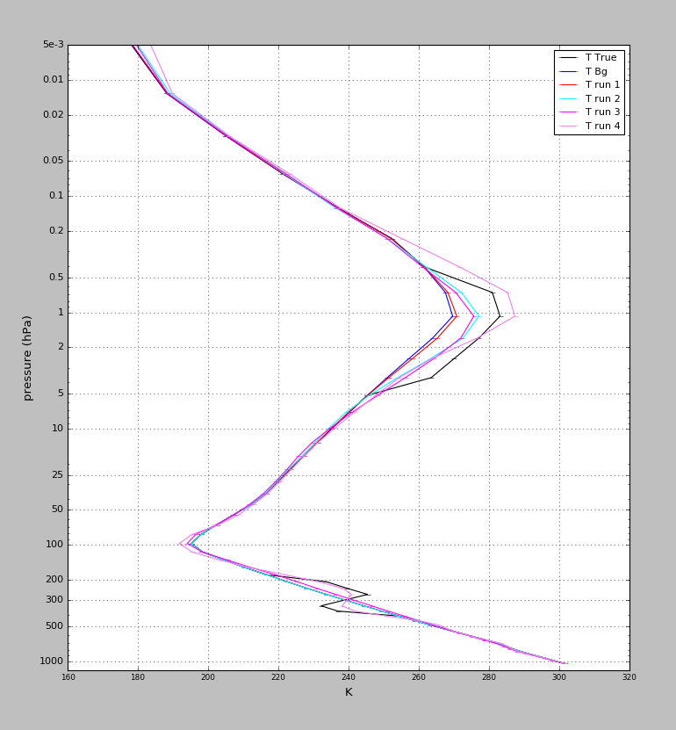
Result of the 1DVAR for IASI
With 800 IASI channels we get a really good adjustment of the background towards the truth!

