Slide 1
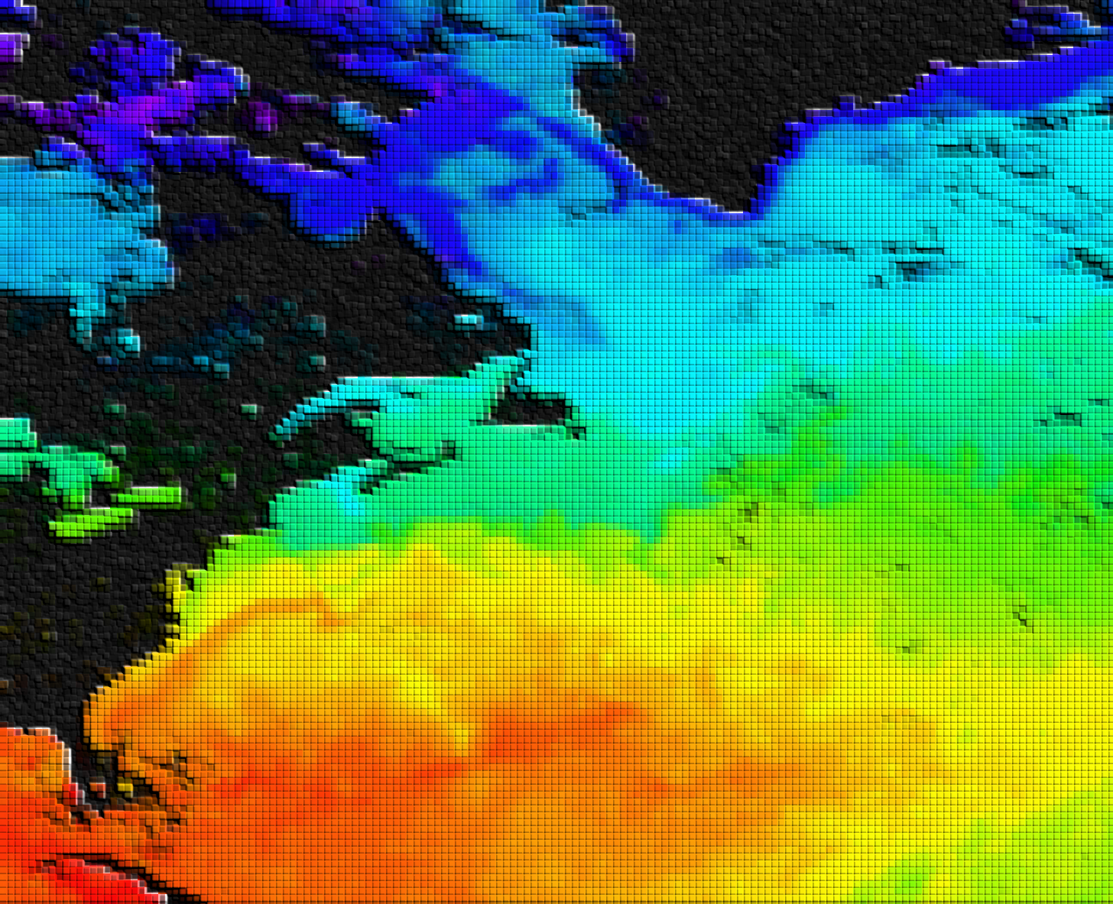
Ocean Data Assimilation
Hao Zuo
Earth System Assimilation Section
With input from Magdalena Balmaseda, Kristian Mogensen, Mohamed Dahoui and others

Slide 2
Outline of lecture
General remarks
  Applications of ocean data assimilation
  Ocean versus Atmosphere DA
  The Ocean Observing System
An example of Ocean DA: NEMOVAR
  NEMOVAR general
  Background co-variances
  Balance relationships: temperature, salinity, sea level and velocity
  Altimeter assimilation
  Bias correction
Ocean analysis system
  OCEAN5 operational system
  Monitoring of OCEAN5 analysis

Slide 3
OCEAN DA: components
The blue ocean: ocean dynamics.
  Primary variables: potential temperature (T), salinity (S) current (U,V) and sea surface height (SSH).
  Density is a function of T and S though the equation of state.
The white ocean: sea-ice. Not covered here
  Sea ice concentration and thickness. Very few thickness obs
  Non gaussian errors. Unknown balance relationships
The green ocean: biogeochemistry. Not covered

Slide 4
Why do we do ocean DA?
Forecasting: initialization of coupled models
  NWP, monthly, seasonal, decadal.
  Different depths of the ocean are involved at different time scales
  Climate resolution (global ~1, 1/4 degrees, …1/12)
Reconstruct & monitor the ocean (re-analysis)
Monitor/forecast the ocean mesoscale and biochemestry
  High resolution ocean analysis (regional, ~1/3-1/9-1/12 degrees)
  Defence, commercial applications (oil rigs …), safety and rescue, environmental (algii blooms, spills)

Slide 5
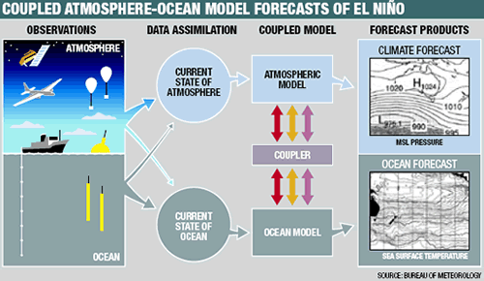
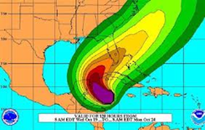
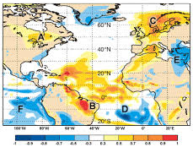

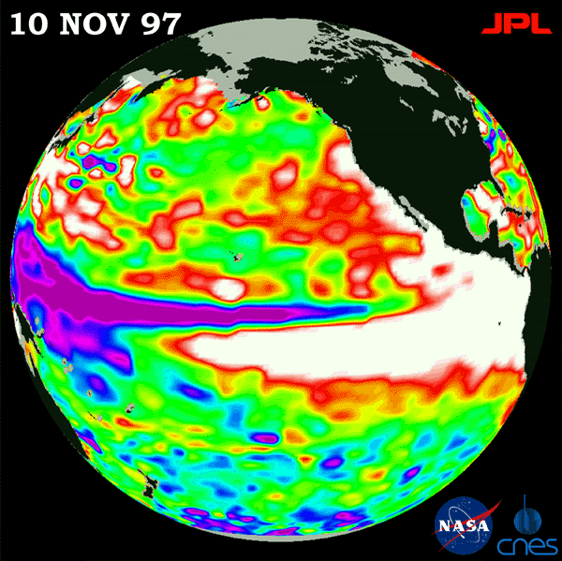
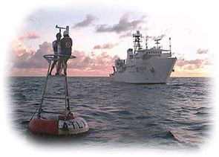
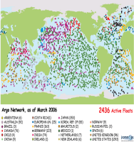
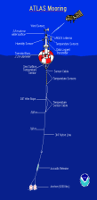
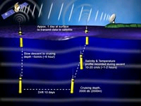
End-To-End Coupled Forecasting System
COUPLED MODEL
Tailored Forecast PRODUCTS
Atmosphere model
Ocean+WAM model
Extreme Forecast Index
Atmosphere model
ENSEMBLE GENERATION
PROBABILISTIC CALIBRATED FORECAST
OCEAN
Ocean+WAM model
Seasonal forecasts of Tropical cyclones
Atmosphere model
Ocean+WAM model
ENSO outlook
Initialization
Forward Integration
Forecast Calibration

Slide 6
Ocean versus Atmosphere: some facts
Spatial/time scales The radius of deformation in the ocean is small (~30km) compared to the atmosphere (~3000km).
  Radius of deformation =c/f where c= speed of gravity waves.
  In the ocean c~<3m/s for baroclinic processes.
  Smaller spatial scales and Longer time scales
The ocean is strongly stratified in the vertical, although deep convection also occurs
  Density is determined by Temperature and Salinity
The ocean is forced at the surface by the wind/waves, by heating/cooling, and by fresh-water fluxes.
  Uncertainty in forcing fluxes contributes to uncertainty in model results.
The electromagnetic radiation does not penetrate into the ocean, which makes the deep ocean difficult to observe from satellites.
  The surface of the ocean can however be observed from space
The ocean has continental boundaries; dealing with them is not trivial in data assimilation

Slide 7
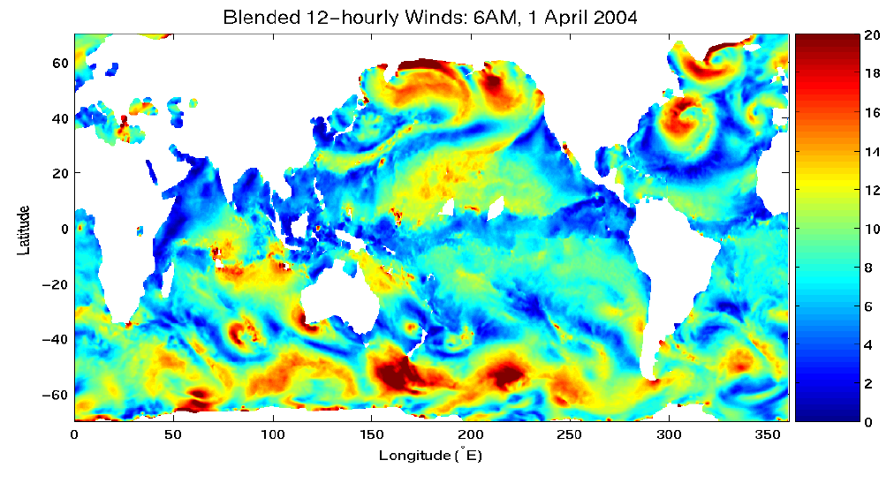
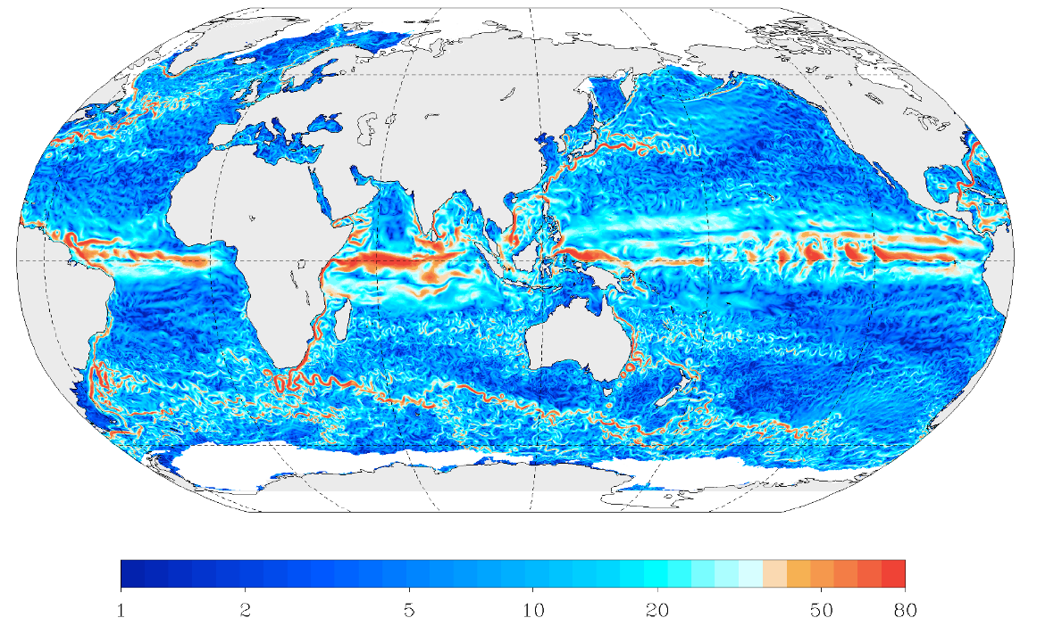
2 - Ocean Weather
Ocean spatial scales
(Zhang et al., )
Atmospheric wind speed (m/s)
Wind speed up to 20m/s
With large spatial scales
1/12 NEMO Ocean current speed (cm/s)
Ocean current speed up to 1m/s
With smaller spatial scales
Notes:
7
Note the different spatial scales of atmosphere and ocean.

Slide 8
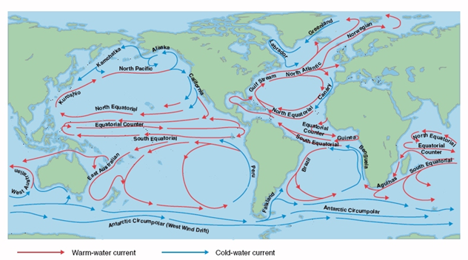
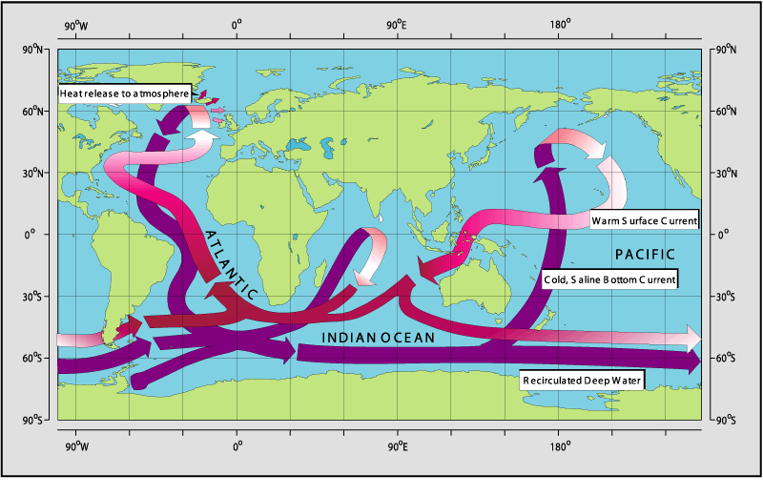
Ocean time scales: from hours to centuries
Wind Driven: Gyres, Western Boundary Currents, Upwelling regions (coastal, equatorial), Ekman pumping and subduction
Density Driven: Thermohaline Circulation

Slide 9
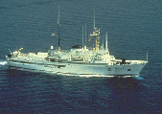
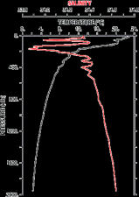
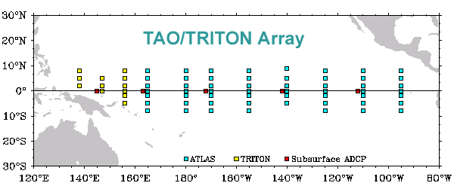

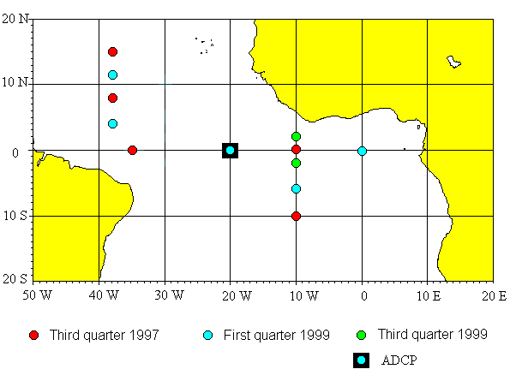
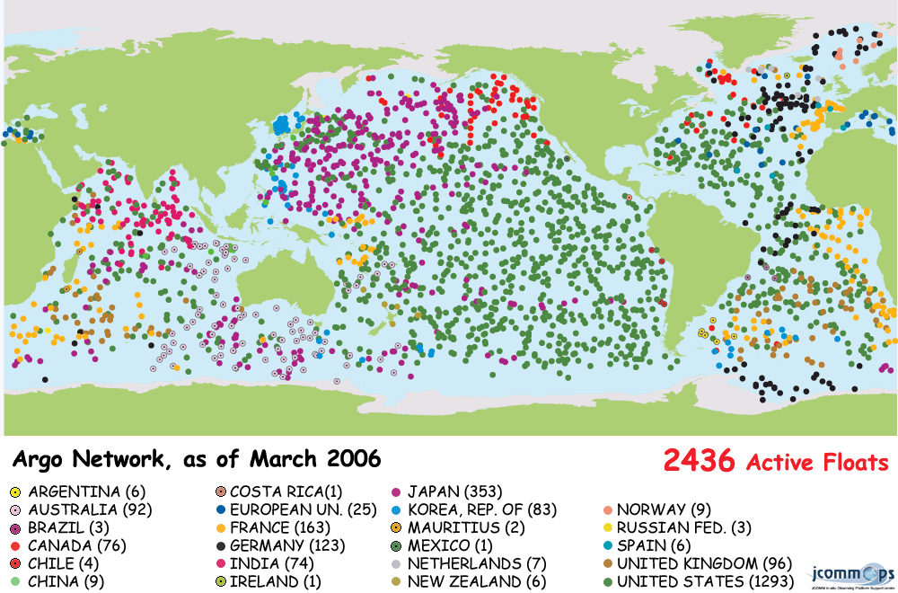
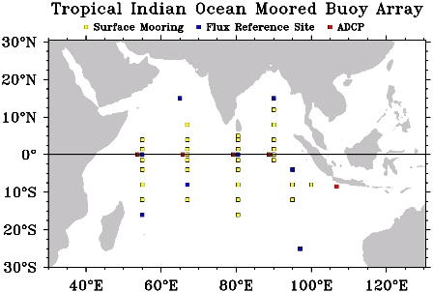
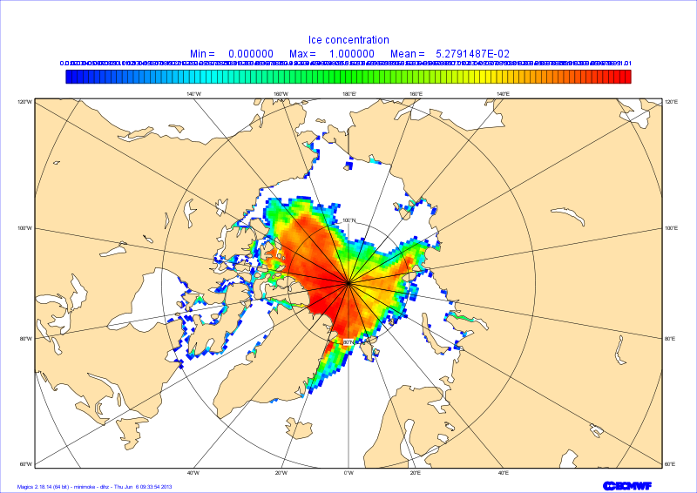
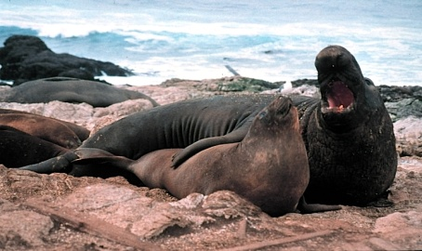
The Ocean Observing system
Ship based (XBT, CTD)
ARGO floats
Moorings
Satellite
SST
Sea Level
Elephant seals
XBT: Expendable BathyThermograph
CTD: Conductivity, Temperature and Depth
Sea Ice
Notes:
Ocean Observing System: the ocean has been poorly observed.
The electromagnetic radiation does not penetrate into the ocean (it is trapped in the upper meters), which is a major problem for full explotation of the satellite revolution
Moorings (Tao, PIRATA AND TRITON) (T and S)
XBTs (dropped from ships of opportunity) (T)
CTDs (High quality but very few- obtained by research ships) T and S
SST from satellite (IR,MW), ship and buoys.
SSS from a few ships, from a few moorings, from satellite in future. (eg SMOS, Aquarius)
Sea level from altimetry (ERS,TOPEX, Jason1, 2)
Current meters (very few ~5 along equatorial pacific)
Subsurface temperature and salinity from ARGO
Elephant seals with T/S sensors provides information about the subsurface in the arctic regions.
(T=Temperature, S=Salinity, SST=Sea Surface Temperature, SSS=Sea Surface Salinity, IR=infrared, MW=micro-wave)

Slide 10
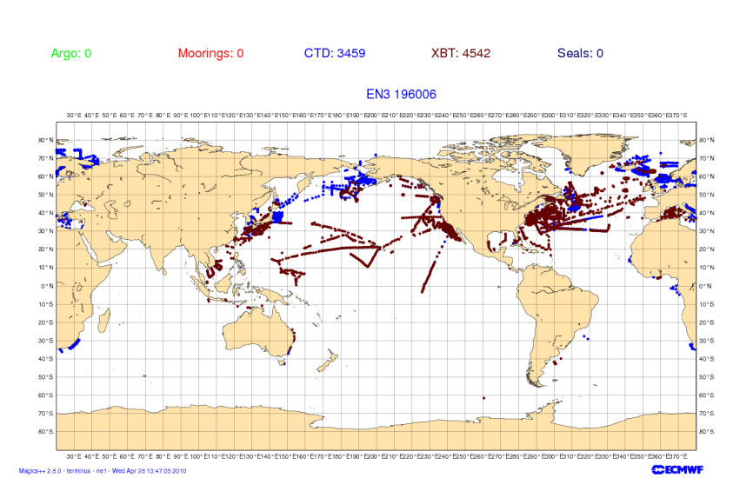
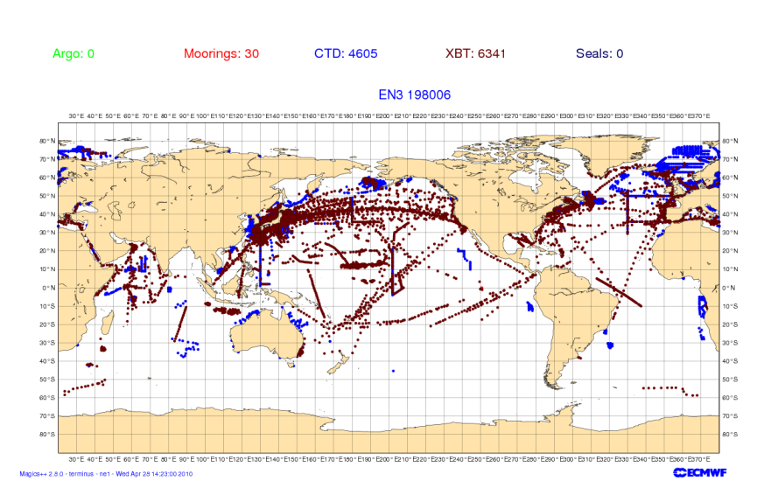
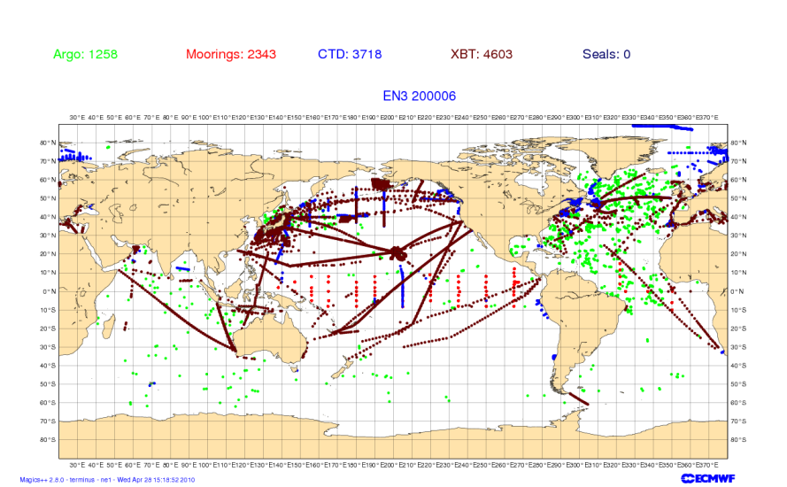
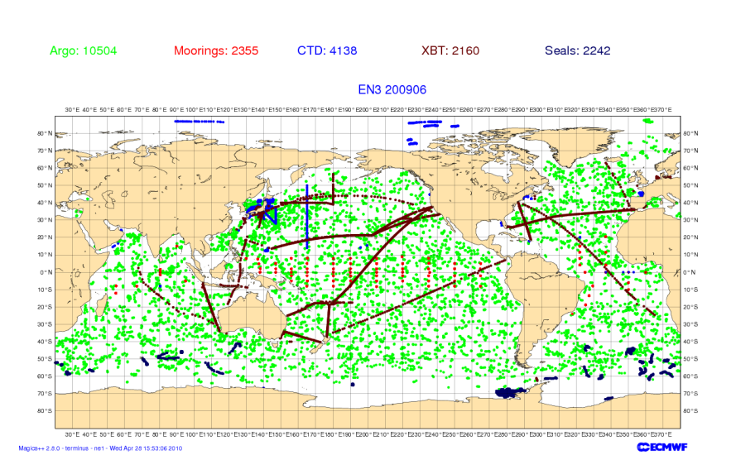
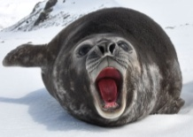
Changes to the T/S obs. network
1960
1980
2000
2009
Very uneven distribution of observations.
Southern ocean poorly observed until ARGO period.
Notes:
EN3 v2a dataset with XBT fallrate corrections
Available from the Met. Office (http://hadobs.metoffice.com/en3/).

Slide 11
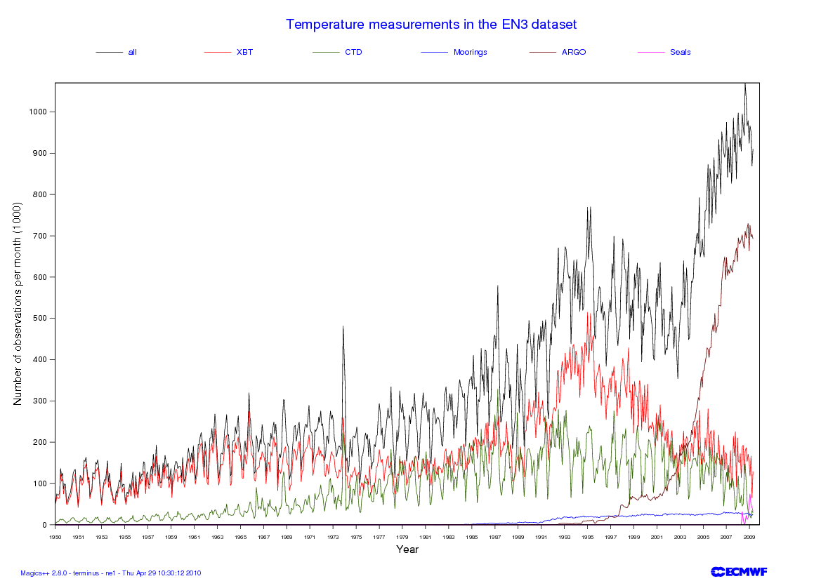
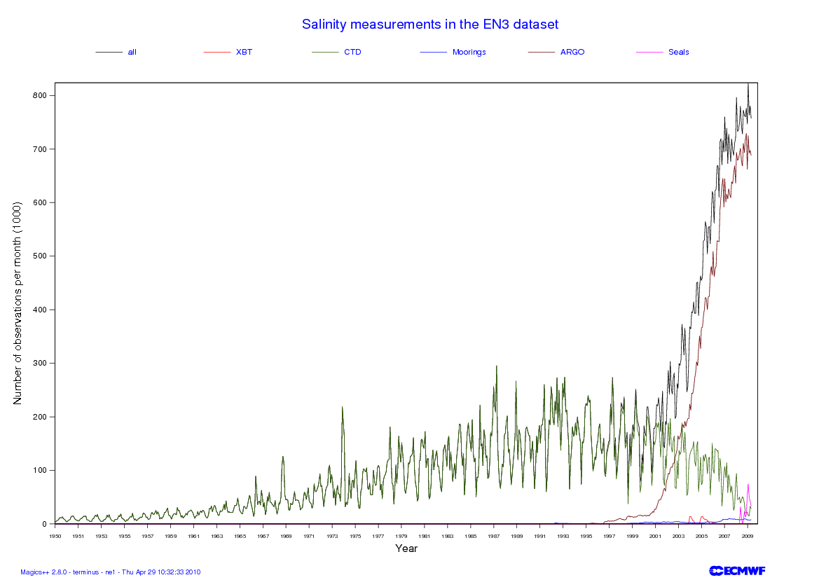
No. of Temperature obs. as function of time
No. of Salinity obs. as function of time
Notes:
Coverage is not uniform in space in the early years which is dominated by localized scientific cruises.
In the later years ARGO has become the primary source of temperature information with close to global coverage.

Slide 12
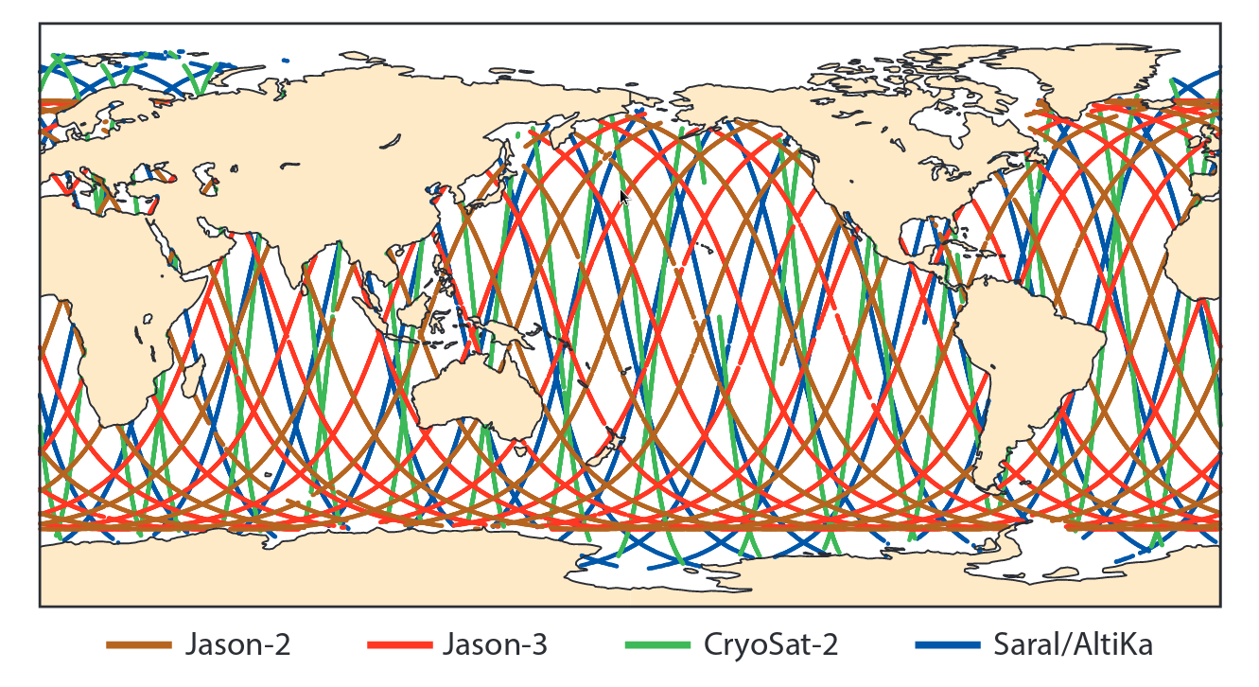
SSH observation coverage
Sea-level anomaly observation coverage. The map shows the coverage of sea-level anomaly observations in a daily near real-time along-track multi-mission radar altimeter SLA product from CMEMS as assimilated in the ECMWF ocean analysis system on 14 February 2017.

Slide 13
Ocean assimilation systems
DA systems based on optimum interpolation (OI), variational techniques (e.g. 3D/4D-Var) or various ensemble Kalman filter based methods.
  Or various hybrid combinations, just like for the atmospheric systems.
First guess given by an ocean model forced by atmospheric fluxes.
Usually observations are used to modify Temperature (T), Salinity (S) and SSH. No direct assimilation of velocities, but derived via balance relationships.
How to deal with coast lines is not trivial.
  E.g. we don’t want increments (result of analysis) from the Pacific to propagate to the Atlantic across Panama.
Bias correction is very important for reanalyses applications (see later)

Slide 14
NEMOVAR assimilation systems
The “NEMOVAR” assimilation system used in ECMWF.
  Variational system as a collaborative project among CERFACS, ECMWF, INRIA and the Met Office for assimilation into the NEMO ocean model.
    Solves a linearized version of the full non-linear cost function.
    Incremental 3D-Var FGAT running operational, 4D-Var in research model
  This system has been adopted by ECMWF and the Met Office for operational ocean data assimilation.
  Use diffusion operators for background correlation model (not discussed here).
  Background errors are correlated between different variables through balance operator
To avoid initialization shock increments are typically applied via Incremental Analysis Update (IAU) which applies the increments as a forcing term over a period of time.

Slide 15
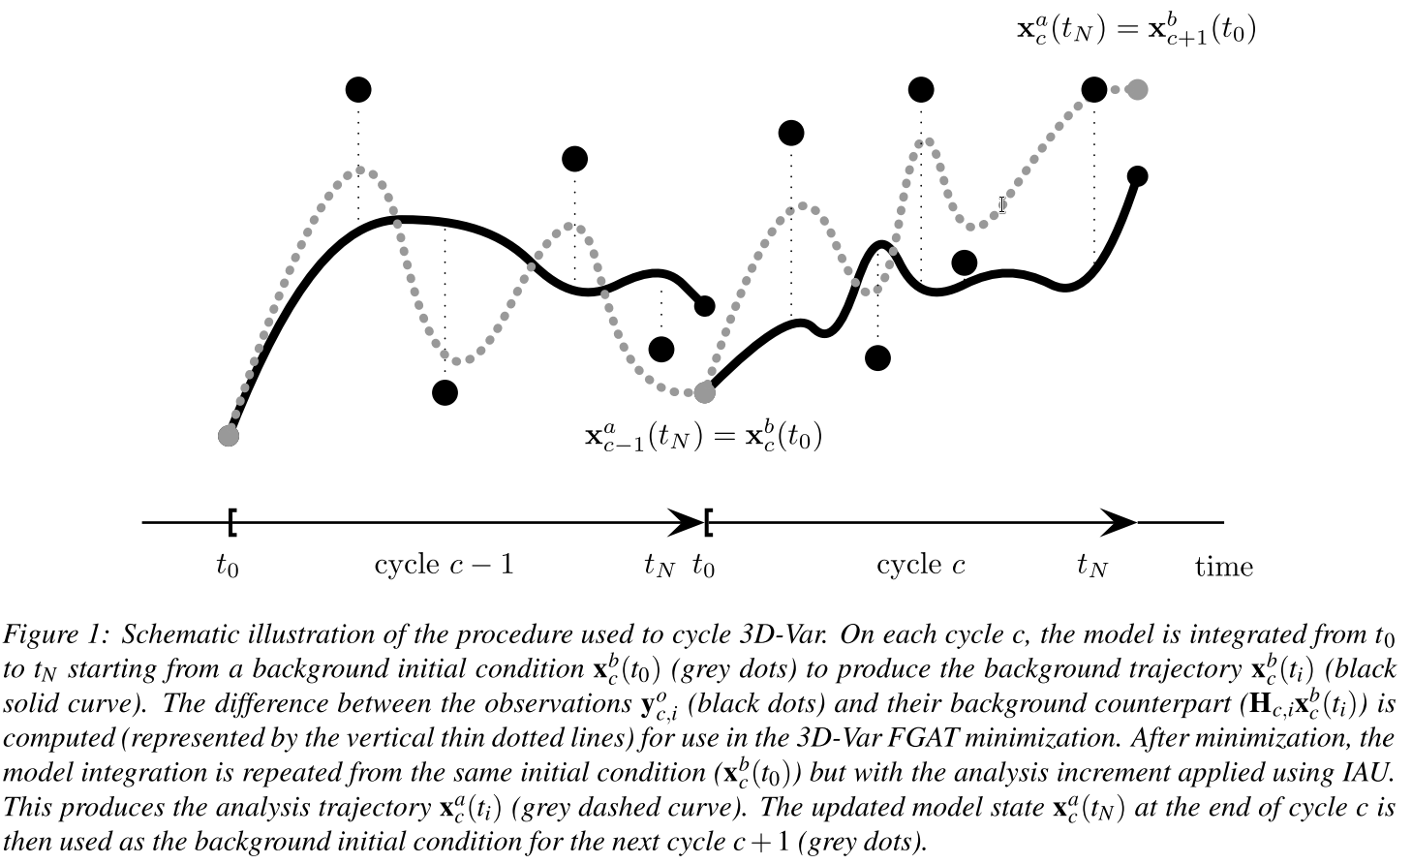
NEMOVAR 3D-Var FGAT
Daget et al 2009

Slide 16



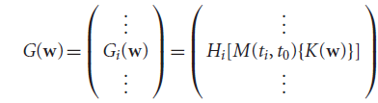



NEMOVAR algorithm
Weaver et al 2003,2005
Daget et al 2009
Mogensen et al 2012
Balmaseda et al 2013
4D observation array
w is the control vector
Departure vector
Solution
In w space, B is block diagonal, representing the spatial covariance model. The variables are linearly independent.
The spatial covariances is specified by diffusion operator (Weaver and Courtier 2001)
IAU,Bloom et al 1996

Slide 17
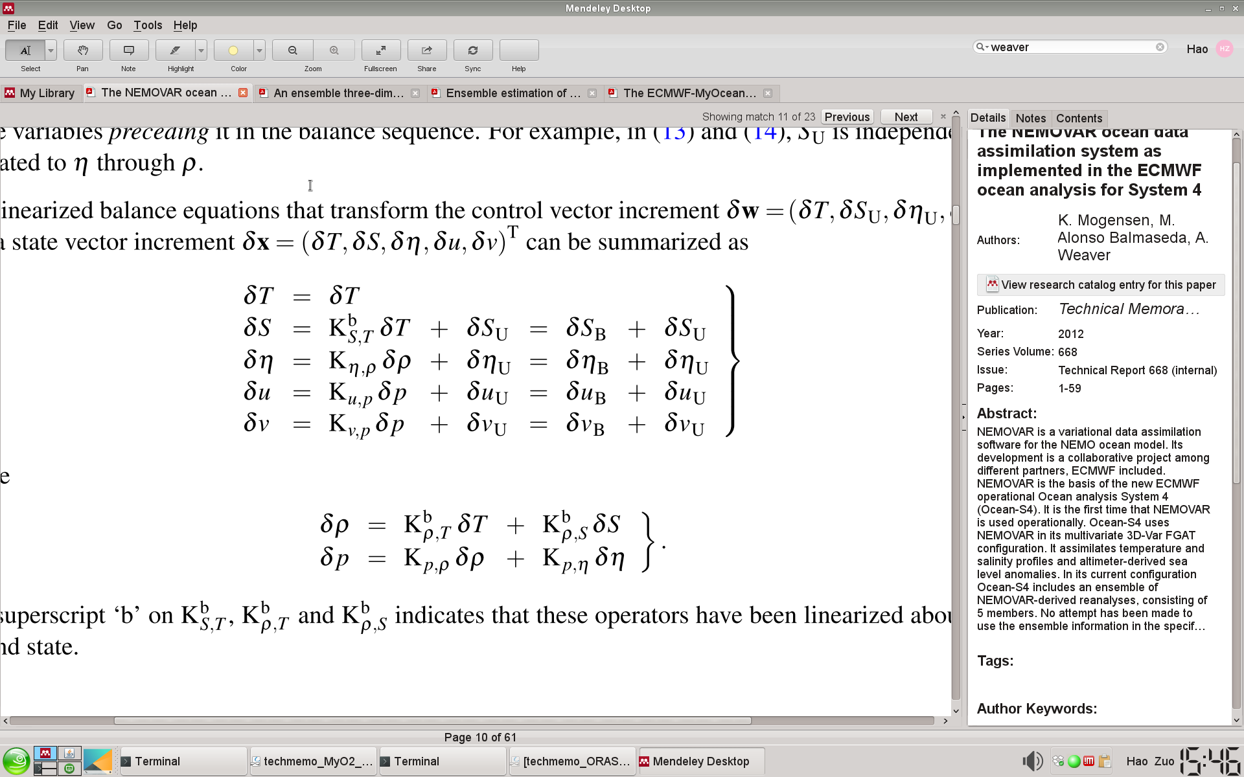
Linearized balance operator
Define the balance operator symbolically by the sequence of equations
Temperature
Salinity
SSH
Treated as approximately
mutually independent without cross correlations
u-velocity
v-velocity
Density
Pressure
(Weaver et al., 2005, QJRMS)
Notes:
17
The balance relationship described above between Temperature and Salinity and density and velocity can be expressed in a matrix form adequate for a multivariate 3D-var. Weaver et al 2005. Note the separation into balance and unbalance components.

Slide 18
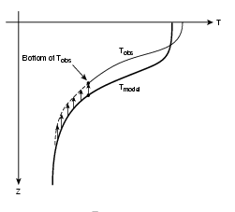
Components of the balance operator
(Ricci et al. 2005)
Salinity balance
(approx. T-S conservation)
SSH balance
(baroclinic)
S
Tanal
u-velocity balance
(geostrophy with
β-plane approx. near eq.)
Sanal
Tmodel
v-velocity
(geostrophy, zero at eq.)
Smodel
A) Lifting of the profile
Density
(linearized eq. of state)
B) Applying salinity Increments
Pressure
(hydrostatic approx.)
T/S/SSH balance: vertical displacement of the profile.
Notes:
18

Slide 19
Background Errors for Ocean DA.
Typical length scales for the applications at ECMWF :
  ~1-2 degree at mid latitudes
  ~15-20 degrees along the eq.
The background error correlation scales are highly non isotropic to reflect the nature of equatorial waves- Equatorial Kelvin waves which travel rapidly along the equator ~2m/s but have only a limited meridional scale as they are trapped to the equator.
Complex structures and smaller length scales near coastlines are usually ignored.
The background errors include some (but not all) flow dependent aspects.

Slide 20
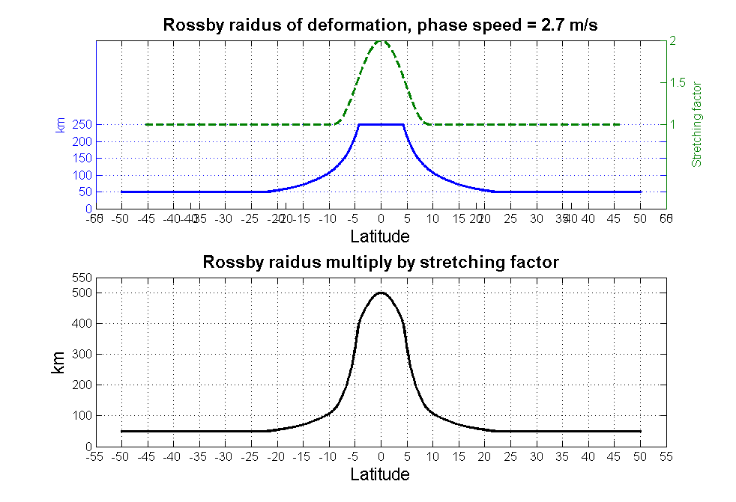
BGE correlation length-scales
In order to account for the fast travelling Equatorial Kelvin waves (~2m/s), a scheme using Rossby radius of deformation for setting up BGE horizontal correlation length-scales was used in ECMWF.
(Zuo et al., 2015)

Slide 21
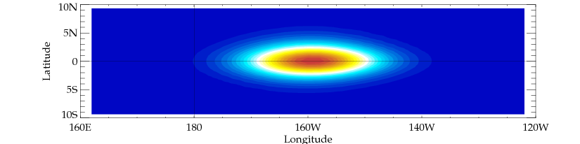
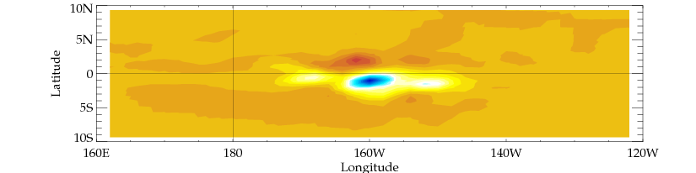
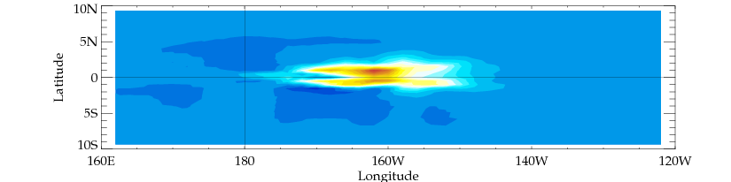
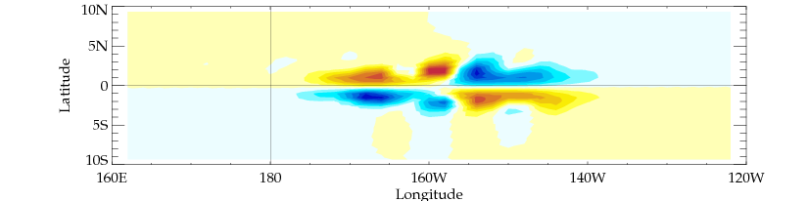

Horizontal cross-correlation of T at 100m
T
S
U
V
SSH
From single observation of temperature experiment.
The specific background determines the shape due to the balance relations.
S, U, V, SSH increments are from balance with T only.

Slide 22
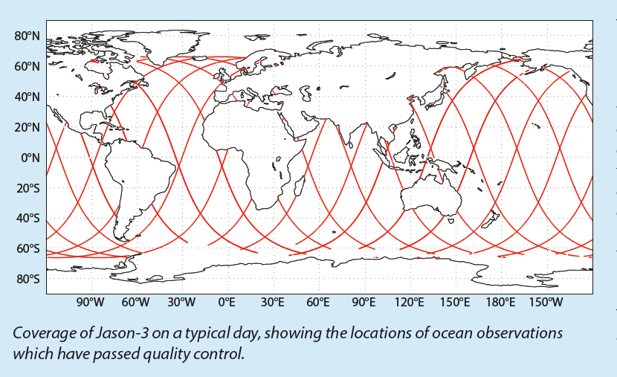
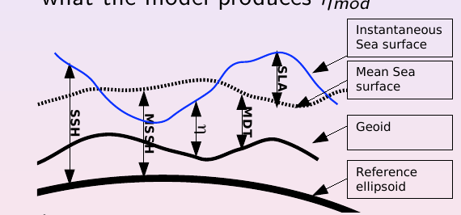
Assimilation of altimeter data
Altimeter measures SSH (respect reference ellipsoide)
Model represents η (ssh referred to the Geoid)
SSH-Geoid= η
Geoid was poorly known (not any longer) and changes in time (*)
Alternative: Assimilate Sea Level Anomalies (SLA) respect a time mean
Obs: SSH anomalies = SSH-MSSH = Obs SLA
Mod: η anomalies = η – MDT = Mod SLA
Where: MSSH= Temporal Mean SSH ;
MDT = Temporal Mean of model SL Mean Dynamic Topography
MSSH – Geoid = MDT

Slide 23
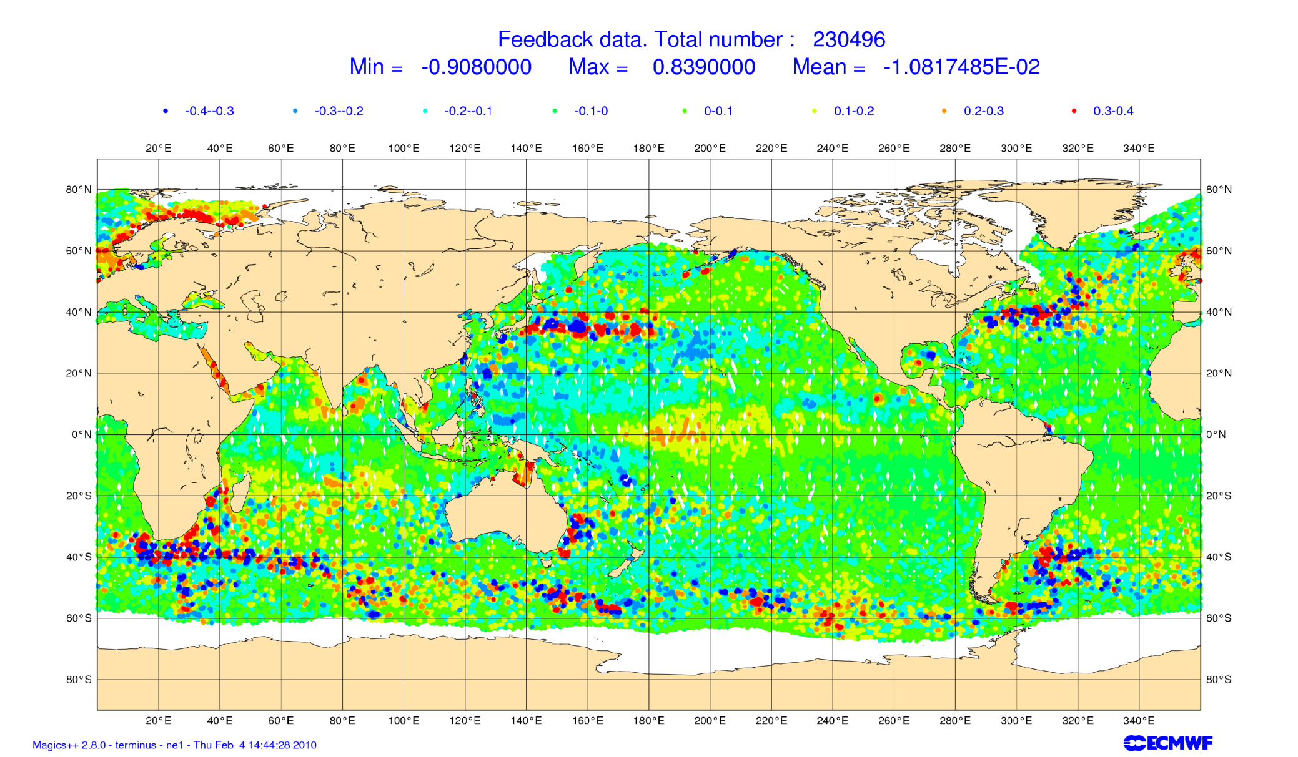
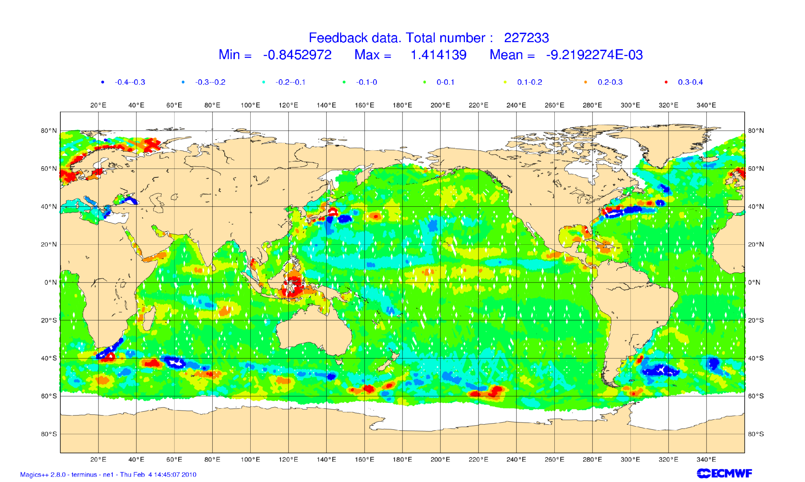
Radar altimeter SLA
Other SLA issues:
The SLA along track data has very high spatial (9-14km) resolution for the operational ocean assimilation systems.
  Features in the data which the model can not represent.
This can be dealt with in different ways:
  Inflate the observation error to account for non representativeness of the “real” world in the assimilation system.
  Construction of “superobs” by averaging.
  Thinning
Model (1 deg) SLA

Slide 24
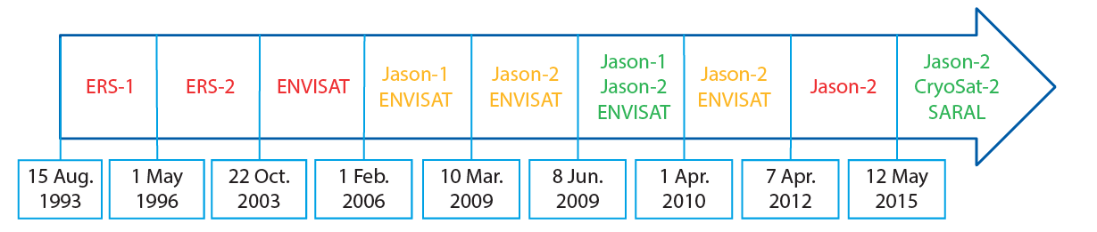
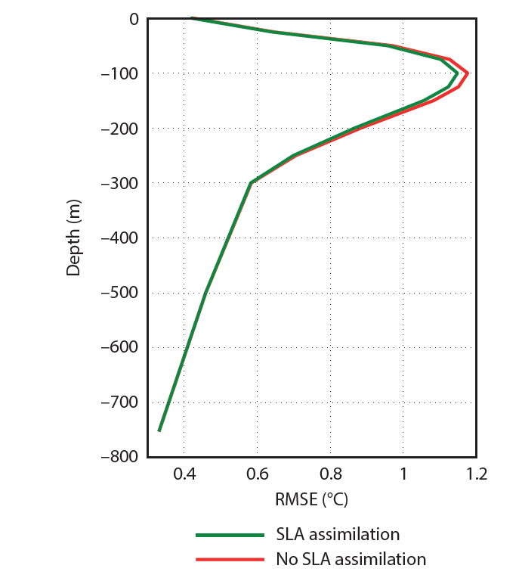
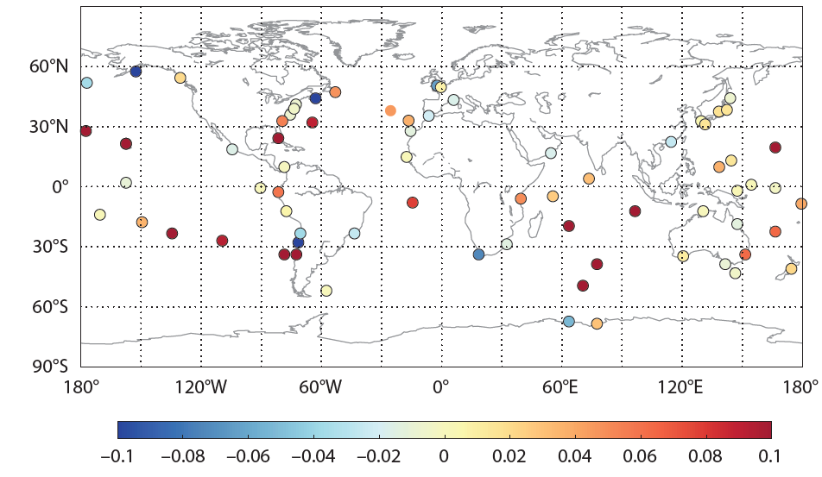
Assimilation of SLA
Temperature RMS errors
Correlation with tide-gauge observations
ORAP5-CNTL

Slide 25
Why a bias correction scheme?
Bias Correction Scheme
Models/forcing have systematic error (correlated in time)
Changes in the observing system can be damaging for the representation of the inter-annual variability.
Part of the error may be induced by the assimilation process.
What kind of bias correction scheme?
Multivariate, so it allows to make adiabatic corrections (Bell et al 2004)
First guess + adaptive component.
Generalized Dee and Da Silva bias correction scheme
(Balmaseda et al 2007)

Slide 26
Impact of data assimilation on the mean
20C thermocline depths at Eq. Atlantic
Assim of mooring data
NoAssim
PIRATA
Large impact of data in the mean state: Shallower thermocline
Notes:
This figure shows the time evolution of the depth of the equatorial thermocline in the Atlantic for 2 experimens:
CTL, (ocean forced by wind, in black), and Assim (in red, where the subsurface data have been assimilated)
The advent of the temperature data for the PIRATA moorings in 1998/1999 can be appreciated in the ASSIM experiment by the sudden shallowing of the thermocline:
The PIRATA data corrects for a systematic error of the background (which has too depth thermocline). The net effect is an spurious jump that induces spurious interannual variability.
To prevent this sort of behaviour, an adequate and explicit treatment of background bias is required

Slide 27
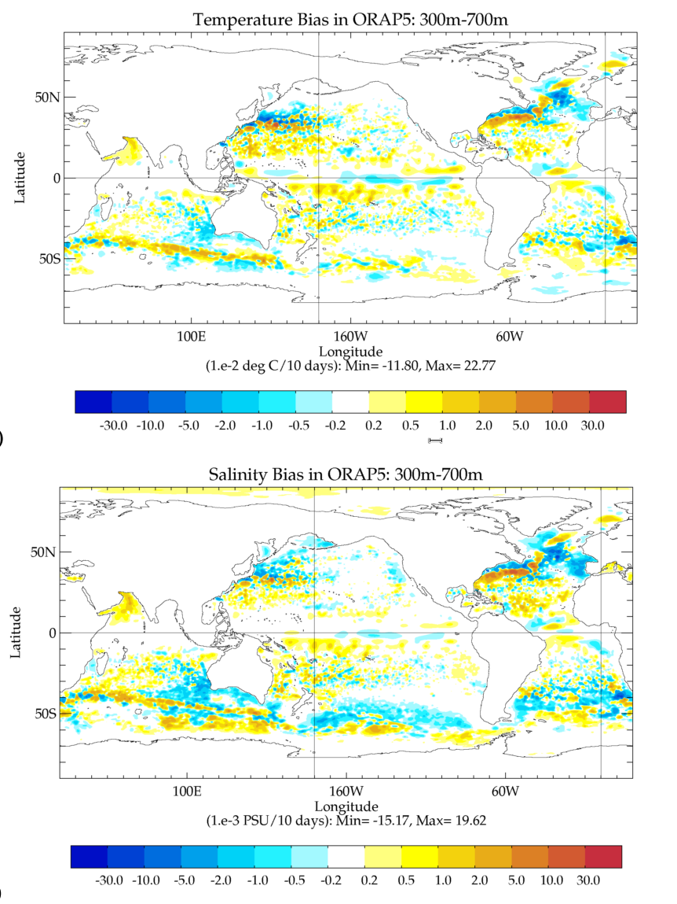
Bias Correction Algorithm
Seasonal term, estimated offline from rich-data (Argo) Period
Slow varying term, estimated online from assimilation increments dk
The offline bias correction is estimated from Argo period.
The correction is applied for the whole reanalysis period, e.g. 1975-present.
It is a way of extrapolating Argo information into the past.

Slide 28
Effect of bias correction on the time-evolution
20C thermocline depths at Eq. Atlantic
Assim of mooring data
No Assim
Bias corrected Assim
Notes:
The a-priori (iterative) estimation of the bias corrects the solution before the PIRATA moorings appear, hence preventing the shock.

Slide 29
ECMWF operational system
Forcing
NEMO
LIM2
Observations
ERA-interim
OPS
+WAM
Temperature
Salinity
Sea-Ice concentration
Sea-Level Anomalies
Sea Surface Temperature
Sea Surface Salinity
Global Mean SL
innovations
NEMOVAR
3D-Var
increments
NEMO
LIM2
OCEAN5: 5 Ens members: 1979 to present

Slide 30
ECMWF operational system
The ECMWF operational ocean analysis system (OCEAN5) comprises a Behind-Real-Time suite and Real-Time suite. It runs daily with 5 ensemble members and provide ocean-sea ice initial conditions for ECMWF’s Coupled Forecasting System.
Behind Real Time Ocean Reanalysis (ORA):
Updated every 5 days, with 5 days assimilation window
Latency time for data reception 3-6 days
Real Time Early Delivery (ORA-RT):
Brought daily to real time starting form BRT ORA with variable assimilation window
ORA | ORA-RT
D-m D D-m+N D+N
Assim Window N days

Slide 31
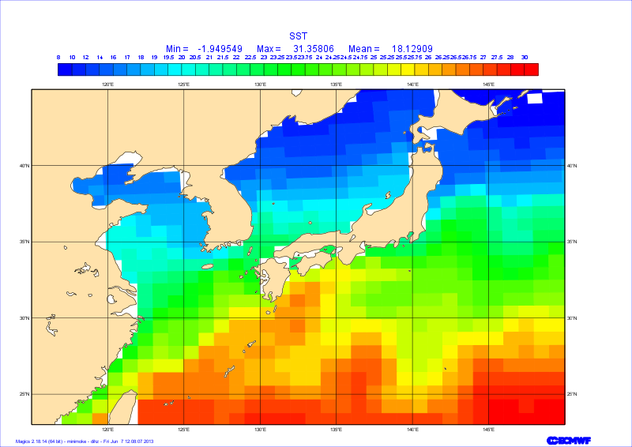
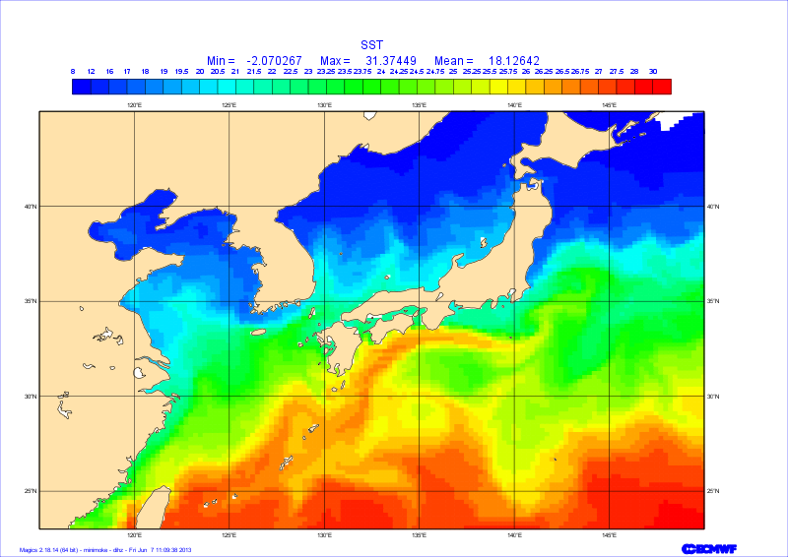
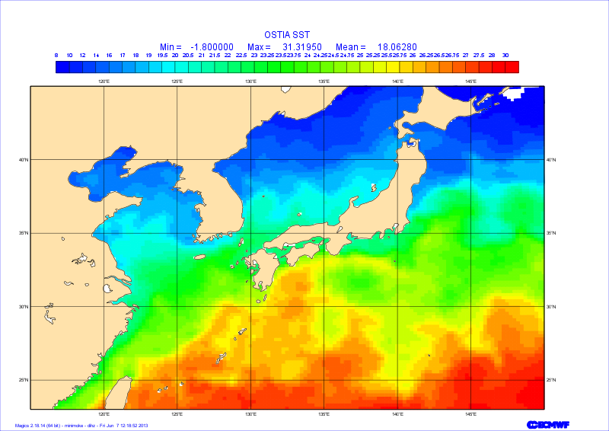
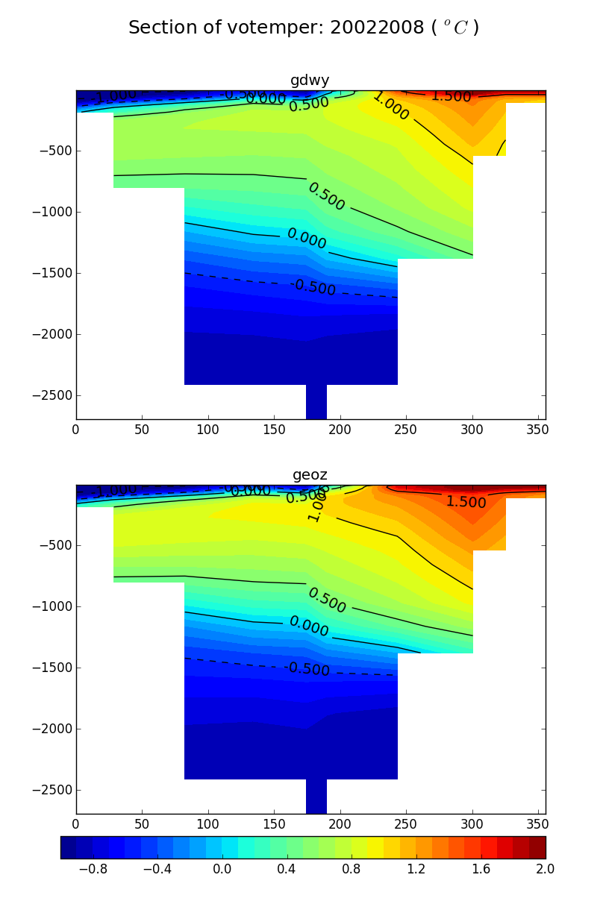


OCEAN5 model resolutions
OCEAN4: ~1x1 degree with 42 levels
OCEAN5: ~¼ x ¼ degree with 75 levels
Daily SST
1 degree
1/4 degree
OSTIA
Temperature section across the Fram strait: 2002-2008
(Beszczynska-Moller, et al., 2012)

Slide 32



OCEAN5 Ensemble generation
(Zuo et al., 2017)
OCEAN5 includes 5 ensemble members, which provide initial uncertainties for the ENS
observation perturbation + forcing fluxes perturbation
+ forcing perts
+ other obs perts
Daily OSTIA SIC assimilated
share the same obs number
regular thinning
Random sampling
Notes:
Maximum ensemble spread for SIC and SIT can be found when near Canadian Archipelago, in the northern of Baffin Bay and along the west coast of Greenland, with maximum std of 10% and 0.35 m, for SIC and SIT respectively. In the northern edge of the Barents Sea and Kara Sea at the ice edge, SIC spread can reach ~7% and that accounts up to half of the SIC in the same area.

Slide 33



Monitoring of OCEAN5 daily analysis: Temperature
FG-OBS
AN-OBS

Slide 34
Summary
Data assimilation in the ocean serves a variety of purposes, from climate monitoring to initialization of coupled model forecasts and ocean mesoscale prediction.
This lecture dealt mainly with ocean DA for initialization of coupled forecasts and reanalyses. Global Climate resolution. NEMOVAR as an example.
Compared to the atmosphere, ocean observations are scarce. The main source of information are temperature and salinity profiles (ARGO/moorings/XBTs), sea level from altimeter, SST and SIC from satellite/ships and geoid from gravity missions.
Assimilation of ocean observations reduces the large uncertainty(error) due to the forcing fluxes. It also improves the initialization of seasonal forecasts and decadal forecasts and it can provide useful reconstructions of the ocean climate.
Data assimilation changes the ocean mean state. Therefore, consistent ocean reanalysis requires an explicit treatment of the bias. More generally, we need a methodology that allows the assimilation of different time scales.
Assimilation of Sea-Level data requires consideration: e.g. conversion between SSH and SLA, calculation of MDT, thinning or superob of the SLA observations.

Slide 35
Further Readings
Ocean Data assimilation
Mogensen, K., Alonso Balmaseda, M., & Weaver, A. (2012). The NEMOVAR ocean data assimilation system as implemented in the ECMWF ocean analysis for System 4. Technical Memorandum (Vol. 668).
Weaver, A. T., Deltel, C., Machu, É., Ricci, S., & Daget, N. (2005). A multivariate balance operator for variational ocean data assimilation. Quarterly Journal of the Royal Meteorological Society, 131(613), 3605–3625.
Daget, N., Weaver, A. T., & Balmaseda, M. A. (2009). Ensemble estimation of background-error variances in a three-dimensional variational data assimilation system for the global ocean. Quarterly Journal of the Royal Meteorological Society, 135(641), 1071–1094. http://doi.org/10.1002/qj.412
Ocean Reanalysis system
Balmaseda, M. A., Mogensen, K., & Weaver, A. T. (2013). Evaluation of the ECMWF ocean reanalysis system ORAS4. Quarterly Journal of the Royal Meteorological Society, 139(674), 1132–1161. http://doi.org/10.1002/qj.2063
Zuo, H., Balmaseda, M. A., & Mogensen, K. (2015). The new eddy-permitting ORAP5 ocean reanalysis: description, evaluation and uncertainties in climate signals. Climate Dynamics. http://doi.org/10.1007/s00382-015-2675-1

