Slide 1
ECMWF-Met Office land surface data assimilation meeting
5 June 2023, University of Reading
Recent snow DA development at ECMWF
Kenta Ochi, Patricia de Rosnay, Gabriele Arduini, Gianpaolo Balsamo
1

Slide 2
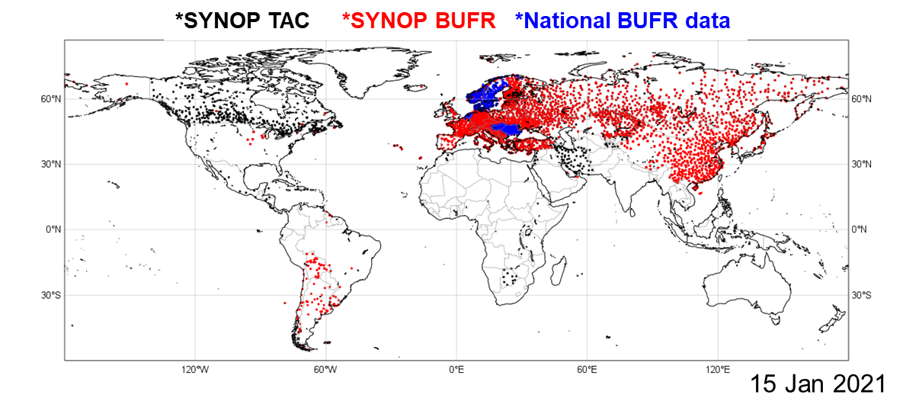
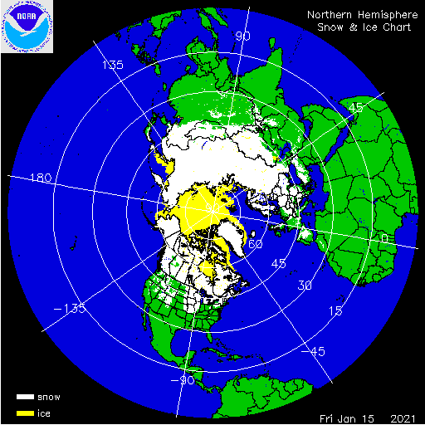
Snow data assimilation at ECMWF
Observations:
  Conventional snow depth data: SYNOP and National networks
  Snow cover extent: NOAA NESDIS/IMS daily product (4km)
    Available daily at 23 UTC, assimilated in the next analysis at 00UTC
Data assimilation:
  Optimal Interpolation (OI)
    Based on horizontal and vertical structure function in Brasnett (1999)
  The result of the data assimilation is used to initialize NWP
One of current issues:
  IMS assimilation below 1500m only, leading to excess snow depth on high mountains
  Especially on the Tibetan Plateau (Orsolini et al, 2019)
2

Slide 3
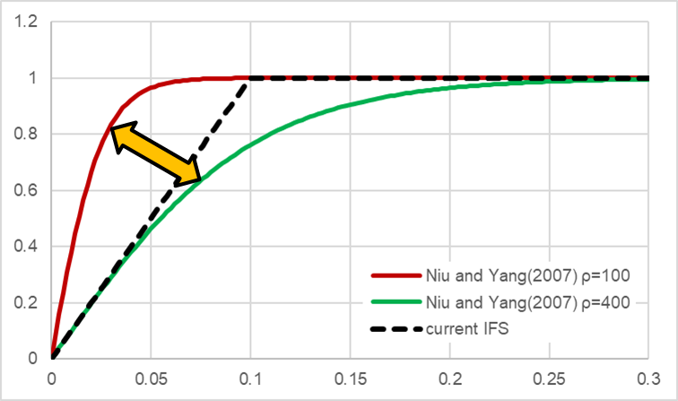
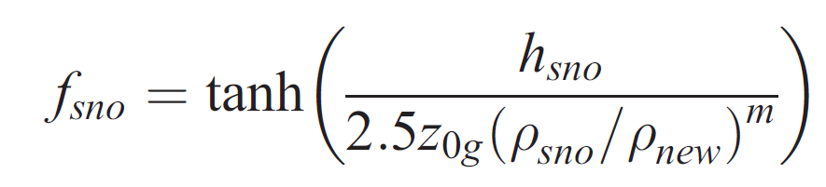
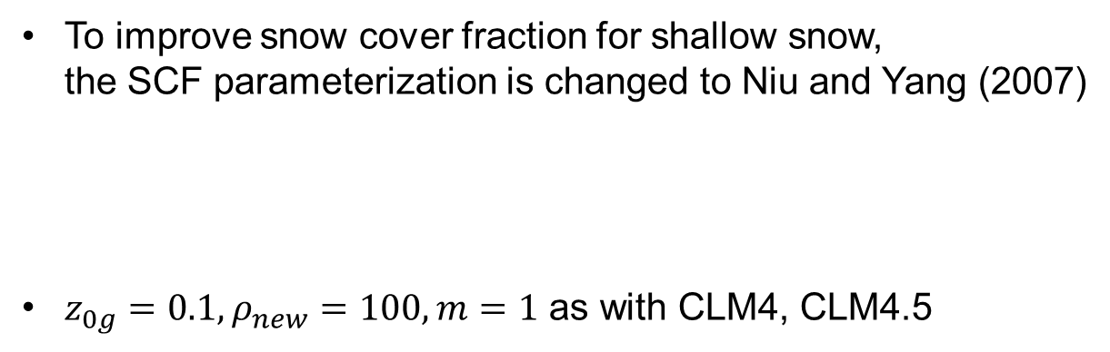
Snow DA and related model changes proposed for CY49R1
 | Current system | Proposed for CY49R1
IMS mask | based on altitude (>1500m) | based on SDFOR* (>250m)
IMS thinning | select 1 from every 36 | select closest 1 to a gaussian grid of 40km
IMS snow depth (SD_{IMS}) | 5cm | 3cm
Condition to assimilate SD_{IMS} | IMS=1 & SD_{model} < 10⁻⁹cm | IMS=1 & SD_{model} < 1cm
Capping value for snow depth | 1.4m | 3.0m
Vertical correlation length in OI | 800m | 500m
* Standard deviation of filtered subgrid orography
To improve snow cover fraction for shallow snow,
the SCF parameterization is changed to Niu and Yang (2007)
$z_{0g}=0.1, ρ_{new}=100, m=1$ as with CLM4, CLM4.5
3
Notes:
Other snow DA changes in CY49R1
Reject IMS on IMS mask
Change SCAN_RAD from 3000km to 300km (reduce computational cost)
Fix the first-guess interpolation for OI
Improve number of O-A in ODB

Slide 4
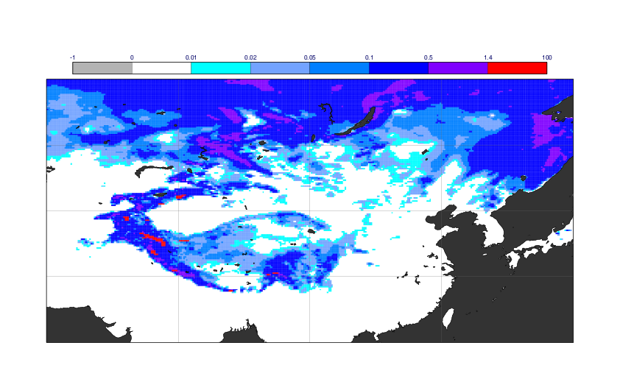
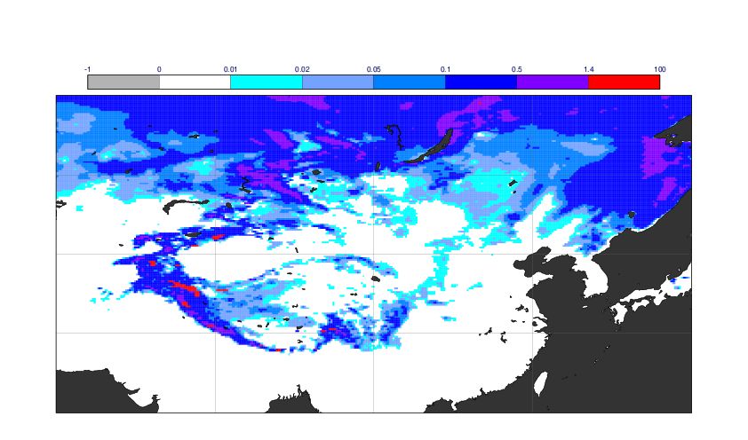
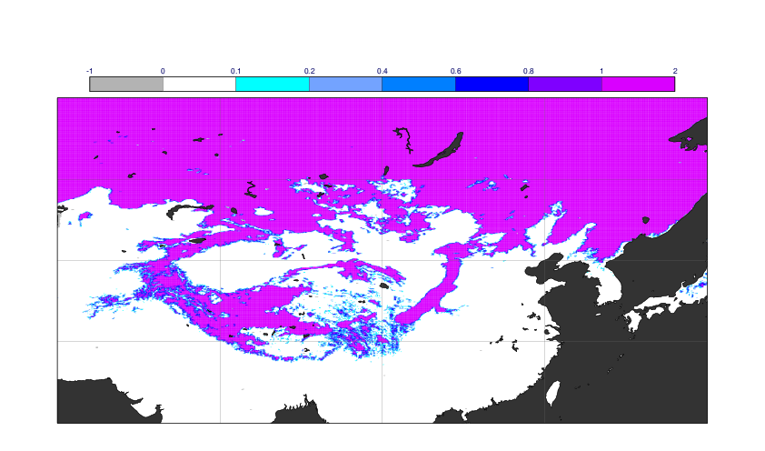
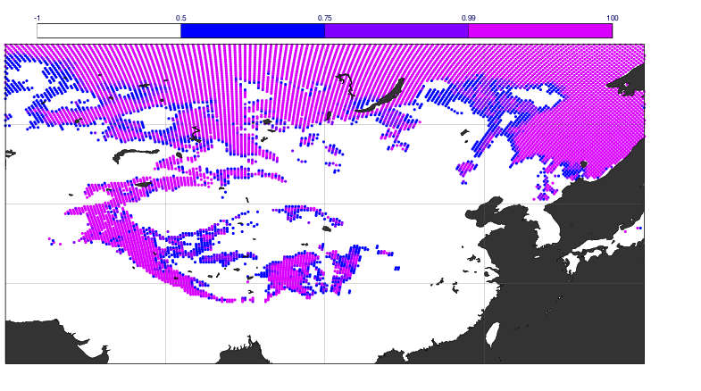
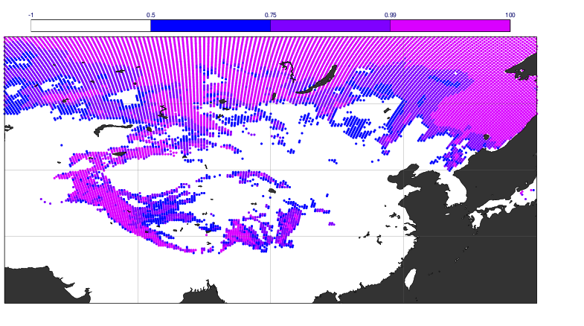
Impact on snow depth and snow cover fraction
CNTL
TEST
Top: snow depth
Bottom: snow cover fraction
on 12th Dec 2021
IMS (SCF>0.5 if IMS=1)
Snow depth is reduced by assimilating IMS on the Tibetan Plateau
SCF is improved (increased) on the Tibetan Plateau and around snow lines by the SCF change
4

Slide 5
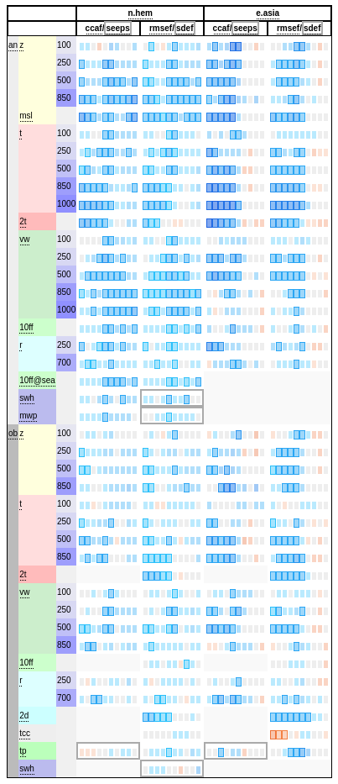
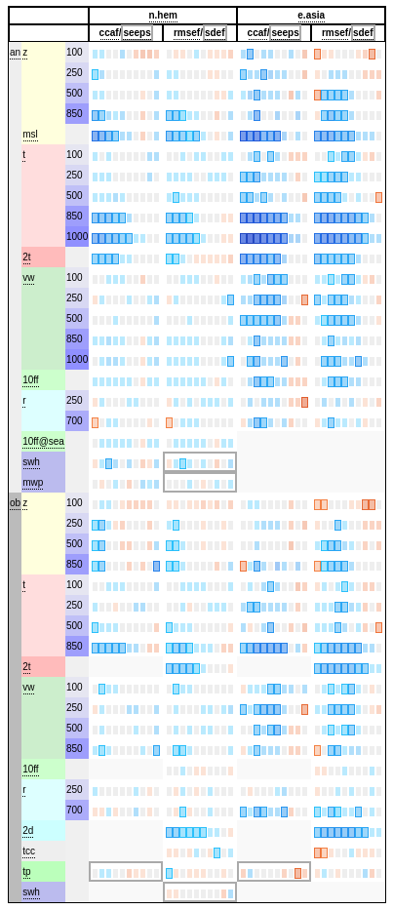
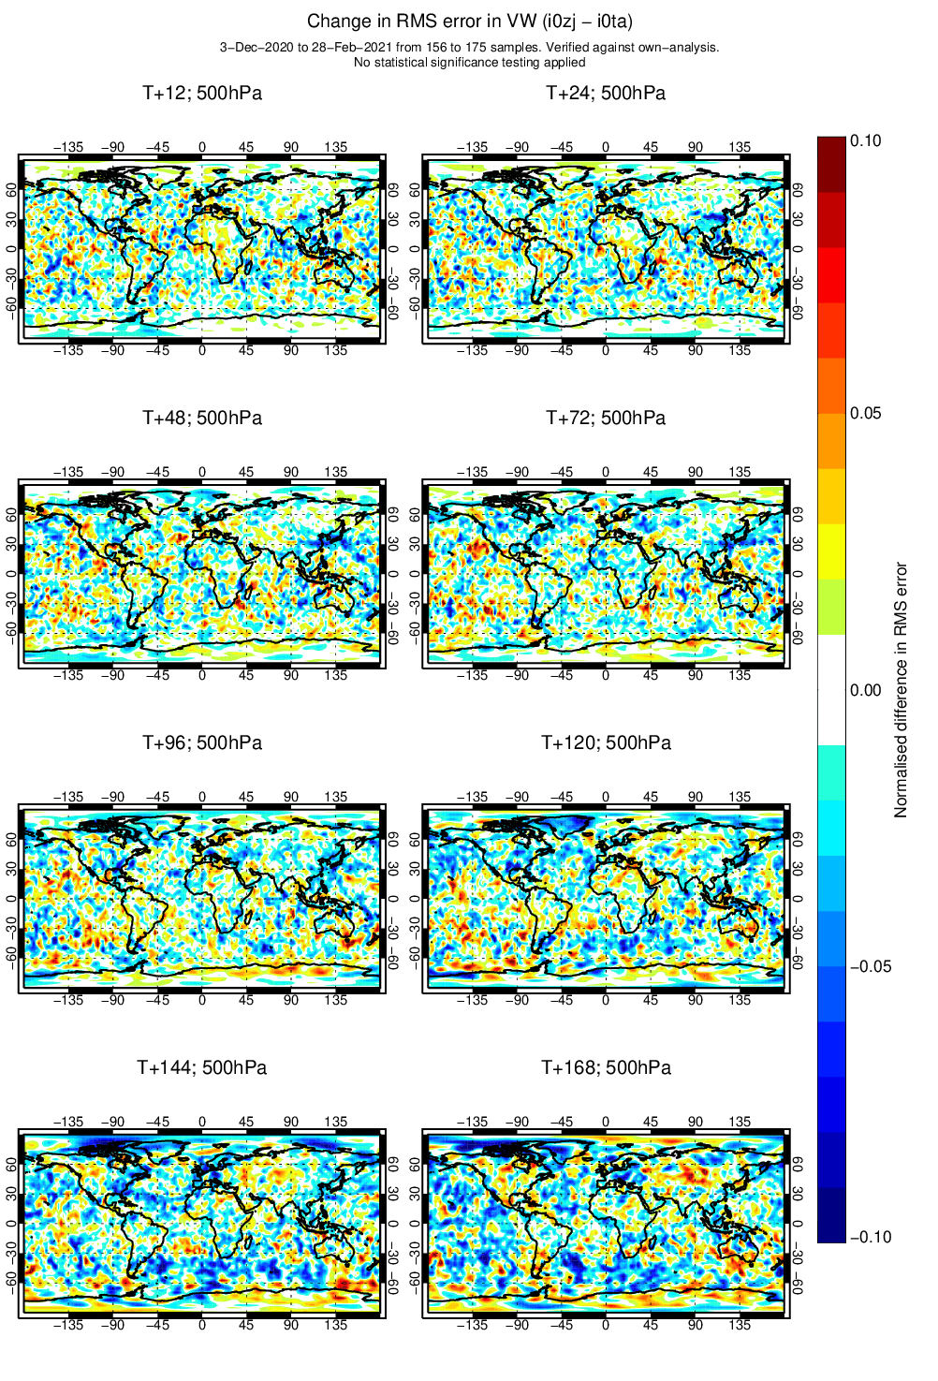
Impact on forecast skill in 2 winter seasons
Winter 2020/21
Winter 2021/22
Normalized diff in RMSE for wind fields at 500hPa
T+48h
Significant improvements in the NH, especially in East Asia
Large impact of snow on forecast skill
5

Slide 6
Summary and ongoing works
Snow DA and related model changes have been tested for the next cycle
The snow changes have large impact on forecast skill in the NH
  Not only near surface temperature, but also in the mid-to-upper troposphere
Ongoing works:
  Implement snow DA in the offline LDAS for SEAS6 and ERA6-Land
  ESA CCI Snow assimilation in ERA6
  Snow DA in a unified multivariate ensemble-based LDAS (de Rosnay et al, 2022)
6

Slide 8
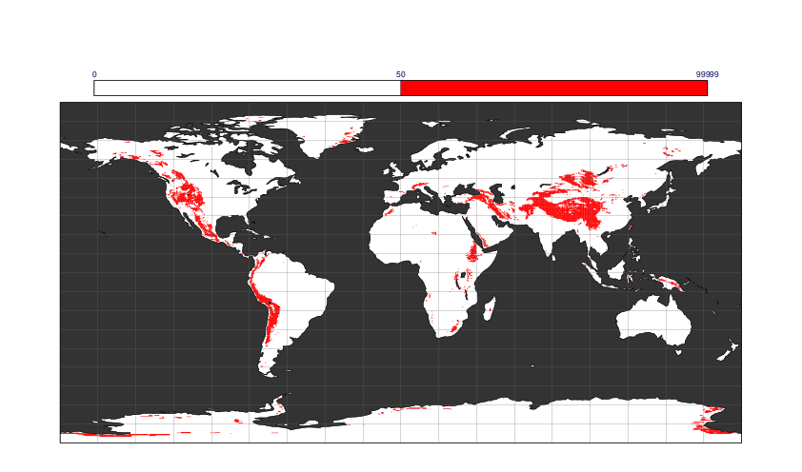
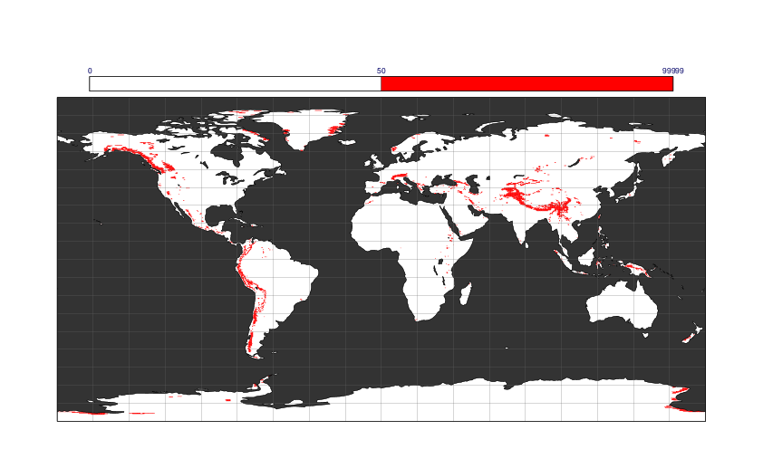
IMS mask
CNTL (altitude > 1500m)
TEST (SDFOR > 250m)
IMS is not assimilated on the areas with red shading

Slide 9
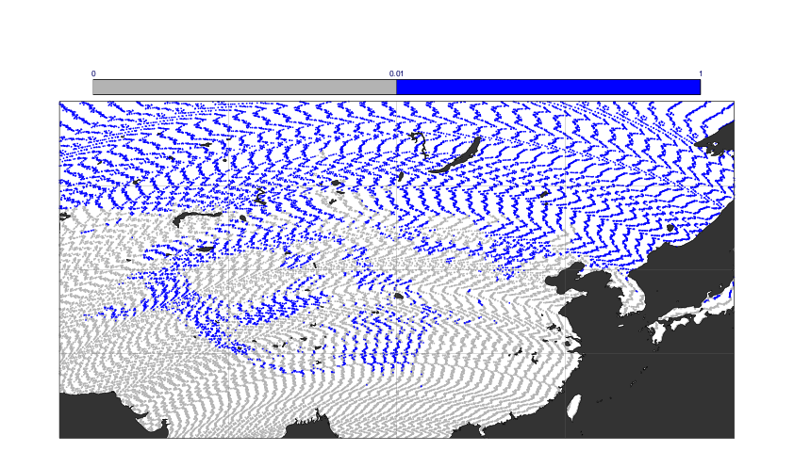
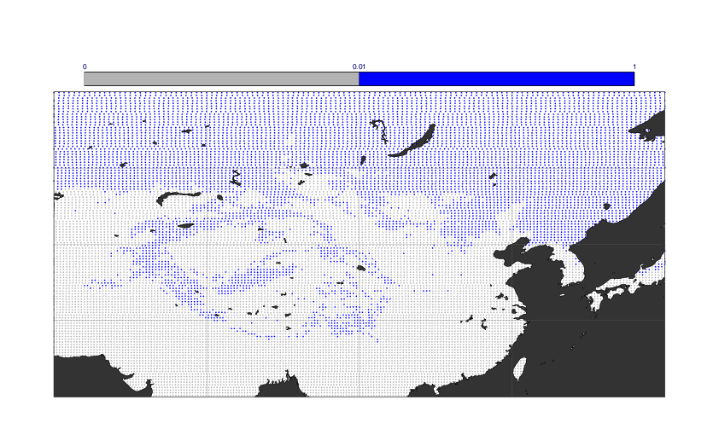
Thinning for IMS
CNTL
TEST
Number of IMS is reduced from 251926 to 70125
More effective and efficient use of IMS
  Considering the current horizontal correlation in the OI

Slide 10
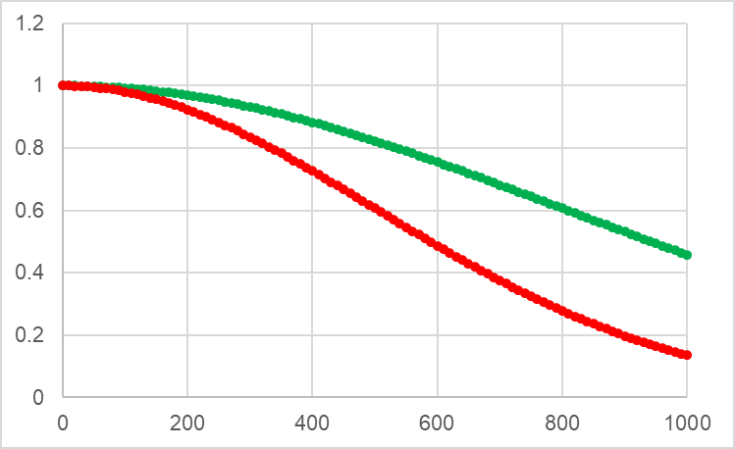
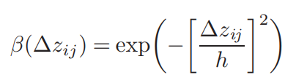
Vertical correlation function
[m]
h is changed from 800m to 500m

