Slide 1
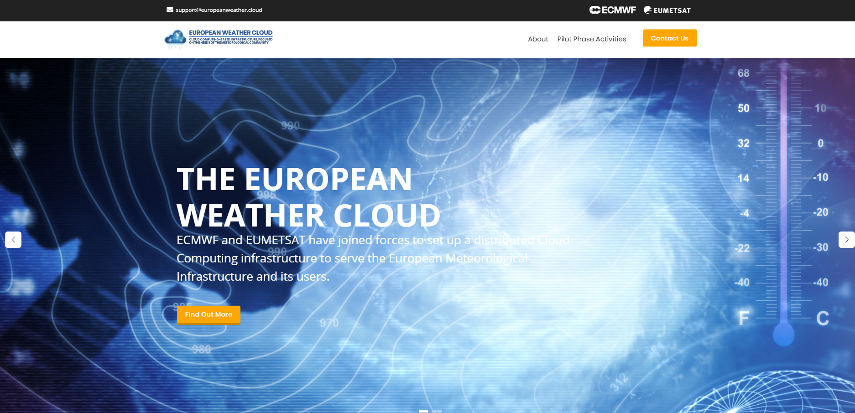
EWC Features Roadmap
Vasileios A. Baousis(PhD) ECMWF
Roope Tervo EUMETSAT
www.europeanweather.cloud

Slide 2
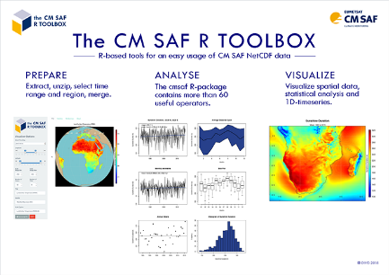
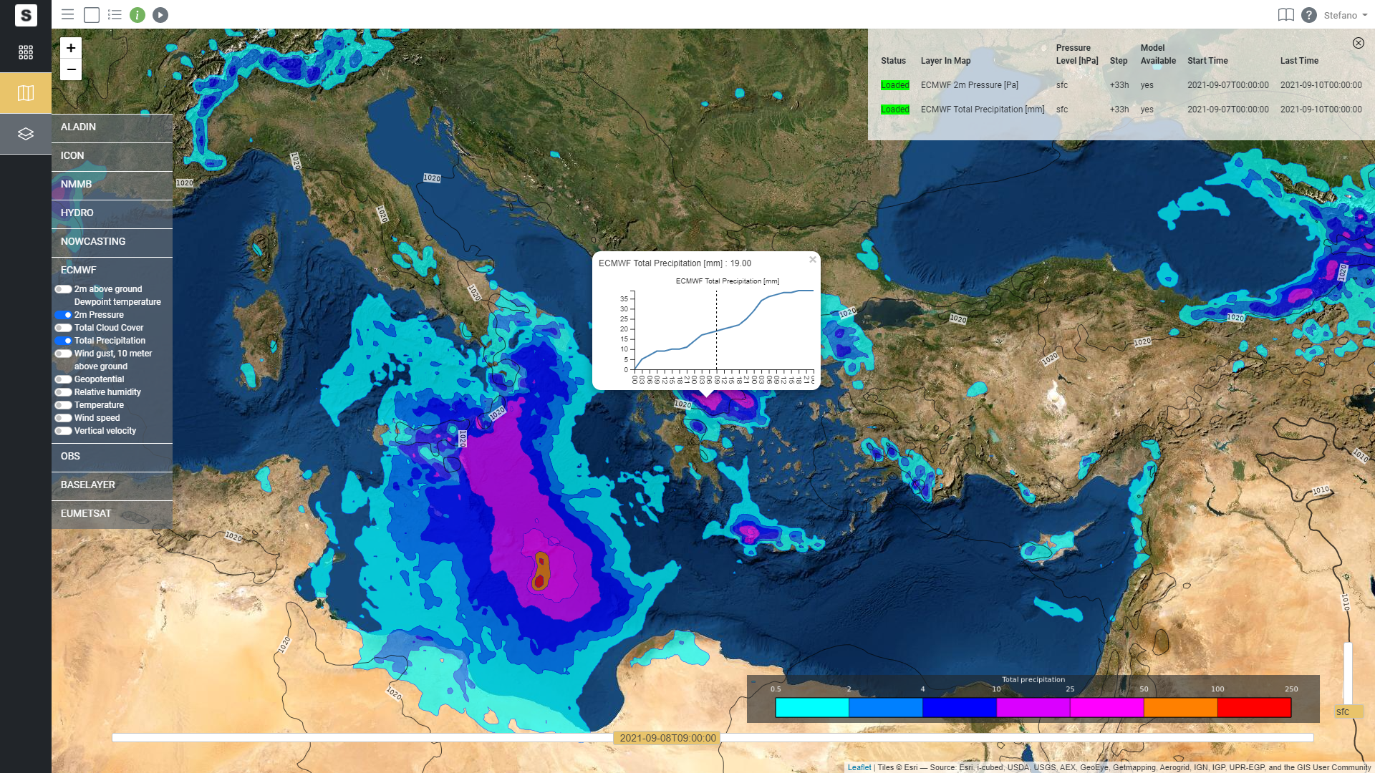
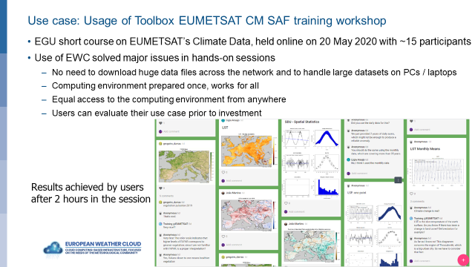
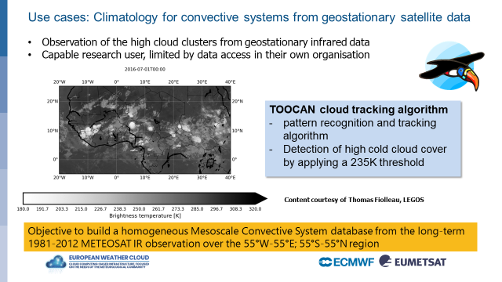
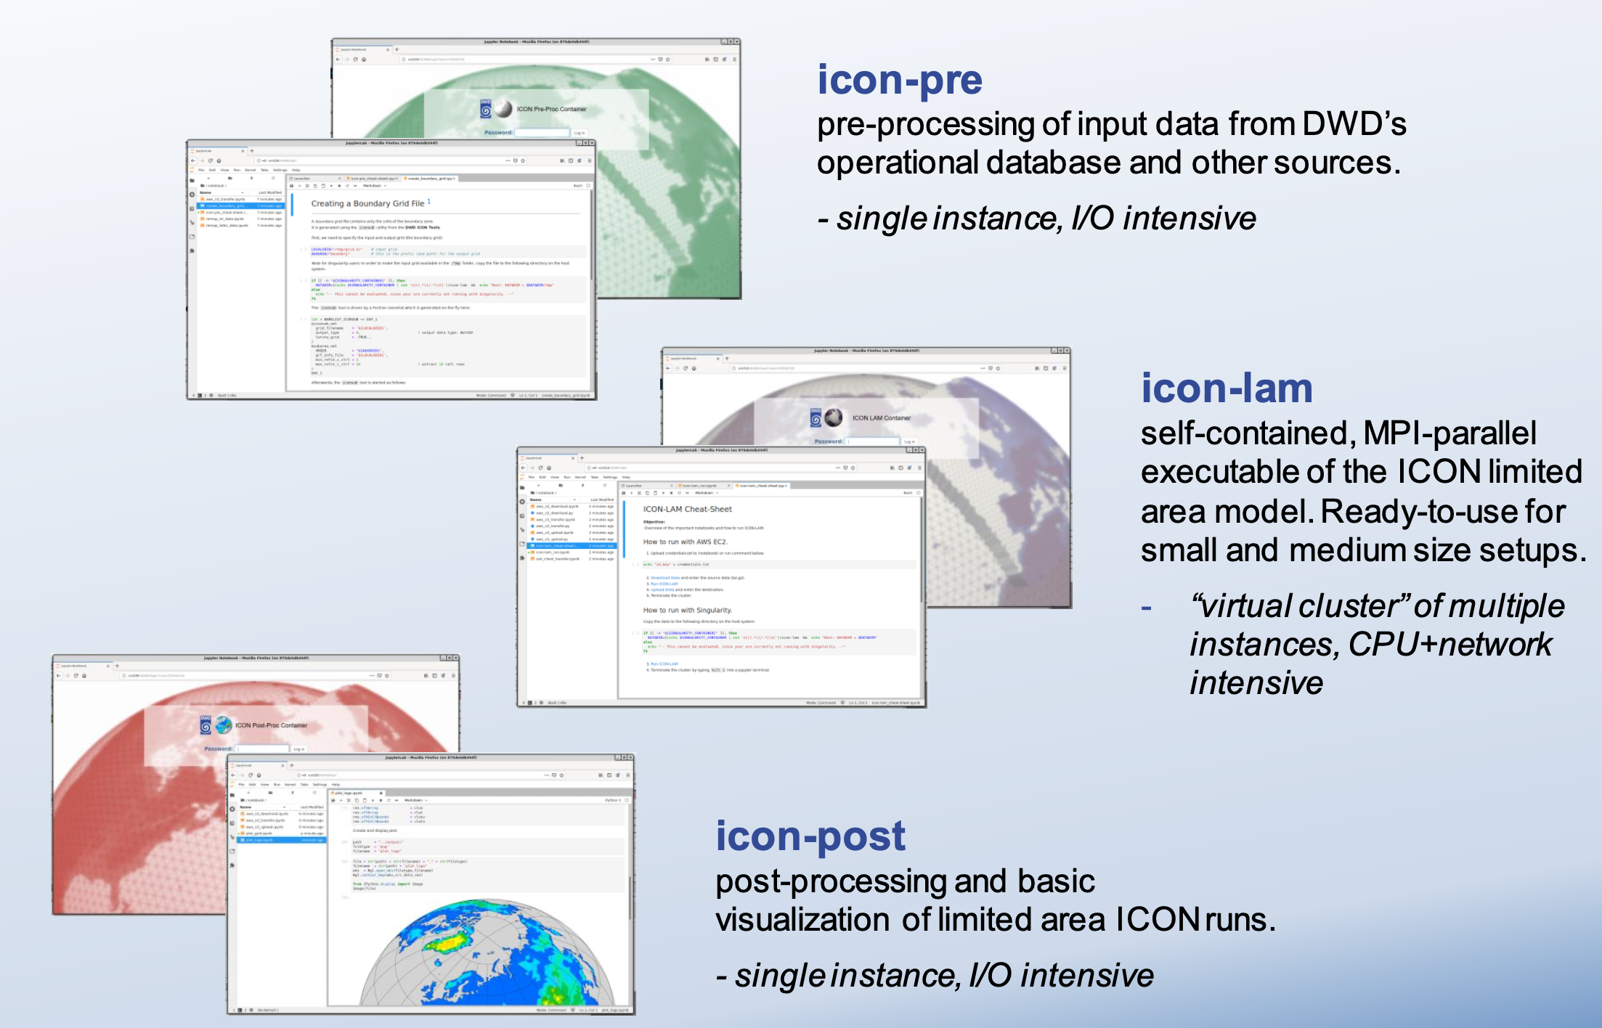
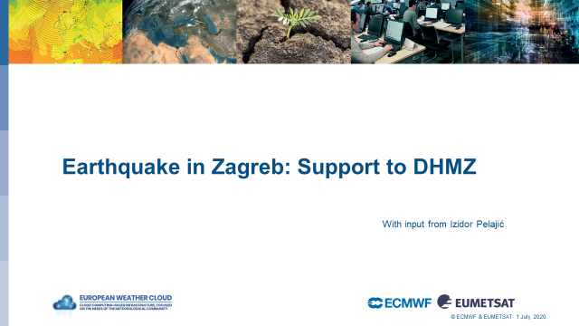
User Feedback from Pilot Phase
Use cases in the pilot phase reflected different user groups varying from researchers to operational application developers and operators. Features and utilities were offered accordingly.
Gathered feedback during the Pilot Phase via several channels.
One major feedback was: Many users faced the hurdle that any service or application they want to run on the cloud must be set up from the bare infrastructure.
Running workload in Kubernetes was popular in many use cases and a managed Kubernetes was strongly requested for operational usage.
2
Notes:
direct interactions b) support interactions c) user workshops; d) questionnaires & user surveys f) usage statistics and analytics
IaaS introduces a barrier for users with a more limited technical background and prevents a higher user uptake. The same is also a significant overhead for IT savvy developers due to the requirement to maintain additional operational infrastructure.
Tenants can provision VMs and host their own applications.
Also very basic level service, such as user management, maintained by the tenants
Benefits are data proximity and community but developing and operating operational services is problematic with just IaaS

Slide 3




Current Offering Infrastructure as a Service
Collaborative development.
Operational use
Data repositories
Tenants can provision VMs and host their own applications
Also basic level service, such as user management, maintained by the tenants
Current advantages are data proximity and community. Users developing and operating operational services would benefit also Platform as a Service (PaaS)
EUMETSAT
cloud
EUMETSAT online data storage
EUMETCast Terrestrial
Elasticity
VM
Data Access APIs
IaaS
Project tenancy: EUMETSAT
ECMWF online data storage
ECPDS
Project tenancy: ECMWF
MARS
ECMWF
cloud
elasticity
WEBAPI
VM
VM
Hybrid cloud management
CDS/ADS API
ECMWF
Cloud on premise
Push service
Pull service
Notes:
Tenants can provision VMs and host their own applications.
Also basic level service, such as user management, maintained by the tenants
Benefits are data proximity and community but developing and operating operational services is problematic with just IaaS

Slide 4



Design considerations in providing PaaS elements on top of IaaS
Focus on domain specific applications
Careful balancing between managed services and sustainability
Need to find a way to provide the best return for the investment
Initially provide services as ready-made templates (user hosted) and then move towards centrally hosted services
Heavy and permanent workloads are always accounted from the users (and has thus no significant effect on infrastructure payload). Some services may also contain free disposable component for development and experiments
Investing effort to develop and maintain centrally hosted platform services provides optimum value when it removes the corresponding maintenance overheads from the Member States
Notes:
Focus on the development is on domain specific applications and especially when
Multi-cloud applications and environments
Using large amounts of data, ML/AI
The enhanced application development is tried to be achieved using containers and providing environment to operate and orchestrate them
Providing hosted services is not easy
Maintenance, user and application security, privacy and isolation (certificate creation etc), data privacy need to be considered
We can provide only carefully selected services
Nevertheless, often (especially in case of operational applications) corresponding maintenance effort is required from each user and detracts from the actual domain-specific task. Investing effort to develop and maintain centrally hosted platform services provides optimum value when it removes the corresponding maintenance overheads from the Member States. Notably, hosting centrally a service with a high maintenance workload for part of the users may save in total more than hosting centrally a service with a low maintenance workload for all users.
Notably, hosting centrally a service with a high maintenance workload for part of the users may save in total more than hosting centrally a service with a low maintenance workload for all users.

Slide 5







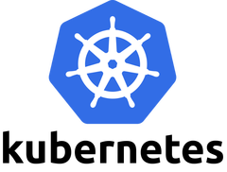

Software Marketplace
Place to share and collaborate
  Domain-specific applications blueprints, templates, algorithms, documentation, etc.
  Infrastructure-as-a-code assets
  To be realised in one primary GIT repository with auxiliary channels
Contributions, maintenance and application support based
mainly on the community contributions→ E&E support for onboarding users and maintaining assets
Examples of possible marketplace offering:
  Web Map Service (WMS) on ECMWF forecast data
  Backend services for forecaster workstation/web services (e.g GeoWeb)
  Notebook environment on ML data analytics on archive or forecast data
Data tailor
SaaS
Dispersion models
Software Marketplace
PaaS
IaaS
Notes:
Envisaged to contain one primary GIT repository and several auxiliary channels for content sharing
GIT Repositories (hosted and others) / Container registries /VM images

Slide 6
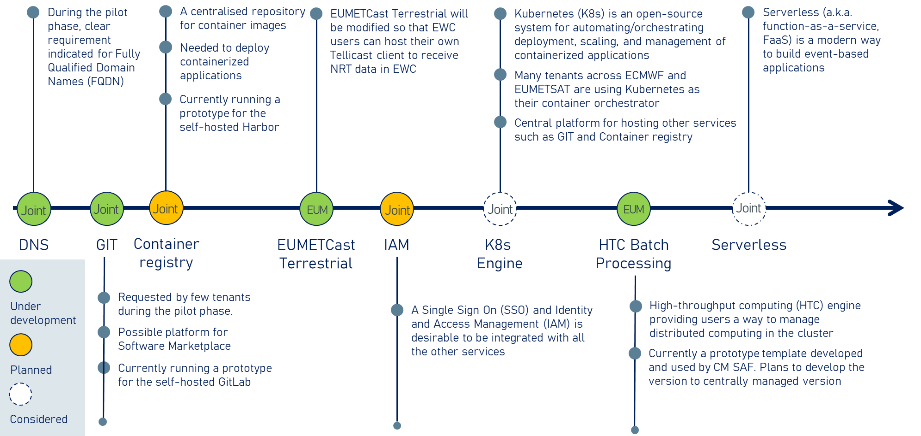
EWC Features Roadmap

Slide 7
Operational Service Principles
Operational Services should have/be:
Lifecycle management
Inline and compatible to the purpose and objectives of the EWC and its users
Proper documentation and established responsibilities
Reliable and available.
Secure
Supported and resourced
Notes:
Principles
Operational services shall be/have:
Lifecycle management
The operational services deployed and supported in the EWC shall have a clearly defined lifecycle. Envisaged lifecycle of each service will be clearly communicated to users so that they can design their architecture and activities respectively. The operational service lifecycle management would also help in removing deprecated services, and it includes the service description, the roadmap and timeline for the staging of the service from demo to PoC, to beta versions and, if the below principles are satisfied, to Operational deployment, offering and support. Support model and associated cost in resources should be clearly defined in the service description to assist in any decision to deploy/support of any service.
Inline and compatible to the purpose and objectives of the EWC and its users
The main goal of the services is to help MS/CS to achieve their goals and objectives by providing means to utilize their EWC allocated resources in the best efficient manner. All services should therefore be grounded in a clearly established user need.
Proper documentation and established responsibilities
All operational services shall have a service description and adequate documentation for a third party to be able to understand the service functionality and be in a position to troubleshot issues (1st or 2nd level support)
Potential training to relevant supporting operators should take place before the service activation.
Established RACI model for service processes and procedures.
Equal administration access for both organizations is granted to all managed services, whenever possible, excluding key infrastructure services (where changes may reach beyond EWC and impact ECMWF or EUMETSAT internal security or operations). This ensures fast reaction time in case of problems and fluent service to users and increase resiliency.
All services should have established operational processes and procedures for change, access, patch, capacity, event and incident management. Operational Processes and Procedures below summarize the scope of these process and procedures. It should be noted that, in general, processes and procedures EWC should be as self-standing as possible from both organizations to ensure the best possible fit for EWC users while also protecting operational services of providing organizations. Thus, using already existing internal services should be avoided.
Reliable and available. Essentially all operational services:
Should be deployed in a High Availability (HA) configuration and mechanisms should be deployed to make the services fault tolerant (e.g. service clusters, load balancers, geo-redundancy of service, back-restore mechanisms etc)
Should are monitored by the providing organization. Both organizations shall have visibility on monitoring for providing support to the users.
Shall have a backup service. Backups are taken from all operational services and they are stored independently to EWC or to both sides of EWC. (E&E cloud infrastructures)
Secure
Security by design should be enforced to all offered services. Where possible services may be audited from a 3rd party to identify/verify their security posture.
Should be compliant (wherever is applicable) with any relevant security standard : i.e GDRP, PCI DSS etc.
Supported and resourced
Support model and associated cost in resources should be clearly defined to assist in any decision to deploy/support of the service.
Enough resources should be available for the support of the operational services, adhering to resources needed to maintain the enforced support model of each service. Quality of each service will be dependent on the actual resources allocated versus the resources needed to support each service.

Slide 8
Service Lifecycle
Step-by-step approach
Develop and enrol new services through a beta version with no quality of service (QoS) targets.
Proof of usage is gathered along with feasibility check in terms of required resources, maintenance, and support effort.
The length of the beta phase depends on the service.
After the beta phase, services may be shut down or transformed to as operational services.
Operational services may be shut down if they have very little usage or are particularly challenging to maintain.
The envisaged lifecycle and all changes to it will be clearly communicated to the users well in advance and in a continues manner.
Notes:
General approach to develop and enrol new services is to launch first beta version with no quality of service (QoS) targets. During the beta phase, proof of usage is gathered along with feasibility check in terms of required resources, maintenance, and support effort. The length of the beta phase depends on the service. After the beta phase, services may be shut down or transformed to as operational services. Also, operational services may be shut down if they have very little usage or are particularly challenging to maintain. The envisaged lifecycle and all changes to it will be clearly communicated to the users well in advance.

Slide 9
Service level expectations and requirements for existing and new services
The service level of operational phase shall be defined to each service individually
  The service level of centrally managed services may vary depending on their lifecycle phase, function, and importance for operations.
  The service levels are reviewed regularly based on their usage and user feedback.
Generally, the services can be categories to three categories:
  Critical services: problems investigated within next business day;
  Additional service: problems investigated within three or more business days;
  Beta services: best effort.
Full 24/7 for managed services would have significant cost implications and is not seen feasible in the beginning of operations.
Notes:
The service level of centrally managed services may vary depending on their lifecycle phase, function, and importance for operations. The service level of operational phase shall be defined to each service individually.
The initial service level of currently envisaged services are listed in . The service levels are reviewed regularly based on their usage and user feedback. Generally, the services can be categories to three categories:
Critical services: problems investigated within next business day;
Additional service: problems investigated within three or more business days;
Beta services: best effort.
Full 24/7 for centrally managed services would have significant cost implications and is not seen feasible in the beginning of operations. Consequently, EWC users are required to design their application architecture respectively. The operational level of each service will be reviewed

Slide 10
Identity and Access Management (IAM)
Primary user group:
All EWC users
Example use case:
Manage identity and access to all resources in the cloud. Tenant admins and developers can create users based on roles and thus manage users in VMs and control access to assets in hosted services (e.g., container registry).
For example, admin creates users to the IAM based on the developer role and read-only role. The developer can then use the developer credentials to create VMs push new images to the container registry. Read-only user may then use the read-only credentials to pull the images to one’s home organization.
A Single Sign On (SSO) and Identity and Access Management (IAM) solution is desirable to be integrated with all the other services
Reduces complexity for users, who do not need to manage a lot of credentials for different systems
One user feedback was to include the possibility of federation with NMHS's and other organisation's IAMs
Desirable service but also quite resource-intensive to maintain

Slide 11
Domain Name Server (DNS)
During the pilot phase, clear requirement indicated for Fully Qualified Domain Names (FQDN), e.g. like www.example.com
  Especially true and essential for automated setups including Kubernetes, for simple ease of use, and when the workloads are part of the larger applications.
  FQDNs may be bound to a service instead of, possibly changing, IP address.
  Tenants can (and should) register/use their own domains for external services. This service provides an essential base only.
Each tenancy will have a separate hosted zone (or subdomain)
  e.g., vm-name.tenancy-name.ewcloud.host
Integration of E&E Morpheus with Route 53 DNS being tested
  The FQDN will be created/deleted when you provision/delete your VM in both E&E clouds.
Primary user group:
All EWC users
Example use case:
Provide FQDNs for applications. Important for example for APIs being part of the distributed application and services provided for end users in the development and testing phase.
For example, developer creates an API end point operated in Kubernetes. The developer may bind a https://cool-api.cool-tenant.k8s.ewc.host to the service which may then be used in UI hosted elsewhere. If the API is changed in the future, developers do not need to make changes to the other part of the application.

Slide 12
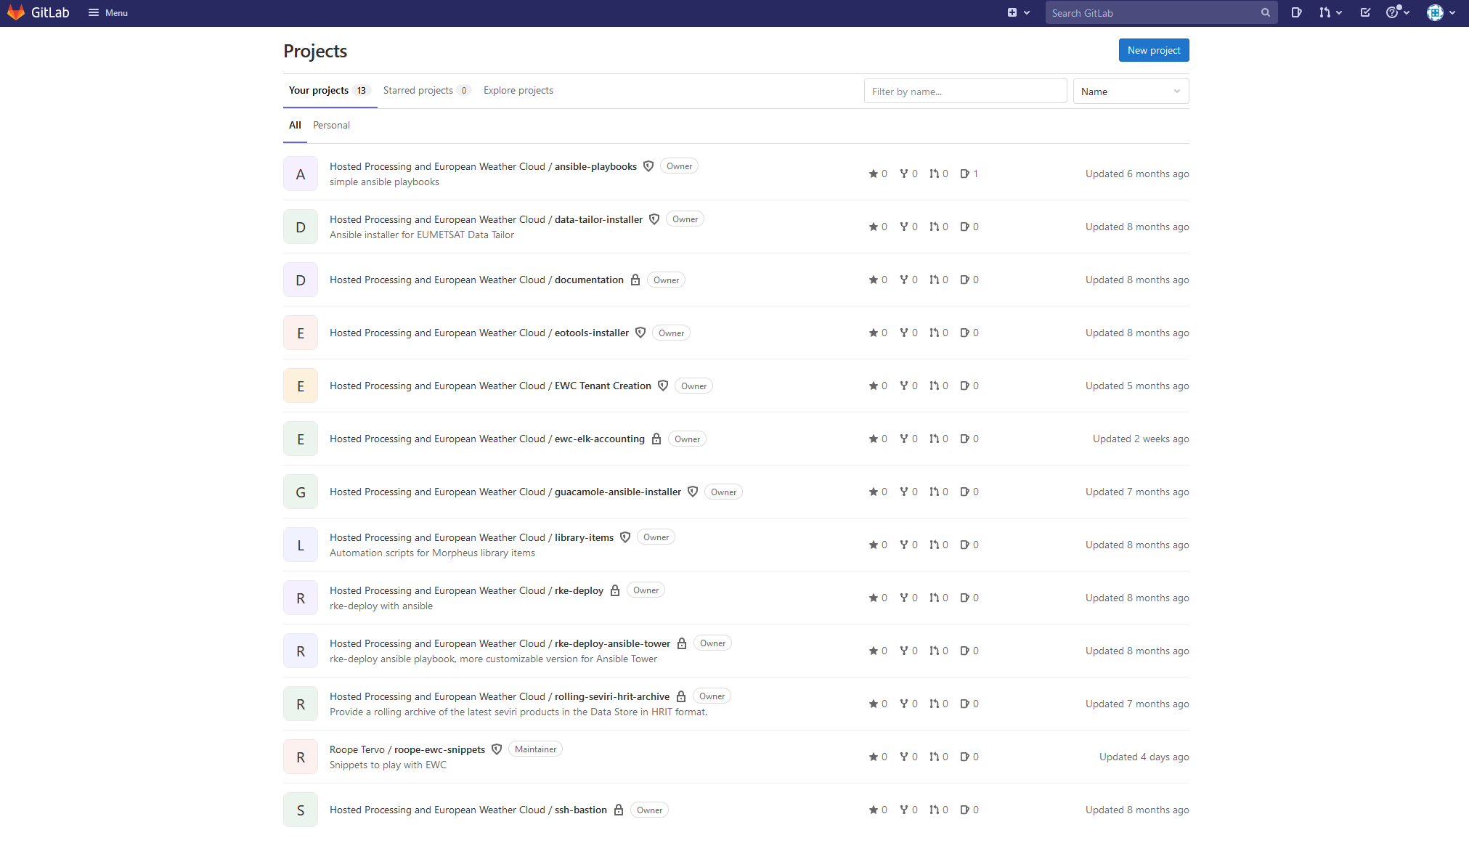
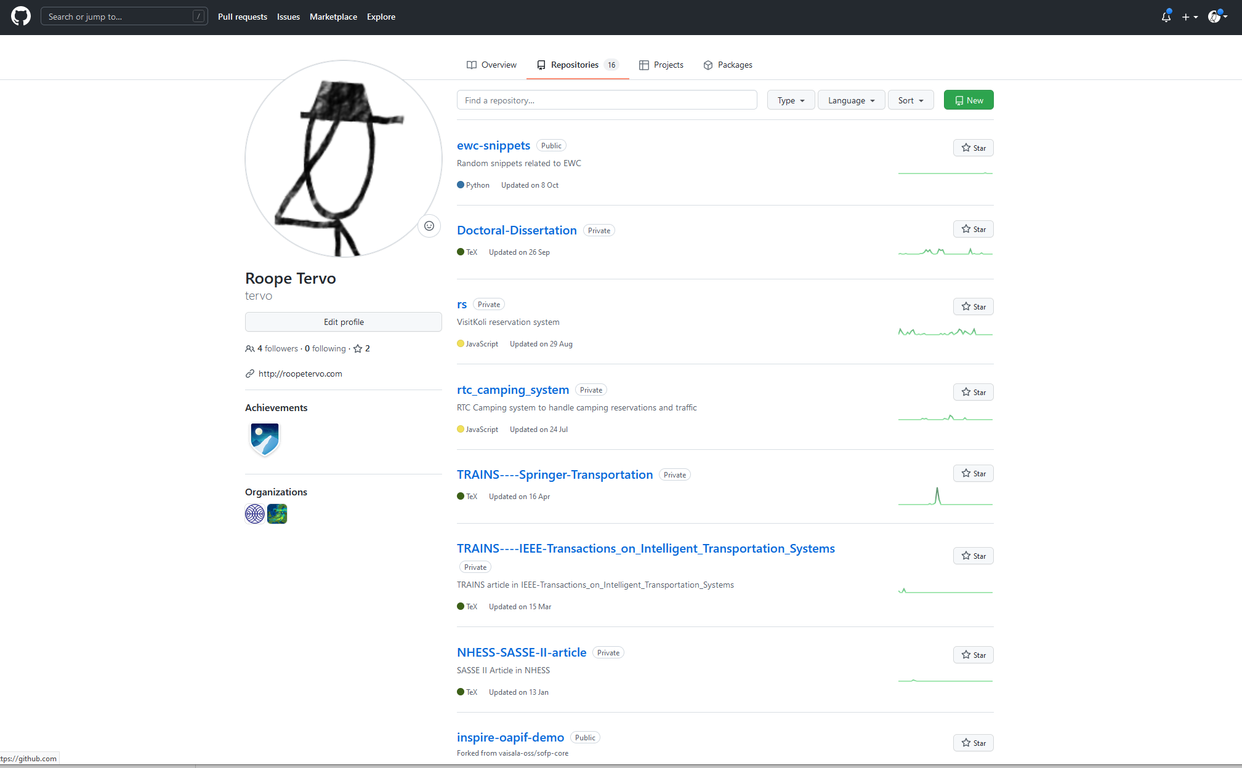
Distributed version control system
Hosted GIT service planned
Repositories can be private, group, or public
Working as part of the marketplace
  Shared structure for infrastructure-as-a-code, documentation, and the software
Primary user group:
All EWC users
Example use case:
Manage source code, documentation, and other assets. Important for users who are not able to use home organizations’ version control system or may not have one (e.g. SAFs). Might be used as part of the Marketplace.

Slide 13
Container Registry
Primary user group:
Application developers
Example use case:
To manage container images. Important for users who are not able to use commercial or home organizations’ registry or do not have one. Will be used as part of the Marketplace.
A centralised repository where users could store and pull container images needed in their applications for deployment
  e.g. deploying a user's container implementing a bias-estimation algorithm to an EWC VM
Mandatory component to manage and deploy modern, cloud-native applications and is part of many deployment pipeline
Home organisation repositories are often internal only, and it may not be permitted to use community/commercial repositories on security and privacy grounds

Slide 14
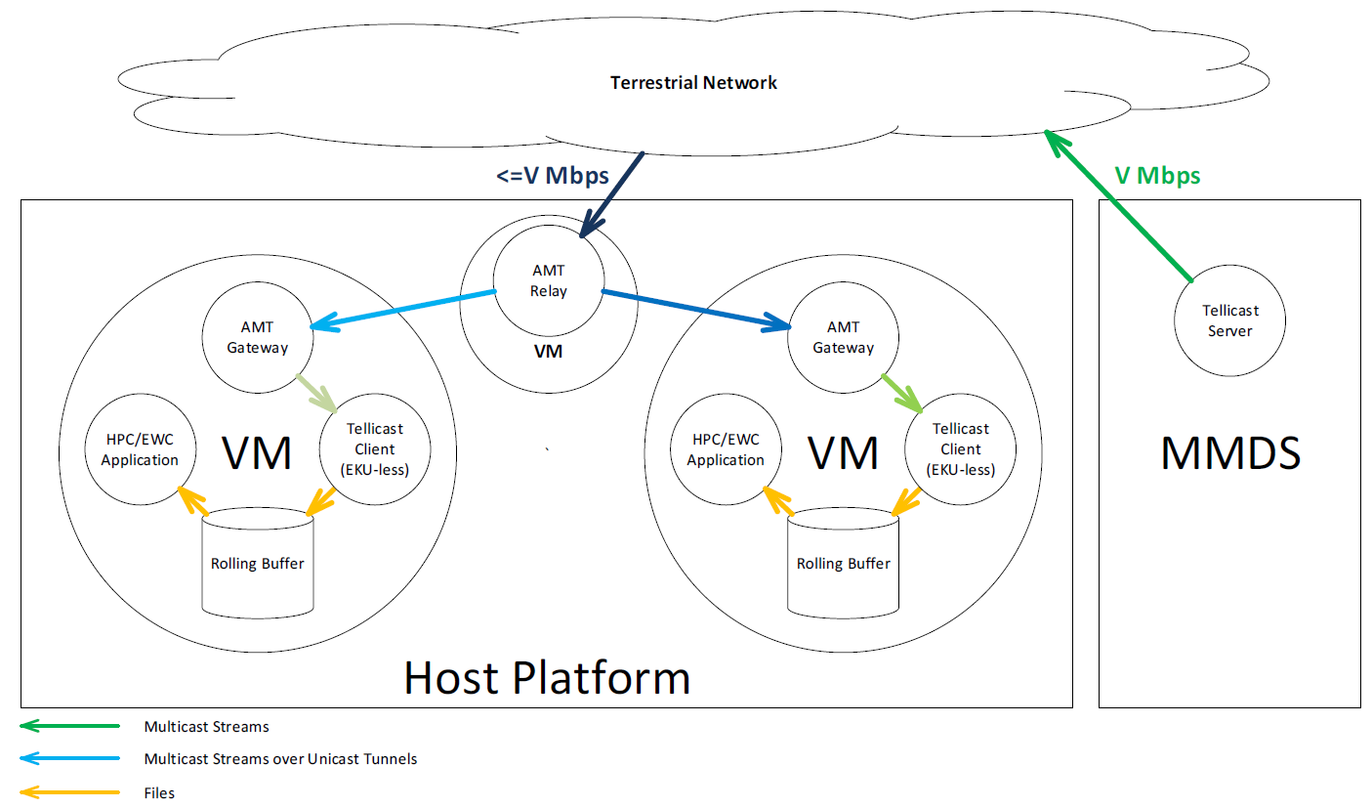
EUMETCast Terrestrial for NRT EUMETSAT data
Each EWC tenant can:
Host its own local Tellicast client
Maintain its own local rolling buffer of NRT data files
Host local processing applications
Benefits:
The format and timeliness of the received NRT data are the same as on the EUMETCast Terrestrial service
The user has full control over the received NRT dataset via their EO portal subscriptions
This approach is fully compliant with the data policy

Slide 15
Kubernetes
Kubernetes (K8s) is an open-source system for automating/orchestrating deployment, scaling, and management of containerised applications
  It is the base platform where many cloud-native applications are deployed.
Many tenants across ECMWF and EUMETSAT are using Kubernetes as their container orchestrator
The Kubernetes cluster deployments can be provided either as a self-hosted version (as a Marketplace item) or as hosted service.
During the pilot phase, many users clearly indicated a request for hosted Kubernetes Engine
  Maintaining operative Kubernetes is a remarkable work, detracting from the actual domain-specific work
Primary user group:
Application developers
Example use case:
Developers manage container-based applications and workloads.
Developers can define the setup as a code and easily deploy the application to any Kubernetes cluster with access to the required assets. Workloads can also easily be scaled up and down.

Slide 16
High-throughput-computing job management system
High-throughput computing (HTC) engine providing users a way to manage distributed computing in the cluster
  The tenant provisions worker nodes and attaches them to centrally hosted master nodes.
  The user may then create a workload consisting of thousands of separate tasks, which are distributed automatically to the computing cluster
  N.B. this is not HPC / parallel processing, as on the ECMWF HPC
Currently a prototype Marketplace template developed and used by CM SAF
  Some users, such as SAFs have been also shown an interest to combine their resources into a common pool for HTC
  As many other users may benefit from the system, and it could improve resource utilisation, EWC is considering managing it as a service
Primary user group:
Research
Example use case:
Manage large-scale computations where one operation does not depend on others. Pool large number of resources for many users to provide large burst capacity.
For example, algorithm developer creates a workload to fetch and aggregate large number of trajectories from ERA5 data. The developer can submit the job to the system and it’s automatically distributed to the cluster

Slide 17
EWC Features Roadmap
Vasileios A. Baousis(PhD) ECMWF
Roope Tervo EUMETSAT
www.europeanweather.cloud

