Slide 1
European Weather Cloud
Status and path to operations
Roope Tervo, Xavier Abellan
Notes:
Roope: 1-5
Xavi: 6-9
Roope: 10-14
Xavi: 15-22

Slide 2
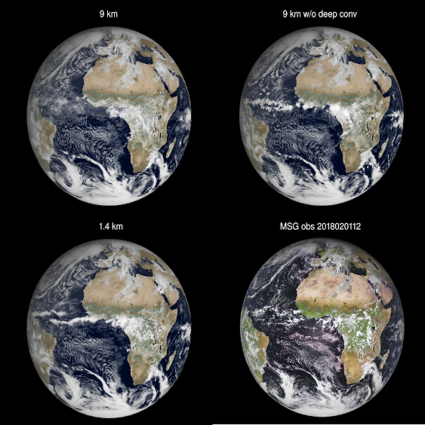

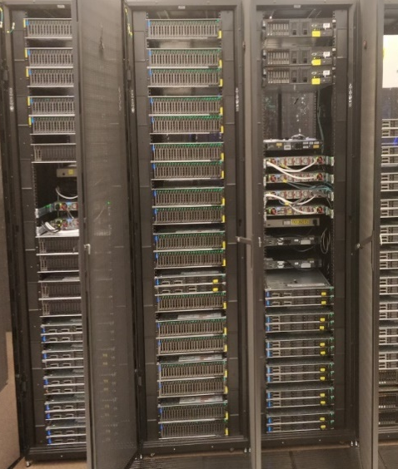
“The European Weather Cloud aims to be the cloud-based collaboration platform for meteorological application development and operations in Europe and enables the digital transformation of the European Meteorological Infrastructure. The European Weather Cloud is dedicated to support the National Hydro-meteorological Services of the Member States of both ECMWF and EUMETSAT in fulfilling their official duties to protect life and property from impending meteorological hazards.”
"a community cloud"
Notes:
Roope
EWC is a joint effort with EUMETSAT and ECMWF to provide: …
Cloud platform for member states, but we are very much focusing on the two assets: data proximity and the community

Slide 3
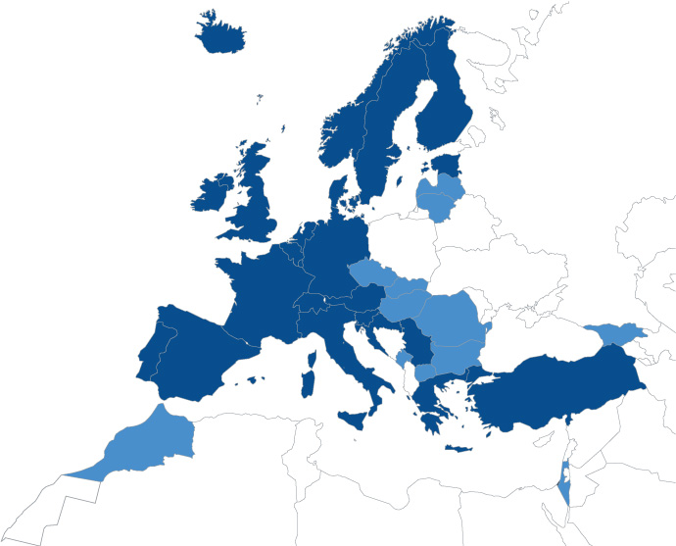
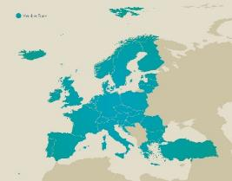
Who is it for?
Member and Cooperating States
ECMWF
Research & Development
ECMWF Special projects
EUMETSAT thematic annual R&D calls
EMI Partners (e.g. EUMETNET)
Internal use
Support training, hackathons
Partners
Contractor interaction / projects
EUMETSAT
Notes:
Roope
EWC is not open community and EWC is not public cloud, it is for …

Slide 4
EUMETSAT starts operations with 225 CRUs
1 CRU = 16 cores; 128GB RAM; 1 GPU; storage: 4TB block, 8TB object, 4TB filestore
EUM resource allocations at beginning of operations:
Allocation | CRUs identified in initial sizing | 2021 | Start of operations
Member States basic allocation | 75 | 22 | 75
Member States pro-rata allocation | 75 | 0 | 75
Support to ECMWF EWC users/tenants | 44 | 4 | 20
SAFs | 64 | 34 | 40
Research (indicative, 25-100 CRUs) | 25 | 0 | 0
Other EUM internal usage | 45 | 14 | 14
Optional EUMETNET usage/ additional community relevant data and services | 2 expected | 0 | 1
Totals | 328 | 74 | 225
CPU | 3600
RAM | 28.8 TB
Block Storage | 900 TB
S3 | 1.8 PB
SFS | 900 TB
vGPU* | 225
The actual sizing will be based on the actual usage within the limits of Member States allocation and sizing of different usage categories
The operational phase is to be started with 10Gbps dedicated network link based on the experiences gained from WEkEO
Link capacity is to be evaluated each year and increased if necessary. Remarkable evolution is envisaged in 2025 due to both increased amount of usage and data.
Notes:
Roope

Slide 5
What will be allocated to Member States
EUMETSAT
Member state | Base allocation (CRUs) | Pro-rata allocation (CRUs) | Total (CRUs)
Austria | 2.50 | 1.63 | 4
Belgium | 2.50 | 1.94 | 4
Bulgaria | 2.50 | 0.25 | 3
Croatia | 2.50 | 0.19 | 3
Czech Republic | 2.50 | 0.81 | 3
Denmark | 2.50 | 1.31 | 4
Estonia | 2.50 | 0.13 | 3
Finland | 2.50 | 1.00 | 4
France | 2.50 | 10.25 | 13
Germany | 2.50 | 14.56 | 17
Greece | 2.50 | 0.81 | 3
Hungary | 2.50 | 0.50 | 3
Iceland | 2.50 | 0.06 | 3
Ireland | 2.50 | 1.06 | 4
Italy | 2.50 | 7.63 | 10
Latvia | 2.50 | 0.13 | 3
Lithuania | 2.50 | 0.19 | 3
Luxembourg | 2.50 | 0.19 | 3
Netherlands | 2.50 | 3.25 | 6
Norway | 2.50 | 1.63 | 4
Poland | 2.50 | 1.94 | 4
Portugal | 2.50 | 0.81 | 3
Romania | 2.50 | 0.81 | 3
Slovakia | 2.50 | 0.38 | 3
Slovenia | 2.50 | 0.19 | 3
Spain | 2.50 | 5.06 | 8
Sweden | 2.50 | 2.13 | 5
Switzerland | 2.50 | 2.63 | 5
Turkey | 2.50 | 3.25 | 6
United Kingdom | 2.50 | 10.38 | 13
Each Member State will receive a share of the infrastructure:
Equal basic allocation for all MS + additional allocation pro-rata to contribution. EUMETSAT example agreed at a 50/50% split between basic and pro-rata;
Cloud Resource Unit (CRU) is used for planning purposes, while the real resource provisioning for tenants will be based on the actual resource needs expressed in number of cores, storage amount etc.
In operational phase, Member State shares will be managed by the Computing Representatives
Indicative proposal in EUM/C/97/21/DOC/06 to be finalised this Autumn
1 CRU = 16 cores; 128GB RAM; 1 GPU; storage: 4TB block, 8TB object, 4TB filestore
Notes:
Roope

Slide 6
What will be allocated to Member States
ECMWF
Each Member and Cooperating State will receive a share of the infrastructure
Similar model to the existing HPCF service
  Proportional and fair share of resources based on contributions
  Bigger Member and Cooperating States get more resources
  Baseline guaranteed for smaller Member and Cooperating States
Exact figures to be published soon
Notes:
Xavi

Slide 7
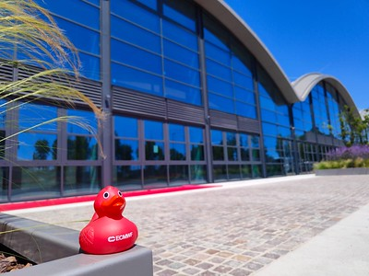
ECMWF Operational infrastructure
New Cloud Infrastructure being procured as we speak
To be installed in ECMWF’s Bologna Home
  Collocated with other key ECMWF Computing and Data Services
Ready by end of Q1 2023
  Pilot infrastructure in Reading will continue until it is ready
  Migration of existing tenants planned between Q1 and Q2 2023
2 Production clouds - one on each computer hall
  Based on Openstack and Ceph
Coming soon!
Cores | 5632
Memory | 53 TB
Storage | 4 PB
GPUs | 32 x A100 80 GB
Notes:
Xavi

Slide 8
Tenants can use their yearly allocation flexibly
Overall available resources
Tenants will have yearly budgets of credits and resource quota based on their allocation:
  Allocating any type of resources will consume credits
This will allow tenants to use their yearly allocation in shorter period
Member States can share their credits to several tenants and combine them with other Member States
EWC support team will monitor and control the usage so that overall limit is not exceeded
  In case of many tenants will use burst capacity at the same time, action might be needed.
Quota set to CF OpenStack tenancy
Hard limit, cannot be exceeded at any point of time
Annual credits set for a tenancy
Limit for the whole year. Might cover for example 560 640 CPU hours and corresponding amount other resources.
Actual use at some particular moment
Tenant 1
Tenant 2
Tenant 3
Tenant 4
Notes:
Xavi
Tenants get a yearly budget…
Provisioning any kind of resources consume these credits → users can use most of their budget by using just one type of resource (for example GPU or storage)
In the picture, light blue bar represents the annual budget, which might cover for example 560 000 CPU hours
In addition, the monthly budget is presented with white dashed line.
Notably monthly budget is larger than yearly budget divided by 12 meaning that having burst capacity is possible
Tenants can use their yearly allocation in shorter period of time
Finally, all tenants will have a quota – a hard limit which cannot be exceeded at any point of time
This is obviously set up to protect the system and to ensure a fair share of resources for all tenants
EUMETSAT will monitor and control the usage so that overall limit (225 CRU) is not exceeded
Because with this kind of setup it is possible in theory…
Action might be asking someone to reduce resources or getting more resources using elasticity contract
In the beginning, budgets and quotas will be set conservatively. In the future, when we have more experience, more loose limits might be set
This is aligned with ECMWF HPC usage conventions and plans with EWC
Notably, MSs can share the credits and combine them…

Slide 9
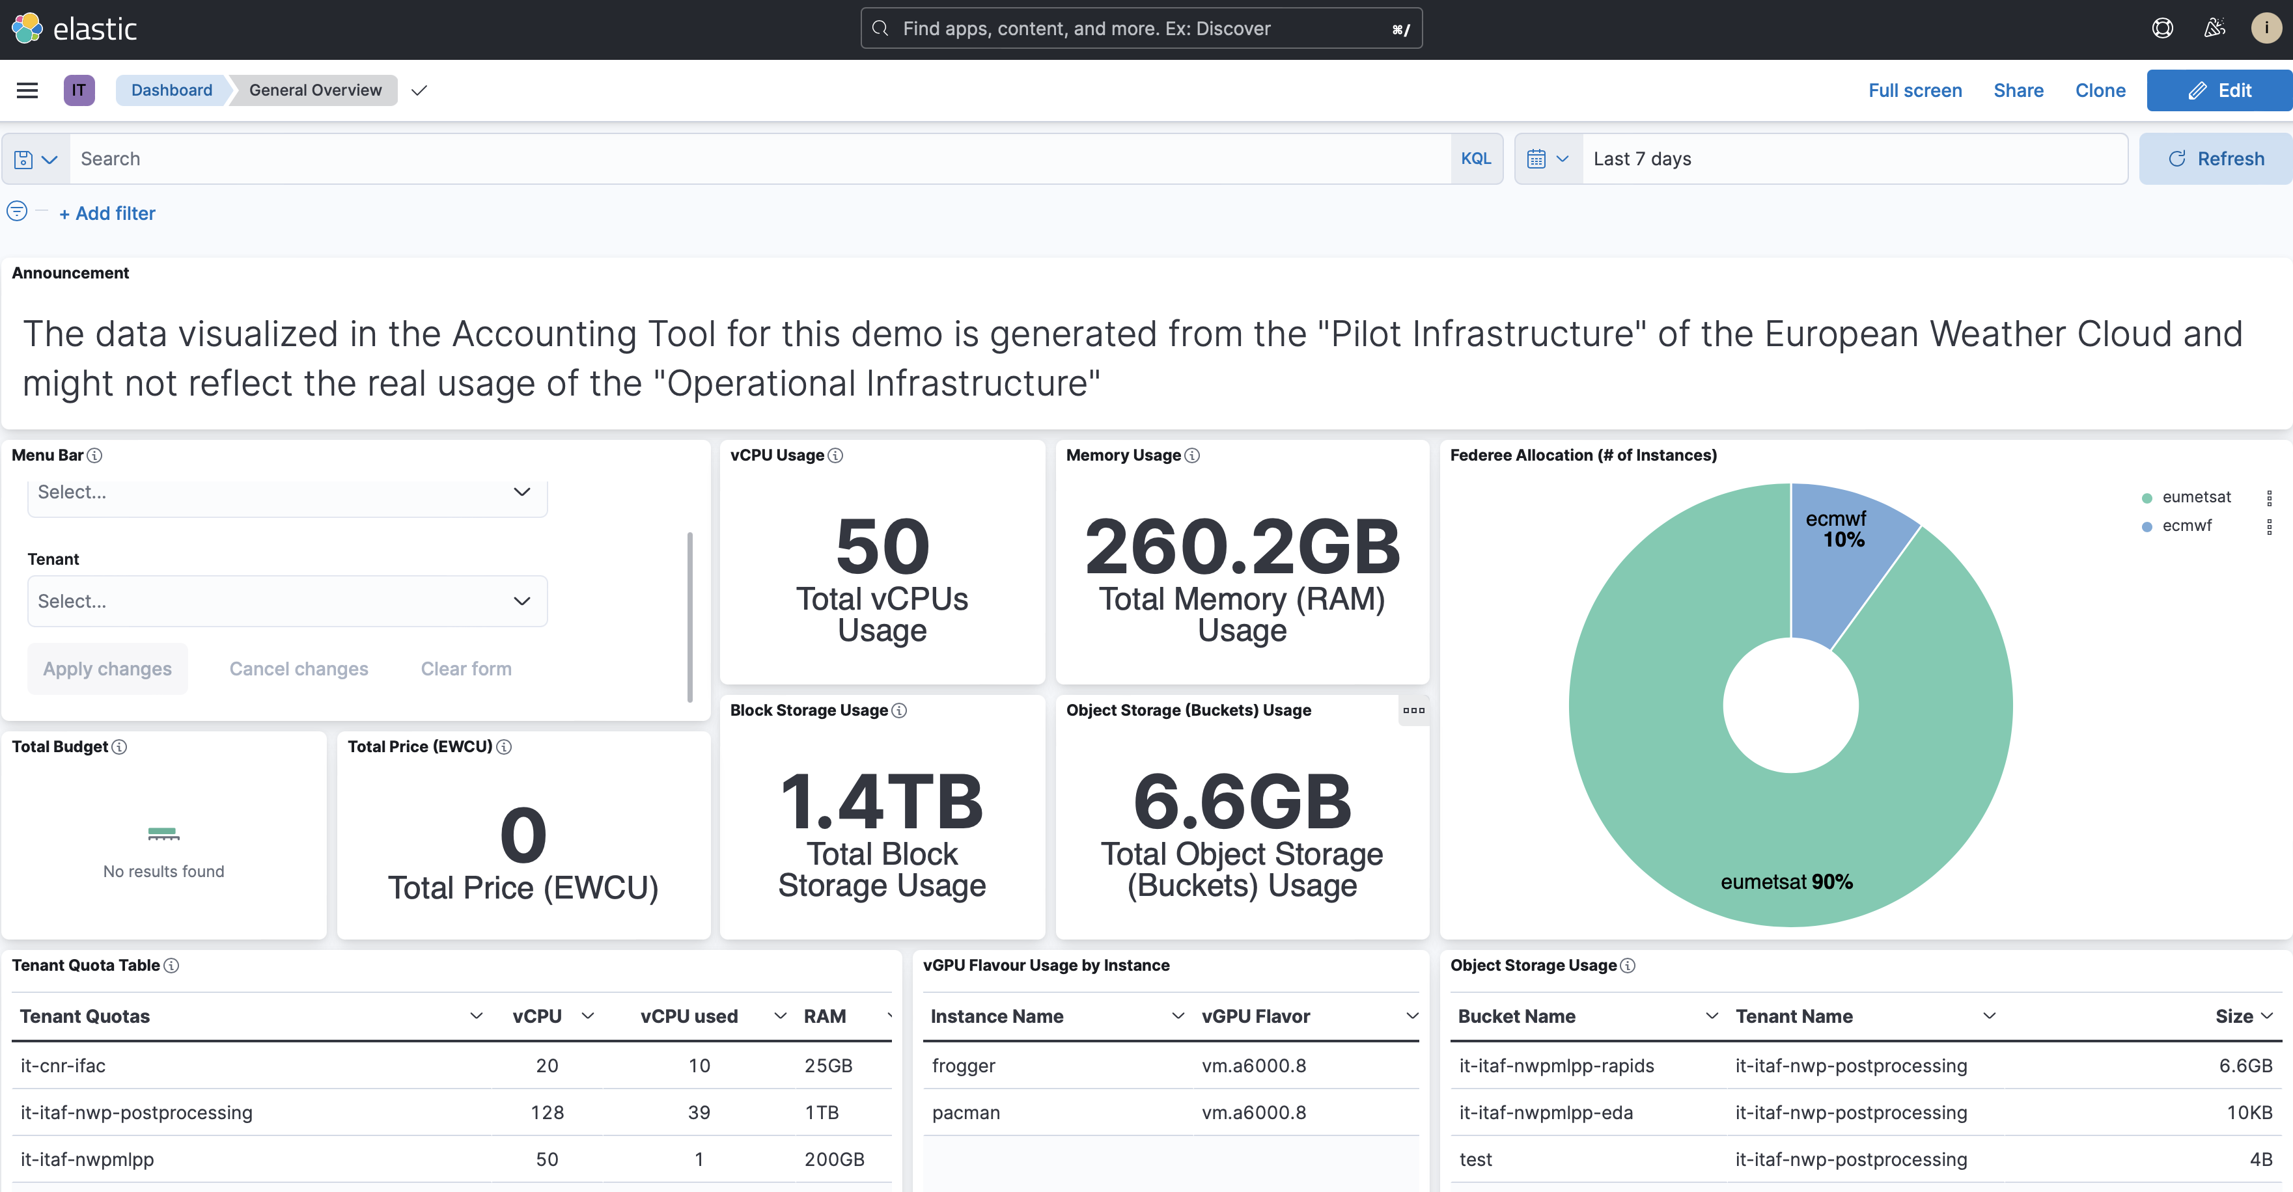
Accounting
Computing Representatives get access to accounting dashboard
Notes:
Xavi
- We hope to provide the similar access to the all tenant admins

Slide 10
Target to be operational in Spring 2023
EUMETSAT infrastructure almost operational
Service readiness checkpoint successful August 2022 with an exclusion of direct link and Flash+ storage tier
Final acceptance in 2022
ECMWF infrastructure contract signed
Infrastructure expected to be ready in Q1/2023
Joint OR
Checkpoint
Pilot preparation & user onboarding
Pilot usage and feedback
Extended pilot phase
Operational ramp-up
European Weather Cloud operations
Decision point
Q4 / 2021
User workshop 5
13/10/2022
User workshop 2
Q4 / 2020
User workshop 1
Q2 / 2020
User workshop 3
Q2 / 2021
User workshop 4
Q4 / 2021
EUM R&D call
Aug 2022
Continued development and
user consultation
Notes:
Roope

Slide 11
Roadmap to operations
Detailed introduction of EWC and Comp. Rep role
Final acceptance of EUMETSAT infrastructure
ECMWF infrastructure ready in Bologna
Joint operational checkpoint covering joint aspects of the EWC
Introduction of the accounting tool
Old use case responsibility change
ECMWF pilot phase use case migration
New use cases via Comp.reps.
Joint
EUM
EC
Joint
Computing
Representatives
meeting on 12 Oct
EUM infrastructure service readiness checkpoint Q4/22
ECMWF infrastructure ready
Joint operational checkpoint Spring 2023
Notes:
Roope

Slide 12
Tasks to conduct before operational checkpoint
Color coding based on current status
Not done
Started
Almost done
Done
Governance | Joint management model |  |  |  |  |  |  | T&C
Operations | Processes and responsibilities |  |  | User support & knowledge base |  |  |  | Accounting
Security | Baseline recommendations for providers |  | Security processes |  |  | 3rd party evaluation of Cross-cloud security compliance
Training and outreach | User support |  | Discussion platform(s) |  | User workshops |  |  |  | Training
Use case migration | EUMETSAT |  |  |  |  |  |  | ECMWF (BO)
Infrastructure | Operational infrastructure (EUMETSAT) | Test and validation (EUMETSAT) |  |  |  |  |  | Operational infrastructure (ECWMF) | Test and validation (ECMWF)
Pilot
Full operations
Notes:
Roope
User interaction processes: support, helpdesk, feedback, workshops, training, computation representatives…
Reference document needed for Comp Reps, T&C
KPI
Infrastructure processes: monitoring, responses to faults, disaster recovery…
Security processes
Link security teams
3rd party evaluation for both E&E Cloud/storage infra performance / benchmarking and Security posture
Joint discussion platform to be installed as Pilot
Training plan introduced
Accounting
Tool to gather metrics
Portal / UI to show them to comp. reps.
Monitoring
Infrastructure
Services
Auxiliary services
Data flows

Slide 13




What being operational means?
Collaborative development.
Operational use
Data repositories
Tenants can provision VMs and host their own applications
Also basic level service, such as user management, maintained by the tenants
EUMETSAT
cloud
EUMETSAT online data storage
EUMETCast Terrestrial
Elasticity
VM
Data Access APIs
IaaS
Project tenancy: EUMETSAT
ECMWF online data storage
ECPDS
Project tenancy: ECMWF
MARS
ECMWF
cloud
elasticity
WEBAPI
VM
VM
Hybrid cloud management
CDS/ADS API
ECMWF
Cloud on premise
Push service
Pull service
Notes:
Roope
Tenants can provision VMs and host their own applications.
Also basic level service, such as user management, maintained by the tenants
Benefits are data proximity and community but developing and operating operational services is problematic with just IaaS

Slide 14
What being operational means?
Collaborative development.
Operational use
Data repositories
EUMETSAT infrastructure contract contains 99.5% SLA
  (allowing ~3,5h downtime per month)
EUMETSAT Morpheus and Big Data Services are not in 24/7 maintenance
ECMWF Infrastructure with 99.9% guaranteed availability and 24/7 operational monitoring
EUMETSAT
cloud
EUMETSAT online data storage
EUMETCast Terrestrial
Elasticity
VM
Data Access APIs
IaaS
Project tenancy: EUMETSAT
ECMWF online data storage
ECPDS
Project tenancy: ECMWF
MARS
ECMWF
cloud
elasticity
WEBAPI
VM
VM
Hybrid cloud management
CDS/ADS API
ECMWF
Cloud on premise
Push service
Pull service
Notes:
Roope
Tenants can provision VMs and host their own applications.
Also basic level service, such as user management, maintained by the tenants
Benefits are data proximity and community but developing and operating operational services is problematic with just IaaS

Slide 15




Roles and definitions
Authorizing Officer
Tenancy User
    The designated representative of ECMWF, EUMETSAT and Member and Co-operating States of EUMETSAT and ECMWF who authorizes access to the EWC Services.
    Authorizing officer may act as tenant admin or delegate the task.
    A user authorized by a Tenancy Owner or another existing Tenancy User to use one or more identified Tenancies on the EWC. A Tenancy User may generate Tenancy -based Services for End-Users
Tenancy
    An isolated environment offering services on the EWC and administered by a Tenancy Owner authorized by the Authorizing Officer.
Tenancy Owner
    A user who administers one or several tenancies available on the EWC in accordance with an agreement with the Authorizing Officer.
Notes:
Xavi

Slide 16


Shared responsibility model
    Authorizing officer will authorize users
    Authorizing officer may act as tenant admin or delegate the task.
Cloud provider
Tenant
Application security
OS level updates
Access control to VMs
Network security
Data protection
…
Infrastructure
Provides secure by default initial setup
Provide support
Can interrupt the service if legally required to
May monitor traffic
NO access to VMs
    Using EWC implies the acceptance of Terms and Conditions
Notes:
Xavi

Slide 17

EWC resources administration and use
Authorises and binds with T&Cs
Requested and owns
Tenancy Owner
End Users
ECMWF
EUMETSAT
Tenancy 1
Federated Member State
cloud
Accesses without control
Authorising Officer
ECMWF
EUMETSAT
Tenancy 2
Tenancy-based service
MS CompRep
VM
Accesses with control
MS CompRep
Authorises and binds with T&Cs
Requested and owns
Develops, sysadmins, configures, controls
Tenancy User
(no direct access to VMs, but with control via services, e.g. Jupyter Notebook)
Tenancy Owner
Authorises and binds
Tenancy User (access to VMs)
Grants access and binds
Authorises and binds
Notes:
Xavi

Slide 18


Getting a tenancy workflow
Default flow
Alternative flow
Create tenancy
Create tenancy or user
Request
Request
Request
Consult
Authorizing
officer
(Comp.Rep. / SAF rep.)
EWC Support
EWC Support
User needing
a tenancy
User needing
a tenancy
Authorizing
officer
(Comp.Rep. / SAF rep.)
Consult
Create user to existing tenancy
Tenancy will be created to either ECMWF or EUMETSAT side based on the primarily use case
Tenancy can have resources at both sides
Member states can have tenancies at both sides
Users may be directly in contact with EWC support in which case support will consult authorizing officer or forward the request
Notes:
Xavi

Slide 19
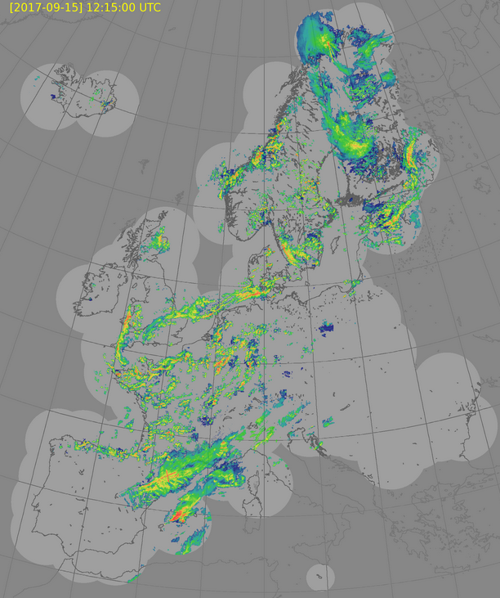
External data in EWC
ECMWF and EUMETSAT are in negotiations to host OPERA composites for EWC users in EWC
  OPERA data contains volume data from radars and composites covering Europe created by EUMETNET OPERA program
  Most probably provided via S3 buckets
  (feedback welcome!)
Users can easily establish data sharing buckets in the EWC for collaboration. Examples:
EUMETSAT is currently coordinating SAF CDOP4 data needs to collaborate in external data access
As part of the MAELSTROM EuroHPC project that ECMWF is coordinating, six benchmark datasets for machine learning applications from five partners are stored and made available online via S3 buckets
Odyssey radar composite. Image taken from OPERA wiki (https://agora.fmi.fi/display/OPERA/Feedback+from+users) Mar 22
Notes:
Xavi
Also: Supplementary data hub is planned to be hosted in EWC at ECMWF side (in DWD allocation)

Slide 20
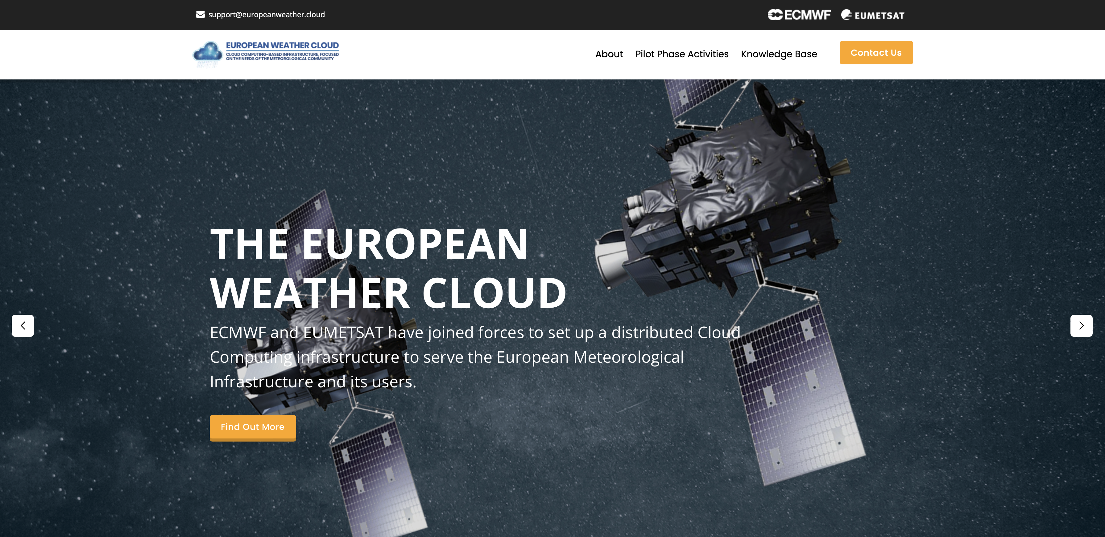
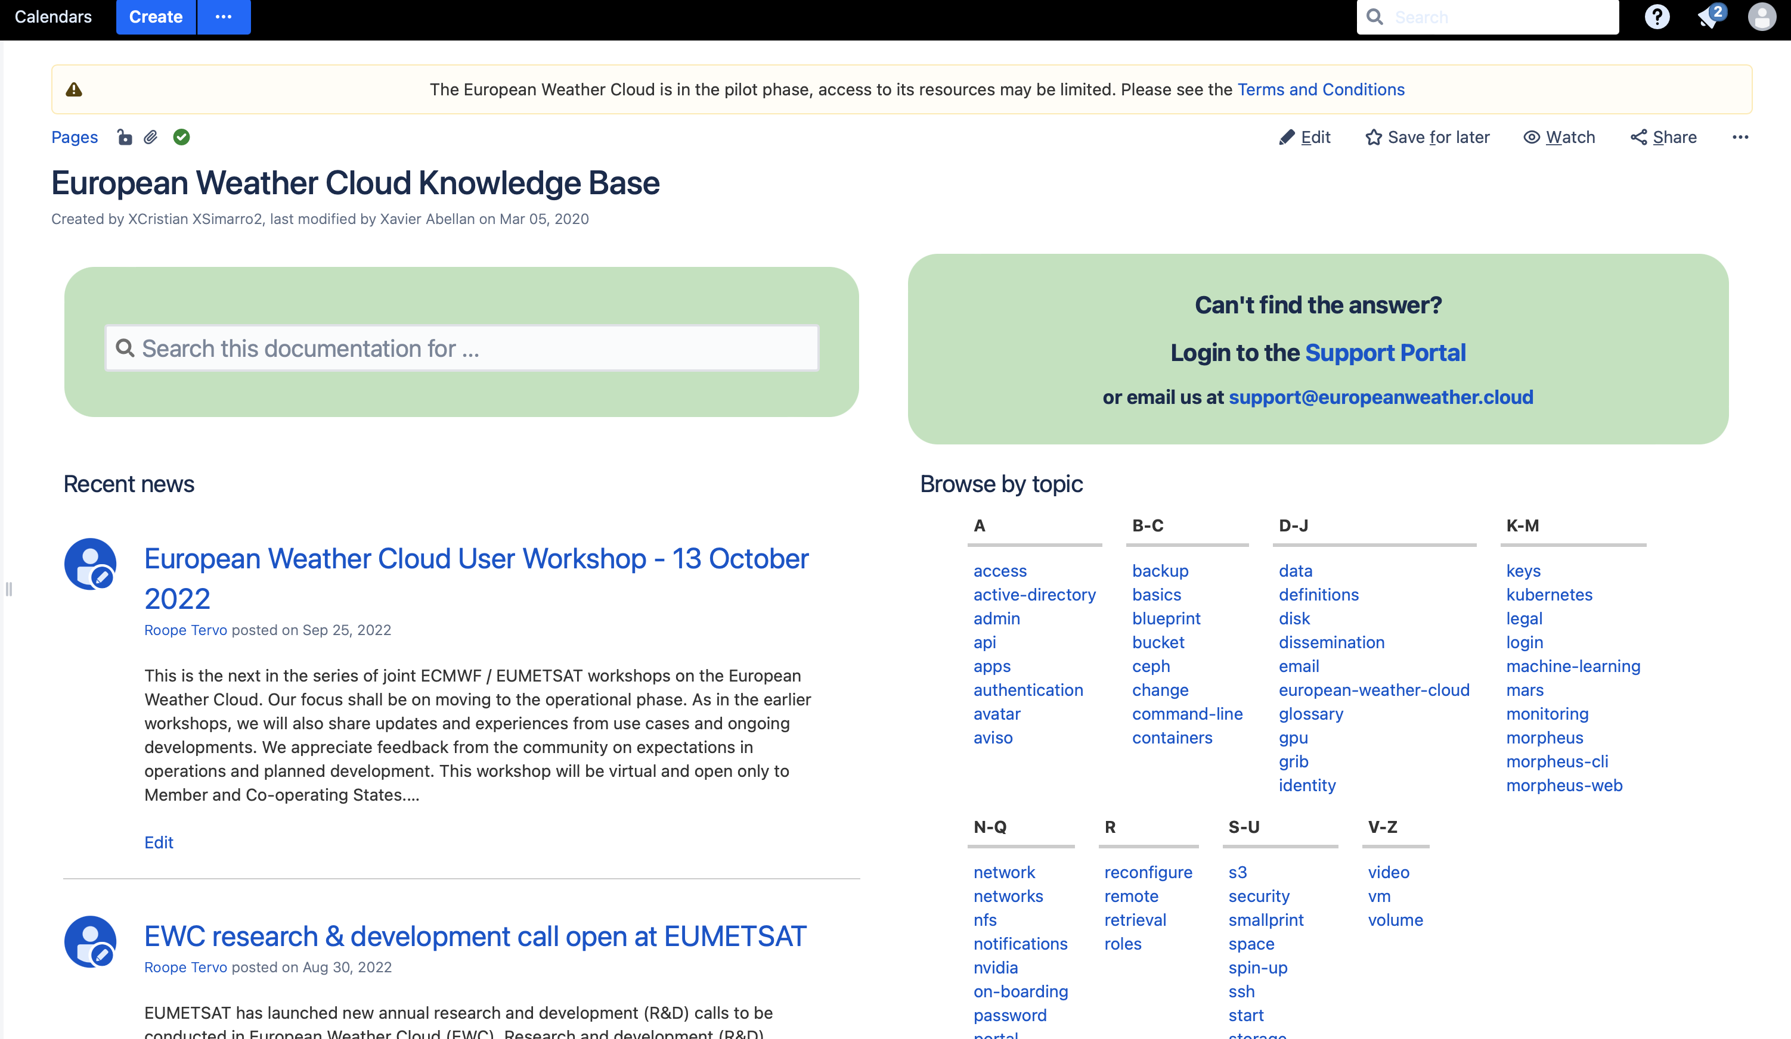
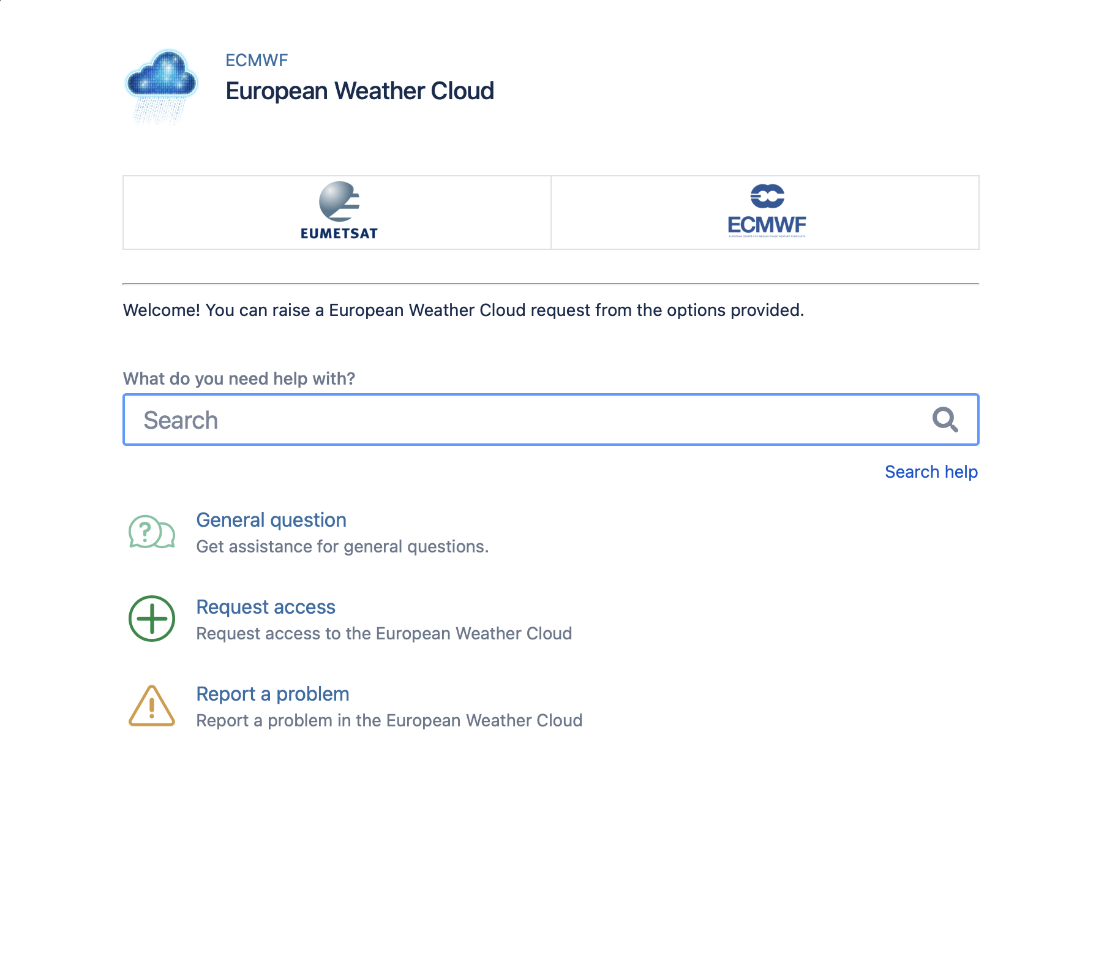

More information
https://www.europeanweather.cloud
Knowledge Base
User Support
Coming soon!
https://chat.europeanweather.cloud
Notes:
Xavi

Slide 21
EUMESTAT R&D calls and ECMWF Special projects
ECMWF Special projects experiments or investigations of a scientific or technical nature, undertaken by one or more Member States, likely to be of interest to the general scientific community
  Traditionally for HPCF resources
  They can now include EWC resources in their request
  https://www.ecmwf.int/en/research/special-projects/special-project-application
Researchers from member states’ public institutions can now apply annually for resources for research and development (R&D) projects to be conducted on EWC at EUMETSAT.
  Also possible to apply for the fast-track project which can have more limited resources and in maximum duration of maximum of one year
  https://www.eumetsat.int/european-weather-cloud-research-development-call
 | EUMETSAT | ECWMF
Application Deadline | End of November | End of June
Start - implementation | May | First of January
Notes:
Xavi
ECMWF Special Projects:
Special Projects are defined as 'experiments or investigations of a scientific or technical nature, undertaken by one or more Member States, likely to be of interest to the general scientific community'.
Users within one of ECMWF's Member States may apply for resources as a Special Project. This possibility is particularly, but not exclusively, suitable for projects which are undertaken in co-operation between several institutions, nationally or internationally. The decision to treat a project request as a Special Project application is made ultimately by the Director of the national meteorological service of the project's Principal Investigator. Internal procedures will, however, depend on the national meteorological service.
Only infrastructure with support provided
The projects are expected to range from 50 to 100 vCPUs, 400-800 GB of RAM, 50-100 TB of storage and 4-8 vGPUs
Application form can be found behind the link. It is very simple containing basic information and estimation of required resources. Extended abstract (up to 5 pages) need to be added.
ECMWF Special project had deadline on 30 June but late requests can be still left
---
Following basic principles govern the process
Proposals are submitted by Member States through a nominated representative able to oversee the research interest of the Member State applicable to the EWC. Proposals supported by more than one Member State are strongly encouraged
Proposals must at least in part use EUMETSAT Data or Products
The evaluation of the scientific validity of the proposals should be undertaken in an independent manner focused on their intrinsic scientific value
The outcome of the activity should be as openly available as possible, and as a minimum open to scientific peer review and derived data-sets and software made available to the scientific community.
Evaluation Criteria:
Relevance to the objectives of the call
Scientific and technical quality
Overall maturity of the proposal
Justification of the resources requested
Wide applicability of the outcome to the Member States
Enhancement of interdisciplinary collaboration
Previous EWC R&D Project reports and the use of EUMETSAT software and data infrastructure will also be considered in the evaluation process
Call publication: The call will be published by EUMETSAT via its web site. The call will be promoted on suitable events such as the EUMETSAT conference and using social media.
Proposals submission:
Eligible for application for resources are Member States’ public institutions, i.e., public services and academia
An organisation or consortium represented by a Principal Investigator from the leading organisation need to submit a proposal as outlined in Annex I
Projects can have a maximum length up to 3 years after which a new proposal would be expected
To ease the process and to reduce the workload of the Member States it is proposed that the proposal submission is handled similarly to the one for special projects at ECMWF I instead submitting through a nominated national representative. EUMETSAT shall forward the proposals to the Head of the relevant STG Delegation for possible objection to the forwarding to the evaluation process.
Technical evaluation: EUMETSAT will assess the technical feasibility of the proposal within the constraints of resources of the EWC for R&D projects and eventually clarifies technical inputs with the proposer.
Submission to scientific evaluation committee: One month after the proposal deadline all proposals for which the technical feasibility can be confirmed will be sent to the evaluation committee (see section 2.5 for the setup of the committee).
Evaluation by the scientific committee: The committee will evaluate the proposals according to the criteria set out in section 2.3.1 and compile an evaluation report for the STG-SWG making recommendations for each evaluated proposal. This report will be submitted in time to be considered at the following STG-SWG meeting.
STG-SWG meeting: The STG-SWG meeting will discuss the evaluation results and recommends it to STG for approval with appropriate changes if needed. The STG OPSWG is informed about the result by the STG SWG Chairperson.
STG meeting: If recommended by STG-SWG the evaluation report is submitted to the STG for approval. Note that at the 97th Council it was proposed that Council delegates the decision on the EWC research projects to the STG. The EUMETSAT Secretariat plans to propose this change of the STG ToRs in the 2022 autumn round of Delegate Bodies.
Implementation: After a positive decision by STG the implementation of the projects will start (see details in section 3).

Slide 22
Questions?

