Slide 1
Lab-Session
Practical experience in using ECMWF products through the study of an interesting meteorological case

Slide 2
Assignement
A user is interested in having regularly updated weather forecasts for the North West of Italy (near Genoa) between 24 and 26 November 2016.
You belong to a group of forecasters from the Met Service that is responsible for giving meteorological guidance for that area. The forecast/guidance has to be prepared well in advance. Updates are needed at specific times:
  3 months
  1 month
  2 weeks
  7 days
  5 days…
  3, 2 and 1 day before the event

Slide 3
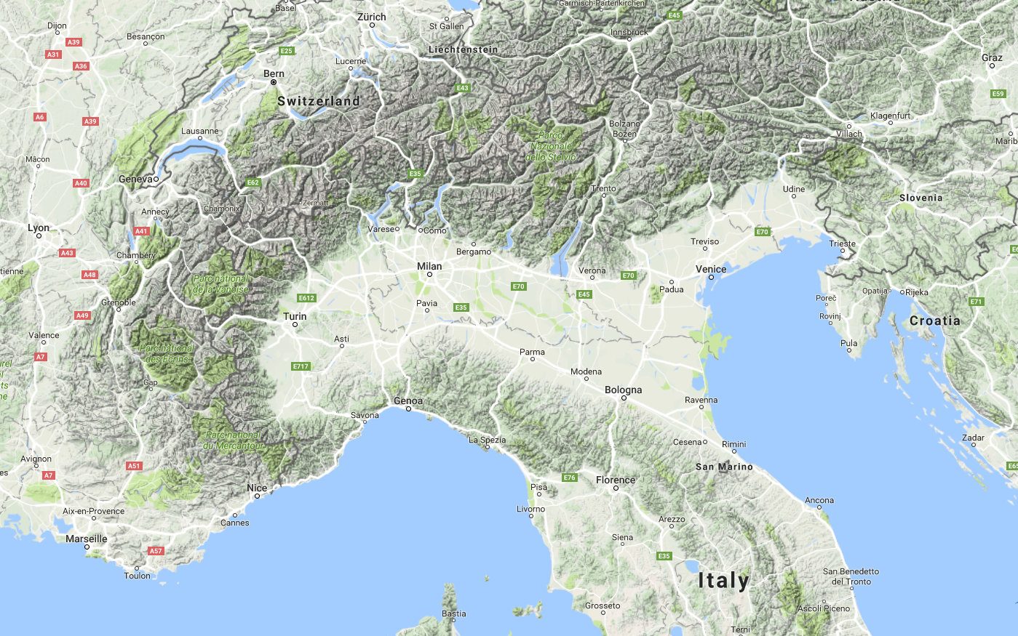

Slide 4
Products
Model Climate
Monthly forecast
ENS forecasts combined with the HRES model
  Dynamical fields (Geopotential height, temperature, wind, etc)
  Ensemble Meteograms
  Probabilities
  Spread charts
  Clusters
  Features tracking
  EFI (extreme forecast index)

Slide 5
Timing
Location
Timing
Location
Occurrence
Magnitude
Location
Occurrence
Magnitude
Timing
Occurrence
Magnitude
T+0
Forecast range
Error growth

Slide 6
Flow dependence of forecast errors
26th June 1995
26th June 1994
If the forecasts are coherent (small spread) the atmosphere is in a more predictable state than if the forecasts diverge (large spread)

Slide 7
Guidelines
Model known issues and limitations
https://software.ecmwf.int/wiki/display/FCST/Known+IFS+forecasting+issues
Model upgrades
http://www.ecmwf.int/en/forecasts/documentation-and-support/changes-ecmwf-model
Model verification scores
http://www.ecmwf.int/en/forecasts/quality-our-forecasts

Slide 8
Guidelines
Monthly Forecast
4 week and beyond: Reference
3 weeks: Trend
2 weeks: Look at the anomalies in more detail
Climatology and Seasonal forecasts
Medium range
Consistency of ENS and HRES
Short range forecast
HRES
In case of large inconsistencies, complete with the ENS
Detailed meteorological parameters: temperature, wind, precipitation, extreme events
7 days forecast
Meteograms
Probabilities
EFI
Complete with the HRES if the consistency is acceptable

Slide 9
Model climate

Slide 10
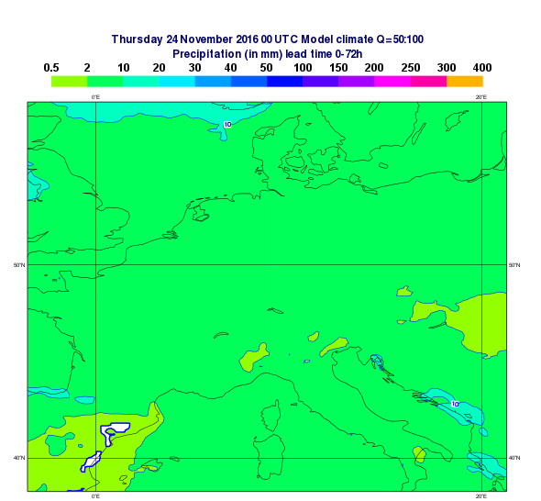

Slide 11
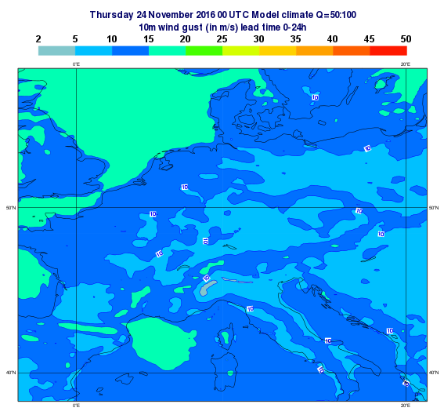
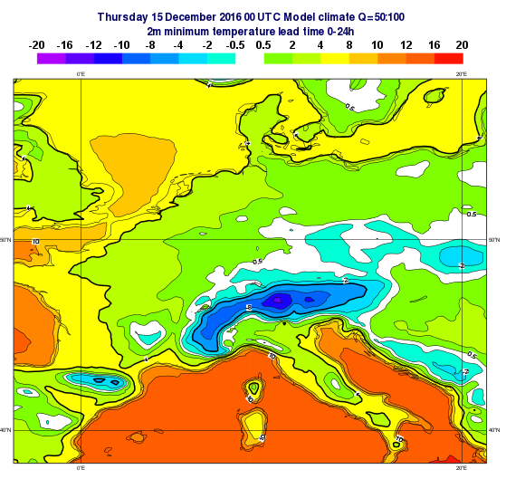

Slide 12
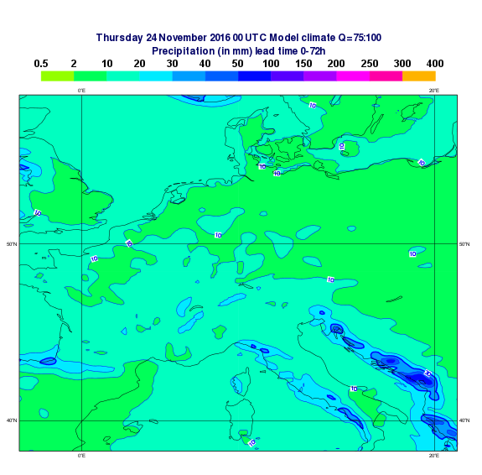

Slide 13
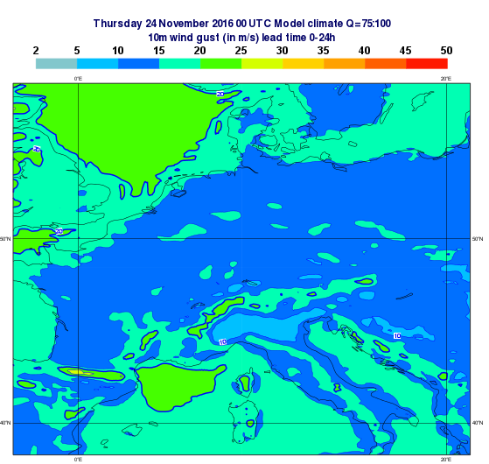
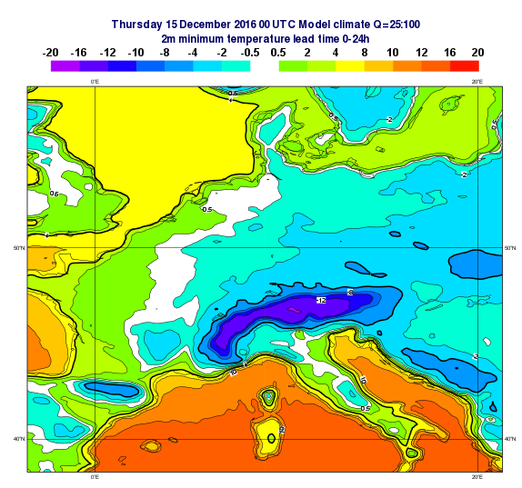

Slide 14
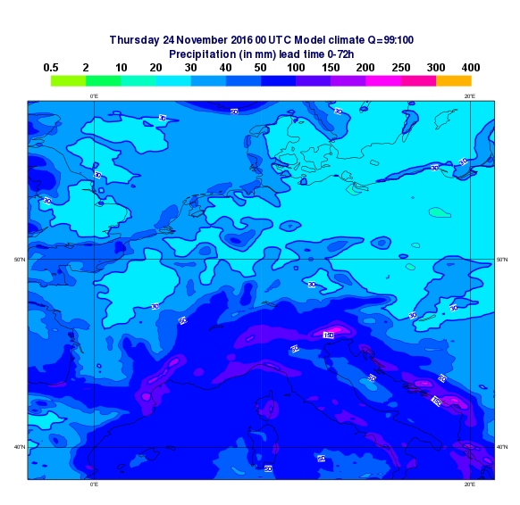

Slide 15
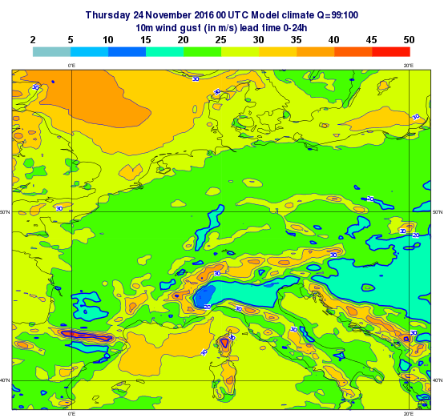
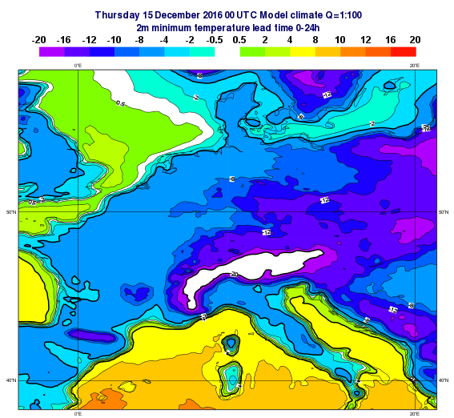

Slide 16
Seasonal forecasts

Slide 17
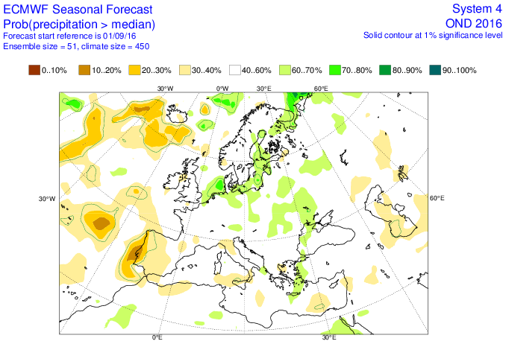

Slide 18
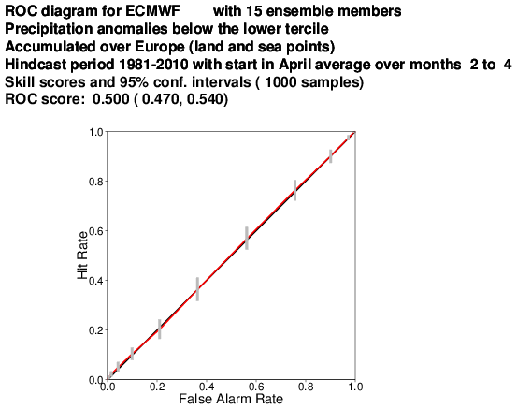
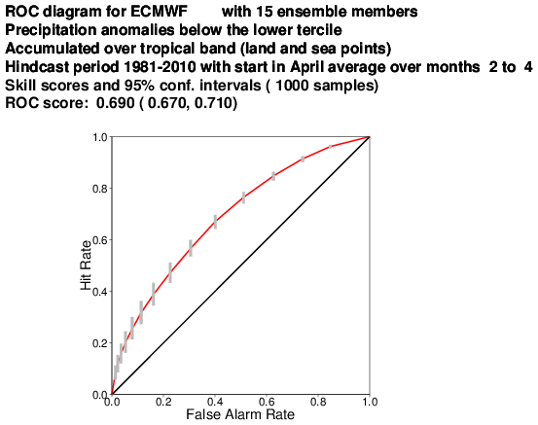

Slide 19
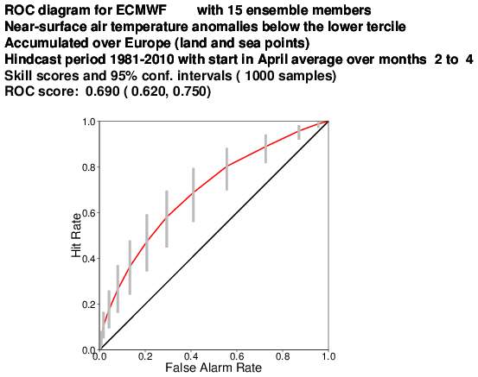
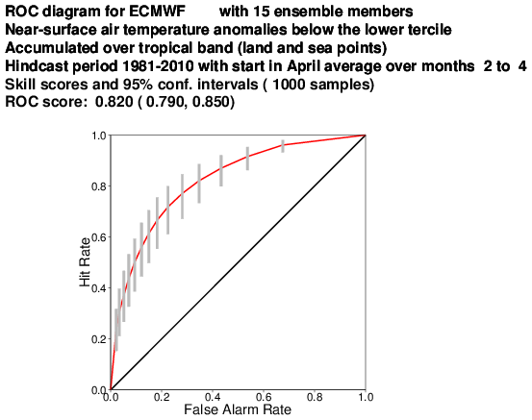

Slide 20
Monthly forecasts

Slide 21
2016-10-27

Slide 22
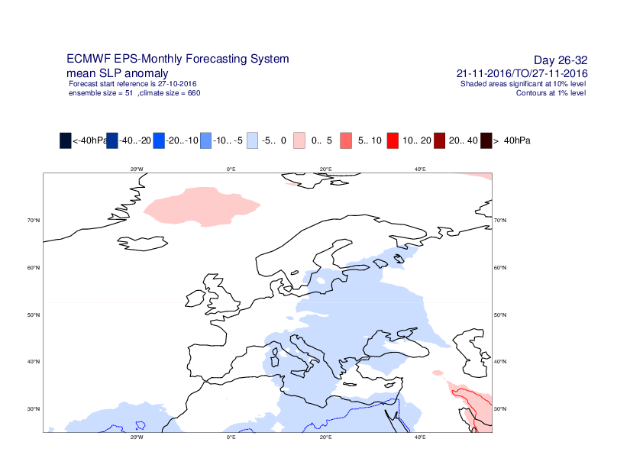

Slide 23
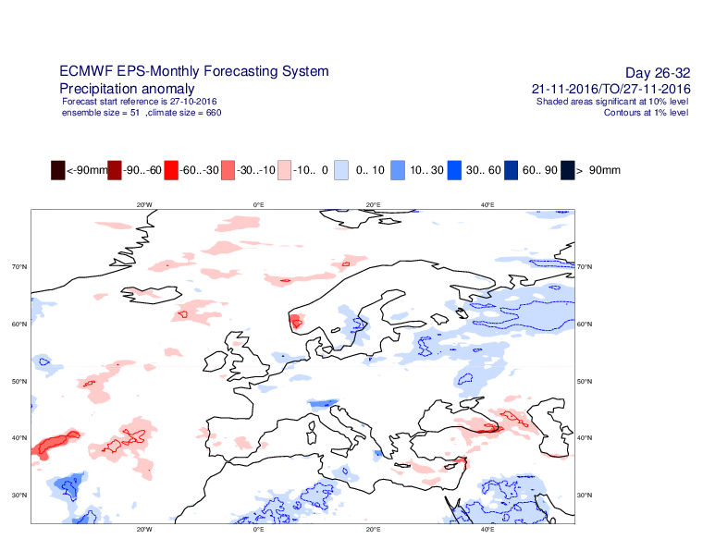

Slide 24
2016-10-31

Slide 25
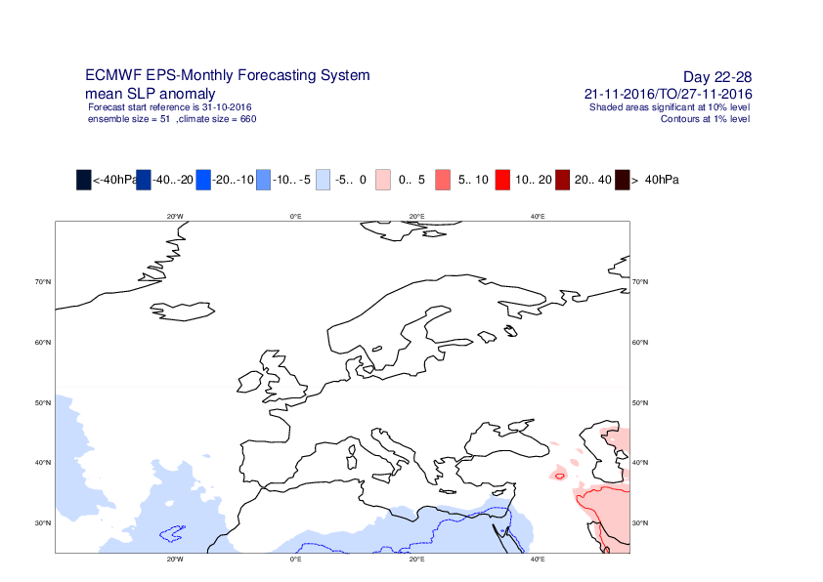

Slide 26
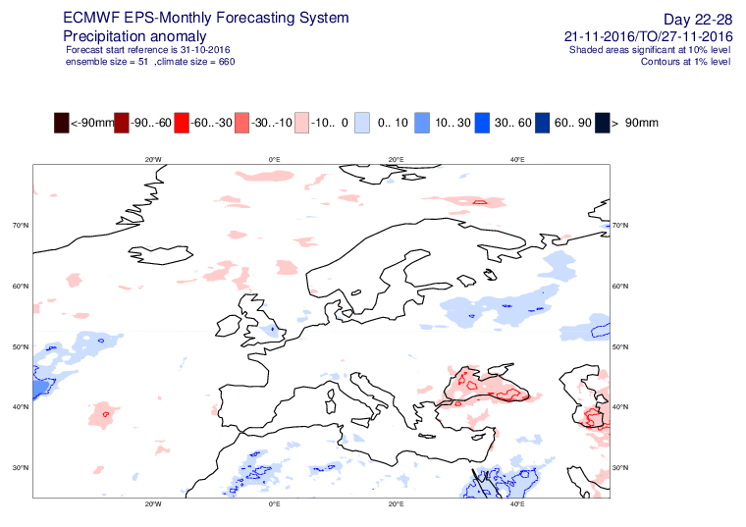

Slide 27
2016-11-03

Slide 28
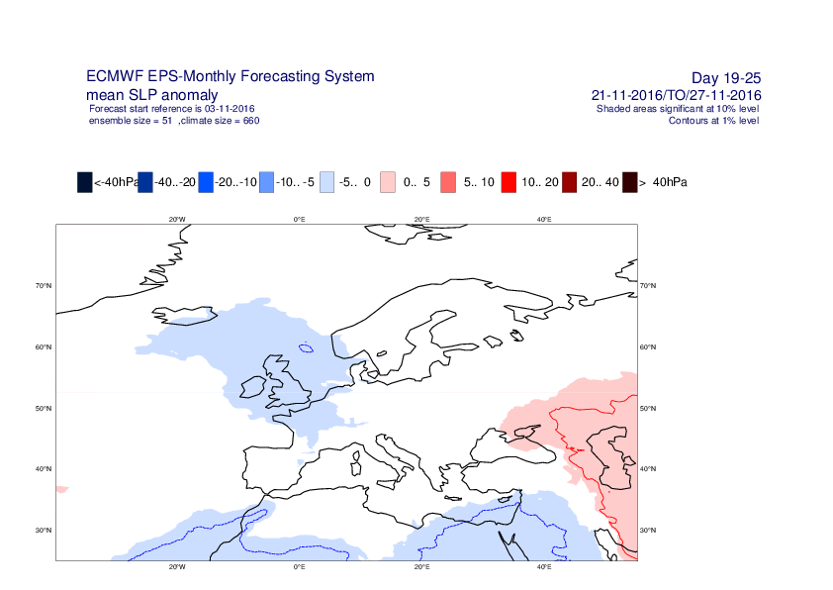

Slide 29
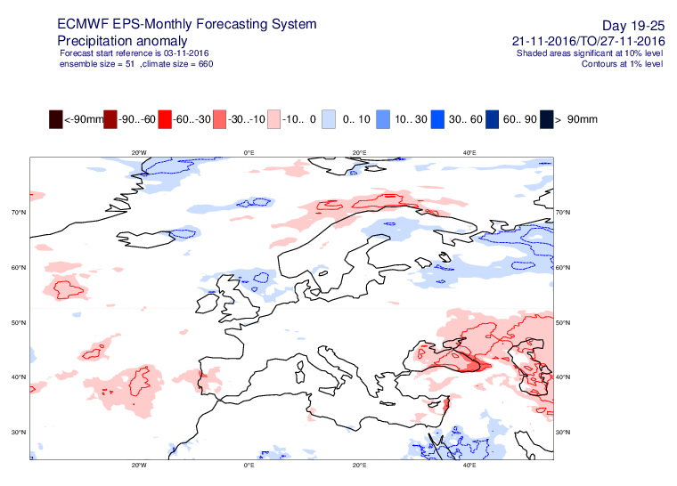

Slide 30
2016-11-07

Slide 31
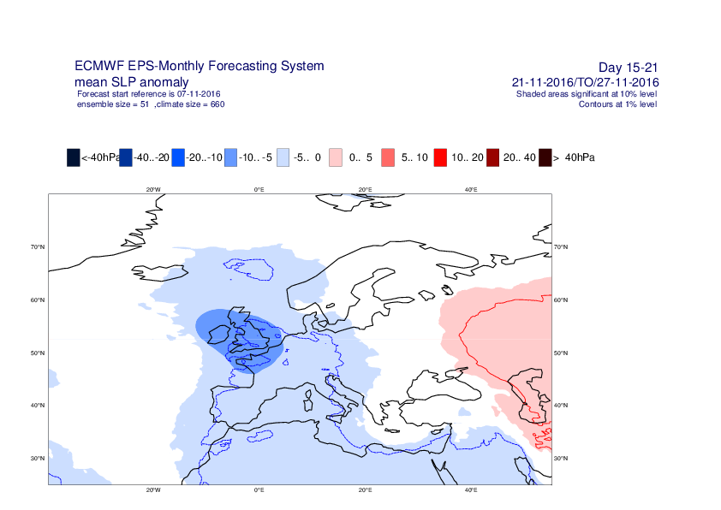

Slide 32
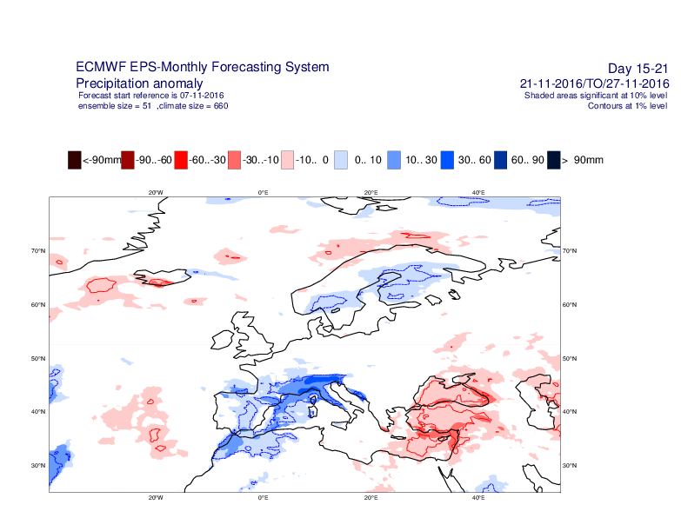

Slide 33
2016-11-10

Slide 34
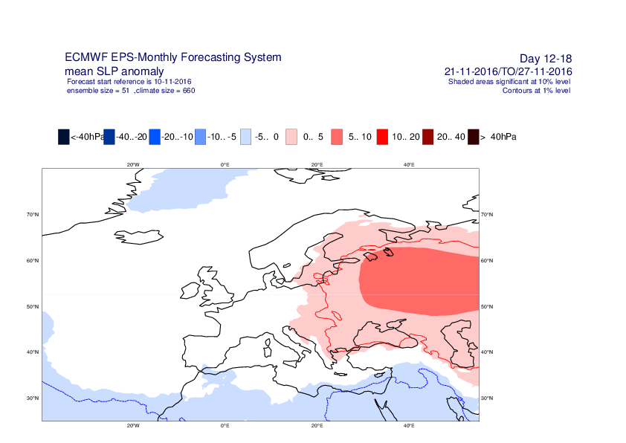

Slide 35
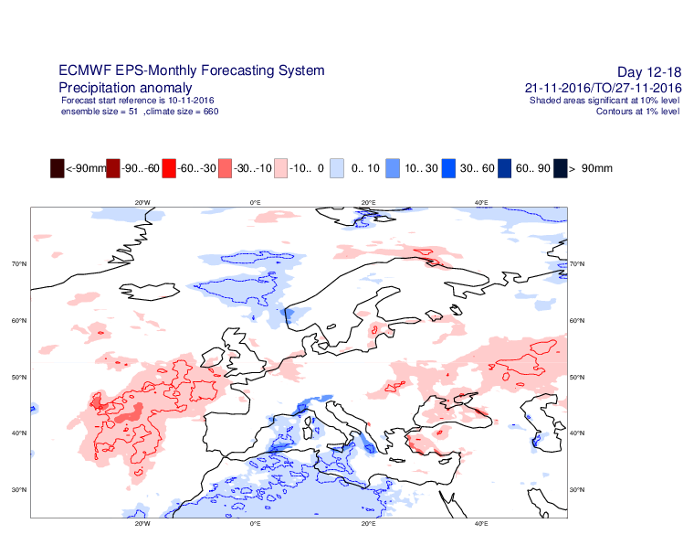

Slide 36
2016-11-14

Slide 37
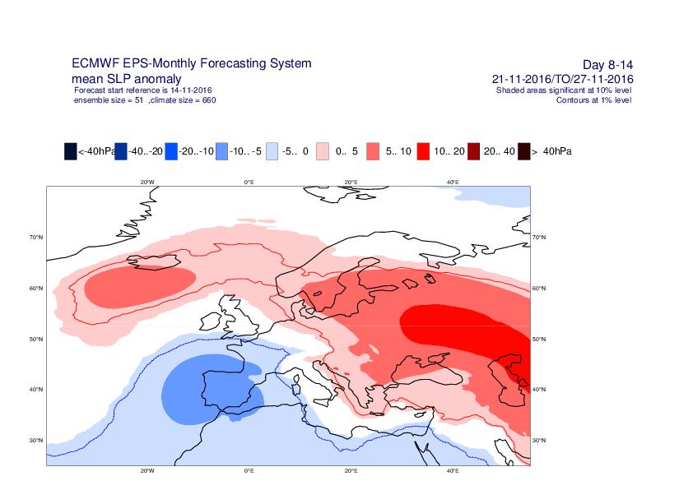

Slide 38
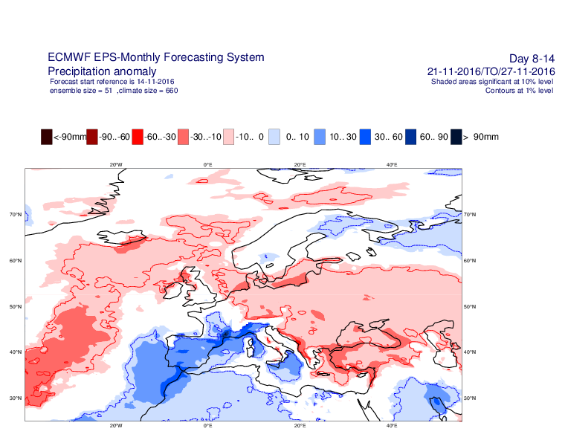

Slide 39
2016-11-17

Slide 40
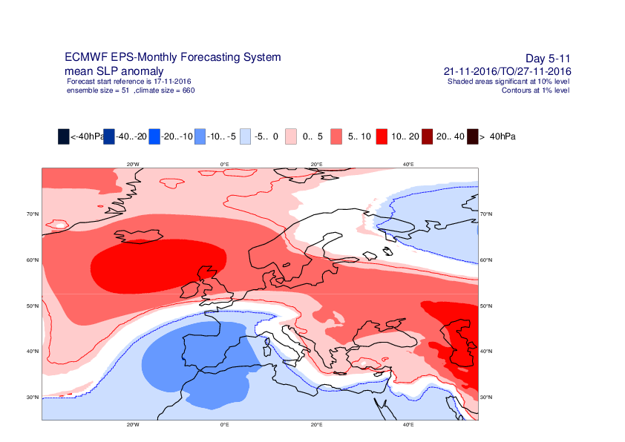

Slide 41
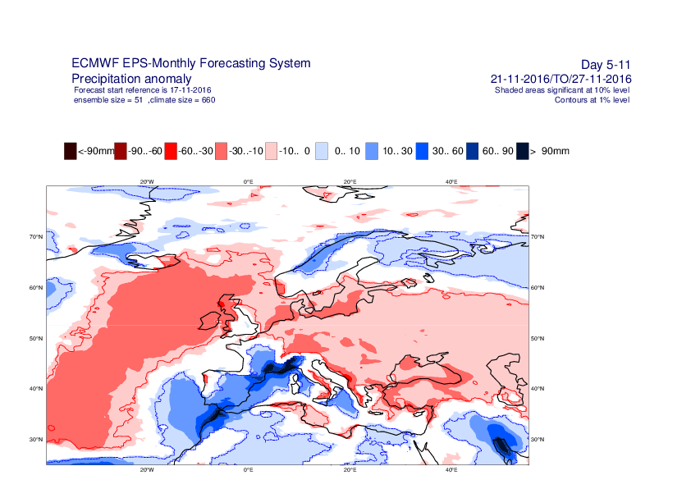

Slide 42
Sources of predictability
Land surface conditions: soil moisture and snow
Ocean conditions: SST and sea-ice
Stratospheric conditions
MJO
Large scale dynamical processes: Rosby waves

Slide 43
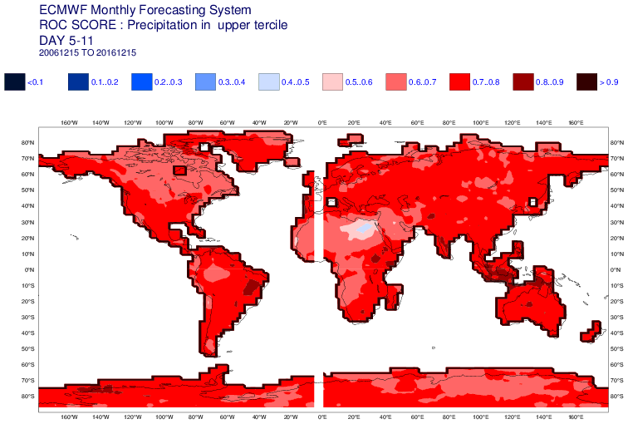
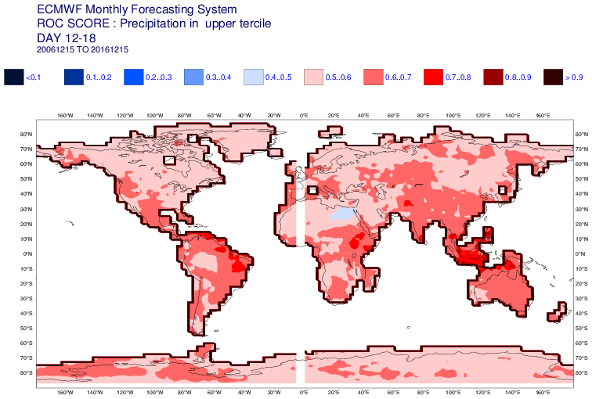
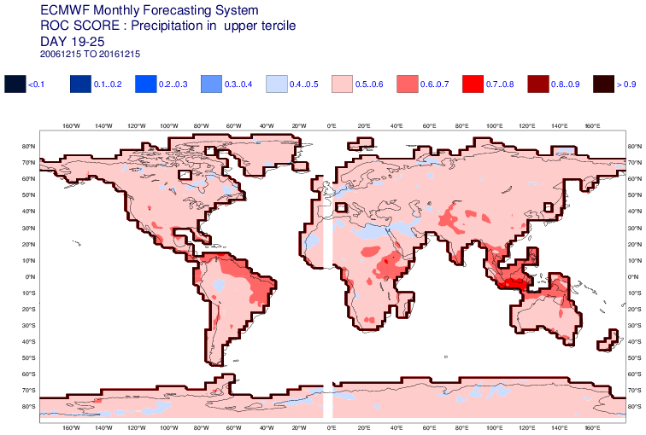
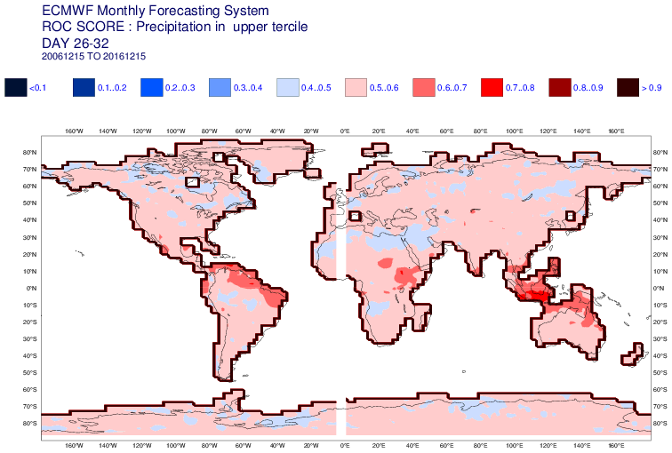

Slide 44
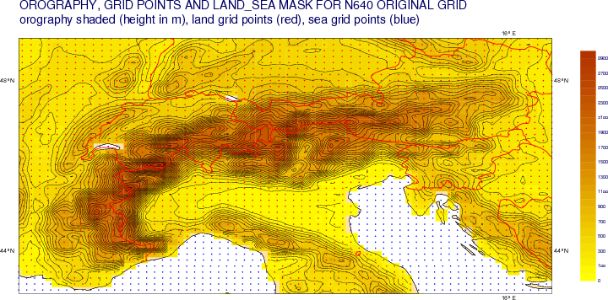
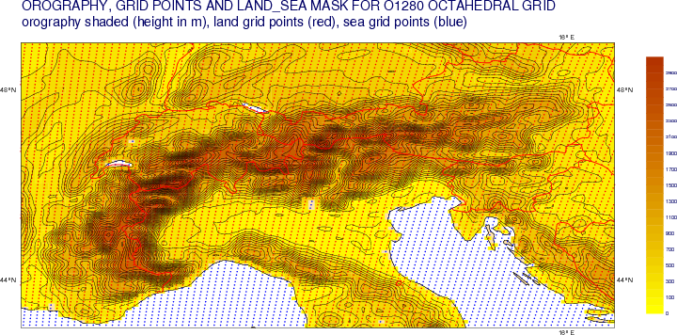
HRES
~ 16 km resolution
0 – 10 days
~ 9 km resolution

Slide 45

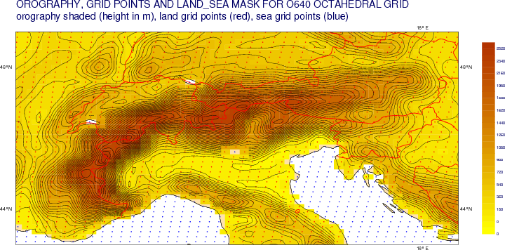
ENS
~ 32 km resolution
0 – 10 days
~ 18 km resolution
0 – 15 days

Slide 46

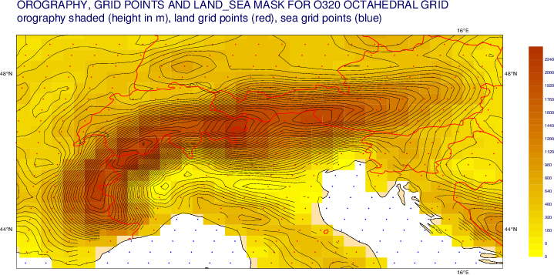
ENS
~ 64 km resolution
11 – 46 days
~ 36 km resolution
16 – 46 days

Slide 47
2016-11-14 12UTC

Slide 48
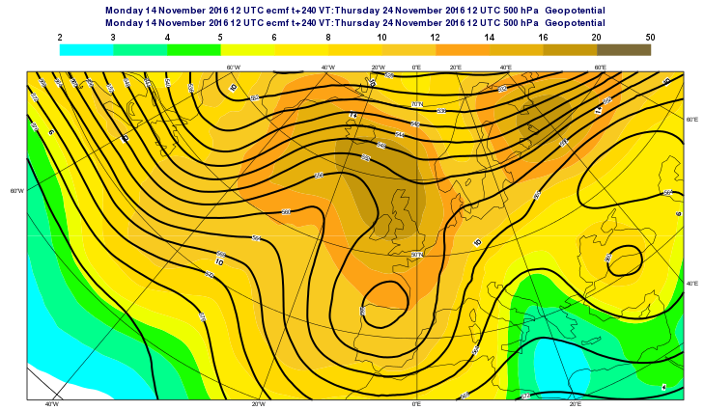
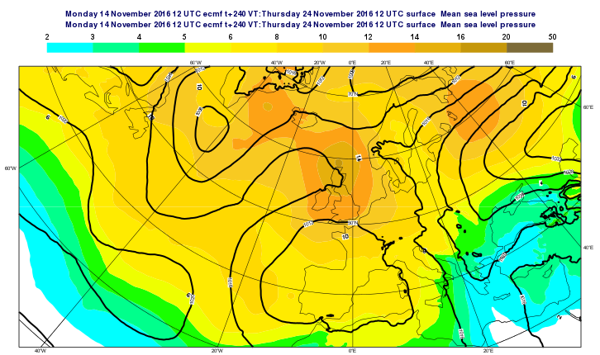
Z500 EM and spread
MSLP EM and spread

Slide 49
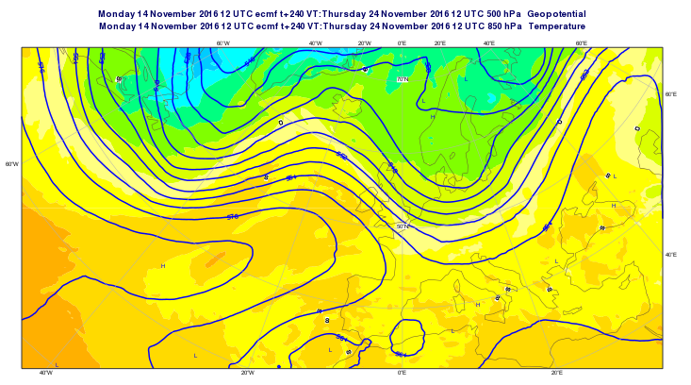

Slide 50
2016-11-15 00 UTC

Slide 51
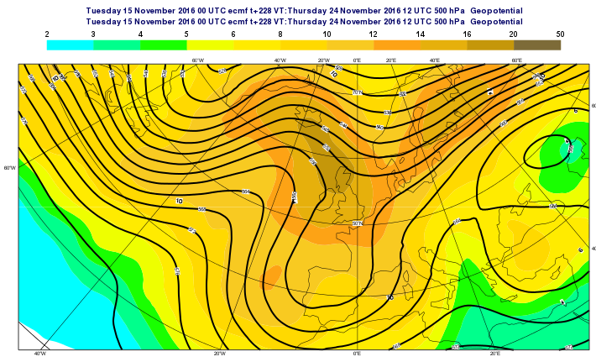
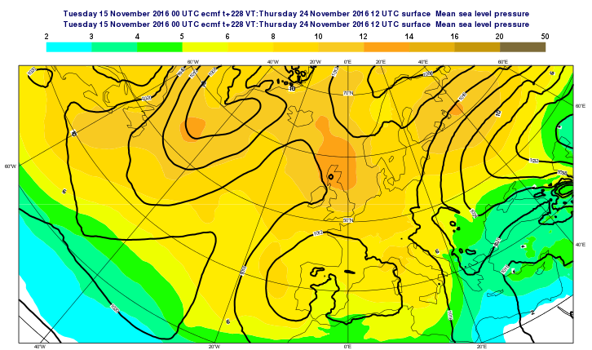
Z500 EM and spread
MSLP EM and spread

Slide 52
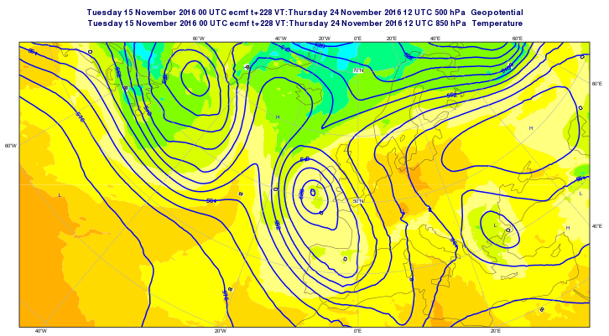

Slide 53
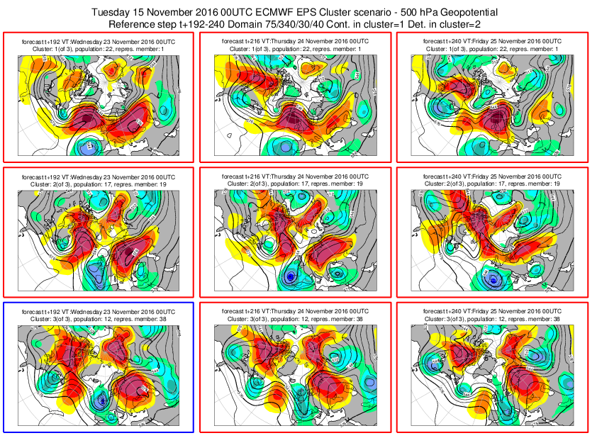

Slide 54
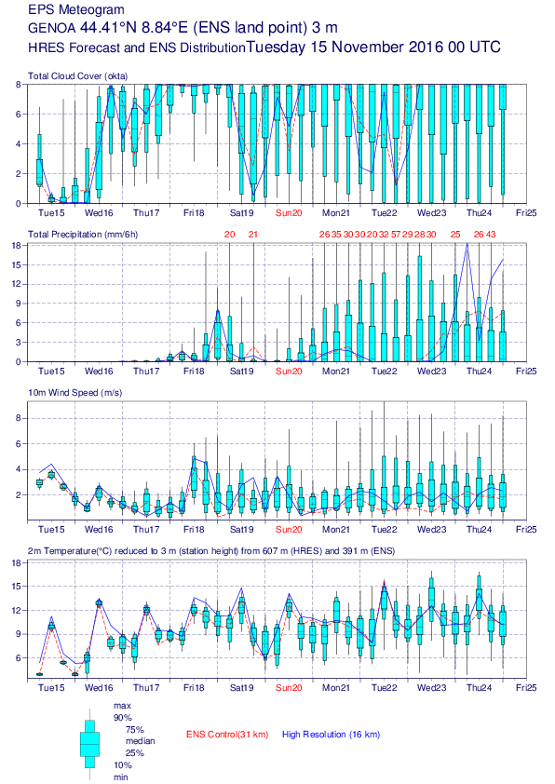
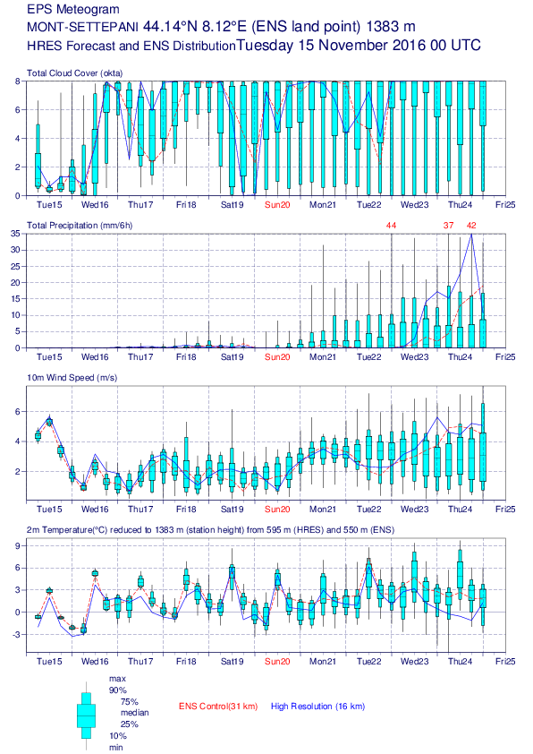

Slide 55
2016-11-15 12 UTC

Slide 56
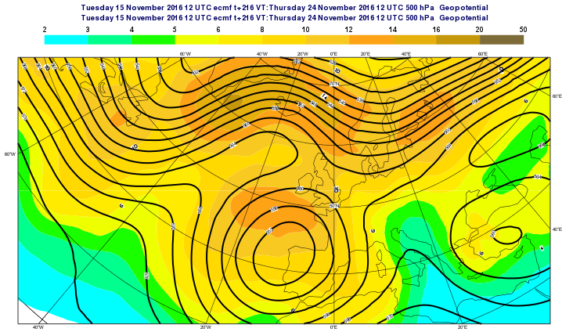
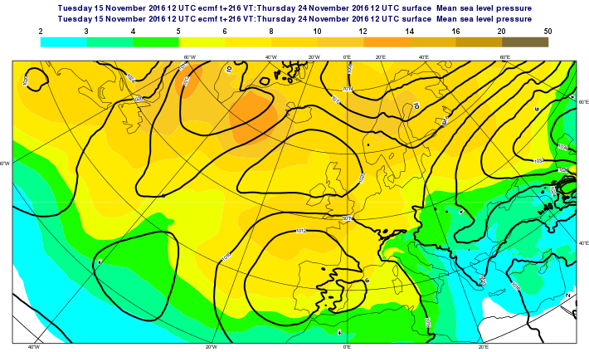
Z500 EM and spread
MSLP EM and spread

Slide 57
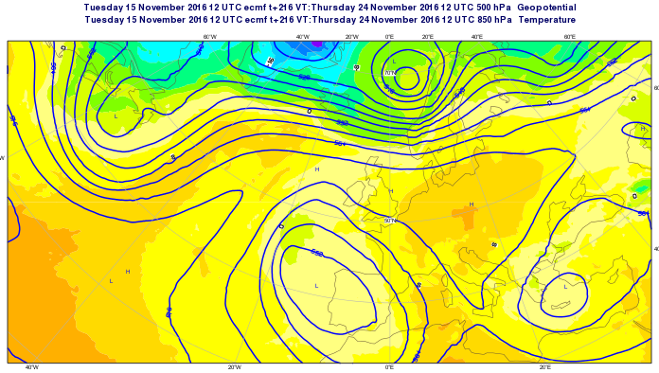
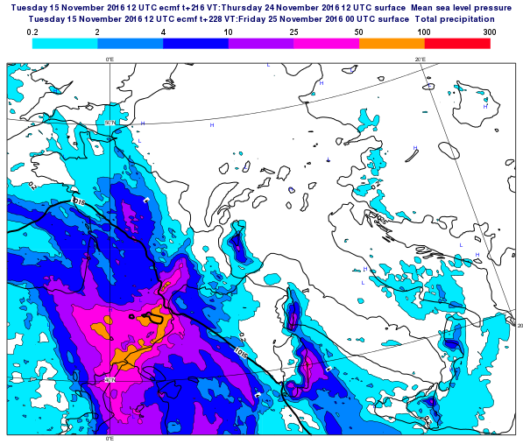

Slide 58


Slide 59



Slide 60
2016-11-16 00UTC

Slide 61


Z500 EM and spread
MSLP EM and spread

Slide 62




Slide 63


Slide 64


Slide 65



Slide 66
2016-11-16 12UTC

Slide 67


Z500 EM and spread
MSLP EM and spread

Slide 68




Slide 69


Slide 70



Slide 71
2016-11-17 00UTC

Slide 72


Z500 EM and spread
MSLP EM and spread

Slide 73




Slide 74


Slide 75


Slide 76


Slide 77


Slide 78



Slide 79
2016-11-17 12UTC

Slide 80


Z500 EM and spread
MSLP EM and spread

Slide 81




Slide 82


Slide 83


Slide 84



Slide 85
2016-11-18 00UTC

Slide 86


Z500 EM and spread
MSLP EM and spread

Slide 87




Slide 88


Slide 89


Slide 90


Slide 91



Slide 92



EFI & SOT Forecast from 18.11.2016/00UTC

Slide 93



Slide 94
2016-11-18 12UTC

Slide 95


Z500 EM and spread
MSLP EM and spread

Slide 96




Slide 97


Slide 98


Slide 99



Slide 100



Slide 101



Slide 102



Slide 103
2016-11019 00UTC

Slide 104


Z500 EM and spread
MSLP EM and spread

Slide 105




Slide 106


Slide 107


Slide 108


Slide 109



Slide 110



Slide 111



Slide 112



Slide 113
2016-11-19 12UTC

Slide 114


Z500 EM and spread
MSLP EM and spread

Slide 115




Slide 116


Slide 117


Slide 118



Slide 119



Slide 120



Slide 121



Slide 122
2016-11-20 00UTC

Slide 123


Z500 EM and spread
MSLP EM and spread

Slide 124




Slide 125


Slide 126


Slide 127


Slide 128



Slide 129



Slide 130



Slide 131



Slide 132
2016-11-20 12UTC

Slide 133


Z500 EM and spread
MSLP EM and spread

Slide 134




Slide 135


Slide 136


Slide 137



Slide 138



Slide 139



Slide 140



Slide 141
2016-11-21 00UTC

Slide 142


Z500 EM and spread
MSLP EM and spread

Slide 143




Slide 144


Slide 145


Slide 146



Slide 147



Slide 148



Slide 149



Slide 150
2016-11-21 12UTC

Slide 151


Z500 EM and spread
MSLP EM and spread

Slide 152




Slide 153


Slide 154


Slide 155



Slide 156



Slide 157



Slide 158



Slide 159
2016-11-22 00UTC

Slide 160


Z500 EM and spread
MSLP EM and spread

Slide 161




Slide 162


Slide 163


Slide 164



Slide 165



Slide 166



Slide 167



Slide 168
2016-11-22 12UTC

Slide 169


Z500 EM and spread
MSLP EM and spread

Slide 170




Slide 171


Slide 172


Slide 173



Slide 174



Slide 175



Slide 176



Slide 177
2016-11-23 00UTC

Slide 178



Slide 179




Slide 180


Slide 181


Slide 182



Slide 183



Slide 184



Slide 185



Slide 186
2016-11-23 12UTC

Slide 187




Slide 188


Slide 189


Slide 190



Slide 191



Slide 192



Slide 193



Slide 194
2016-11-24 00UTC

Slide 195




Slide 196


Slide 197



Slide 198



Slide 199



Slide 200





Slide 201


Slide 202



Slide 203

http://www.euronews.com/2016/11/24/torrential-rains-cause-widespread-flooding-in-northern-italy

