Slide 1
Using microwave observations in data assimilation, including under conditions of cloud and precipitation
Alan Geer
Thanks to: Bill Bell, Peter Bauer, Fabrizio Baordo, Niels Bormann, Katrin Lonitz and Richard Forbes
ECMWF/EUMETSAT NWP-SAF satellite training course 20/3/2019

Slide 2
Last time…
What is special about the microwave frequency range?
Sensitivities
Radiative transfer basics
Microwave sensors
Using AMSU-A sounding radiances in the ECMWF data assimilation system
More on cloud and precipitation sensitivities, modelling, and screening
All-sky assimilation
This time…

Slide 3
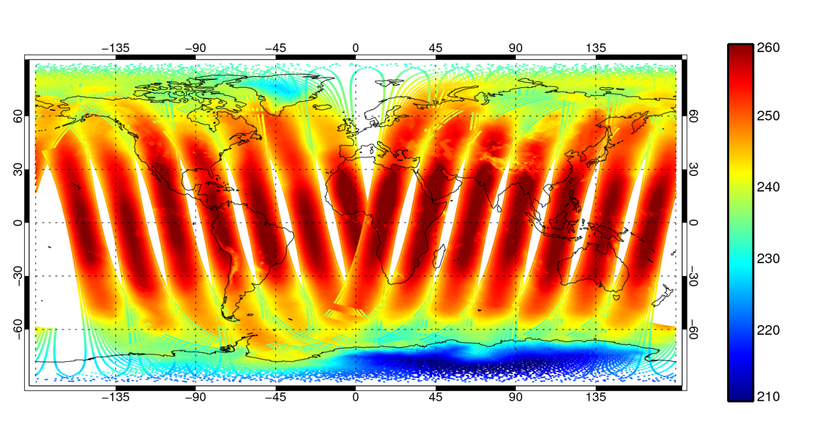
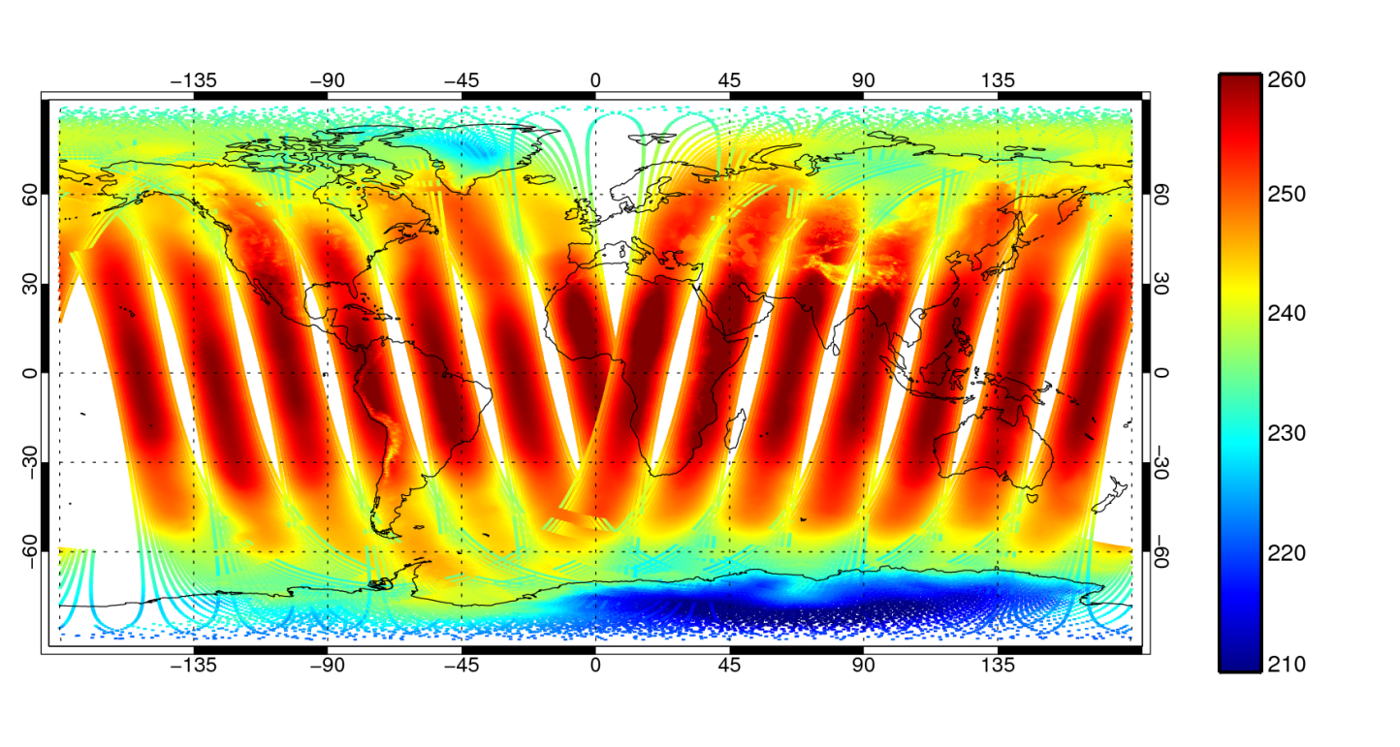
AMSU-A channel 5 radiances:
Metop-A satellite, 9pm 25/4 to 9am 26/4/2012
Observed TB [K]
First guess TB [K]
“Clear sky” assumption: no cloud or precipitation radiative transfer

Slide 4
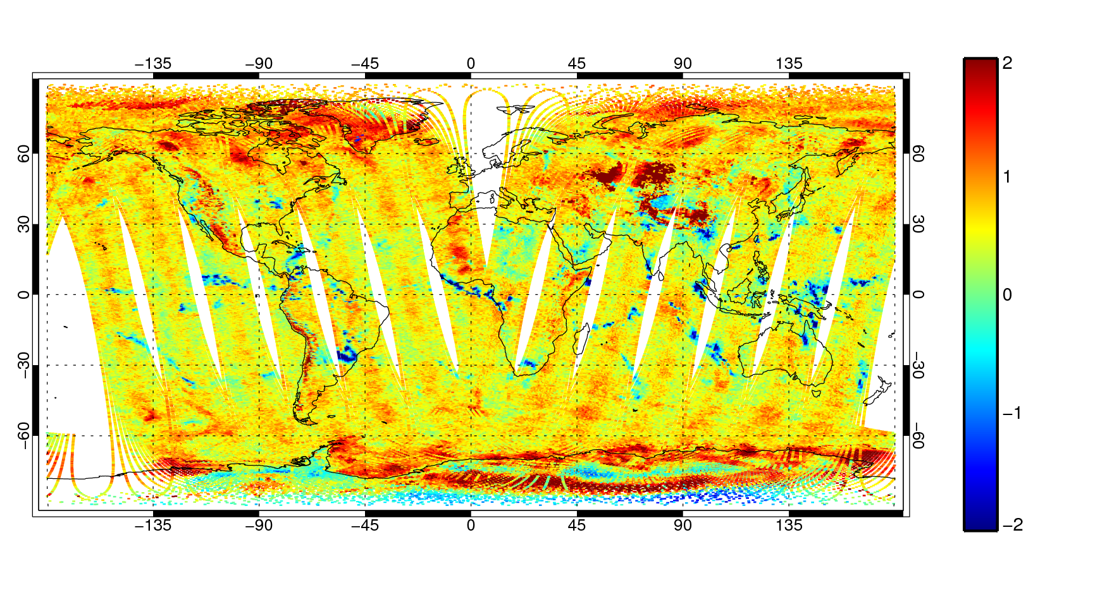
AMSU-A channel 5 radiances
First guess departures
[K]
Scan bias
General “warm” bias

Slide 5
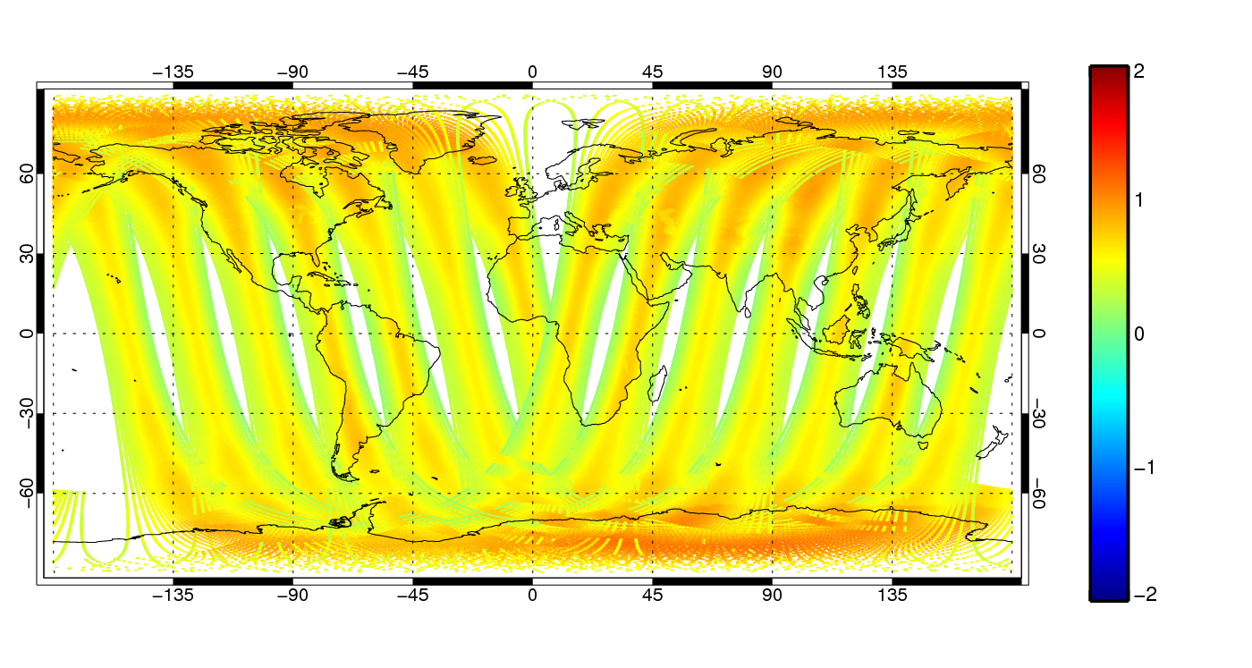
AMSU-A channel 5 radiances
Bias correction
[K]
Scan bias correction
Airmass correction (layer mean temperature)
Mean offset

Slide 6
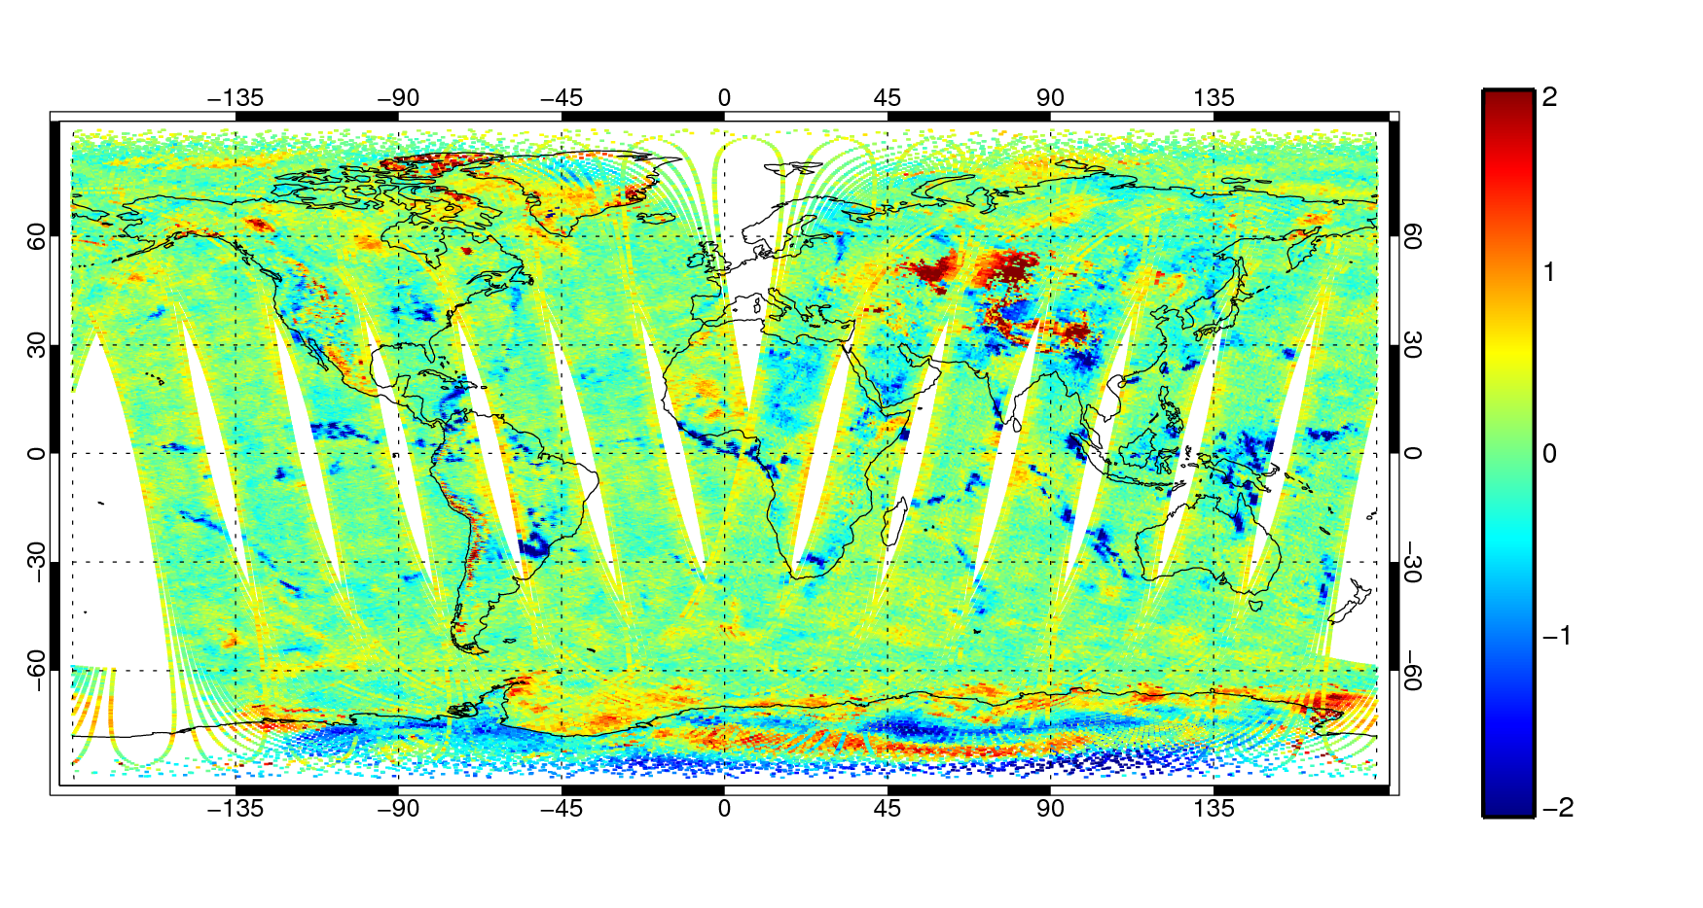
AMSU-A channel 5 radiances
Bias corrected first guess departures
[K]
The Andes
Sea ice
Snow and ice
Still some scan bias
Precipitation and cloud

Slide 7
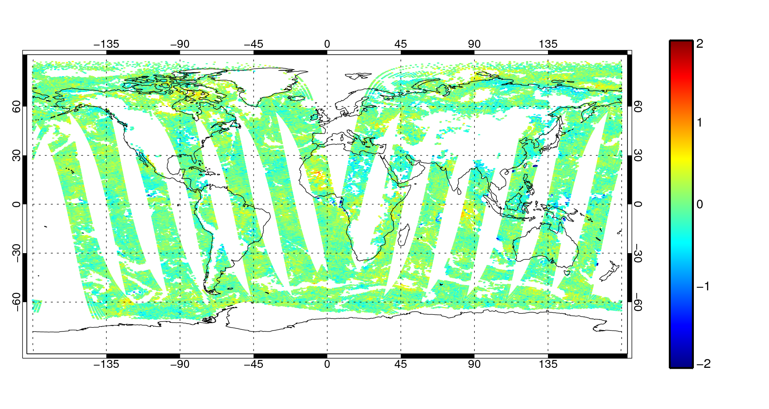
AMSU-A channel 5 radiances
Bias corrected first guess departures
After blacklisting
[K]
The Andes
Sea ice
Snow and ice
Still some scan bias
Precipitation and cloud

Slide 8
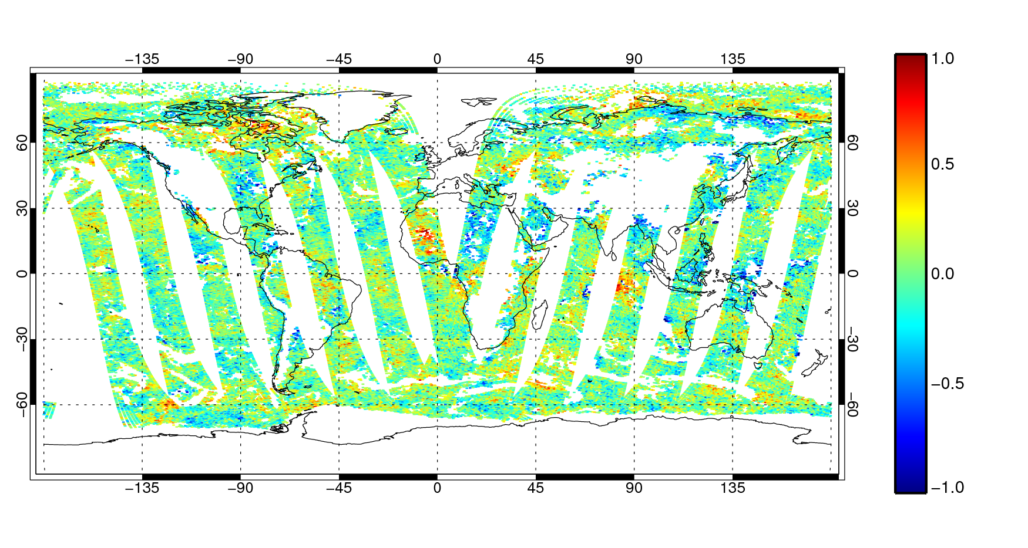
AMSU-A channel 5 radiances
Bias corrected first guess departures
After blacklisting
[K]

Slide 9
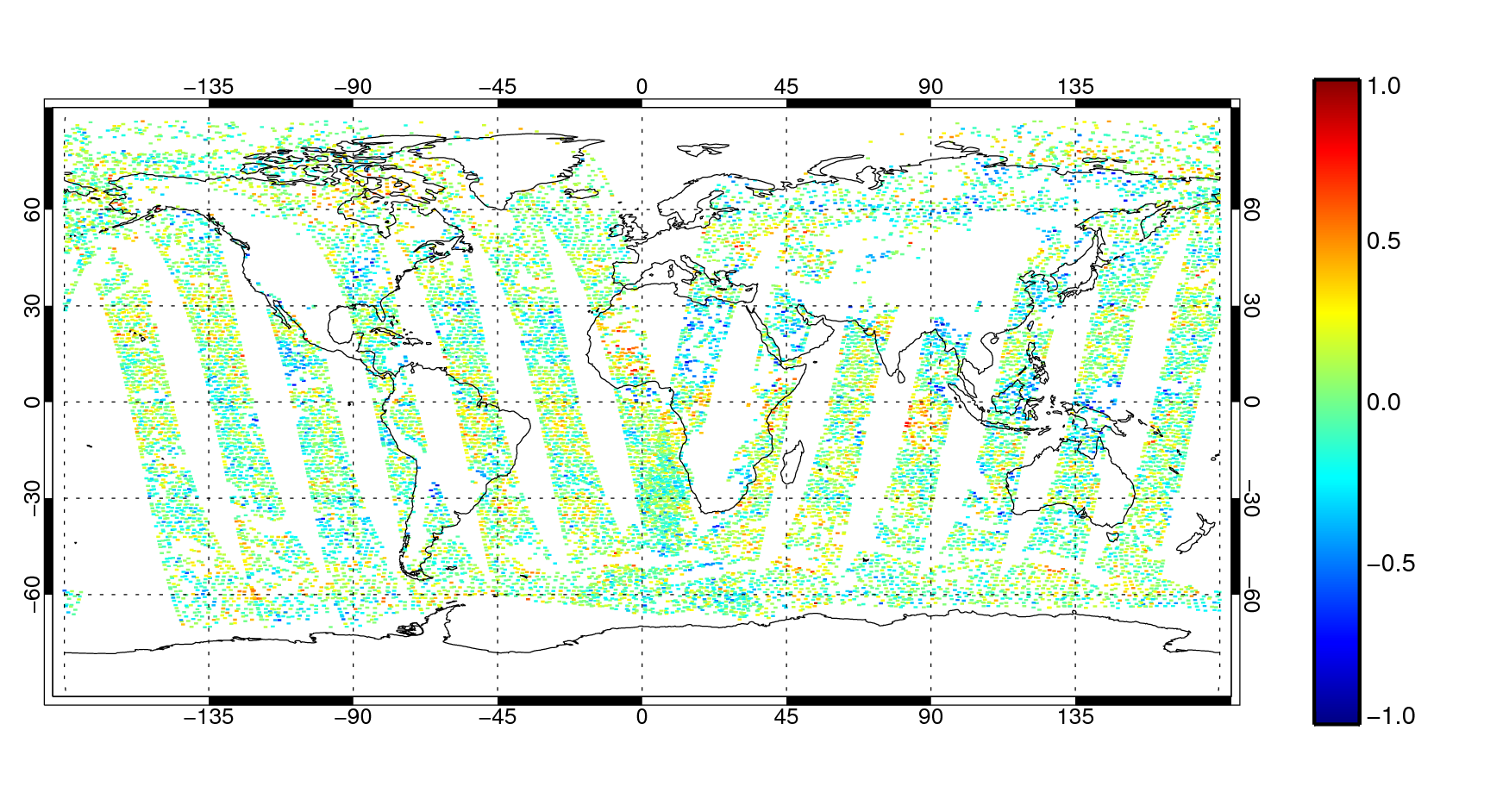
AMSU-A channel 5 radiances
Bias corrected first guess departures
After blacklisting
After active thinning and VarQC

Slide 10
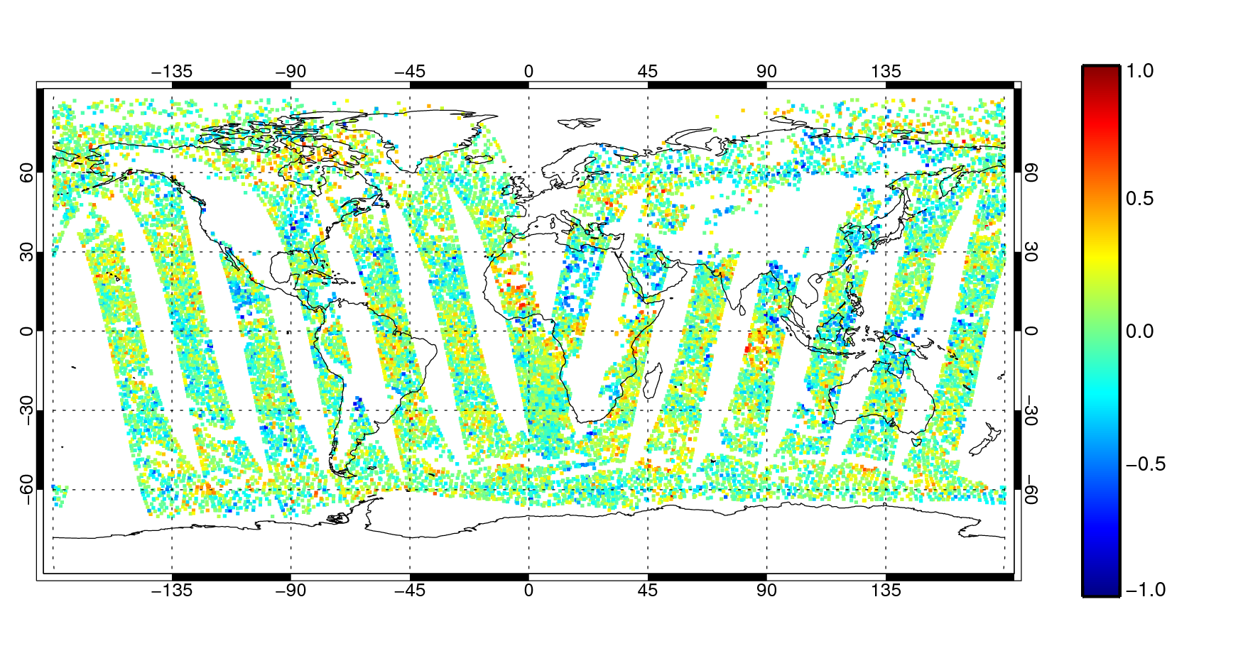
AMSU-A channel 5 radiances
Bias corrected first guess departures
After blacklisting
After active thinning and VarQC

Slide 11
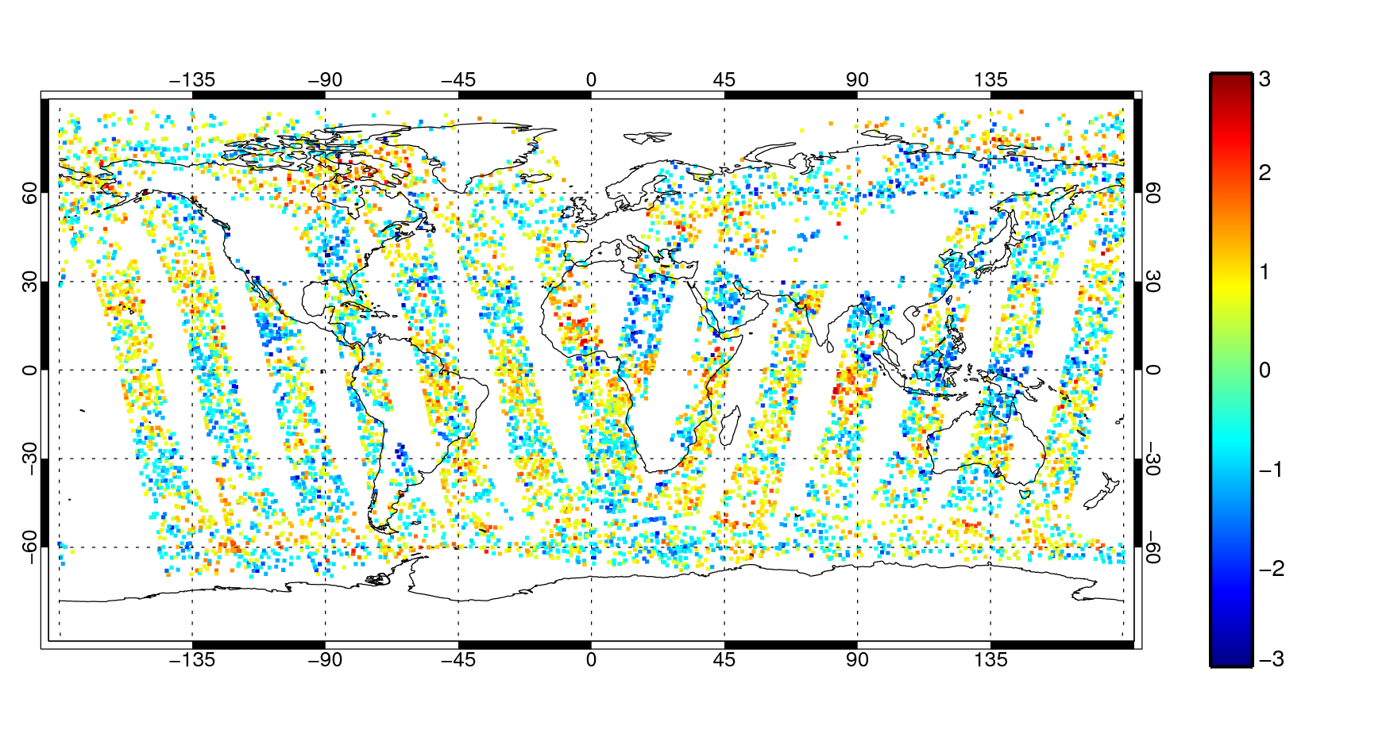
AMSU-A channel 5 radiances
Departures normalised by
observation error, σ_{o} = 0.28K
(Absolute values < 0.5 removed here for visual clarity)

Slide 12
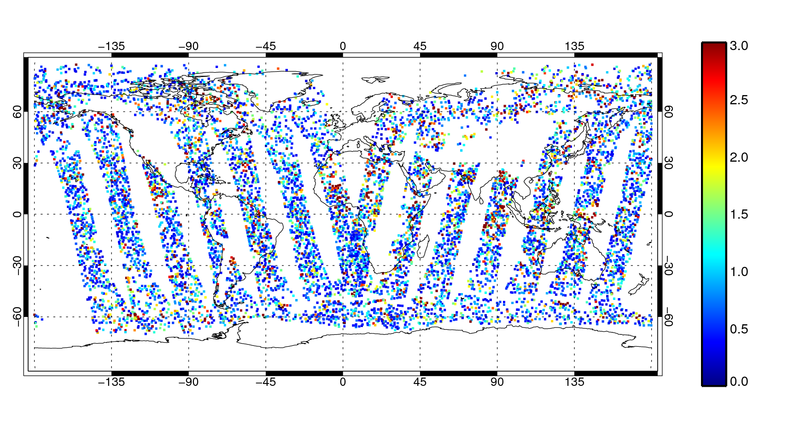
AMSU-A channel 5 radiances
Contribution to cost function (as before, low contribution values removed for clarity)

Slide 13
Now we need to minimise 4D-Var
Feed the minimisation algorithm with…
Cost function
What we just calculated

Slide 14
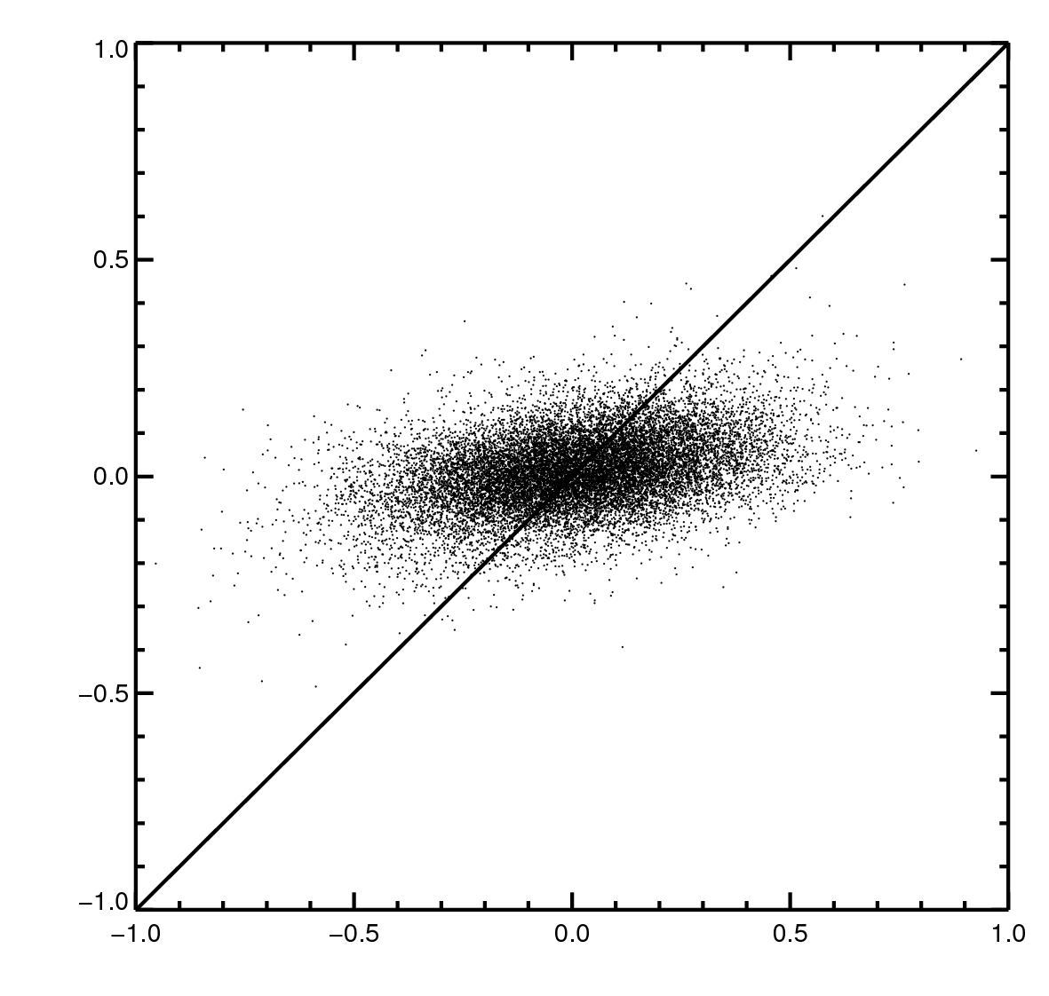
What did 4D-Var do with AMSU-A channel 5, and all the other observations in the analysis?
Increment [K]
Just a little nudge in the direction of the observations
1:1 line - if the analysis exactly fitted the observations
FG departure [K]

Slide 15
Sensitivities to cloud and precipitation

Slide 16
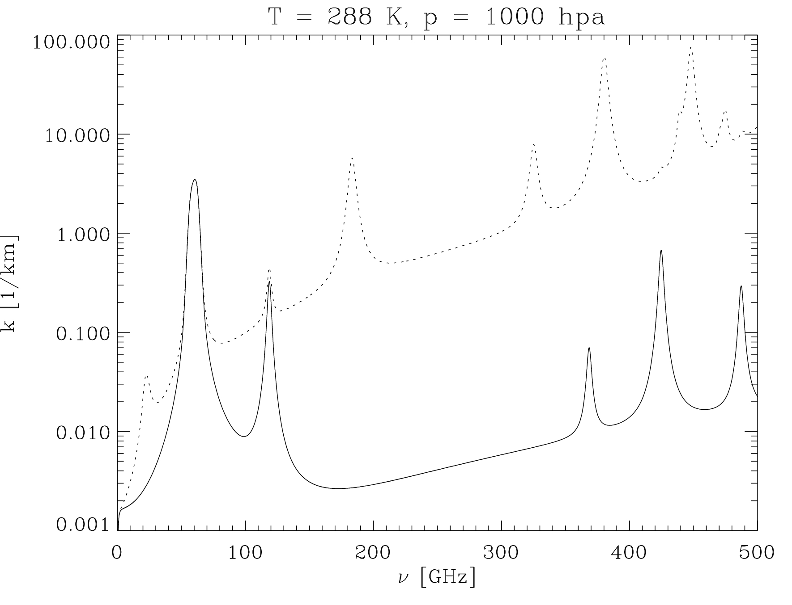
The microwave gas absorption spectrum
Absorption coefficientβ_{a} [1/km]
H₂O Rotation lines
+
Water vapour continuum
O₂ Rotation Lines
+
Dry air continuum
Moist
“Imaging channels” in the windows
Temperature sounding:
60 GHz oxygen line
Dry
Moisture sounding:
22 GHz and 183 GHz water vapour lines

Slide 17
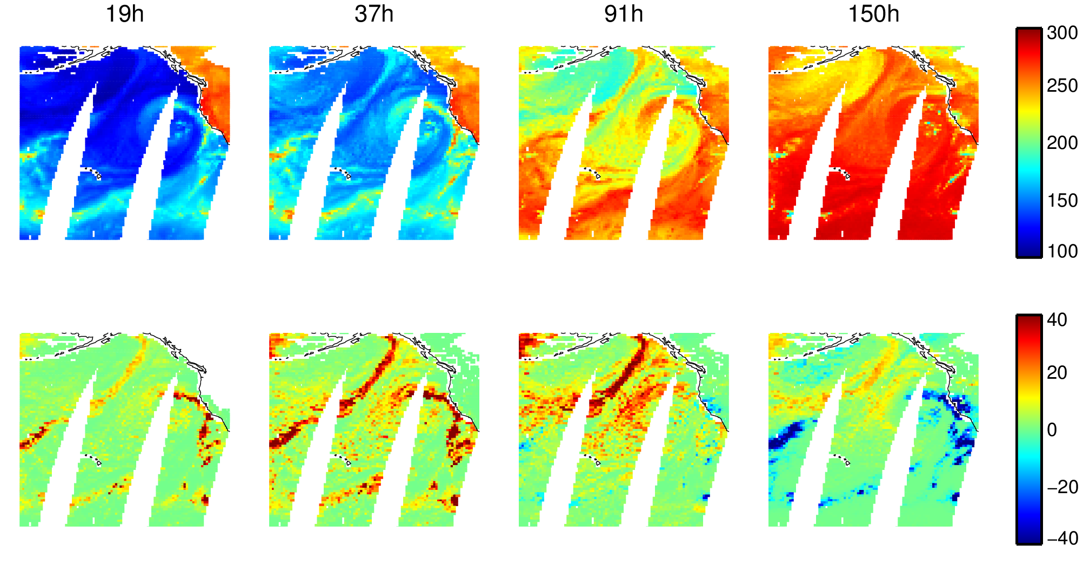
Window channels (“imaging”): surface properties, water vapour, cloud and precipitation (from SSMIS – conical imager)
Increasing frequency [GHz] (h = horizontal polarization)
Observed TB [K]

Slide 18
Window channels (“imaging”): surface properties, water vapour, cloud and precipitation (from SSMIS – conical imager)
Increasing frequency [GHz] (h = horizontal polarization)
Observed TB [K]
Hydrometeor effect: observed TB – Simulated clear-sky TB [K]
Rain (absorption, increases TB)
Snow/graupel/hail (scattering, decreases TB)
Cloud (absorption, increases TB)

Slide 19
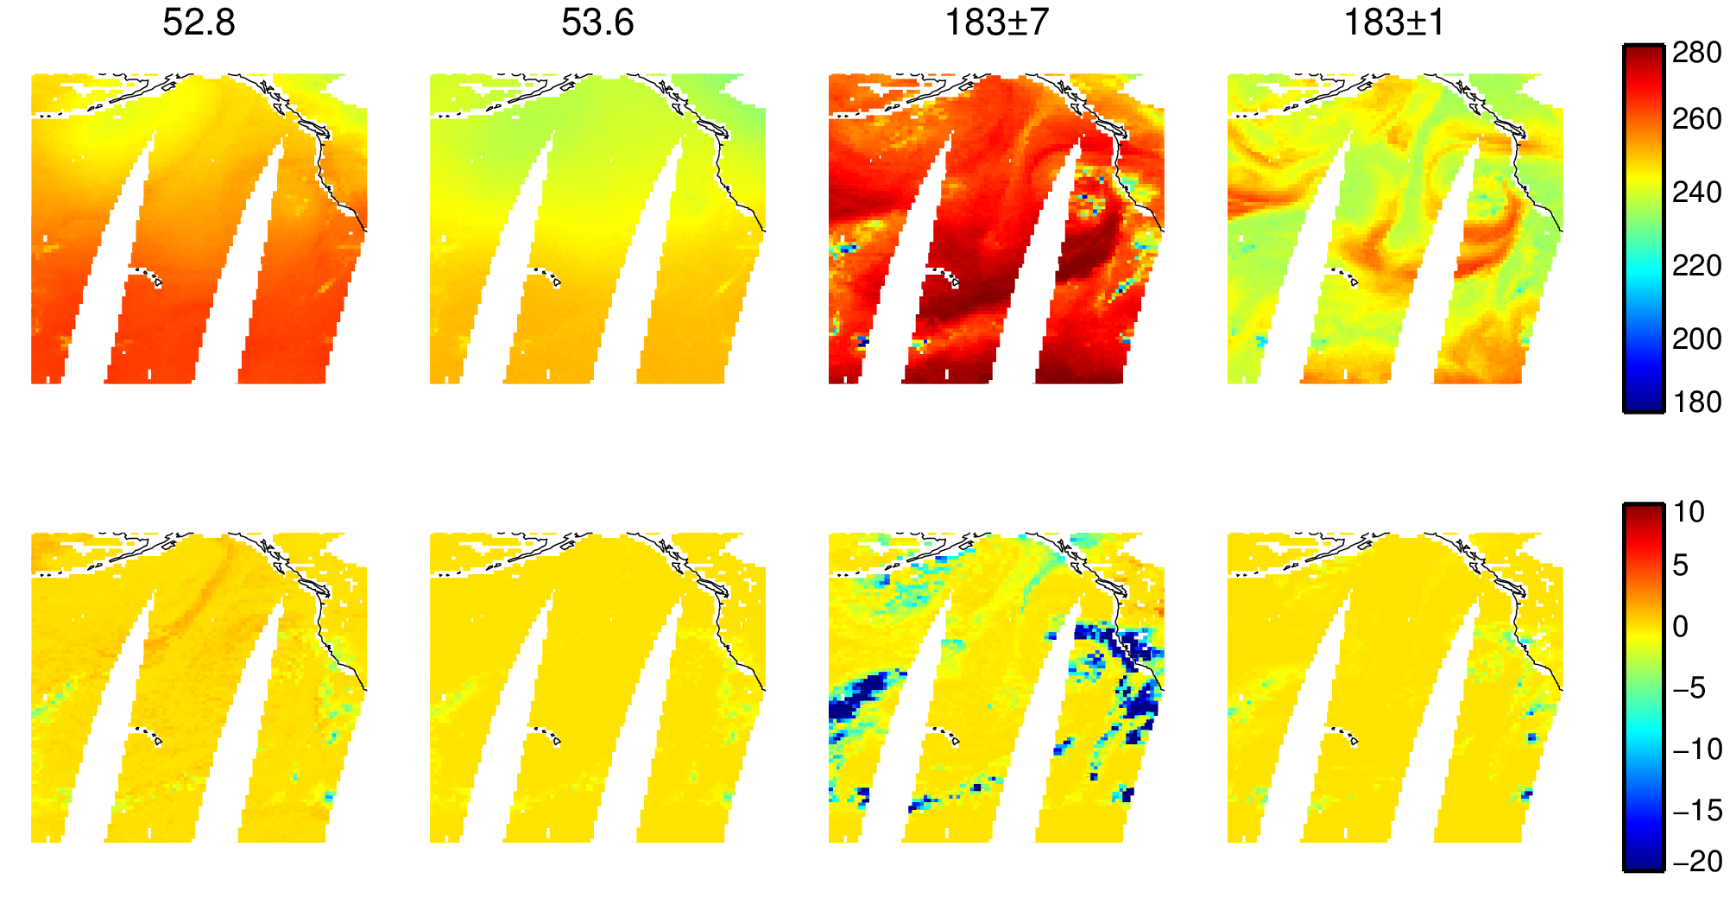
Sounding channels: temperature, water vapour, cloud and precipitation (from SSMIS – conical imager)
Temperature sounding:
Lower troposphere Mid troposphere
Water vapour sounding:
Mid troposphere Upper troposphere
Observed TB [K]
Hydrometeor effect: observed TB – Simulated clear-sky TB [K]
Cloud (absorption, increases TB)
Cloud and rain (absorption, pushes up weighting function altitude, decreases TB)
Cloud and snow/ice/graupel (absorption and scattering, decreases TB)

Slide 20
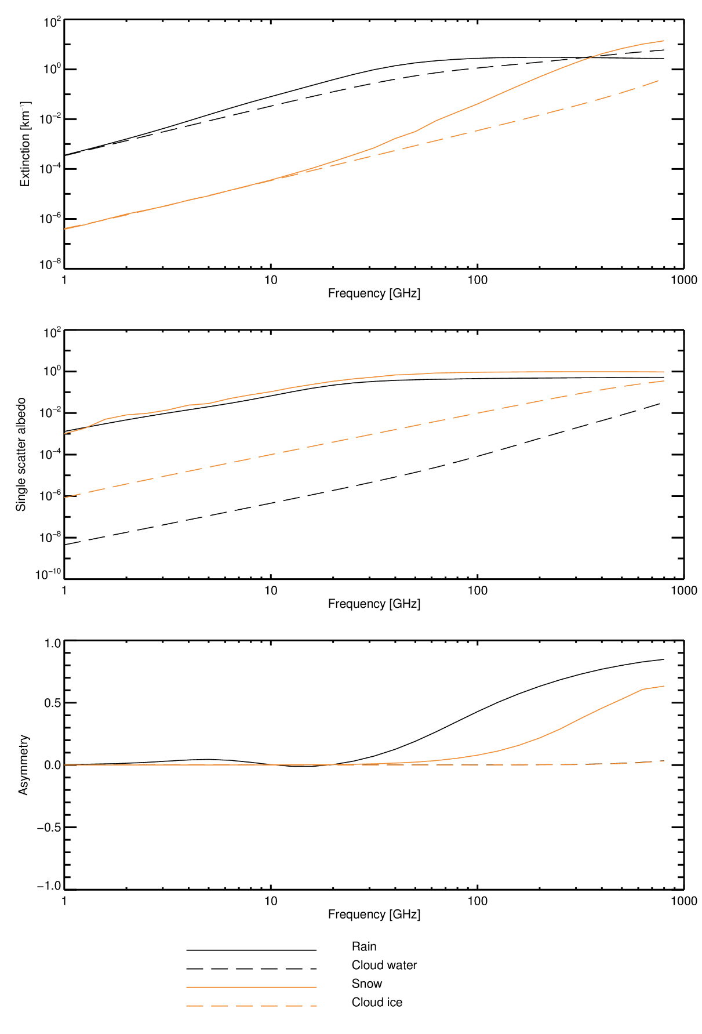
The microwave particle optical property “spectrum”
1.0 g m⁻³ of hydrometeor at 260 K

Slide 21
The microwave particle optical property “spectrum”
1.0 g m⁻³ of hydrometeor at 260 K

Slide 22
Radiative transfer for cloud and precipitation

Slide 23
Spherical particles interacting with radiation
Rayleigh “scattering” (x < 0.2):
  an approximate solution for spherical particles much smaller than the wavelength
  for x < 0.002 scattering is negligible (but particles still absorb and emit radiation): e.g. at low microwave frequencies, liquid water cloud acts like a gaseous absorber
Mie scattering (0.2 < x < 2000):
  a complete solution for the interaction of a plane wave with a dielectric sphere
  valid for all x, but depends on a series expansion in Legendre polynomials - can be slow to compute
Geometric optics (x > 2000):
  e.g. the rainbow solution for visible light

Slide 24
Non-spherical particles interacting with radiation
Discrete dipole approximation (DDA):
Other solution methods exist or are being developed, e.g. T-matrix, boundary integrals
1. Create a 3D model of a snow or ice particle
2. Discretise into many small polarisable points (dipoles). Grid spacing << wavelength
3. Solve computationally – can be slow

Slide 25
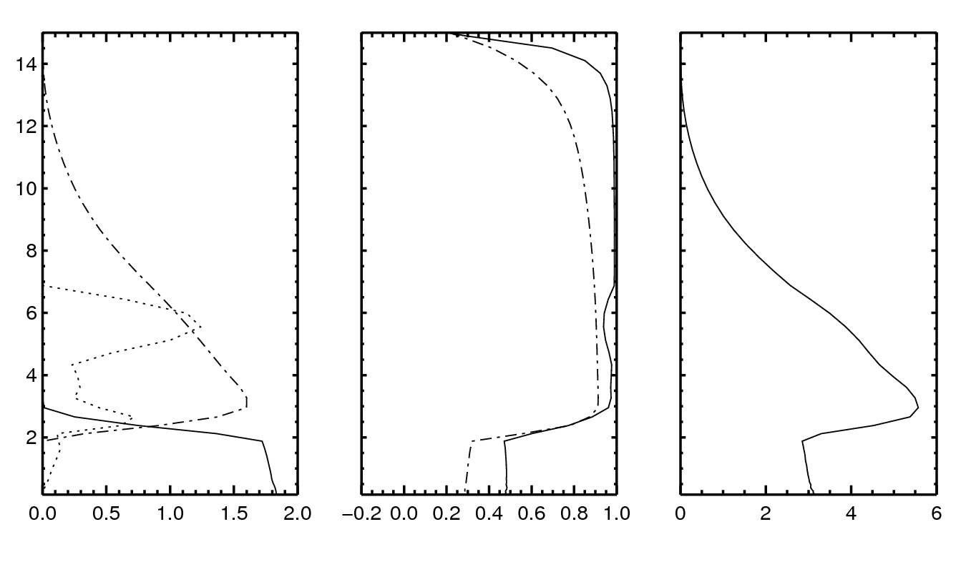
Cloud and precipitation at 91 GHz
Strong scattering in deep convection
Altitude [km]
Single
scatter
albedo
Snow
Asymmetry
Water cloud
Rain
Rain and snow flux [g m² s⁻¹]
Cloud mixing ratio [0.1 g kg⁻¹]
Extinction coefficient β_{e}
[km⁻¹]

Slide 26
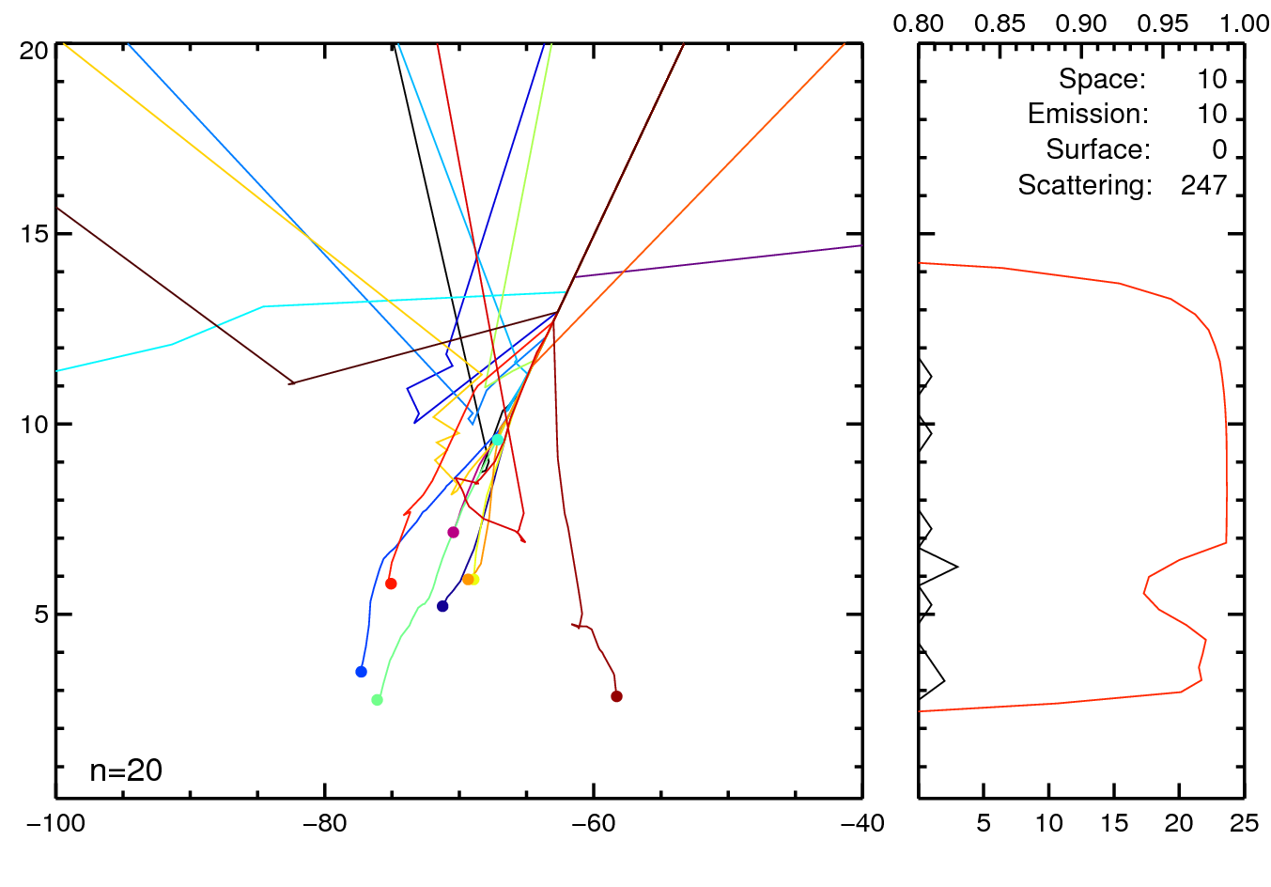
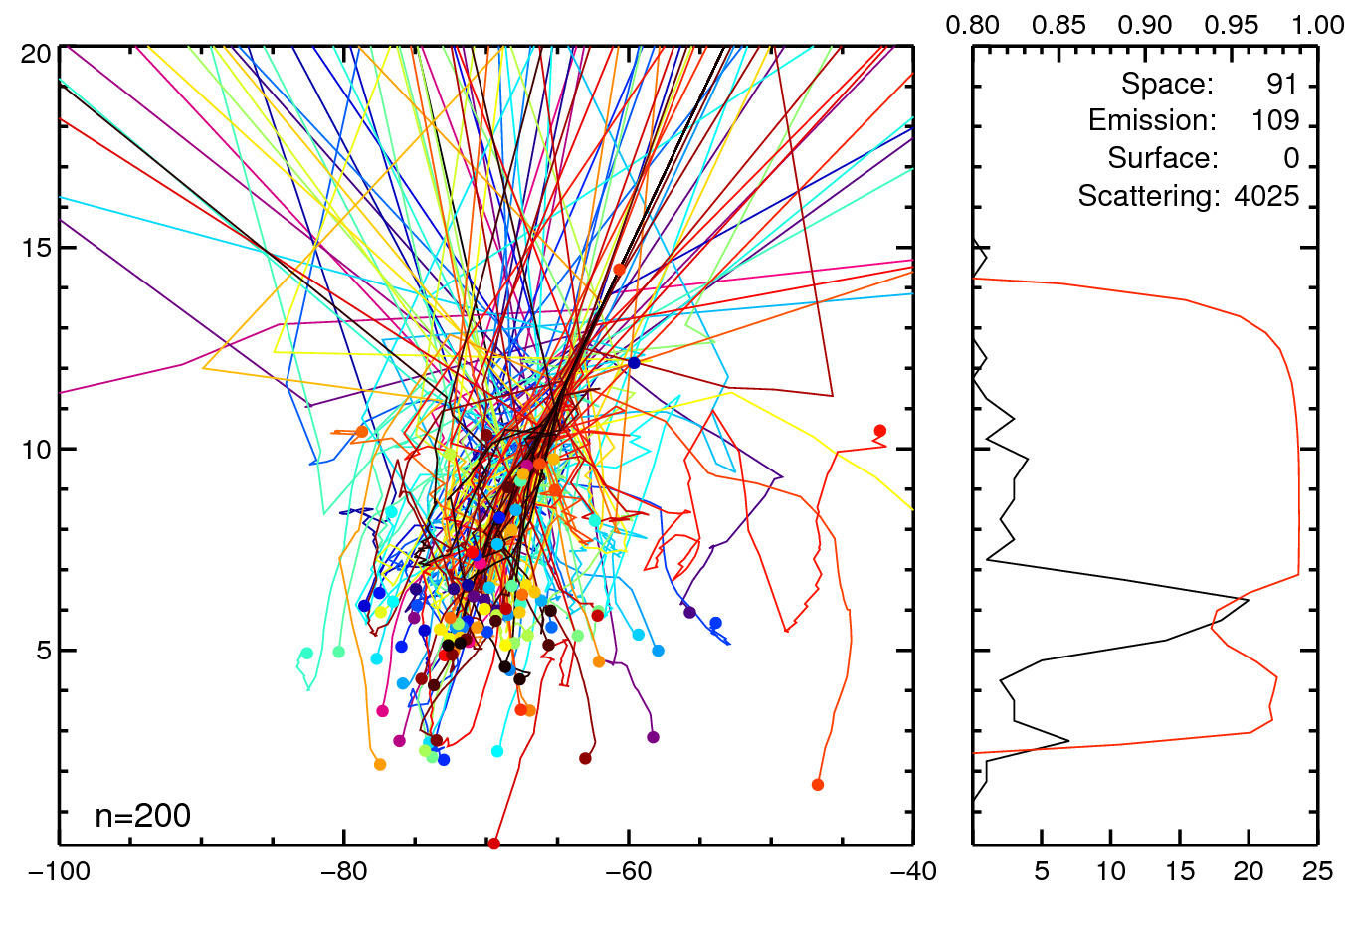
Cloud and precipitation at 91 GHz
Strong scattering in deep convection
To sensor
SSA [0-1]
[km]
Snow
Cloud
Rain
[km]
No. of emissions

Slide 27
Scattering solvers
Reverse Monte-Carlo
  Great for understanding and visualisation
  An easy way to do 3D radiative transfer
  Much too slow for operational use: many thousands of “photons” are required for convergence to a useful level of accuracy
Accurate but too slow for use in assimilation:
  DISORT (Discrete ordinates) – a generalisation of the two-stream approach
  Adding / doubling, SOI (Successive Orders of Interaction)
Two-stream and delta-Eddington approaches
  What we use operationally at ECMWF (in RTTOV-SCATT)
  Though quite crude methods, the accuracy is usually more than sufficient: the main R/T error sources in NWP are rarely in the solver

Slide 28
Clear-sky or ‘all-sky’ assimilation?

Slide 29
Clear-sky or all-sky assimilation?
Clear-sky assimilation:
  Remove any cloud-contaminated observations
  Do not model the effect of cloud on brightness temperatures
  Used for temperature sounding channels (e.g. AMSU-A channel 5)
  Extract small signals of temperature forecast errors (order 0.1K) that would be swamped by errors from displaced clouds and precipitation (10-100K)
All-sky assimilation
  Model the effect of cloud and precipitation on the observations
  Assimilate all data, whether clear, cloudy or precipitating
  Used for water-vapour sounding and imaging channels
  Use the tracing mechanism of 4D-Var to infer the dynamical state from errors in the location/intensity of water vapour, cloud and precipitation

Slide 30
Cloud screening
Use clear-sky radiative transfer but remove situations where the observations are cloudy or precipitating
Cloud screening methods:
  FG departures in a window channel
  Simple LWP or cloud retrieval
    Sounders: Grody et al. (2001, JGR)
    Imagers: Karstens et al. (1994, Met. Atmos. Phys.)
    Imagers: 37 GHz polarisation difference, Petty and Katsaros (1990, J. App. Met.)
  Scattering index (SI)
    Over land, or in sounding channels affected by ice/snow scattering, not cloud absorption: Grody (1991, JGR)
Used for screening AMSU-A channel 5-8 at ECMWF

Slide 31
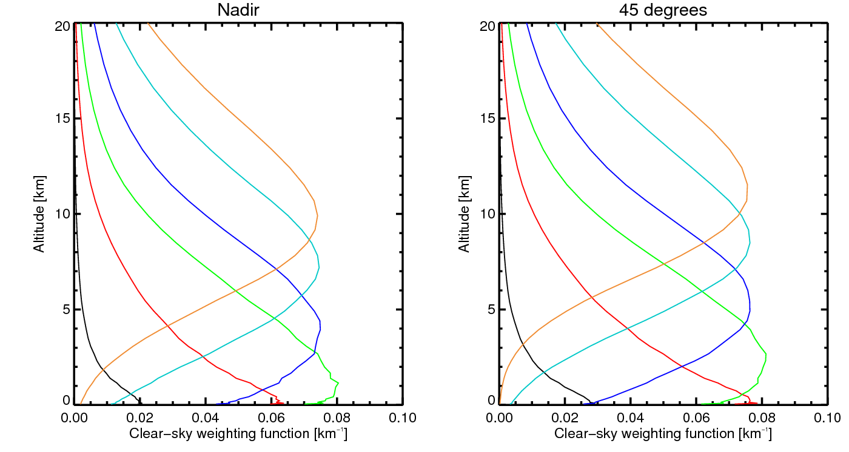
AMSU-A clear-sky nadir weighting functions these are approximately fixed, in an oxygen line (a well-mixed gas)
Channel
Transmittance surface to space
Channels being assimilated (plus ch. 8-14 also)
7 0%
6 0%
5 5%
4 19%
Channel for cloud screening
3 56%
2 92%

Slide 32
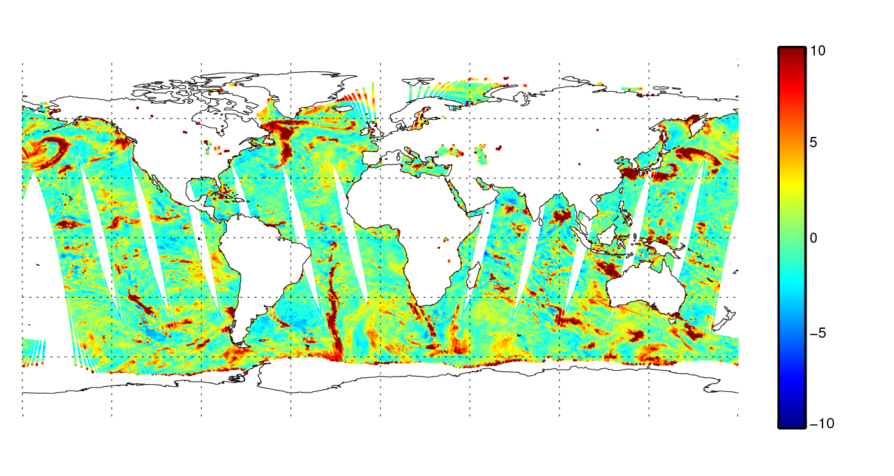
AMSU-A channel 3 departures for cloud screening
50.3 GHz observation minus clear-sky first guess (bias corrected), ocean surfaces
K
Cloud shows up as a warm emitter over a radiatively cold ocean surface

Slide 33
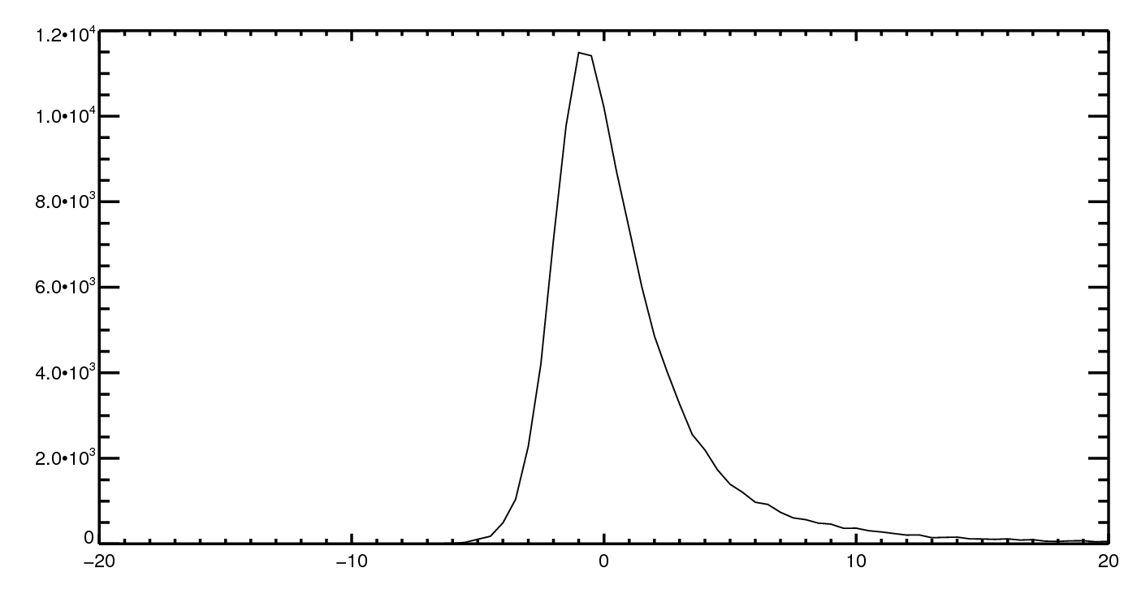
AMSU-A channel 3 departures for cloud screening
50.3 GHz observation minus clear-sky first guess, ocean surfaces
3K limit
20% of observations removed
Warm tail = cloud
FG departure [K]

Slide 34
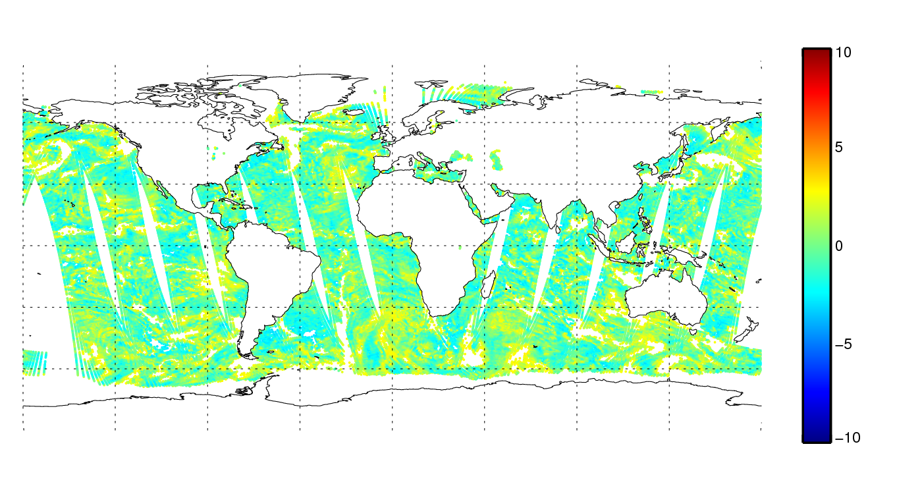
AMSU-A channel 3 departures for cloud screening
50.3 GHz observation minus clear-sky first guess (bias corrected), ocean surfaces
K

Slide 35
Clear-sky assimilation
Model | Observations
✓
×
×
✓?

Slide 36
All-sky assimilation
Model | Observations
✓
✓
✓
✓

Slide 37
All-sky assimilation: impact and mechanism

Slide 38
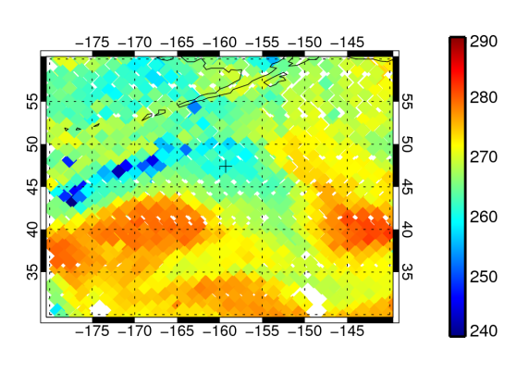
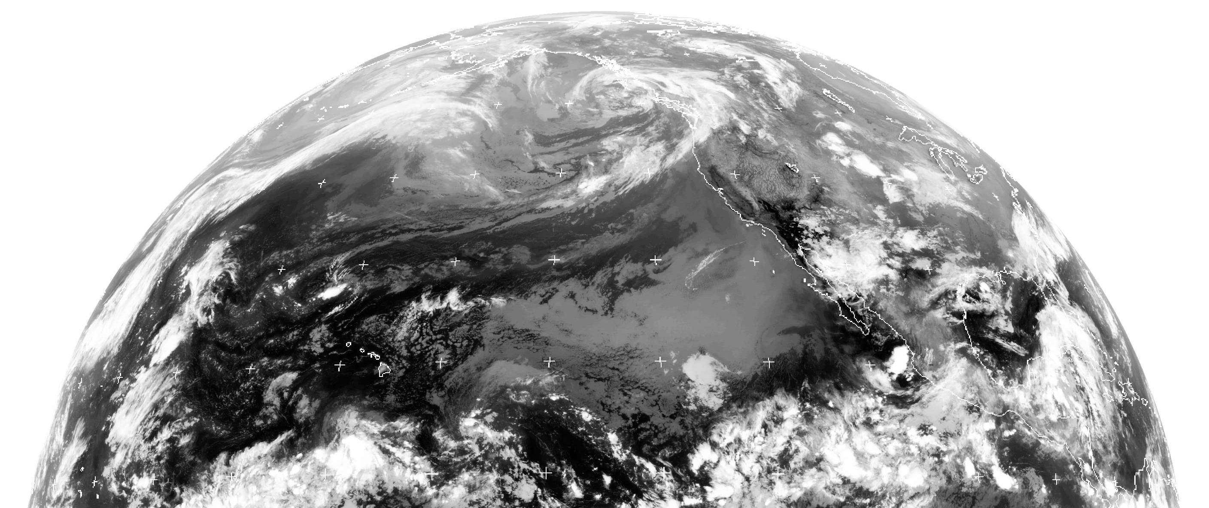
Frontal cloud and precipitation: single-observation example at 190 GHz
Metop-B MHS
190 GHz
08Z, 15 Aug 2013
47°N 159°W
GOES 10μm
Dundee receiving station

Slide 39
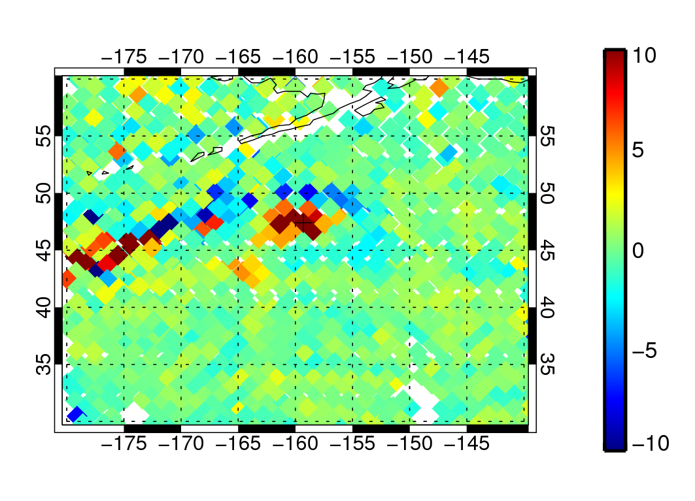
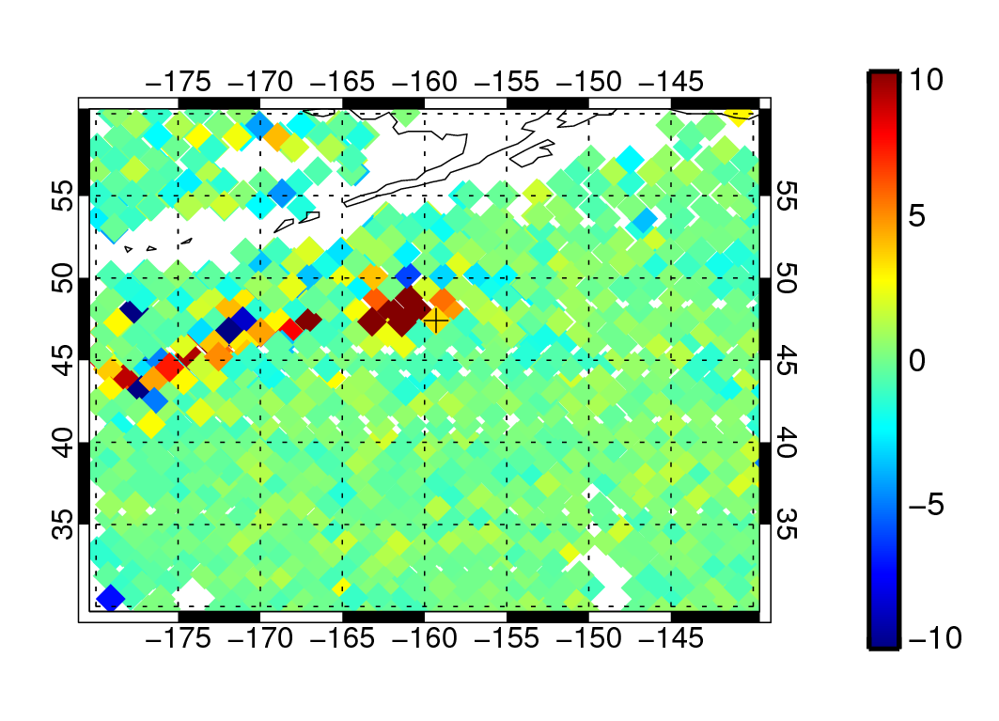
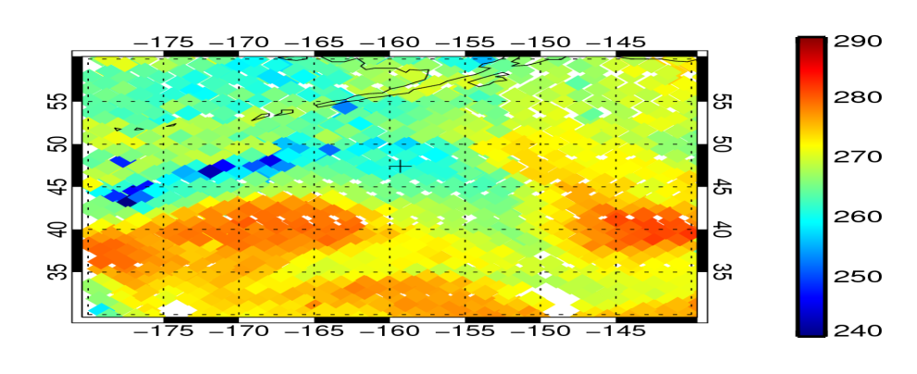
Frontal cloud and precipitation – all observations
[K]
[K]
FG depar
Analysis depar (all obs)
[K]
Obs

Slide 40
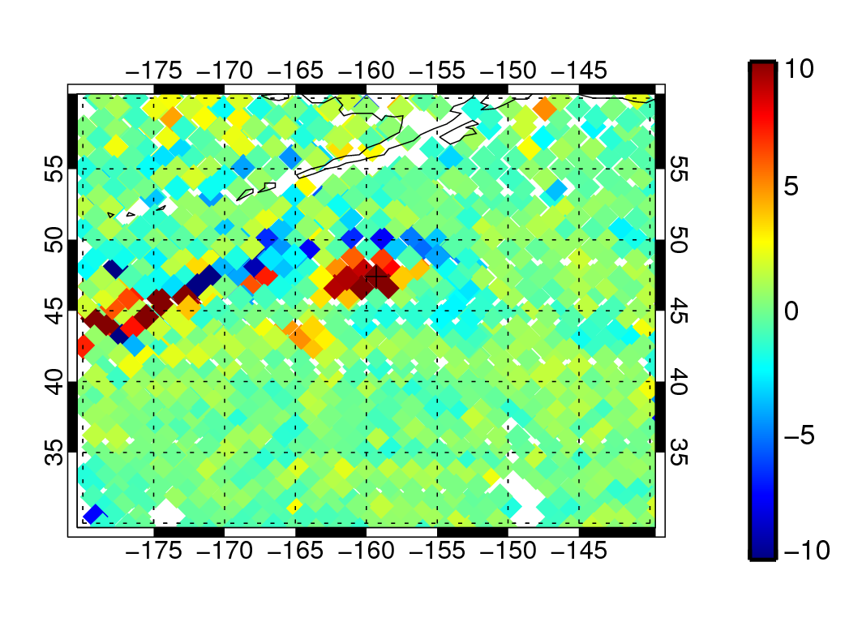
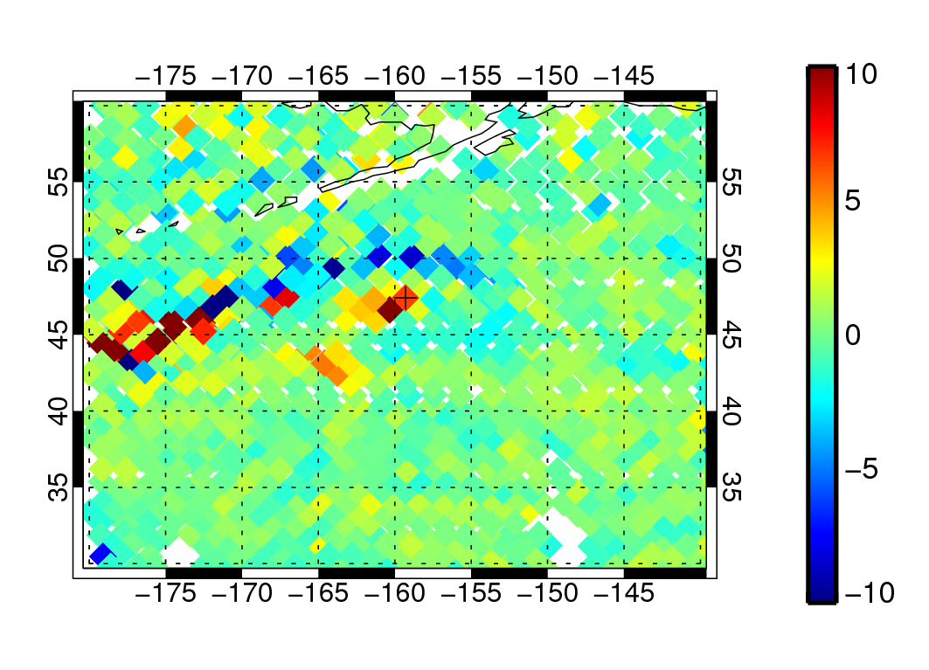
Frontal cloud and precipitation – single all-sky obs
[K]
[K]
FG depar
Analysis depar (all obs)
[K]
[K]
AN dep (single obs, normal obs error)
AN dep (single obs, low obs error, no VarQC or BgQC)
25% error reduction (honest!)
80% error reduction.
Locally better than full observing system!

Slide 41
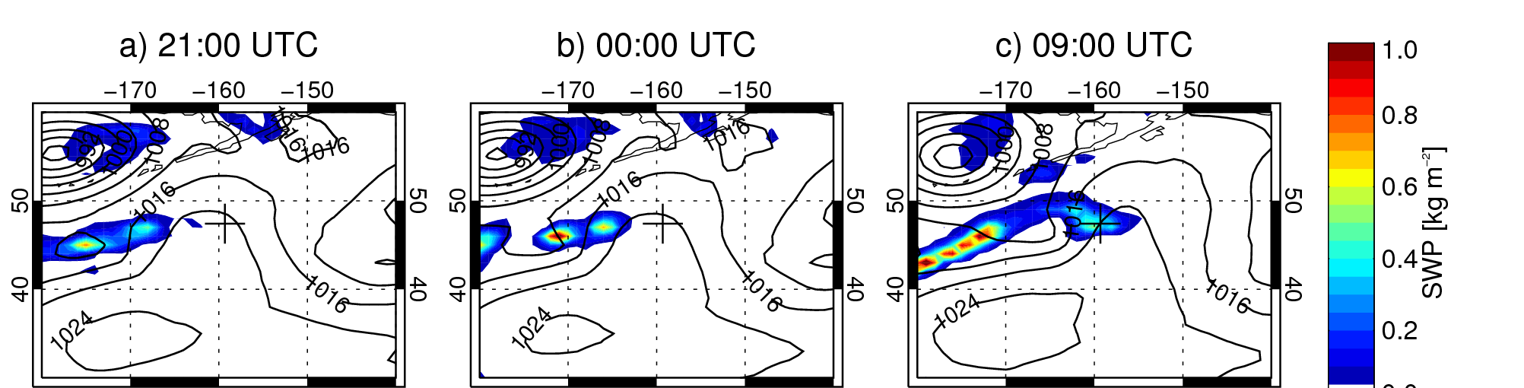
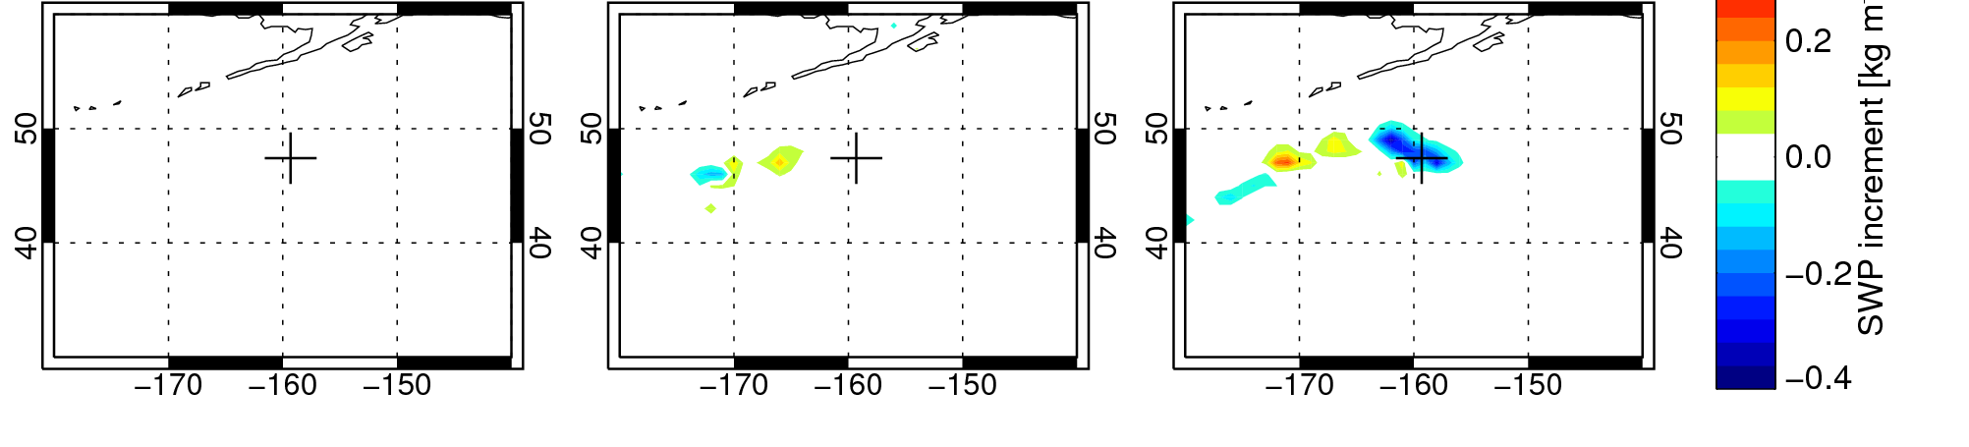
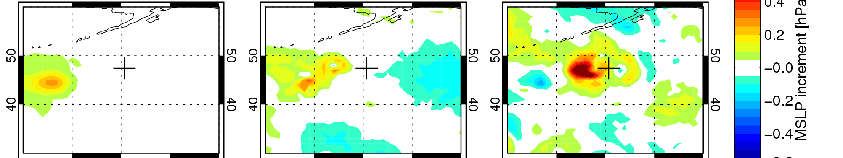
B) Frontal cloud and precipitation – 190 GHz
Time of
observation (08Z)
Start
Assimilation window
End
MSLP and
snow column (FG)
Snow
column
increment
Snow reduction at observation time generated by reduction in strength of low pressure area 1000km away, 11h earlier
MSLP
increment

Slide 42
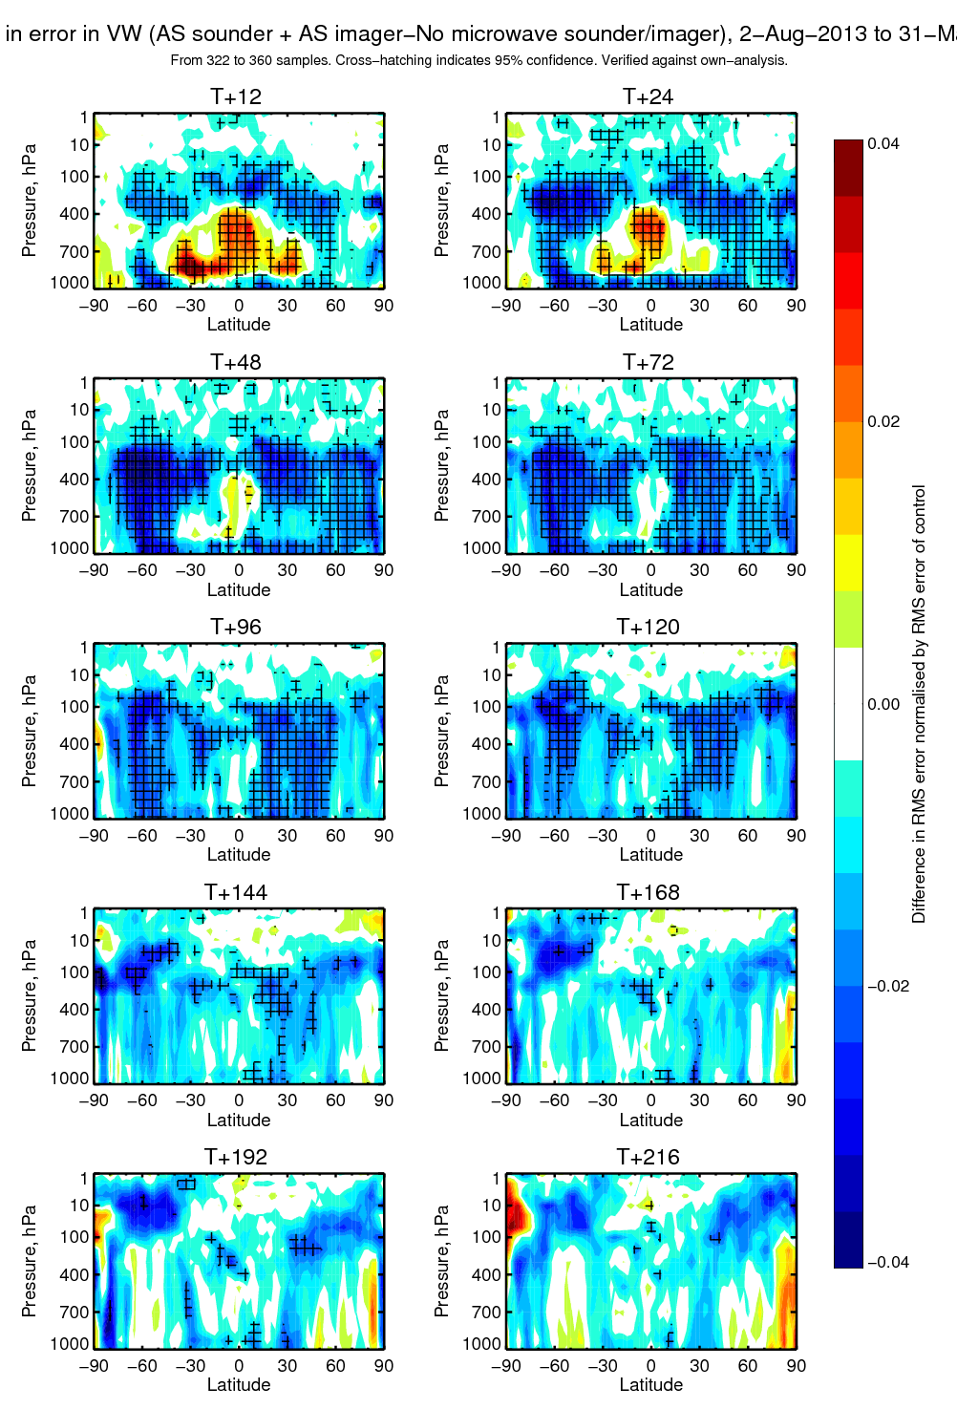
Impact of all-sky microwave humidity sounders and imagers -on top of the otherwise full observing system
Bad
2-3% impact on day 4 and 5 dynamical forecasts
Change in RMS error of vector wind Verified against own analysis
Blue = error reduction (good)
Based on 322 to 360 forecasts
Cross hatching indicates 95%
confidence
Good

Slide 43
How observations sensitive to cloud and precipitation benefit global NWP
Use more satellite observations, even if there’s no benefit from the cloud and precipitation information itself
  e.g. try to recover some of the 80% of data lost to cloud in lower-sounding IR channels
Directly improve dynamical initial conditions through the observation of cloud and precipitation
  e.g. infer the strength of a low pressure system from the intensity of its frontal precipitation: the “generalised 4D-var tracer effect”
Initialise cloud and precipitation itself
Help improve the forecast model – the indirect effect
  Benefits all forecast ranges, even when initial conditions are lost

