Slide 1
Microwave spectrum – measurement, modelling and information content
Alan Geer
Thanks to: Bill Bell, Peter Bauer

Slide 2
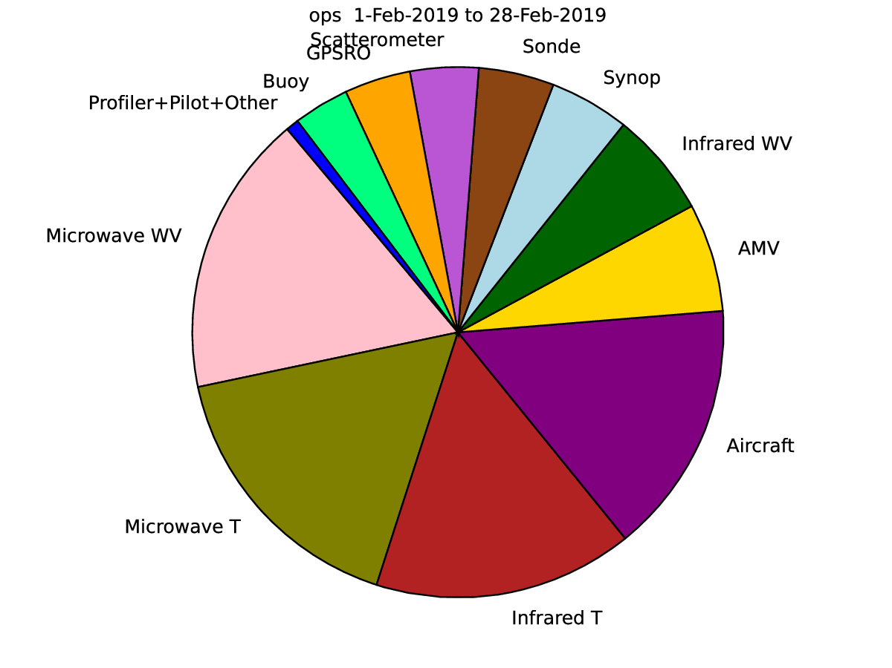
FSOI of observing systems, February 2019
100% = full operational observing system
Microwave instruments together account for 30% of short-range forecast impact, with “moist” assimilation (WV, cloud, precipitation channels) having slightly more impact than “dry” assimilation (T channels)

Slide 3
Two microwave talks:
1. Sensitivities, theory, and instrumentation
  The observations, their physical properties, their information content
  Further reading:
    Grant Petty: A first course in atmospheric radiation
    Thomas and Stamnes: Radiative transfer in the atmosphere and ocean
    Rodgers: Inverse methods in atmospheric sounding
2. Applications, all-sky data assimilation, cloud detection
  The inverse problem – getting useful information from the radiances
  Dealing with observations affected by cloud and precipitation
  Further reading:
    ECMWF tech memos, papers
    (Kalnay: Atmospheric modelling, DA and predictability)

Slide 4
Orientation

Slide 5
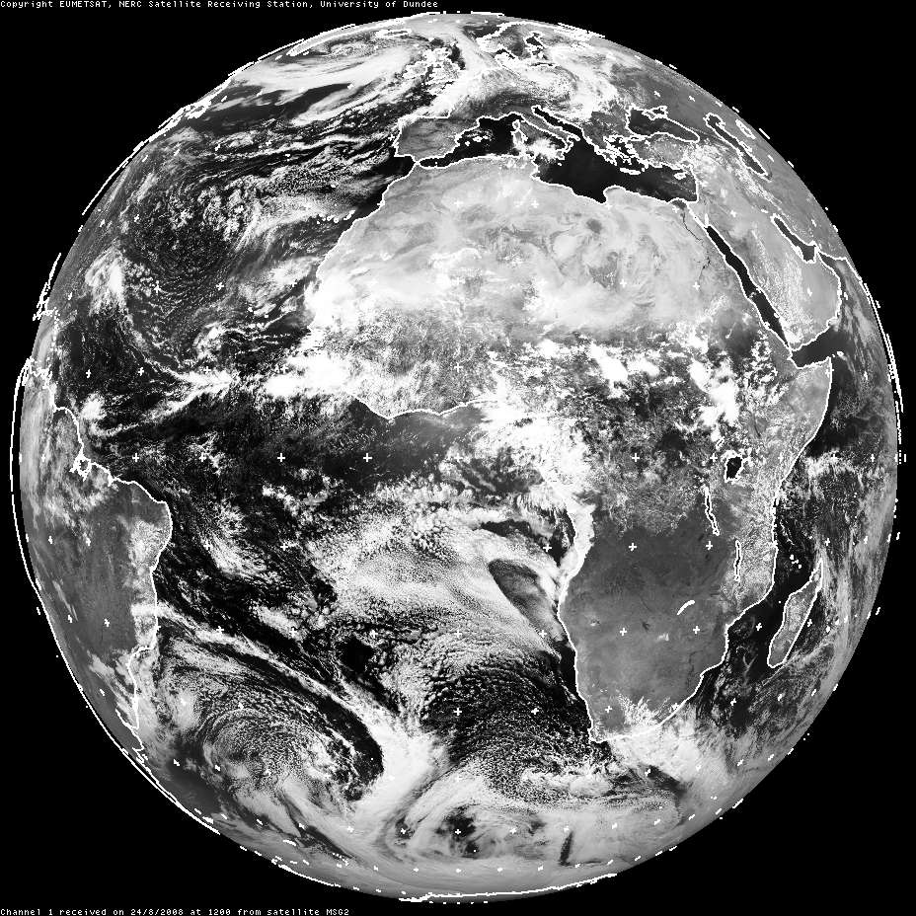
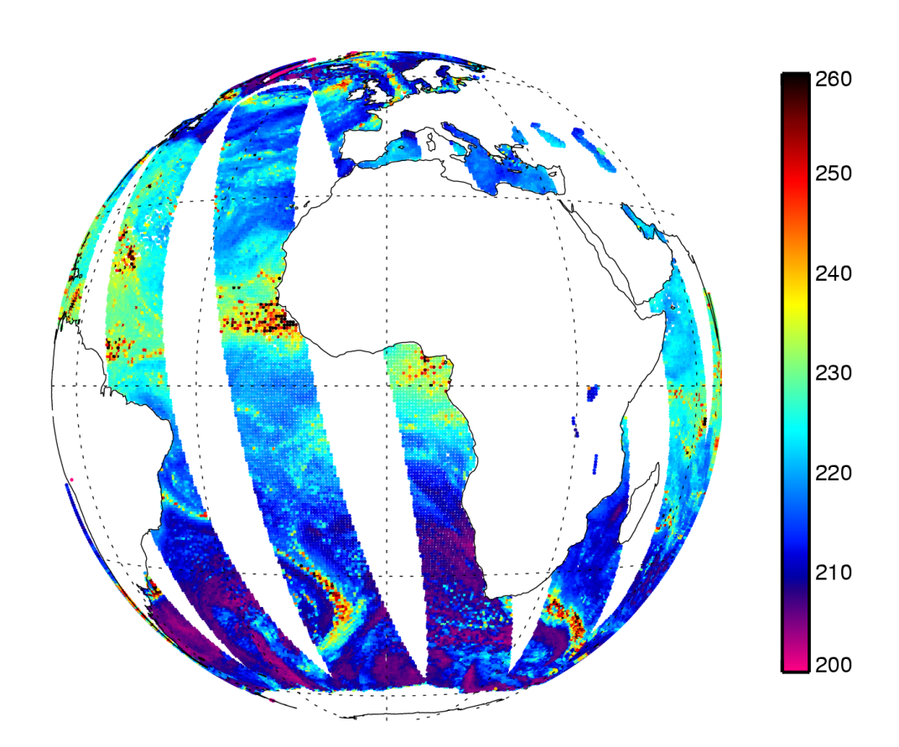
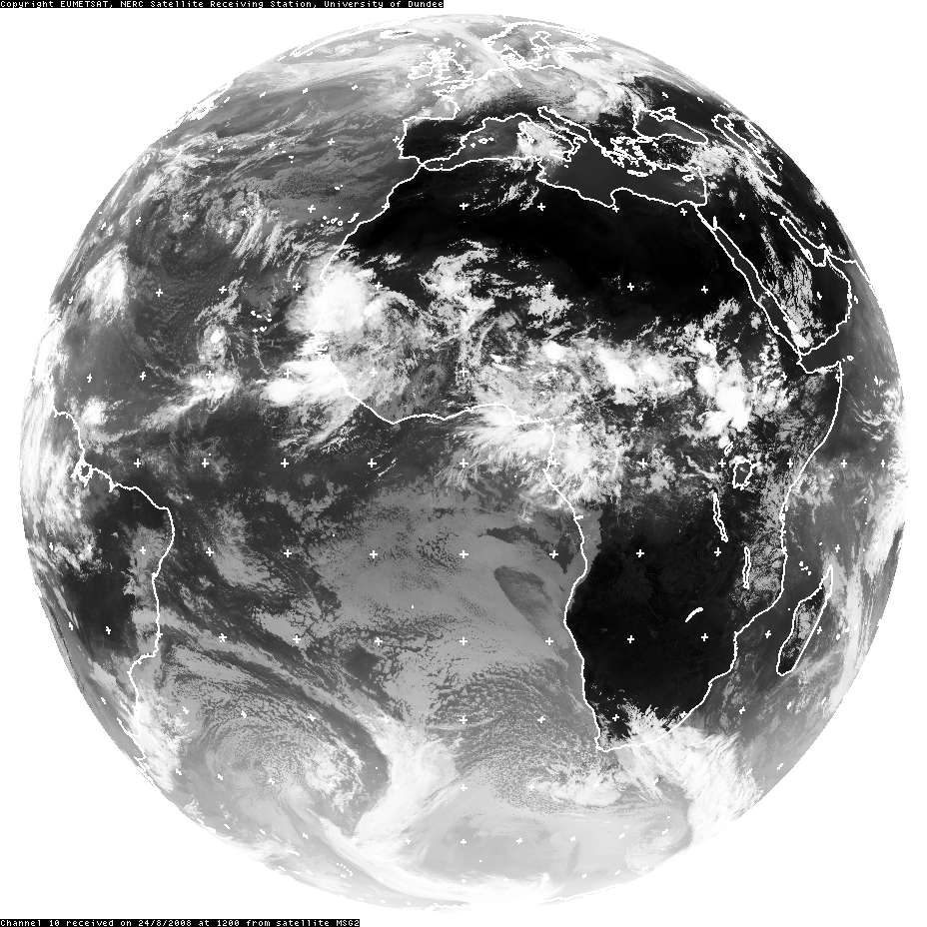
Visible
SEVIRI channel 1
0.56-0.71 μm
Microwave
AMSR-E channel 37v
8108 μm (37 GHz v-pol)
from Dundee Satellite Receiving Station, © Eumetsat
Infrared
SEVIRI channel 10
11-13 μm
TB [K]
Window channels
24th August 2008 at around 12UTC

Slide 6
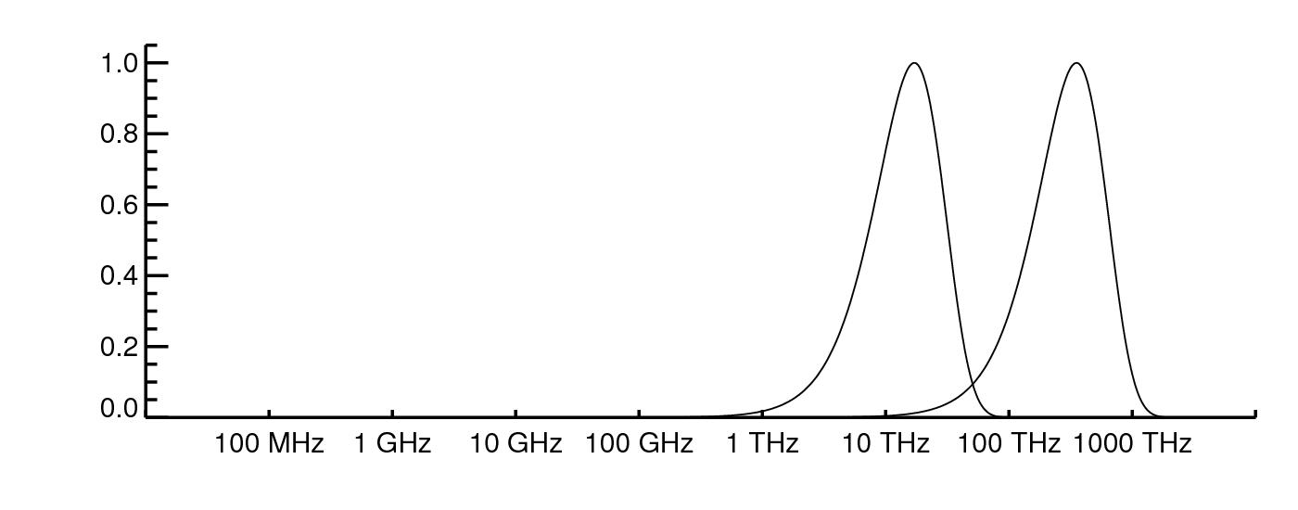
Where is the microwave?
Terrestrial
T = 290K
Solar
T = 6000K
Normalised radiance
Planck function
Frequency
10m
10cm
1mm
10μm
0.1μm
Wavelength
Radio
Infrared
Ultraviolet
Microwave
Visible

Slide 7
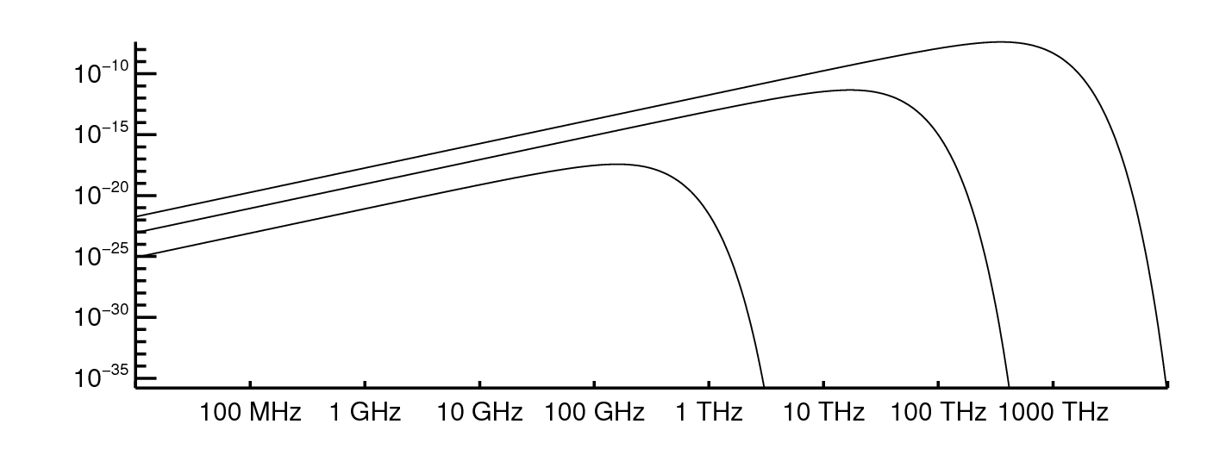
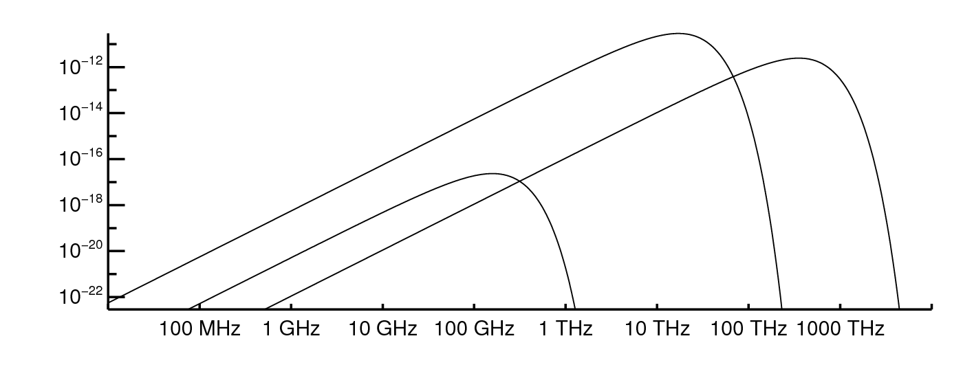
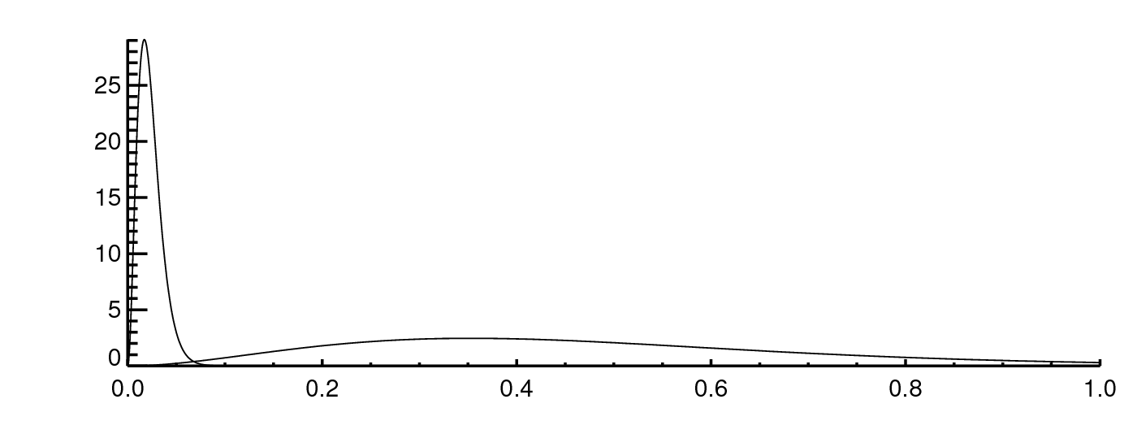
How much energy is there?
Solar
T = 6000K
Planck
Function
Radiance
W m⁻² sr⁻¹ Hz⁻¹
Terrestrial
T = 290K
Deep space
T = 2.7K
Flux
W m⁻² Hz⁻¹
Solar
radiance × 6×10⁻⁵ sr
Terrestrial
radiance × 6.28 sr
Deep space
radiance × 6.28 sr
Flux
10⁻¹² W m⁻² Hz⁻¹
Terrestrial
Solar
Frequency [10³ THz]

Slide 8
Atmospheric particles and microwave radiation
Size parameter
30 GHz frequency ↔ 10mm wavelength (λ)
Particle type | Size range, r | Size parameter, x | Scattering solution
Cloud droplets | 5 – 50 μm | 0.003 – 0.03 | Rayleigh
Drizzle | ~100 μm | 0.06 | Rayleigh
Rain drop | 0.1 – 3 mm | 0.06 – 1.8 | Mie
Ice crystals | 10 – 100 μm | 0.006 – 0.06 | Rayleigh, DDA
Snow | 1 – 10 mm | 0.6 – 6 | Mie, DDA
Hailstone | ~10 mm | 6 | Mie, DDA

Slide 9
Visible
SEVIRI channel 1
0.56-0.71 μm
Microwave
AMSR-E channel 37v
8108 μm (37 GHz v-pol)
from Dundee Satellite Receiving Station, © Eumetsat
Infrared
SEVIRI channel 10
11-13 μm
TB [K]
Window channels
24th August 2008 at around 12UTC

Slide 10
Sensitivities

Slide 11
Sensor and channel types
Sensor types (to be explained in later section):
  Swath-scanning
  Conical-scanning
Channel types
  Imaging: generally see the surface
    SST, column water and cloud
  Sounding: generally don’t see the surface
    Temperature sounding – Oxygen lines
    Humidity sounding – H₂O lines
  The above is best seen as a ‘historical’ view
    Most microwave channels are sensitive to multiple earth system components including cloud and precipitation

Slide 12
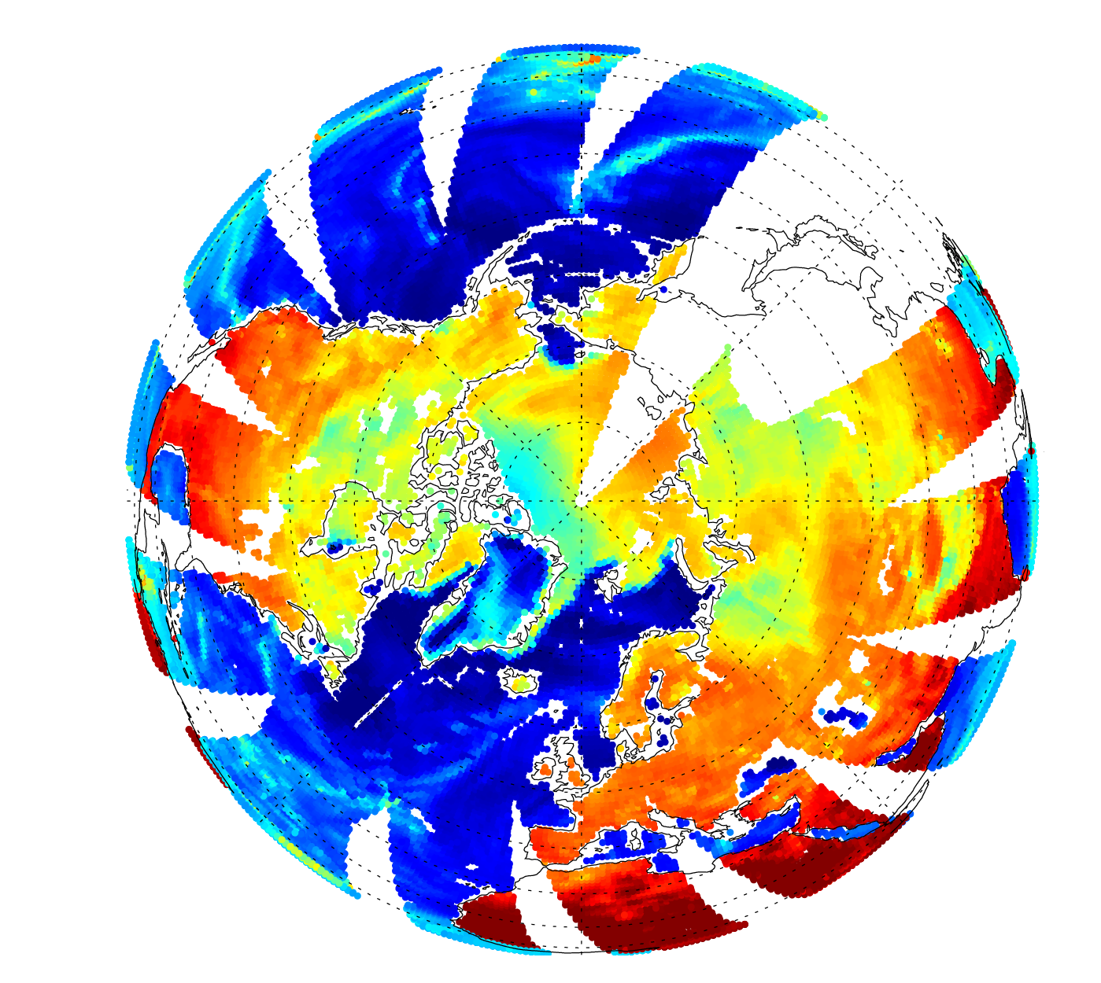
Sensitivities: window (“imager”) channels
Ocean waves, wind, skin temperature
SSMIS F-17 channel 13 (19 GHz, v)
Observed TB, 3rd December 2014
Atmospheric water vapour
High altitude
Cloud and precipitation
Snow cover
Deep fresh snow
Sea-ice
Land surface temperature, biomass, soil/rock, soil moisture

Slide 13

Brightness temperature (TB)
Radiance that would be produced by black-body radiation of a specified temperature T_{B} (Planck function)
Convert radiance (a non-intuitive quantity) into the “radiant temperature”
In the microwave, we can use Rayleigh-Jeans approximation:
$$B_{λ}(T_{B})=\frac{2c}{λ^{4}}k_{B}T_{B}$$
Radiance
Brightness temperature

Slide 14
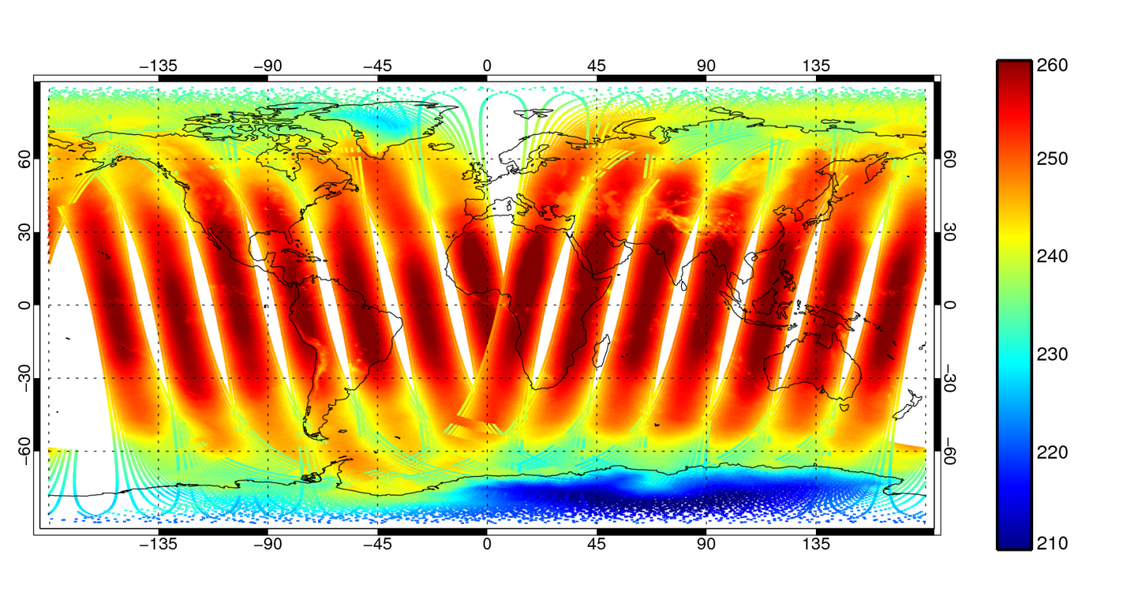
Sensitivities: temperature sounding channels
AMSU-A channel 5 radiances:
Metop-A satellite, 9pm 25/4 to 9am 26/4/2012
Cross-track scanner
Deep convection
Observed TB [K]
Temperature of approx. lowest 10km of atmosphere
Zenith angle dependence
Surface sensitivity

Slide 15
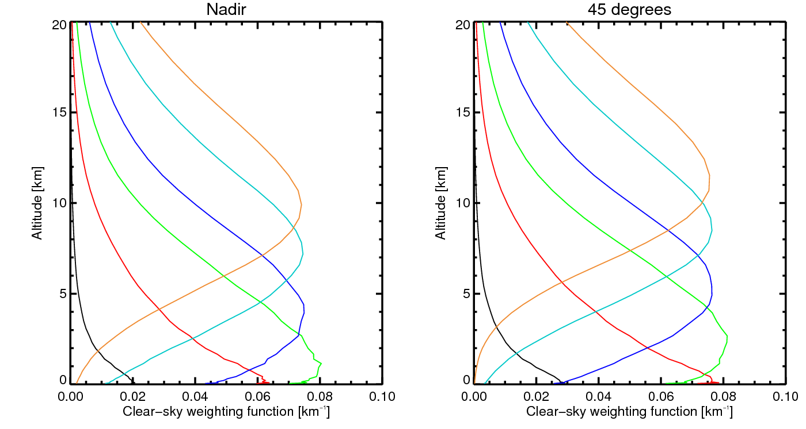
AMSU-A clear-sky nadir weighting functions these are approximately fixed, in an oxygen line (a well-mixed gas)
Channel
Transmittance surface to space
7 0%
6 0%
5 5%
4 19%
3 56%
2 92%

Slide 16
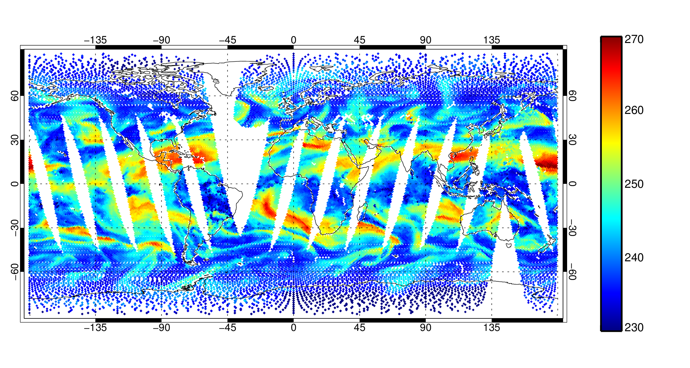
Sensitivities: humidity sounding channels
SSMIS F-17 channel 11 (183±1 GHz)
Conical scanning imager and sounder
Observed TB [K]
Deep convection
Relative humidity variations

Slide 17
Humidity-sounding weighting functions
(clear-sky)
High humidity: weighting function high in troposphere
TB = 230 K (found at approx. 400 hPa)
TB = 265 K (found at approx. 700 hPa)
Low humidity: weighting function lower in troposphere

Slide 18

Humidity-sounding weighting functions
(deep convection)
Deep space radiation: 2.7K
TB = 150 K (not anything like an atmospheric temperature)
Strongly scattering layer of large frozen particles
Scattering layer “reflects” upwelling radiation
TB = 265 K (found at approx. 700 hPa)
Humidity weighting function: thermal emission from lower in troposphere

Slide 19
Sensitivities: window (“imager”) channels
Ocean waves, wind, skin temperature
SSMIS F-17 channel 13 (19 GHz, v)
Observed TB, 3rd December 2014
Atmospheric water vapour
High altitude
Cloud and precipitation
Snow cover
Deep fresh snow
Sea-ice
Land surface temperature, biomass, soil/rock, soil moisture

Slide 20
Imaging channel (low frequency) radiative transfer (cloudy-sky)
TB = 2.7 K
TB = 240 K
Cloud (and often rain): acts like an emitting gas
T = 280 K
Water vapour: is an emitting gas
Ocean surface: radiatively cold (e.g. 90K, Fresnel)
Or land / snow / sea-ice surface (high emissivity, possibly some scattering)

Slide 21
Radiative transfer basics

Slide 22
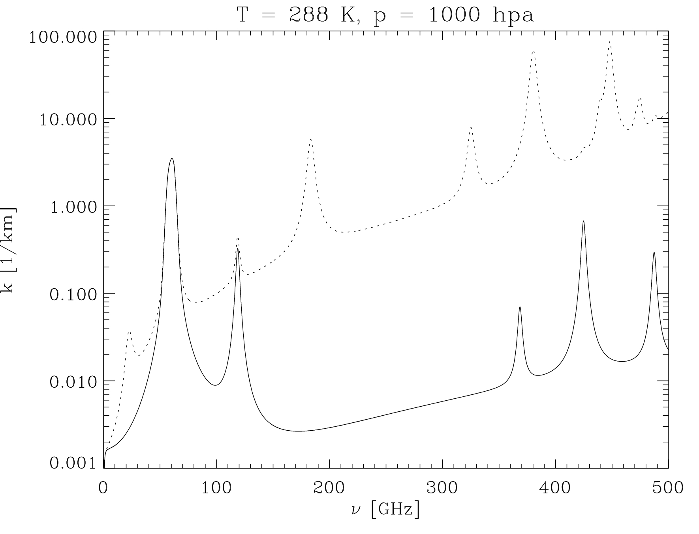
The microwave gaseous absorption spectrum
Absorption coefficient
β_{a} [1/km]
H₂O Rotation lines
+
Water vapour continuum
O₂ Rotation Lines
+
Dry air continuum
Moist
“Imaging channels” in the windows
Temperature sounding:
60 GHz oxygen line
Dry
Moisture sounding:
22 GHz and 183 GHz water vapour lines

Slide 23

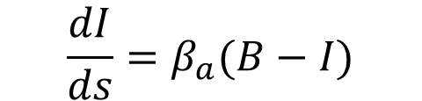



In gases / cloud : Schwarzchild’s equation
Planck function
Change in radiance per distance
Radiance
$$\frac{dI}{ds}=β_{a}(B−I)$$
Absorption coefficient
$$ds$$
Loss through absorption
$$I$$
$$I−{I β}_{a}ds$$
$${+Bβ}_{a}ds$$
Gain through thermal emission

Slide 24






Adding scattering
Extinction coefficient
$$β_{e}=β_{a}+β_{s}$$
Scattering coefficient
$$ds$$
Loss through extinction
$$I$$
$$I−{I β}_{e}ds$$
Gain from scattering into the beam
$${+? }_{}$$
$${+Bβ}_{a}ds$$
Gain through thermal emission

Slide 25

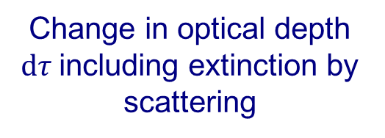
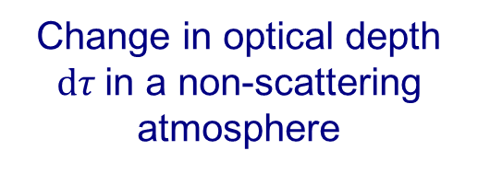

Optical depth
Change in optical depth $dτ$in a non-scattering atmosphere
$$dτ=−β_{a}ds$$
Change in optical depth $dτ$including extinction by scattering
$$dτ=−{(β}_{a}+β_{s})ds=−β_{e}ds$$

Slide 26

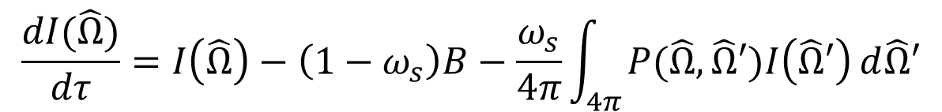


The full scattering radiative transfer equation
Direction vector
Integral over all solid angle
$$\frac{dI(\hat{Ω})}{dτ}=I\left(\hat{Ω}\right)−\left(1−ω_{s}\right)B−\frac{ω_{s}}{4π}\int_{4π}{P(\hat{Ω},\hat{Ω}′)I\left(\hat{Ω}′\right)}d\hat{Ω}′$$
Single scattering albedo
Scattering phase function
Change in optical depth
$$ω_{s}=\frac{β_{s}}{{(β}_{a}+β_{s})}$$
This can be complex to solve:
  , the radiance in one direction, depends on radiance from all other directions:
  and all levels depend on each other
$$I\left(\hat{Ω}\right)$$
$$I\left(\hat{Ω}′\right)$$

Slide 27



Simulating scattering from particles: just need to know
$$P(\hat{Ω},\hat{Ω}′)$$
Scattering phase function
$$β_{e}$$
Extinction coefficient
$$ω_{s}$$
More on Wednesday…
Single scattering albedo

Slide 28
Radiation and the earth’s surface
Specular reflection
Direct reflection
Emission
Emissivity

Slide 29
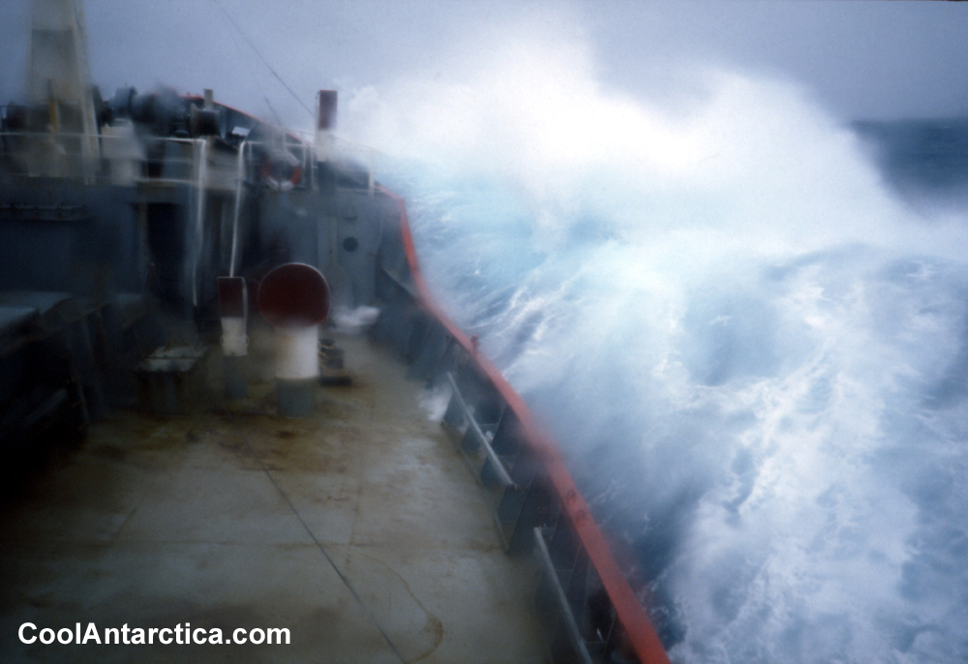
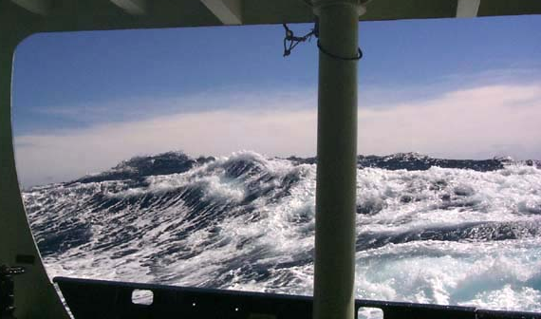
Emissivity physics: oceans
Plane water surface: low emissivity - Fresnel equations
Macro structure: waves, swell – geometric optics
Micro structure, e.g. cm: diffraction from capillary waves
Foam: much higher emissivity than water
Correction for non-specular reflection
NOAA Ocean Explorer

Slide 30
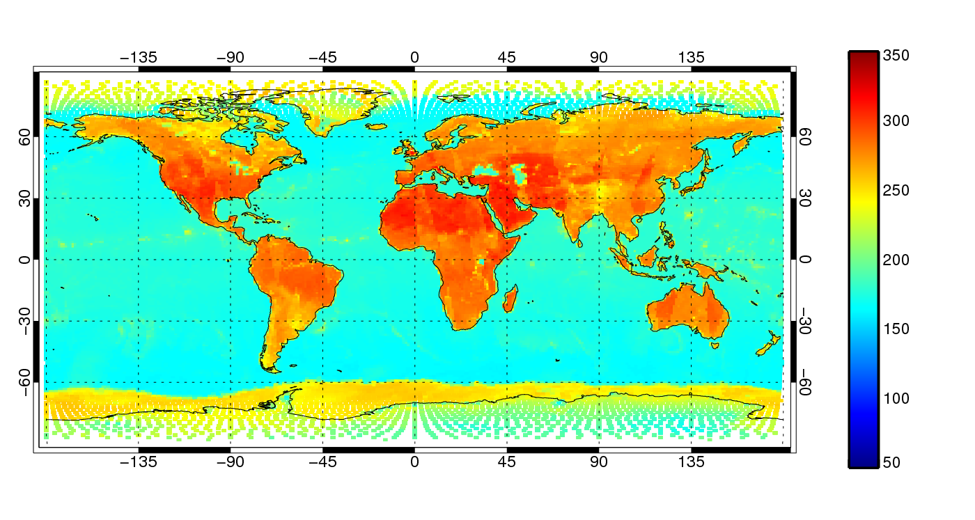
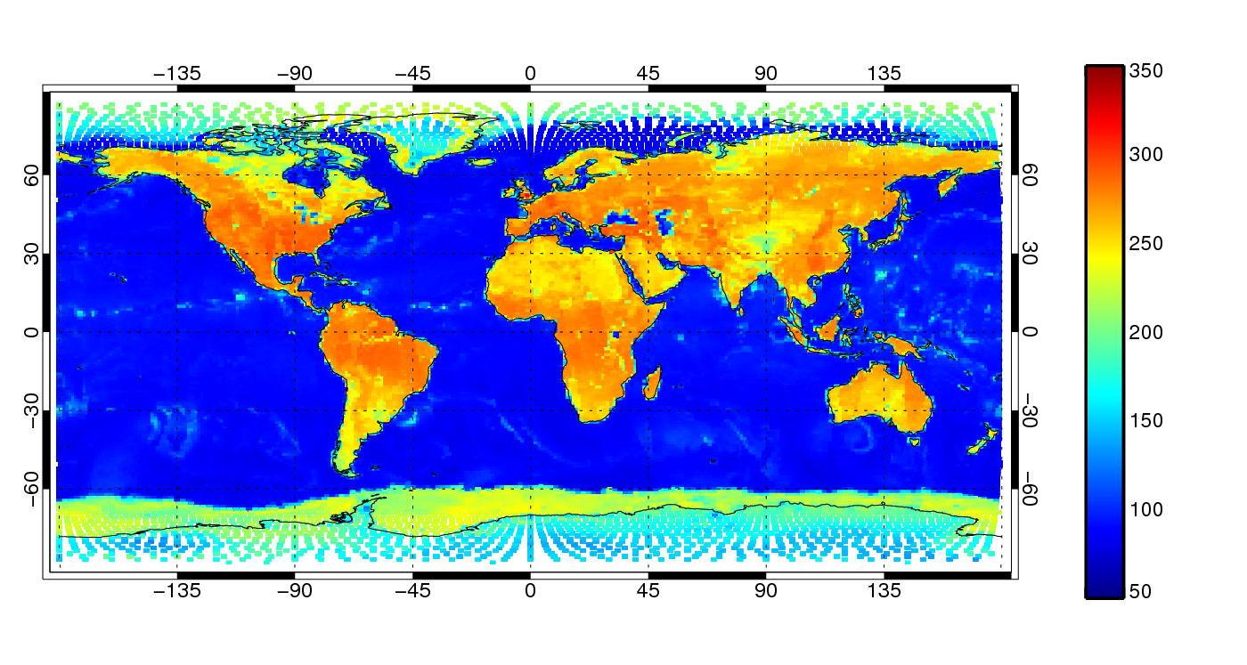
Ocean surface emission is polarised
TB [K]
10 GHz v-pol
Ocean TB:
~150 K v-pol
~90 K h-pol
TB [K]
10 GHz h-pol

Slide 31
Sensors

Slide 32
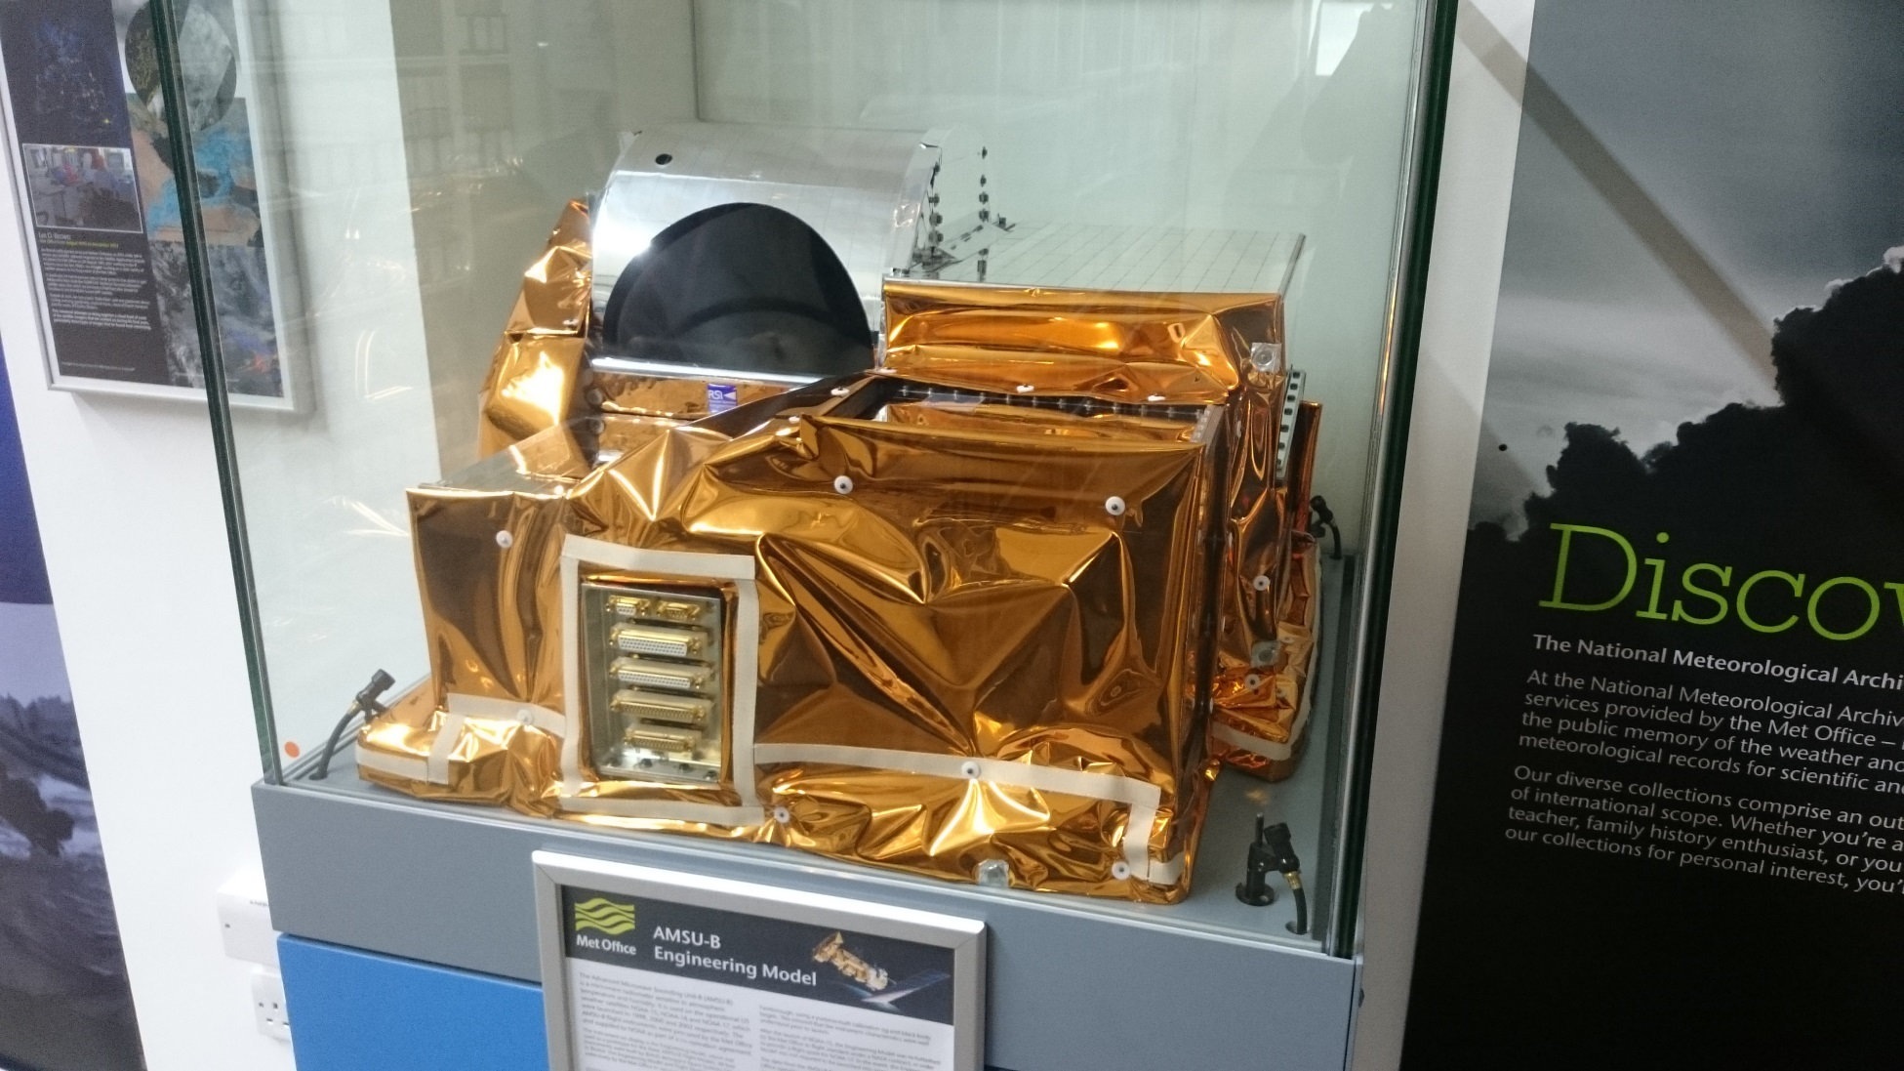
The AMSU-B in the Met Office library

Slide 33
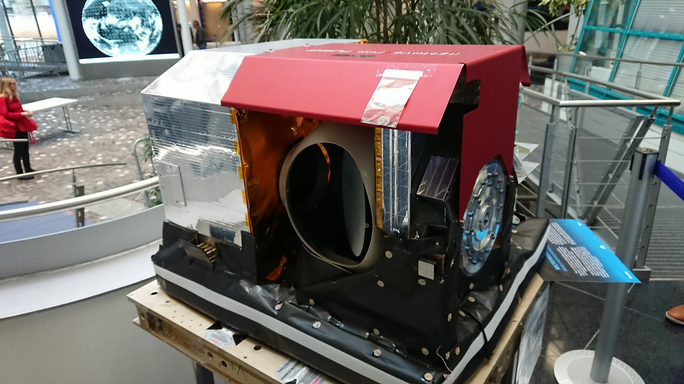
The MHS at EUMETSAT

Slide 34
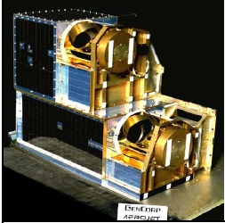
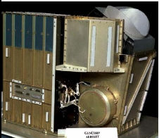
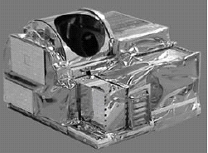
AMSU: cross track microwave sounder
Aperture: D< 30cm
Purpose: temperature and moisture sounding
AMSU A1
AMSU A2
AMSU B
Channels 1&2
(23.8 GHz, 31.4 GHz)
Channels 15-20
(89, 150, 3 × 183GHz)
Channels 3-15
(50-57 GHz, 89 GHz)

Slide 35
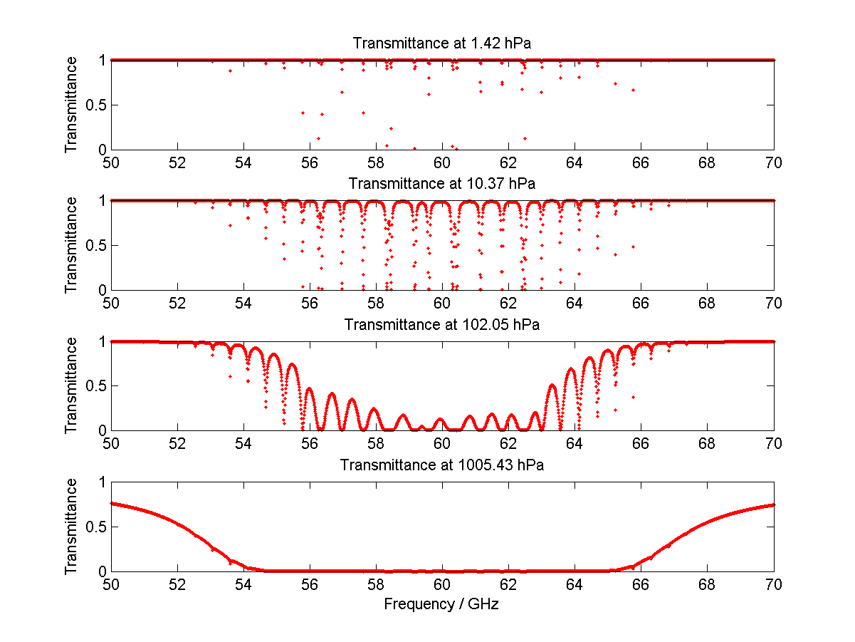
Fine-scale structure in the 60 GHz oxygen line
Typical MW radiometer passband
at 54.4 GHz
Level to TOA transmittance
from Liebe MPM 92 model
Narrow lines ~ several MHz
Increasing pressure
broadening

Slide 36
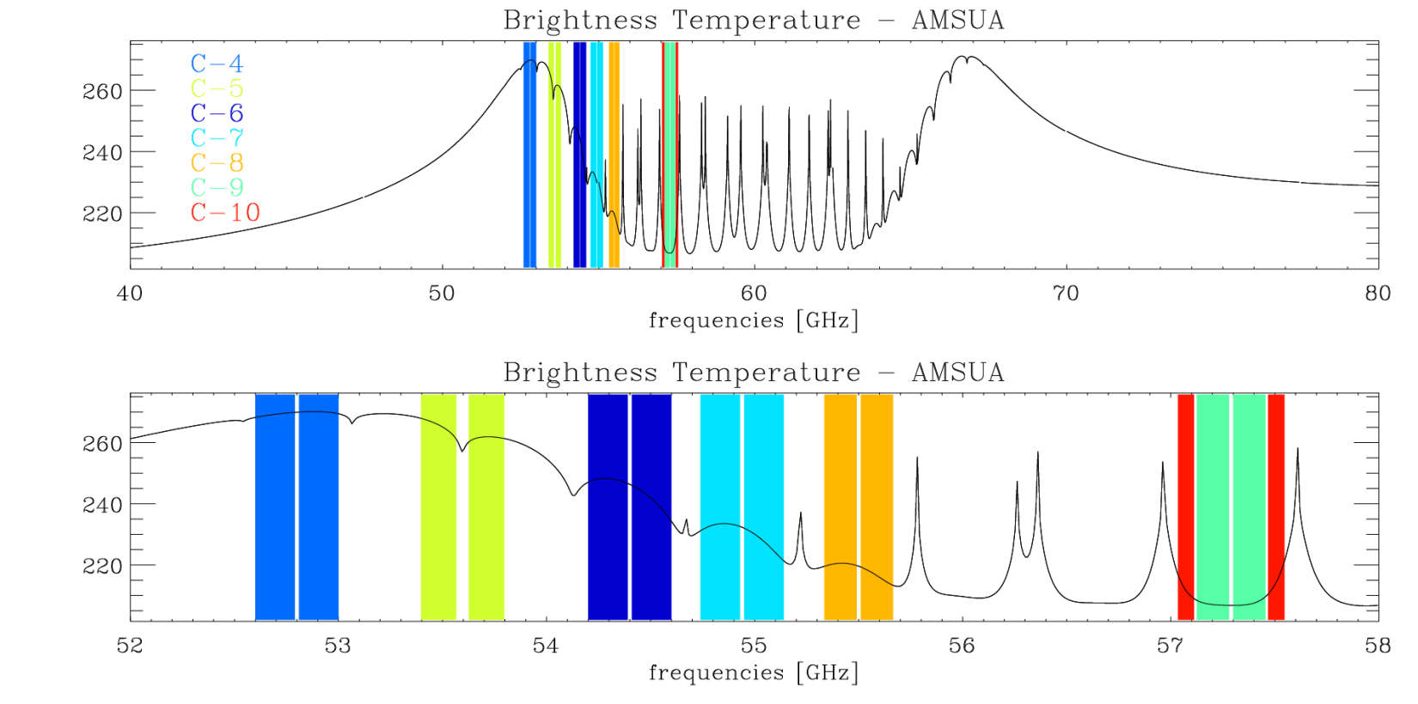
AMSU-A 50-60 GHz temperature channels
Channel positions and bandwidths are based on trade-offs aimed at simultaneously optimising :
  width of the band (wider bands give lower noise)
  flatness of optical depth across the band (narrow weighting functions)

Slide 37
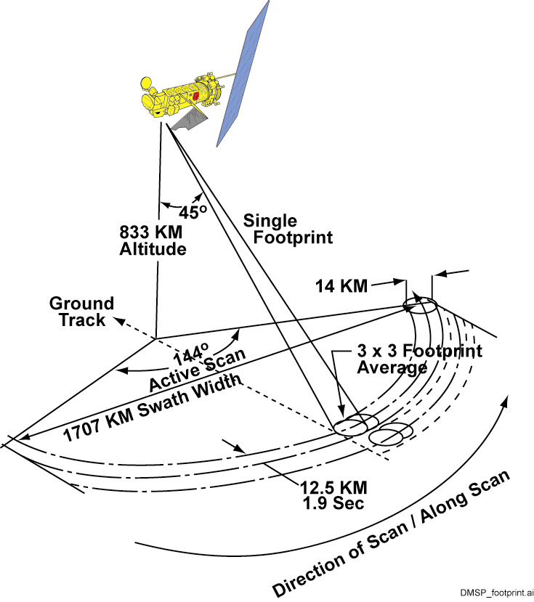
SSMIS – A conical microwave sounder / imager
60 cm

Slide 38
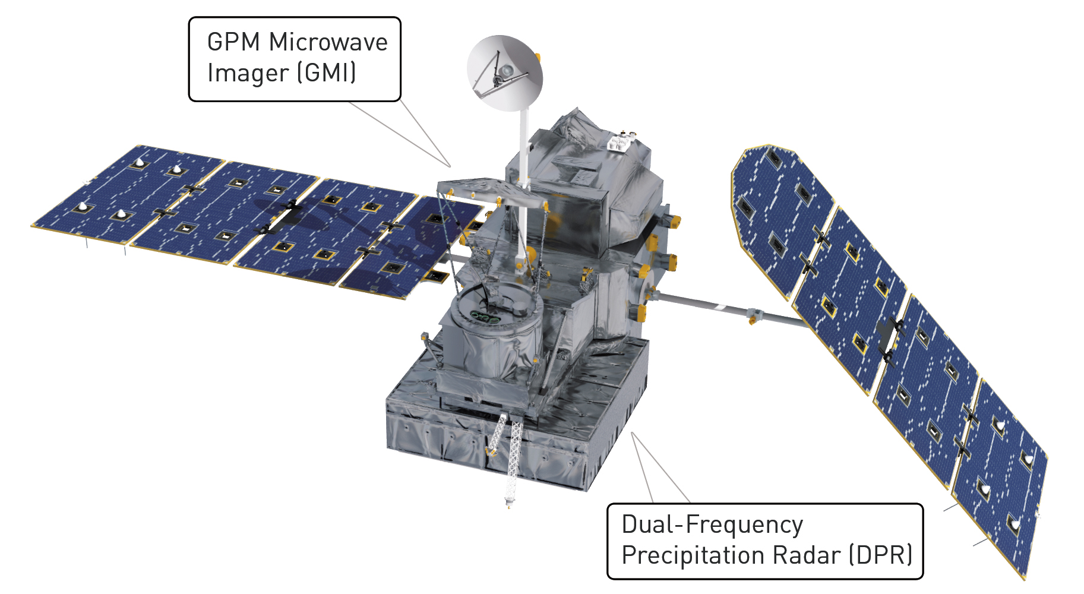
GMI: imager, targeting preciptiation
Global precipitation mission:
Launched Feb 2014
Precipitation radar at 13 GHz and 36 GHz
NOAA
NASA / JAXA

Slide 39
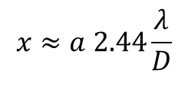
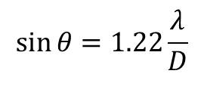
Field of view size and aperture approximate calculations in a diffraction-limited system
Airy disk size:
Aperture size
D
$$\sin{θ}=1.22\frac{λ}{D}$$
Wavelength
$$x≈a 2.44\frac{λ}{D}$$
θ
T-sounder: 50 GHz: λ ≈ 0.006 m
(like AMSU-A) satellite altitude 800 km
aperture 0.3 m
FOV ≈ 40 km
Imager: 20 GHz: λ ≈ 0.016 m
(like GMI) satellite altitude 400 km
45° view angle: a=600 km
aperture 1.2 m
FOV ≈ 20 km
a
Satellite to earth distance
FOV size
x

Slide 40
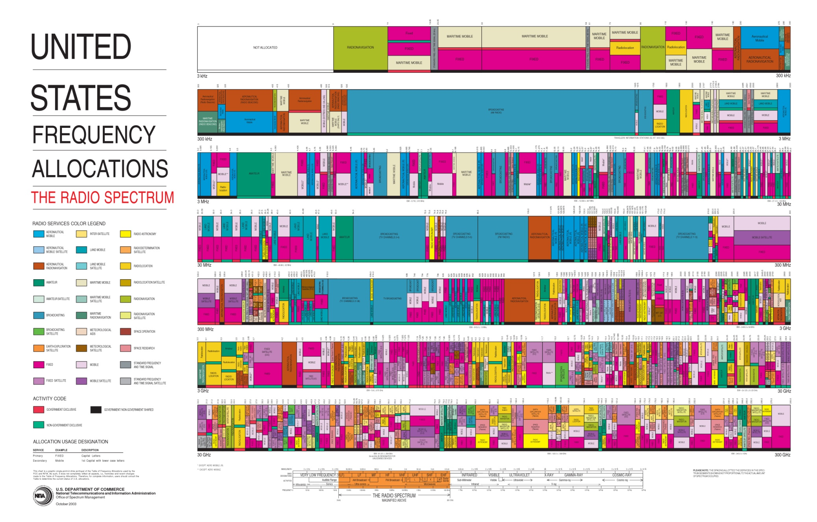
Frequency allocation and protection
3 KHz
Earth observation
Sky Sports
30 GHz
300 GHz

Slide 41
What is satellite radiance data assimilation?

Slide 42
An inverse problem: turn this into initial conditions of wind, temperature, humidity, cloud...
SSMIS F-17 channel 13 (19 GHz, v)
Observed TB, 3rd December 2014

Slide 43
Satellite radiance data assimilation
Technical
Observations
Earth system modelling
Verification
Satellites
New missions
ODB
Sensors
Debugging
Coding
Detective work
Cubesats
Space agencies
Atmosphere
Land surface
Supercomputing
Orbital mechanics
Passive
Active
Cal/val
Physics
Ocean,wave & sea-ice
Scores
Microwave
Infrared
Solar
Dynamics
Obs fits (O-B)
Forecast sens. (FSOI)
Conical
Swath
Frequency protection
Electromagnetic modelling
Data assimilation
Statistical significance
Background errors
Full EM modelling
Radiative transfer
Geometric optics
Fast models
Algorithms
Ensemble
Variational
Bias correction
Snowpack / sea-ice
Discrete dipole
Non-scattering
Ocean surface
Lookup tables
EDA
4D-Var
Quality control
Scattering
Principal components
Observation errors
Mie theory
VarBC
Particle interactions
Scalar or vector (full Stokes)
Surface interactions
Modelling error
BgQC
Solvers
Representation error
2-stream
DISORT
Absorption/ emission
Water permittivity
Instrument noise
VarQC
Monte-Carlo 3D
Particle modelling
Correlations
Thin
Spectroscopy

