Slide 1

GPS radio occultation (GPS-RO): Lecture 1 – Principles and NWP use
ECMWF/EUMETSAT Satellite training course, March 19, 2019
Chris Burrows (majority of material prepared by Sean Healy)
chris.burrows@ecmwf.int
sean.healy@ecmwf.int
http://www.romsaf.org

Slide 2
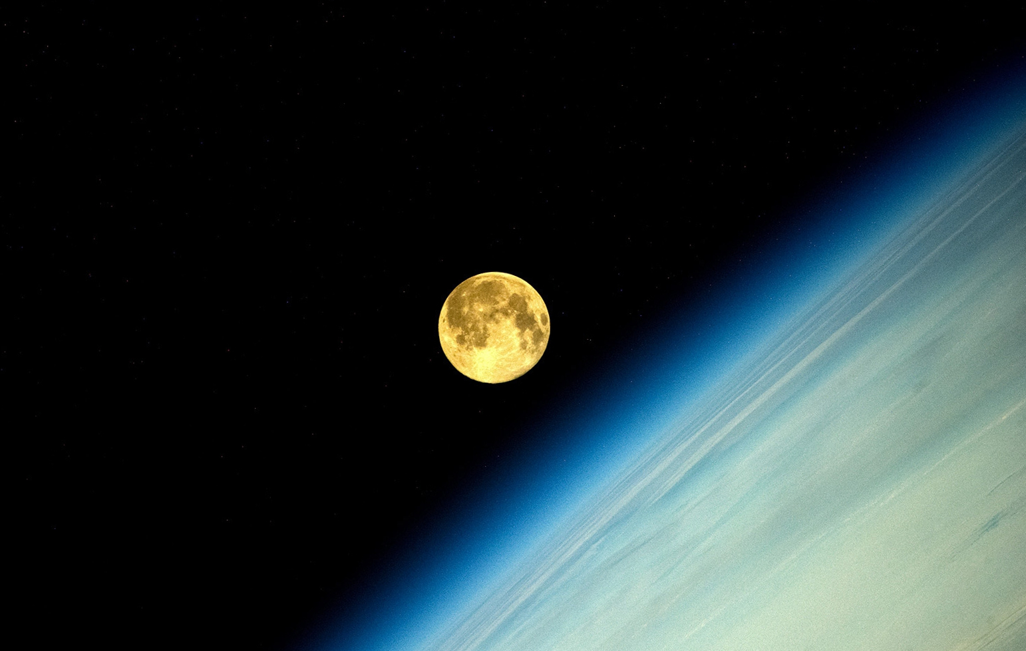
Photos by Cosmonaut Oleg Artemyev. Taken from the International Space Station in 2014.

Slide 3
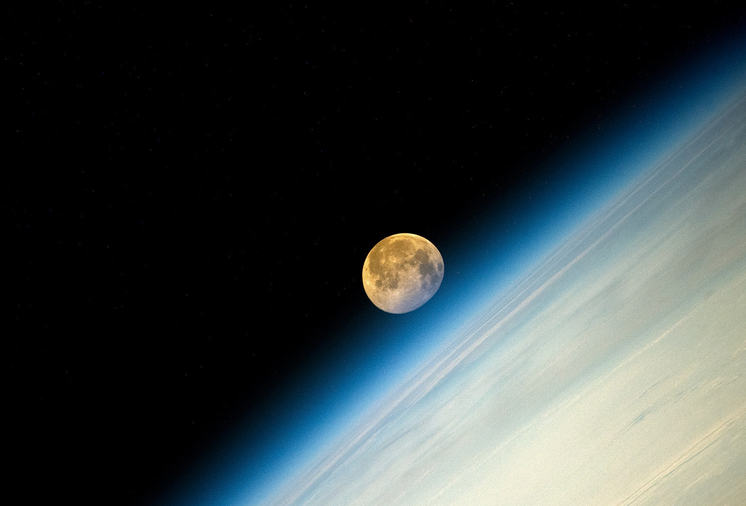

Slide 4
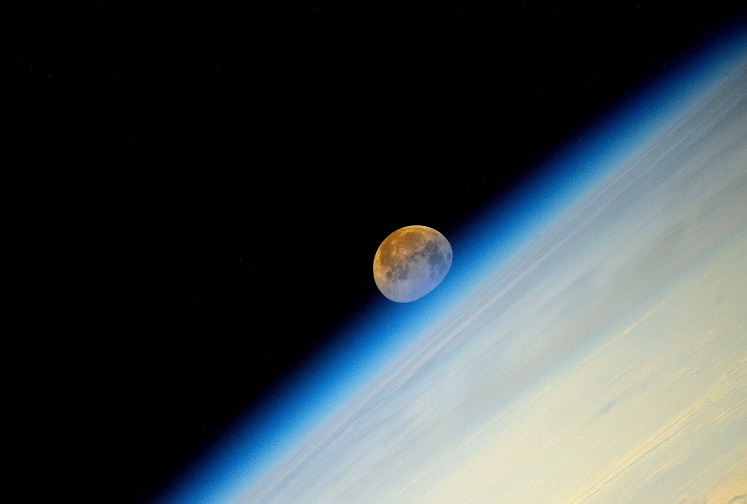

Slide 5
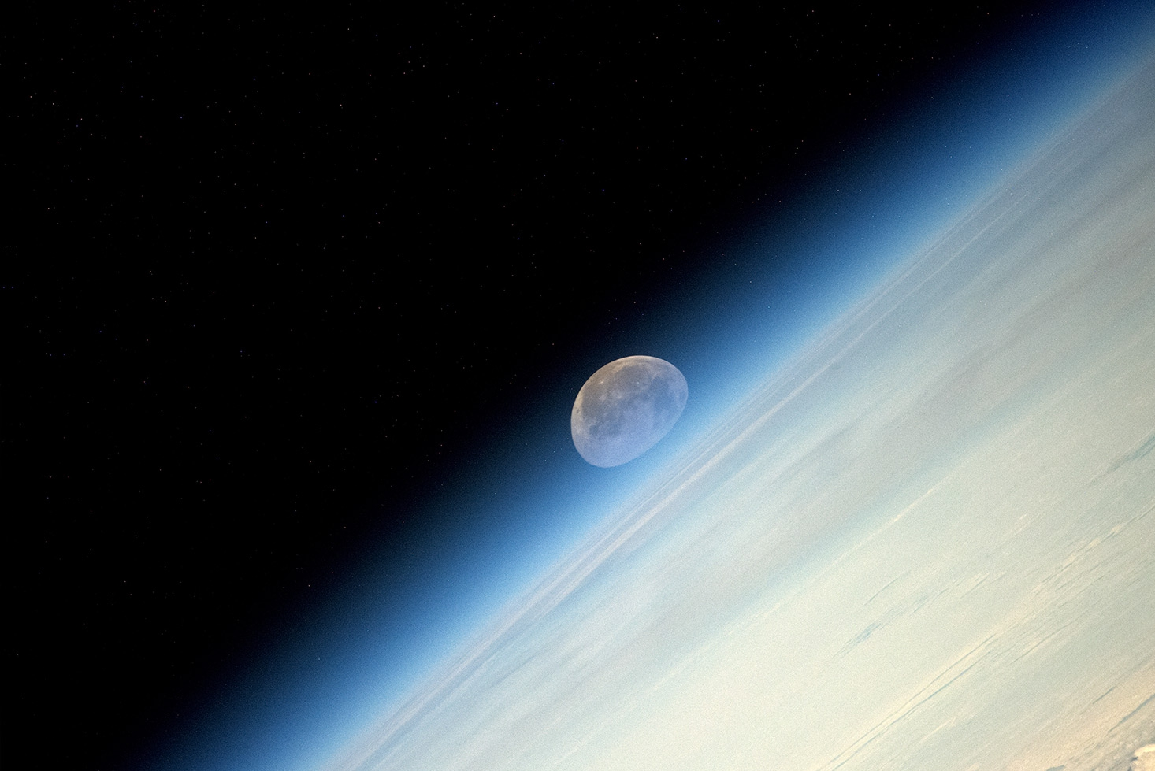

Slide 6


Slide 8
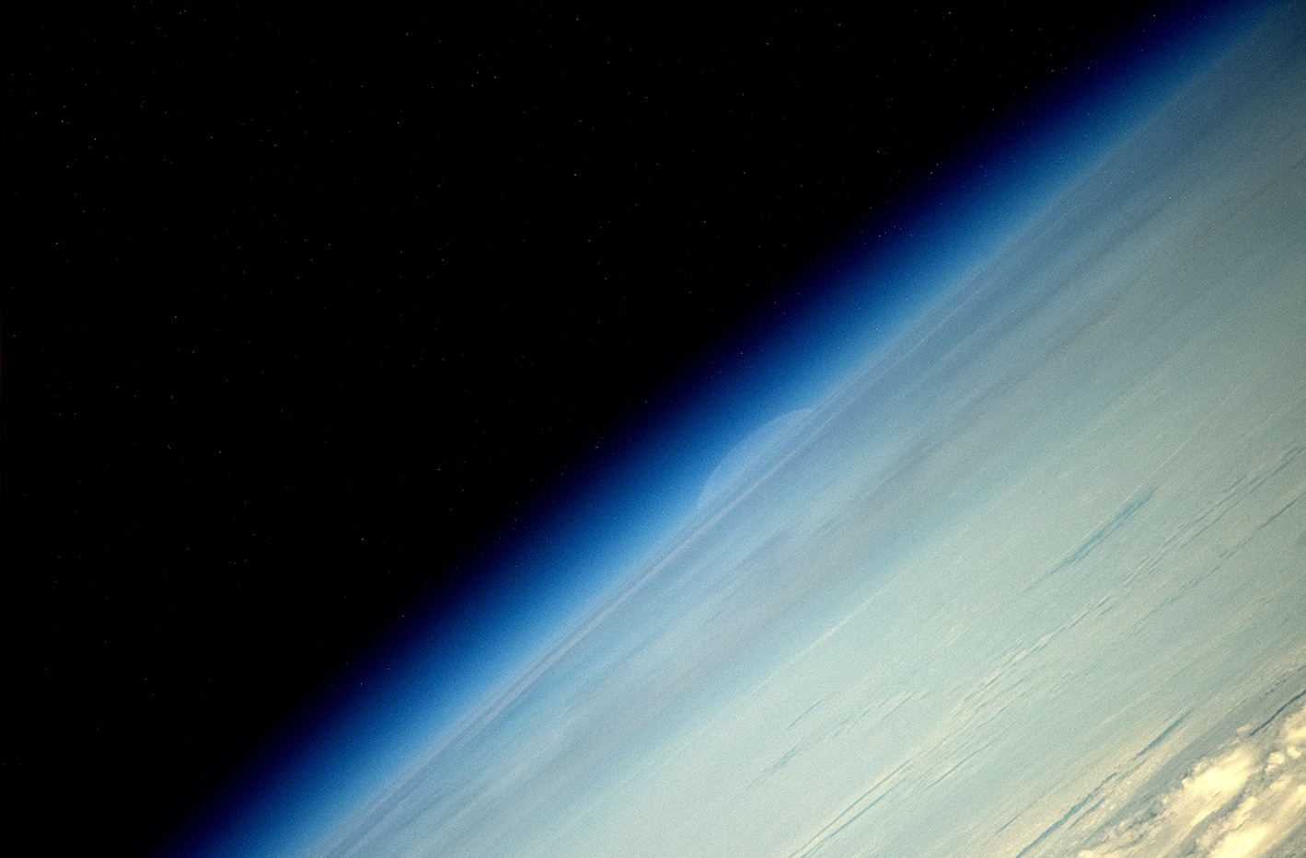

Slide 10
Outline
GPS-RO Principles
  GPS (should really be “GNSS”) measurement geometry.
  Basic physics, some history …
  GPS radio occultation and “Classical” GPS-RO retrieval development.
  Some limitations.
Assimilation of GPS-RO data
  Information content and resolution estimates from 1D-Var.
  4D-Var assimilation of GPS-RO measurements (GPS-RO null space).
  Move to more complicated 2D operators.
Summary and conclusions.
Lecture 2 will cover forecast impact, reanalysis applications, climate trends, diagnosis of boundary layer height, etc.

Slide 11
GPS-RO Principles

Slide 12
GPS-RO Principles

Slide 13
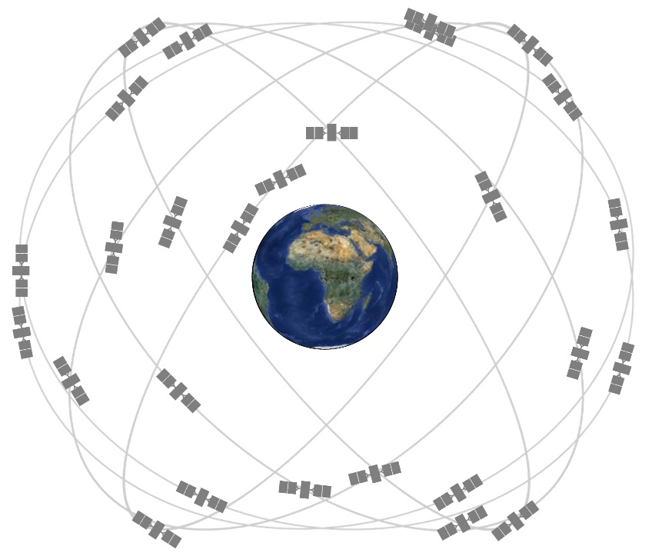
What are GNSS, GPS etc.?
Satellites in Medium Earth Orbit (~20,000km) emit radio signals.
For navigation purposes, the time taken to receive the signals from multiple satellites is used to calculate the position of the receiver.
GNSS (Global Navigation Satellite System) is a generic name for any system where satellite signals are used for navigation globally.
  GPS (Global Positioning System) is the original US system and by far the most widely used (e.g. satnavs). Only GPS is used for RO currently, though this will change soon.
  Galileo is a European GNSS system.
  GLONASS is the Russian system.
  BeiDou is the Chinese system (and includes geostationary satellites).

Slide 14
Atmospheric measurements made using GPS signals – three types
GPS Radio Occultation (profile information from the atmospheric limb)
GPS Receiver
placed on satellite in Low Earth Orbit (LEO)
GPS
LEO
Wind speed information from reflected signal (“GNSS-reflectometry”)
Ground-based GPS
(Column integrated water vapour)
GPS
LEO
GPS
GPS receiver
on the ground

Slide 15
The basic GPS-RO physics – Snel’s Law
(Not “Snell”, Peter Janssen)
Refractive index: Speed of an electromagnetic wave in a vacuum divided by the speed through a medium.
Snel’s Law of refraction – bending occurs when refractive index changes. In the atmosphere the refractive index varies continuously.

Slide 16
The basic GPS-RO physics – Snel’s Law
(Not “Snell”, Peter Janssen)
Refractive index: Speed of an electromagnetic wave in a vacuum divided by the speed through a medium.
Snel’s Law of refraction – bending occurs when refractive index changes. In the atmosphere the refractive index varies continuously.
In the atmosphere, the refractive index varies smoothly, though sharp gradients can occur.

Slide 17
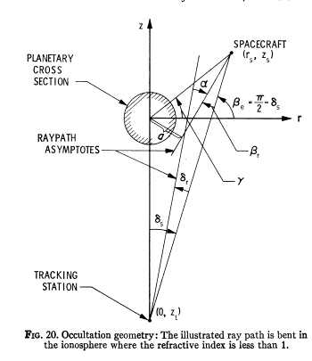
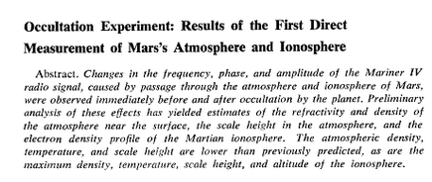
Radio Occultation: Some Background (1)
Radio occultation (RO) measurements have been used by to study planetary atmospheres (Mars, Venus) since the 1960s. It is an active technique. The paths of radio signals are bent by refractive index gradients in the atmosphere/ionosphere.
Fjeldbo et al 1970
Kliore et al Science, 1965, Vol. 149, No. 3689, pp. 1243-1248

Slide 18
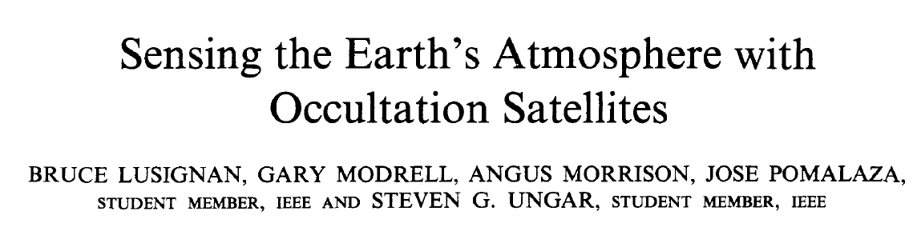
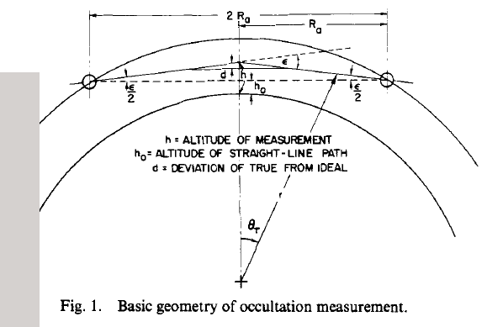
Radio Occultation: Some Background (2)
The use of RO measurements in the Earth’s atmosphere was originally proposed in 1969 (Proceedings of the IEEE, vol. 57, no. 4, pp. 458-467, 1969!)

Slide 19
Radio Occultation: Some Background (3)
The ideas outlined in 1969 seem to have got lost. Probably because the costs looked prohibitive.
… but then the GPS constellation was launched in the 1980s.
Use of GPS signals for RO discussed at the Jet Propulsion Laboratory (JPL) in late 1980s (e.g. Tom Yunck).
In 1996 the proof of concept atmospheric RO experiment, “GPS/MET”, – funded by the US NSF – demonstrated useful temperature information could be derived from the GPS-RO measurements. (There are plans to use this in reanalysis – tests show an improved fit to radiosonde temperatures).

Slide 20
GPS-RO: Basic idea
The GPS satellites are primarily a tool for positioning and navigation These satellites emit radio signals at L1= 1.57542 GHz and L2=1.2276GHz (~20 cm wavelength).
As it passes through a limb of the atmosphere, the GPS signal velocity is modified in the ionosphere and neutral atmosphere because the refractive index is not unity, and the path is bent because of gradients in the refractive index.
GPS-RO is based on analysing the bending caused by the neutral atmosphere along ray paths between a GPS satellite and a receiver placed on a low-earth-orbiting (LEO) satellite.

Slide 21
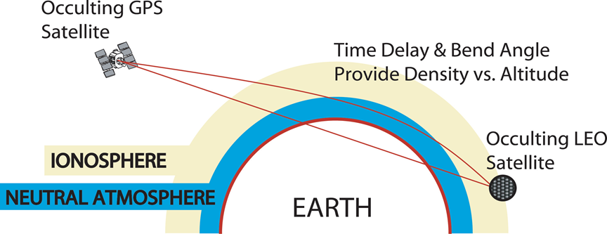
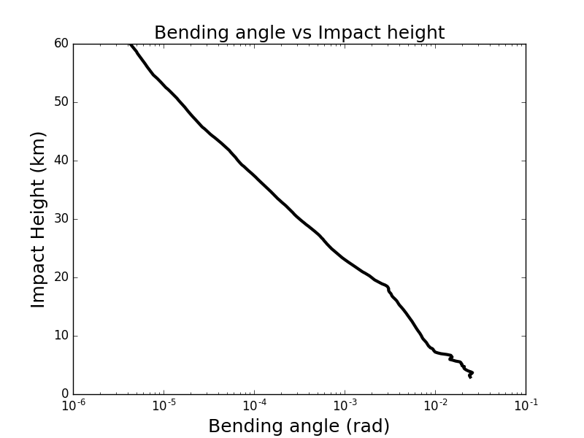
GPS-RO geometry. Bending angles
(Classical mechanics: e.g, Compare this picture with the deflection of a charged particle by a spherical potential!)
Remember the moon photos!
The LEO tracks the ray as the GPS satellite sets below the horizon.
Tangent point
20,200km
α
800km
α
Setting occultation: as the LEO moves behind the earth we obtain a profile of bending angles, α, as a function of impact parameter, a.
The impact parameter is the distance of closest approach for the straight line path. It is directly analogous to angular momentum of a particle.

Slide 22
GPS-RO characteristics
Good vertical resolution: 100m to 1km.
Around 70% of the bending occurs over a ~450km section of ray-path, centred on the tangent point (point closest to surface) – it has a broad horizontal weighting function, with a ~Gaussian shape to first order!
All weather capability: not affected by cloud or rain (unlike many radiances).
The bending is ~1-2 degree at the surface, falling exponentially with height. The scale-height of the decay is approximately the density scale-height (~6-7km).
A profile of bending angles from ~60km tangent height to the surface takes about 2 minutes. Tangent point drifts in the horizontal by ~200 km during the measurement.

Slide 23
RO processing and retrievals:
How to get temperature profiles using the “classical” retrieval.

Slide 24
How to get meaningful information?
Process:
Excess phase
Doppler shift
Bending angle (L1 and L2)
Ionospherically-corrected bending angle
Assumptions are required at each step.
Refractivity / refractive index
Temperature

Slide 25
Ray Optics Processing of the GPS-RO Observations (1)
GPS receivers do not measure temperatures/ray bending directly!
The GPS receiver on the LEO satellite measures a time series of phase-delays φ(i-1), φ(i), φ(i+1),… at the two GPS frequencies:
L1 = 1.57542 GHz
L2 = 1.22760 GHz
The phase delays are “calibrated” to remove special and general relativistic effects and to remove the GPS and LEO clock errors – calibration is referenced to atomic clocks.
(“Differencing”, see Hajj et al. (2002), JASTP, 64, 451 – 469).
We know accurately where the satellites are. Calculate Excess phase delays: remove straight line path delay, Δφ(i).
A time series of Doppler shifts at L1 and L2 are calculated by differentiating the excess phase delays with respect to time.

Slide 26
Processing of the GPS-RO observations (2)
The ray bending that is caused by gradients in the atmosphere and ionosphere modify the L1 and L2 Doppler values, but deriving the bending angles, α, from the Doppler values is an ill-posed problem (an infinite set of bending angles could produce the same Doppler).
The problem is made well posed by assuming the impact parameter,
given by
has the same value at both the satellites.
Given accurate position and velocity estimates for the
satellites, and making the impact parameter assumption,
the bending angle, α, as a function of impact parameter a can be
derived simultaneously from the Doppler shift.
ψ
LEO
r

Slide 27
The ionospheric correction
Every ray passes through the ionosphere!
We have to isolate the atmospheric component of the bending angle. The ionosphere is dispersive, but the neutral atmosphere is not and so we can take a linear combination of the L1 and L2 bending angles to obtain the “corrected” bending angle. See Vorob’ev + Krasil’nikov, (1994), Phys. Atmos. Ocean, 29, 602-609.
Constant given in terms of the L1 and L2 frequencies.
“Corrected” bending
angles
How good is the correction? Does it introduce time varying biases that with solar cycle?
YES, the retrieved temperatures will be sensitive to this!

Slide 28
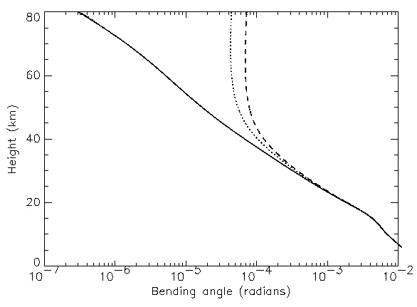
The ionospheric correction: a simulated example
L2
L1
High up, the ionosphere dominates the L1 and L2 signals, but they are affected differently to each other.
Low down, the atmospheric signal dominates and the lines overlap.
Assumed error above ~30 km
Log scale
The “correction” is very big!

Slide 29
Deriving the refractive index profiles
Assuming local spherical symmetry, we can use an Abel transform to retrieve a refractive index profile
Note the upper-limit
of the integral! A priori information
needed to extrapolate to infinity.
The inverse Abel transform can be used to obtain the bending angle profile for a given refractive index profile (i.e. the inversion).
Corrected Bending angle
as a function of impact
parameter
Convenient variable (x=nr)
(refractive index * radius)

Slide 30
GPS-RO limitations – upper stratosphere
In order to derive refractivity the noisy, corrected bending angle profiles must be extrapolated to infinity – i.e., we have to introduce a-priori simulated bending angles.
This blending of the observed and simulated bending angles is called “statistical optimisation”. Consider the (matrix) equation:
We use this “blended” profile in the Abel transform to get refractivity!
It’s a linear combination of simulated bending angles from a climatology model (e.g., MSIS)
Model (e.g. MSIS)
“Corrected” BA
The gain matrix, K, determines the relative contribution of the model. By ~60 km the merged profile is dominated by the model contribution.

Slide 31
Determining profiles of density (dry atmosphere only)
The refractive index (or refractivity) is related to the pressure, temperature and vapour pressure using two experimentally determined constants (from the 1950’s and 1960’s!)
N= refractivity
n= refractive index
c1,c2 refractivity constants
P= pressure
T= Temperature
Pw= partial pressure of water vapour
ρ= density
R= gas constant
This two term expression is probably the simplest
formulation for refractivity, but
it is widely used in GPS-RO.
We now use an alternative
three term formulation, including non-ideal gas effects
If the water vapour is negligible, the 2nd term = 0, and the refractivity is proportional to the density
So we have retrieved a
vertical profile of density!

Slide 32
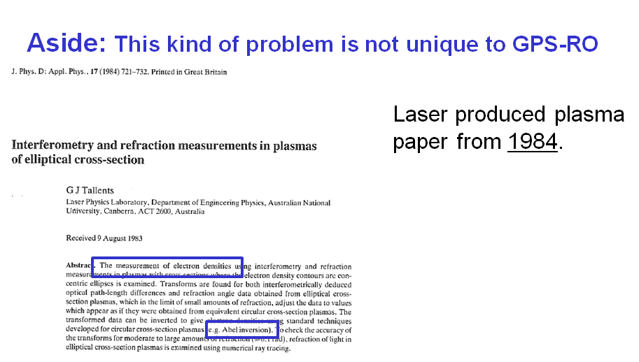
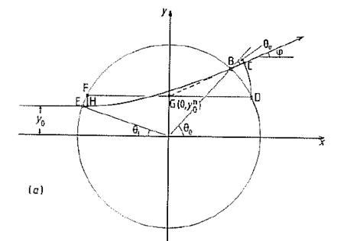

Slide 33
Profiles of pressure (dry atmosphere only).
The refractivity profile is retrieved from the statistically optimised bending angles.
But we also need to estimate the temperature on a pressure level to integrate the hydrostatic equation
Overall, I would be sceptical about GPS-RO temperature retrievals above ~5 hPa. Be aware that the temperature will be very sensitive to the a priori.

Slide 34
“Dry temperature” retrieval
We can derive the pressure by integrating the hydrostatic equation:
a priori
The temperature profile can then be derived with the ideal gas law:
High up, the a priori strongly affects the retrieval. Low down, any water vapour will affect the accuracy.
GPS/MET experiment (1996): Groups from JPL and UCAR demonstrated that the retrievals agreed with co-located analyses and radiosondes to within 1K between ~5-25km.
e.g., See Rocken et al, 1997, JGR, 102, D25, 29849-29866.

Slide 35
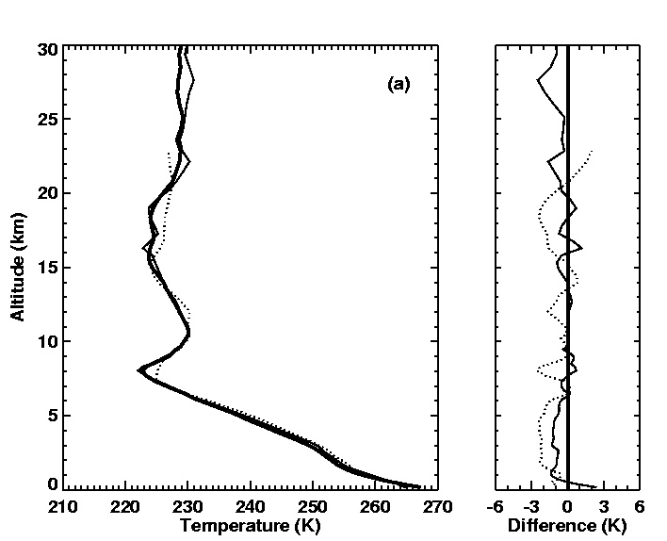
GPS/MET Temperature Sounding
(Kursinski et al, 1996, Science, 271, 1107-1110, Fig2a)
GPS/MET - thick solid.
Radiosonde – thin solid.
Dotted - ECMWF anal.
Results like this by JPL and UCAR in mid 1990’s got the subject moving.
(Location 69N, 83W.
01.33 UT, 5th May, 1995)

Slide 36
Some complexities:
Mostly lower-troposphere

Slide 37
Some subtleties, limitations, complications …
GPS-RO is useful data, BUT if you want to assimilate any new data, you have to think about the limitations of the technique in order to:
  choose a reasonable assimilation strategy (e.g., noting again that GPS-RO does not measure temperature directly).
  obtain a realistic error covariance matrix estimate, R.
Limitations: In GPS-RO we often talk about the core region - a vertical interval between ~8-35 km - where the GPS-RO information content is highest. The GPS-RO signal-to-noise falls outside this interval.

Slide 38
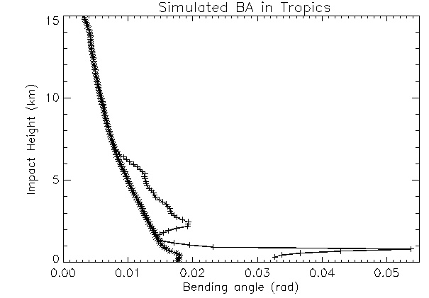
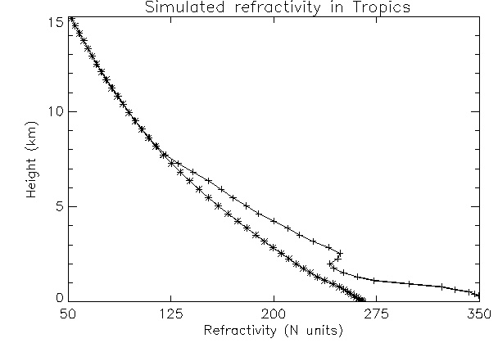
Outside the core-region
Troposphere: we can’t neglect water vapour
Difference between the
lines show the impact of
water vapour.
Simulated ignoring
water vapour.
We need a variational system to reliably retrieve water vapour information.

Slide 39
Physical limitations in the lower troposphere
Atmospheric defocusing: If the bending angle changes rapidly with height, the signal reaching the receiver has less power
A tube of rays is spread out
by the ray bending and the
signal to noise falls.
Atmospheric ducting: if the refractive index gradient exceeds
a critical value the signal is lost
Not affected by clouds? But we often
get ducting conditions near the top
of stratocumulus clouds

Slide 40
Maximum bending angle value
(related to defocusing)
Seems obvious but the receiver has to be measuring a long time to see the large bending angle values. We rarely see an observed bending above ~0.05 rads.

Slide 41
Limitations – lower troposphere
Atmospheric Multipath processing – more than one ray is measured by the receiver at a given time:
The amplitude of the signal can fluctuate rapidly.
Wave optics retrievals – these are elegant co-ordinate transforms. Without these, we would not be able to make good use of GPS-RO in the troposphere. (These still assume spherical symmetry): e.g, Full Spectral Inversion. Jensen et al 2003, Rad. Sci., 38, 10.1029/2002RS002763. Canonical transforms, Gorbunov and Lauritsen, 2004, Rad. Sci., 39, RS4010, doi:10.1029/2003RS002971
Improved GPS receiver software: Open-loop processing.
Single ray region – geometric ray optics approach ok!
Multipath: More than one ray arrives at
the receiver. They interfere.

Slide 42
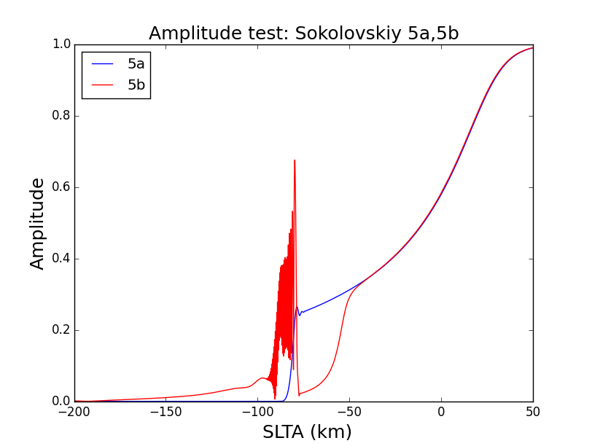
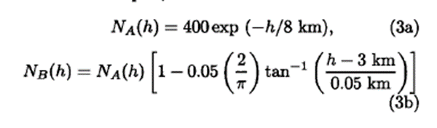
Example of amplitude at the receiver.
Standard atmospheric defocusing
Basically ~time

Slide 43
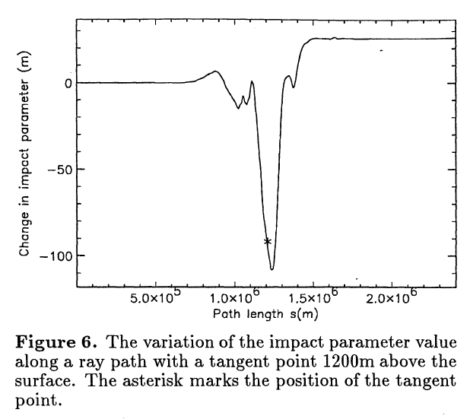
Horizontal gradient errors
The impact parameter – that we assume is constant – actually varies along the ray-path.
We can assign the wrong height to the “measurement!
GPS
LEO

Slide 44
Assimilation of GPS-RO data:
What observations are available?
How do we use them?
Pros and cons.

Slide 45
Data availability
The “proof of concept” GPS/MET mission in 1996 was a major success. This led to a number of missions of opportunity, proposals for a constellation of LEO satellites and first dedicated operational instruments.
Current status (~2700 profiles per day):
  Missions of opportunity: TerraSAR-X and Tandem-X.
  The COSMIC constellation of (originally) 6 LEO satellites was launched 2006. Now, only satellite number 6 is regularly providing data.
  The GRAS instruments on Metop-A, Metop-B and Metop-C (assimilated since 14th March 2019) provides 3x~600 profiles per day. GRAS is the only fully operational instrument.
  The GNOS instrument on the Chinese satellite FY-3C has been assimilated since March 2018. Data from FY-3D are also available.
Near future
  COSMIC-2 is a tropical constellation of 6 satellites. Due to be launched in May 2019.
  GRACE Follow-On.
  KOMPSAT-5 is operating but data are not available to NWP centres yet.
  Commercial companies (Spire, PlanetIQ, GeoOptics,…) have begun to launch satellites with RO instruments.

Slide 46
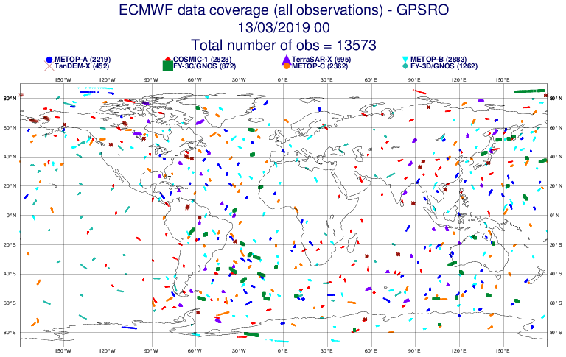

Slide 47
Why are GPS-RO observations useful for NWP given that we already have millions of radiance measurements?
GPS-RO complements the radiances!
Observations are useful if they provide new information.
RO can be assimilated without bias correction. The observations are good for highlighting model errors/biases. Most satellite radiance observations require bias correction to the model. GPS-RO measurements anchor the bias correction of radiance measurements.
Importance of anchor measurements in weak constraint 4D-Var. (Climate/reanalysis applications). More on this tomorrow.
2) GPS-RO (limb sounders in general) have sharper weighting functions in the vertical compared to radiances and therefore have good vertical resolution properties. The GPS-RO measurements can “see” vertical structures that are in the “null space” of the satellite radiances.

Slide 48
Use of GPS-RO in NWP
NWP centres assimilate either bending angle (most!) or refractivity.
The classical retrieval is very useful for understanding the basic physics of the measurement, but it is not recommended for use in NWP.
  The pre-processing steps and a-priori information required to retrieve temperature complicate the error statistics by introducing error correlations.
  Bending angles do not have significant vertical error correlations, but refractivities do!
We can test 1D bending angle and refractivity observation operators in 1D-Var retrievals to estimate the information content and vertical resolution of the measurements.

Slide 49
1D forward model – key steps (more detail later)
Assume that a single model column represents the entire portion of atmosphere traversed by the ray.
First, calculate the refractivity on model levels:
Convert to refractive index:
Use Abel transform to calculate bending angle (assuming ~exponential variation of N(x) between model levels):
I.e. we simulate the bending angles from the model fields.
See Healy & Thépaut, 2006 for more details.

Slide 50
1D-Var retrieval
The 1D-Var retrieval minimises the cost function:
The observation operator -
simulating bending angles or
refractivity from the forecast
state.
The 1D-Var approach provides a framework for testing observation operators that we might use in 3D/4D-Var assimilation.
The information is partitioned between increments in temperature, humidity and surface pressure, according to their relative uncertainties.
We can also investigate various information content measures.

Slide 51
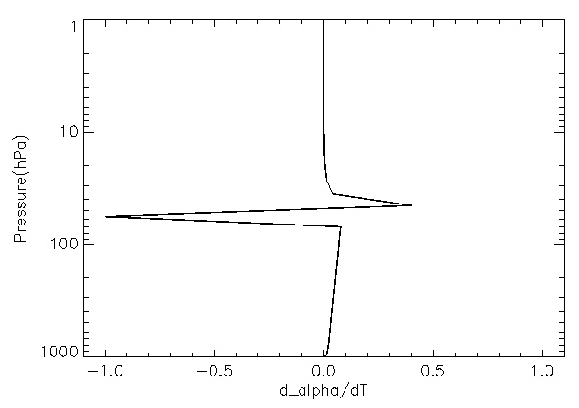
1D bending angle Jacobian (weighting function) for temperature
(Normalised with the peak value)
Weighting function peaks at the pressure levels above and below the
ray tangent point. Bending related to vertical gradient of refractivity:
Sharp structure near
the tangent point
Increase the T on the
lower level – reduce the
N gradient – less bending!
Increase the T on the
upper level – increase
N gradient more bending!
hydrostatic tail
(See also Eyre, ECMWF Tech Memo. 199.)
Very sharp weighting function in the vertical – we can resolve structures
that nadir sounders cannot!
The refractivity Jacobian is even sharper, but vertical correlations are larger.

Slide 52
Useful 1D-Var diagnostics
Linearised
forward model
1D-Var provides an estimate of the solution error covariance matrix.
Information content: related to the uncertainty before and after the measurement is made.
It also gives vertical resolution diagnostics – the averaging kernel.
Solution error cov. matrix
Assumed background
error cov. Matrix.
Assumed observation
error cov. matrix

Slide 53
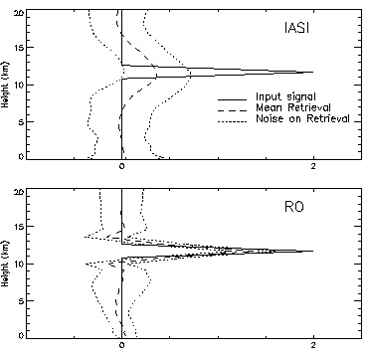
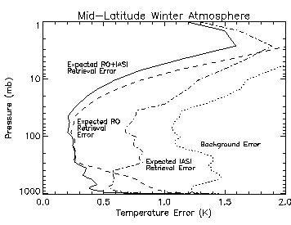
GPS-RO and IASI: 1D-Var simulations
Healy and Collard 2003, QJRMS:
Power to resolve a peak-shaped error in background: Averaging Kernel.
IASI
Expected retrieval error:
RO+IASI
RO
RO
Background
IASI
Co-located RO and IASI observations are assimilated in a 1D-Var.

Slide 54
1D bending angle assimilation at Met Office, NCEP, MF, ECMWF (until 2014)
Most centres assimilate bending angles with a 1D operator: ignore the 2D nature of the measurement and use a single model column to integrate
The forward model, H(x) is quite simple:
  evaluate geopotential heights of model levels
  convert geopotential height to geometric height and radius values
  evaluate the refractivity, N, on model levels from P,T and Q.
  Integrate, assuming refractivity varies ~(exponentially*quadratic) between model levels. (Solution in terms of the Gaussian error function).
  Include tangent point drift (May 2011).
  2D operator operational at ECMWF since 2014 (later in talk).
Convenient variable (x=nr)
(refractive index * radius)

Slide 55
1D bending angle assimilation at Met Office, NCEP, MF, ECMWF (until 2014)
Most centres assimilate bending angles with a 1D operator: ignore the 2D nature of the measurement and use a single model column to integrate
The forward model, H(x) is quite simple:
  evaluate geopotential heights of model levels
  convert geopotential height to geometric height and radius values
  evaluate the refractivity, N, on model levels from P,T and Q.
  Integrate, assuming refractivity varies ~(exponentially*quadratic) between model levels. (Solution in terms of the Gaussian error function).
  Include tangent point drift (May 2011).
  2D operator operational at ECMWF since 2014 (later in talk).
Note the dependence on geopotential height and Q in the forward model!
In principle, GPS-RO provides surface pressure and tropospheric humidity information to the analysis via the adjoint of the forward model.
Convenient variable (x=nr)
(refractive index * radius)

Slide 56
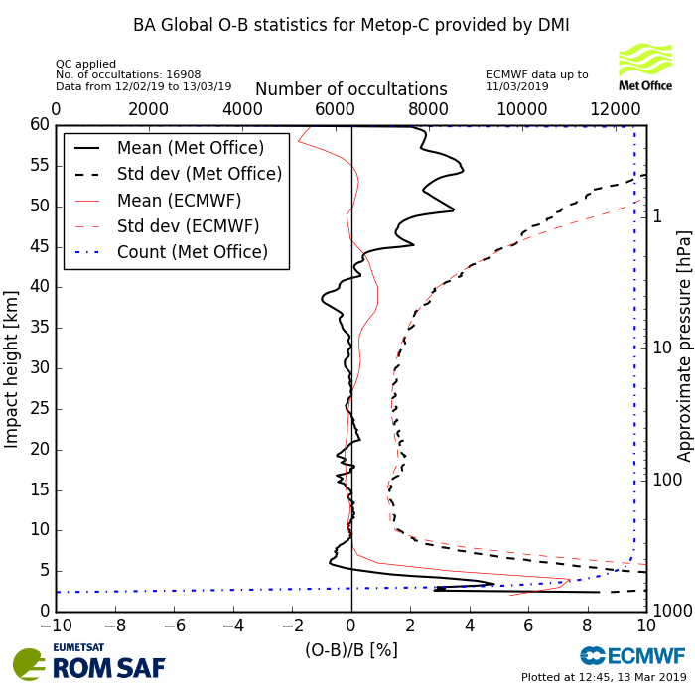
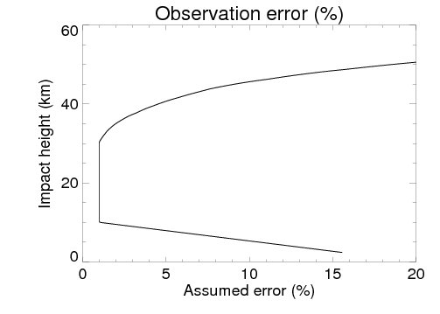
Assumed (global) observation errors and actual
(o-b) departure statistics
Consistent with o-b stats.
See http://www.romsaf.org/monitoring/ for many plots of real-time RO statistics.

Slide 57
Assumed (global) observation errors and actual
(o-b) departure statistics
“Core region”
Consistent with o-b stats.
See http://www.romsaf.org/monitoring/ for many plots of real-time RO statistics.

Slide 58
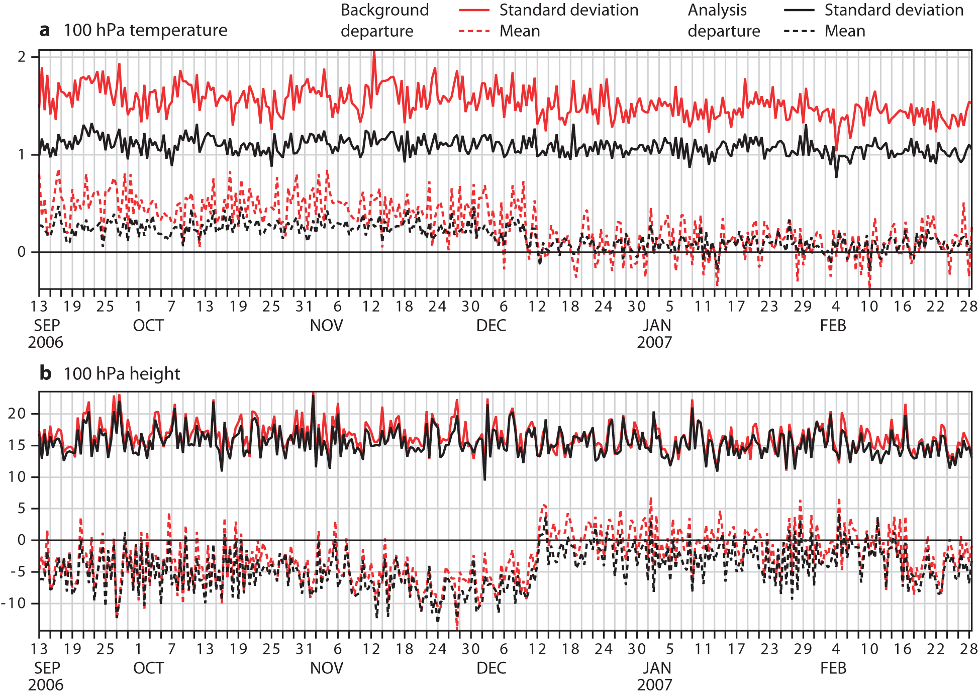
Impact of GPS-RO on ECMWF operational biases against radiosonde measurements
Operational implementation (COSMIC 1-6 and CHAMP)
Notes:
You can see the striking improvement in the fit to radiosondes T and Z measurements at 100 hPa in the SH.

Slide 59
GPS-RO also has a “null space”
The measurement is related to density (~P/T) on height levels and this ambiguity means that the effect of some temperature perturbations can’t be measured. Assume two levels separated by z, with temperature variation T(z) between them. Now add positive perturbation ΔT(z)~exp(z/H), where H is the density scale height
The density as a function of height is almost unchanged. A priori information required to distinguish between these temperature profiles. This is the GPS-RO null space.
P and T have increased
at z, but the P/T is the same.
Pu,Tu,(P/T)u
T(z)+ΔT(z)
z2=z+Δz
z, T(z)
z
P,T,P/T

Slide 60
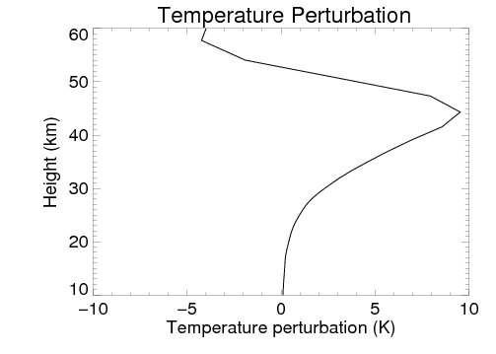
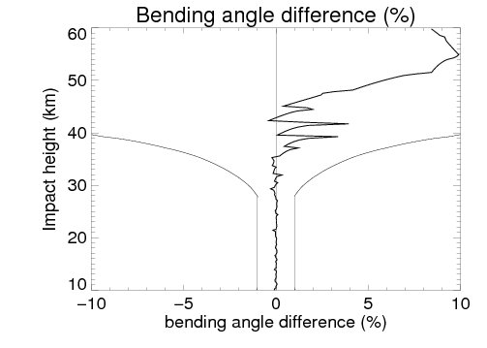
Null space – how does a temperature perturbation propagate through the bending angle observation operator?
1K at ~25km
Assumed ob
errors
The null space arises because the measurements are sensitive to density as function of height (~P(z)/T(z)). A priori information is required to split this into T(z) and P(z). We can define a temperature perturbation ΔT(z)~exp(z/H) which is in the GPS-RO null space. Therefore, if the model background contains a bias of this form, the measurement can’t see or correct it.
Notes:
I derived a T perturbation by averaging forecast differences at the South pole
T(IASI + RO) – T(RO). I then propagated this perturbation through the bending angle forward model. The bending angle change is small compared to the assumed error. The problem is RO can’t see a
T bias that increases ~ exponentially with height, when the scale height of the bias is equal to density scale height.
I think this is an interesting result - some think its obvious.
The sharp structure around 40 km is caused by the discreetization of the state vector (I think).

Slide 61
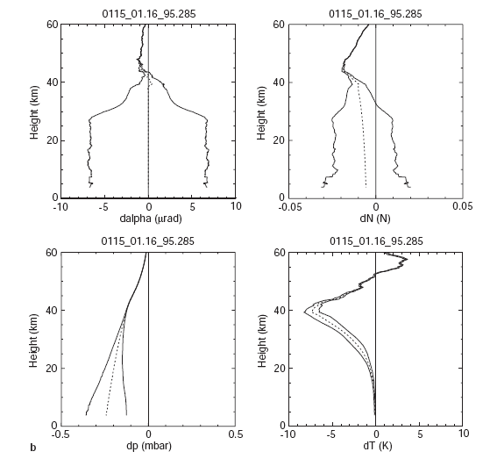
Compare with Steiner et al
(Ann.Geophs., 1999,17, 122-138)
Temperature retrieval
error caused by a 5 %
bias in the background
bending angle used in
the statistical optimization

Slide 62
2D forward models:
Using model information from multiple model columns.

Slide 63
Factors limiting GPS-RO impact
It has been suggested that the use of 1D operators is limiting the GPS-RO impact in the troposphere.
1D operators assume that the entire limb of the atmosphere being sampled can be represented by a single column – a big assumption.
ECMWF now assimilates GPS-RO with a 2D operator.
This complicates the forward model (and, more so, the adjoint!).

Slide 64
Move towards 2D GPS-RO operators
The 2D operators take account of the real limb nature of the measurement, and this should reduce the forward model errors defined as
Reducing the forward model errors should improve our ability to retrieve information from the observation, but this must be balanced:
Extra Information versus Additional Computing Costs.
We are less likely to misinterpret information with a 2D operator.
Forward model error
Noise free observation
Discrete representation of true state from model

Slide 65
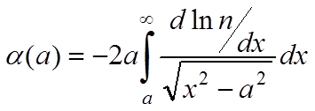
Assimilation with a 2D observation operator
Integrate these differential equations to determine the ray path:
1D:
Rodgers, page 149
s= distance along ray path
The 2D operator requires NWP information interpolated to a plane in the vertical, i.e. interpolated from a number of model columns.

Slide 66
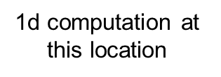

1D/2D hybrid approach
ray path
~80 km
Interpolate 2D information to the ray path
2d computation for ray path below ~80 km
Earth’s surface (transformed here to appear horizontal, hence the bending appears to be negative)
Computational cost
Occultation plane described by 31 profiles with 40 km separation.

Slide 67
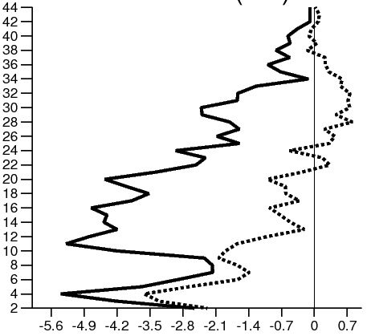
Improvement in GPS-RO (o-b) departure statistics with 2D approach
Impact height (km)
Notes:
We always normalise the departures by assumed sigma_o. I think this a pretty good improvement.
These are pretty typical results for all RO instruments.

Slide 68
Summary
GPS-RO is a satellite-to-satellite active limb measurement.
We outlined the basic physics of the GPS-RO technique and the “classical” (planetary science) retrieval of atmospheric quantities (e.g. temperature). Be wary of classical temperature retrievals above 35-40 km. They mainly contain a-priori information.
GPS-RO Measurements do not require bias correction and are insensitive to clouds. The 1D observation operators are quite simple. GPS-RO has very good vertical resolution, but poor horizontal resolution (~450 km average).
Information content studies suggest GPS-RO should provide good temperature information in the upper troposphere and lower/mid stratosphere. Operational assimilation and recent OSEs supports this.
A 2D operator has been implemented at ECMWF. This improves the modelling of observations.
More tomorrow!

Slide 69
Useful GPS-RO web-sites
International Radio Occultation Working Group (IROWG) www.irowg.org.
The COSMIC homepage www.cosmic.ucar.edu. This contains latest information on the status of COSMIC and an extensive list of papers www.cosmic.ucar.edu/references.html, with some links to .pdfs of the papers, workshops.
The Radio Occultation Meteorology (ROM) SAF homepage www.romsaf.org.
  You can find lists of ROM SAF publications www.romsaf.org/publications.
  Links to GPS-RO monitoring pages (Data quality, data flow of GRAS, COSMIC, TerraSAR-X, FY-3C,…).
  In addition, you can register and download for the ROM SAF’s Radio Occultation Processing Package (ROPP). This F90 software package containing pre-processing software modules,1D-Var minimization code, bending angle and refractivity observation operators and their tangent-linears and adjoints.
2015 and 2008 ECMWF/ROM SAF Workshops papers and presentations.
https://www.ecmwf.int/en/learning/workshops-and-seminars/past-workshops/2008-GRAS-SAF-GPS-radio-occultation
https://www.ecmwf.int/en/learning/workshops-and-seminars/past-workshops/fifth-eumetsat-rom-saf-user-workshop-applications-gps-radio-occultation-measurements

