Slide 1
Wind information from satellites:
Atmospheric Motion Vectors
Passive tracing with GEO radiances
Katie Lean
Thanks to Kirsti Salonen, Cristina Lupu, Mike Rennie and Niels Bormann

Slide 2
Contents
Atmospheric Motion Vectors
What, when, where and why
How are AMVs derived?
How do we use them at ECMWF?
Wind indirectly from radiances
Introduction to clear sky/all sky radiances
Humidity tracing with radiances
Summary and future challenges
Introducing Aeolus

Slide 3
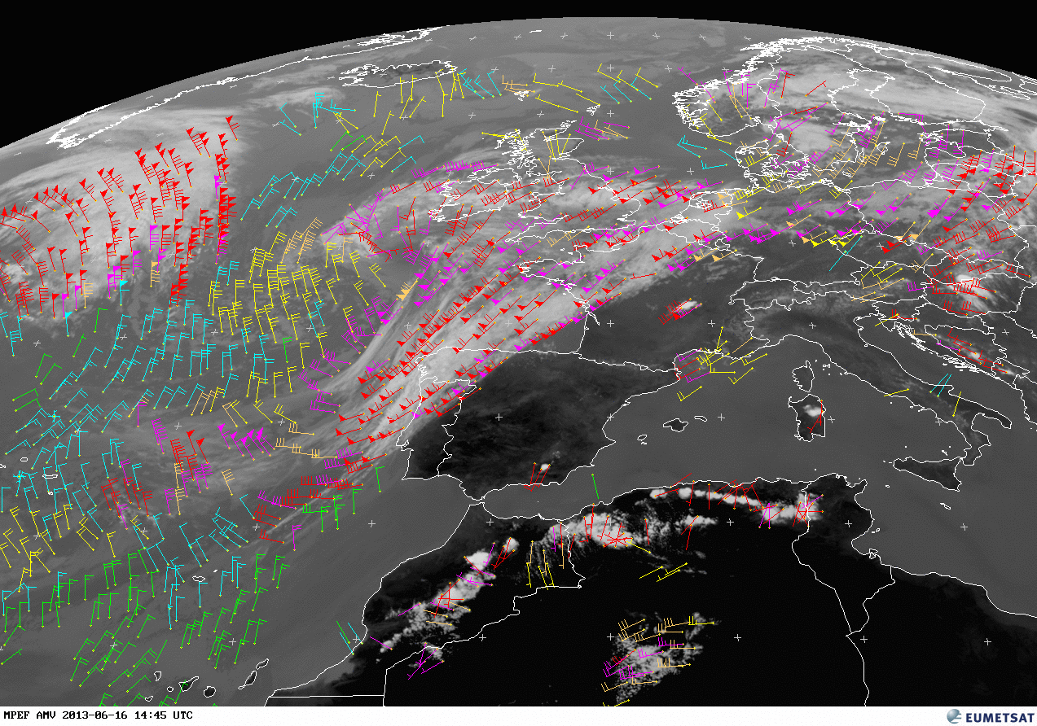
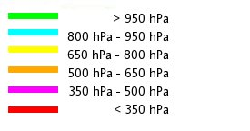
Atmospheric Motion Vectors – what are they?
Wind observations produced by tracking clouds or water vapour features in consecutive satellite images.
Animation from: oiswww.eumetsat.org/IPPS/html/MSG/PRODUCTS/AMV/WESTERNEUROPE/index.htm

Slide 4
AMV production today: geostationary
Cover tropics and mid latitudes
Successive images few minutes to ~30 mins apart
Monitored/assimilated at ECMWF:
  EUMETSAT: Met-8, Met-11
  JMA: Himawari-8
  NOAA/NESDIS: GOES-16, GOES-15 (GOES-17 soon!)
  CMA: FY-2G
  IMD: INSAT-3D
  KMI: COMS
Notes:
Winds are not calculated locally but produced by other centres and then disseminated

Slide 5
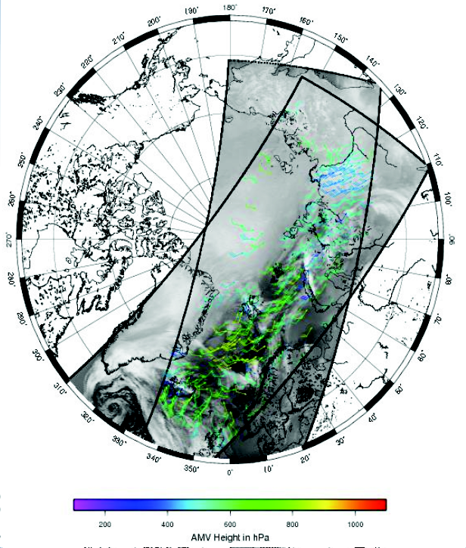
AMV production today: polar orbiting
Uses images from successive orbits from same satellite ~100 mins apart
Images from 2 satellites (using Metop-A, Metop-B or Metop-C), currently ~ 35 mins apart
Monitored/assimilated at ECMWF:
EUMETSAT: Metop-A, Metop-B, Metop-C
NOAA/NESDIS: NOAA-15, -18, -19, (-20 soon!), Aqua, Terra, SNPP
Figure from “AVHRR polar winds derivation at EUMETSAT: Current status and future developments”, Dew and Borde, IWW-11 presentation
Notes:
Images from 2 satellites allow potentially global coverage.

Slide 6
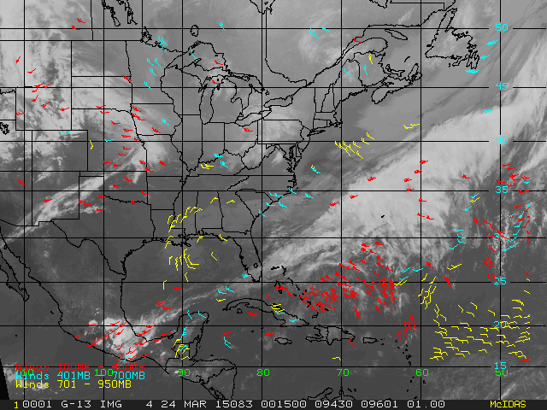
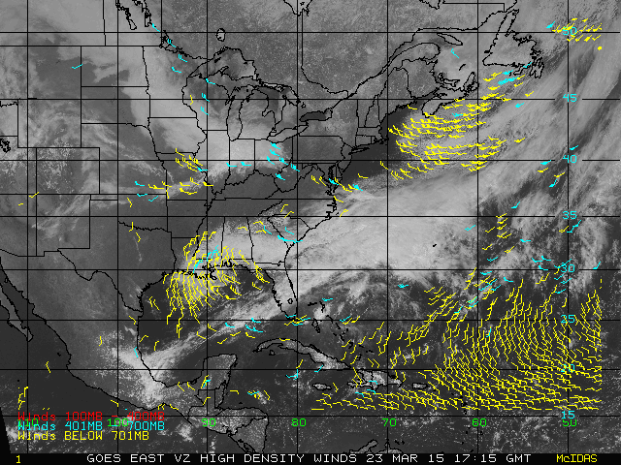
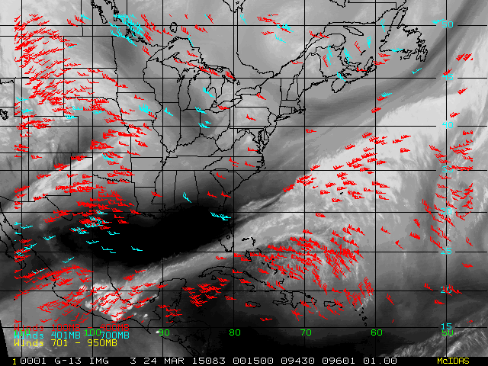
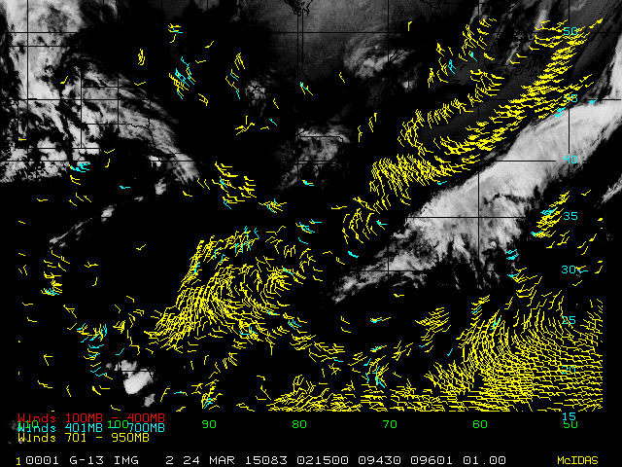
Wavelengths used in AMV production
IR window (~10.7 µm):
Clouds
VIS (~0.65 µm):
Clouds
Water Vapour absorption (~6.7 µm):
Clouds
Clear sky WV features
AMVs mostly cover:
Low troposphere ~850hPa
High troposphere ~200hPa
Short Wavelength IR (~3.9 µm):
Clouds
Figures from: http://www.ospo.noaa.gov/Products/atmosphere/hdwinds/goes.html

Slide 7
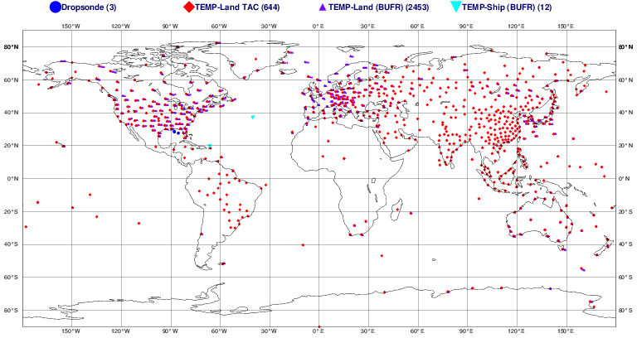
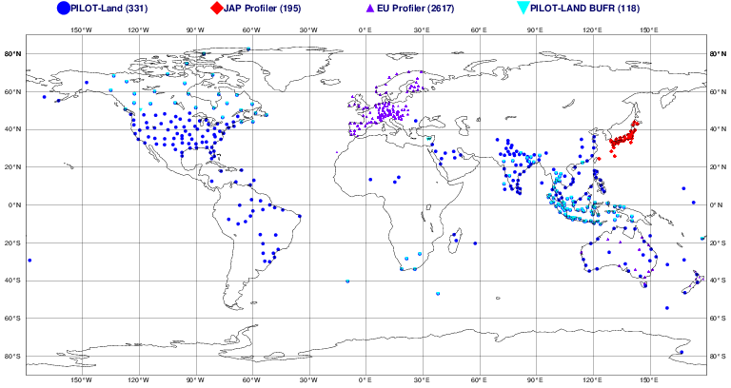
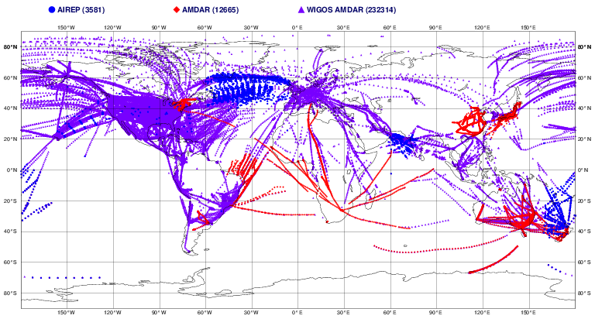
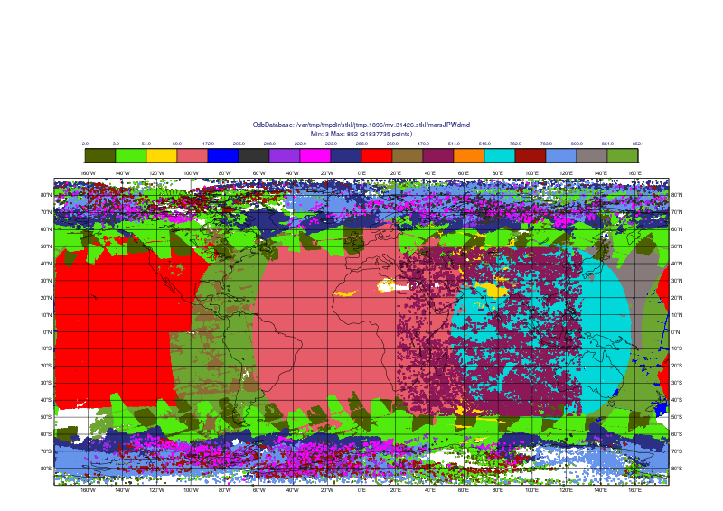
AMVs – why do we need them?
Radiosonde coverage
Pilot-Profiler coverage
Aircraft coverage
AMV coverage
Notes:
For best results, models require information on both the mass field and the wind field.
AMVs are the only observation type to provide good coverage of upper tropospheric wind data over oceans and at high latitudes.

Slide 8
Contents
Atmospheric Motion Vectors
What, when, where and why
How are AMVs derived?
How do we use them at ECMWF?
Wind indirectly from radiances
Introduction to clear sky/all sky radiances
Humidity tracing with radiances
Summary and future challenges
Introducing Aeolus

Slide 9
How are AMVs derived?
Part 1: Tracking
Part 2: Height assignment
Notes:
The derivation is carried out at the production centres.

Slide 10
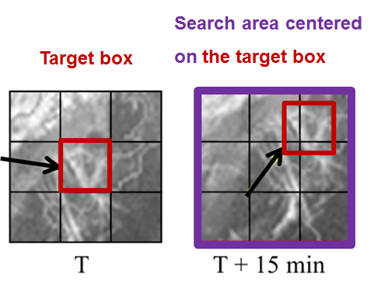
Part 1: Tracking
Correct raw data
Locate suitable tracer (target box)
  (Typical area 24x24 pixels)
Locate same feature in later/earlier image using advanced pattern matching methods
Calculate displacement vector
  (Some new algorithms use nested tracking – track multiple targets and take average)
Assumption: tracked feature travels with local wind

Slide 11
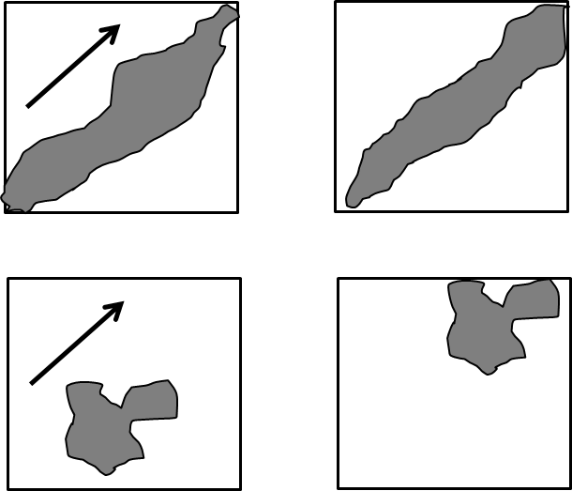
Tracking errors
Target box doesn’t have features with uniform speed/direction
Cross correlation locates incorrect tracer
Shape/orientation of tracked feature
Short time interval causes difficulty for slow wind speeds…
…But for a long time interval, more evolution of feature possible
Harder
Easier
Notes:
Remember for polar satellites we could have up to 100 mins between successive images which could mean the feature has changes significantly. In some cases, a ‘first guess’ using NWP data is used to help with relocating the correct feature.

Slide 12
Part 2: Height assignment
V
Assigned height
Assign representative height to single level wind observation
  High/mid level: cloud top
  Low level: cloud base or top
BUT…
  Clouds have vertical extent
  -> treat as layer average?
  -> apply bias correction to height?
Assigned height
V
Wind speed

Slide 13
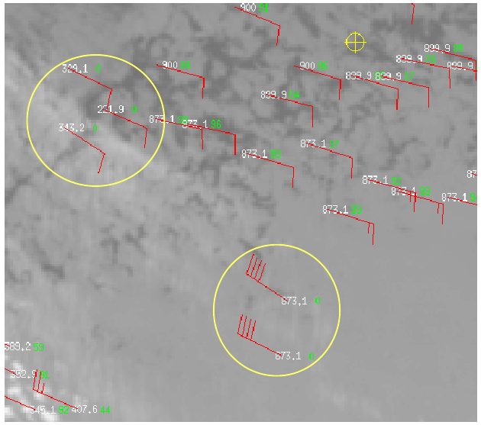
Which pixels are used for the height?
Vector matches low level motion but assigned too high
assigned pressures
Highest contrast dominates tracking -> usually edge of coldest cloud...
…but not always:
Example – thin high cloud overlying low cloud
Just using coldest pixels less good…
…new method uses pixel that contributes most to cross correlation during tracking
Example from Forsythe M. and M. Doutriaux-Boucher, 2005: Second Analysis of the data displayed on the NWP SAF AMV monitoring website.
329.1
899.9
221.9
873.1
343.2
873.1
873.1
873.1
873.1
352.9
873.1
Vector matches high level motion but assigned too low

Slide 14
Height assignment methods
Various methods:
  Equivalent Black Body Temperature
  Carbon dioxide slicing
  Water vapour intercept
  Cloud base techniques
  Optimal cloud analysis – gaining popularity
All have assumptions affecting accuracy
NWP information used
May include errors in short range NWP
Errors in radiative transfer
Error in height assignment dominant source of error for AMVs
Notes:
the uncertainty comes from
both the methods and the assumption of trying to assign the cloud motion
to a representative height ("somewhere" in the cloud)

Slide 15
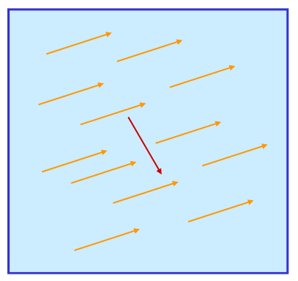
Indication of quality
Variety of independent quality tests:
  Spatial consistency
  Temporal consistency (e.g. speed, direction)
  Forecast consistency (optional)
Final quality indicator weighted mean of tests
Use for screening

Slide 16
Contents
Atmospheric Motion Vectors
What, when, where and why
How are AMVs derived?
How do we use them at ECMWF?
Wind indirectly from radiances
Introduction to clear sky/all sky radiances
Humidity tracing with radiances
Summary and future challenges
Introducing Aeolus

Slide 17
AMV sample coverage: monitored one 12hr cycle (00Z 7th March 2019)
Metop A Metop B Dual Metop A/B, B/C GOES-15 Himawari-8 GOES-16 Met-8 Met-11 AQUA NOAA-15 NOAA-18 NOAA-19 SNPP FY-2G INSAT-3D COMS-1 TERRA
Actively used
Now we will apply blacklisting, a first guess check and thinning

Slide 18
AMV selection: Blacklisting
Apply quality indicator thresholds
Channel specific selection
Regional screening
Seasonal screening

Slide 19
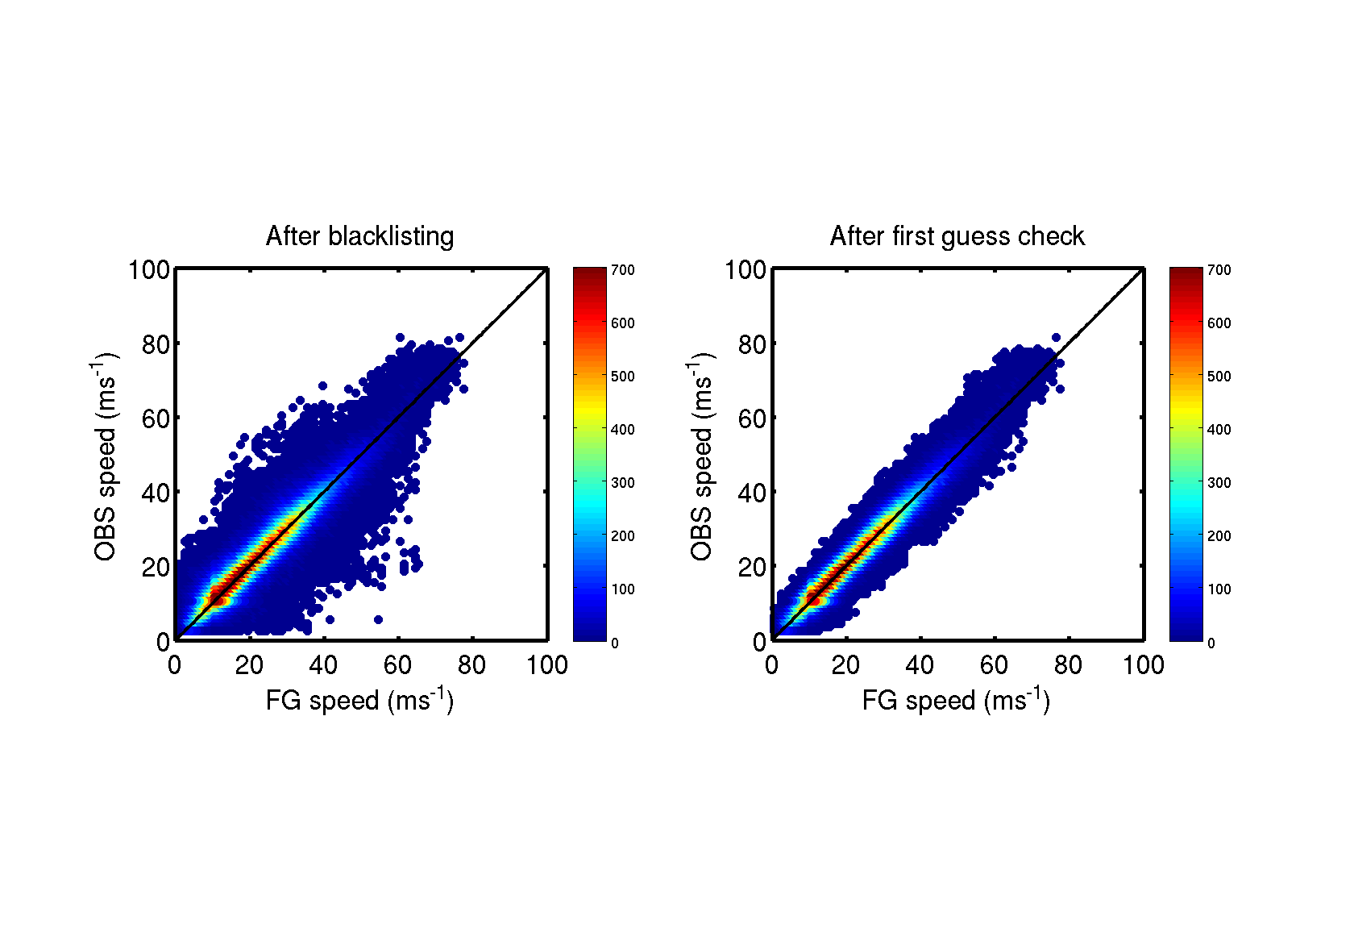
AMV selection: First Guess check
Comparison with short-range forecast from previous model run
Observations deviating too much are rejected

Slide 20
AMV selection: First Guess check
Comparison with short-range forecast from previous model run
Observations deviating too much are rejected

Slide 21
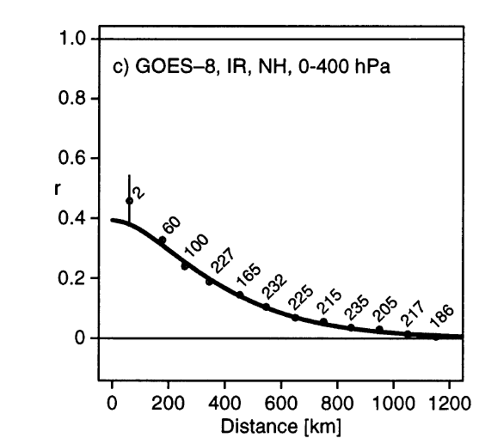
AMV selection: thinning
Assuming uncorrelated observation errors -> thinning required
Significant spatial error correlations up to ~ 800km
Thin by
  200x200km
  50-175hPa boxes (vertical extent varies with height)
  30 mins
Number of collocations in hundreds
AMV-radiosonde departure correlations
as a function of station separation.
Bormann et al., 2003: The spatial structure of observation error in atmospheric motion vectors from geostationary satellite data. MWR, 31, 706 - 718.

Slide 22
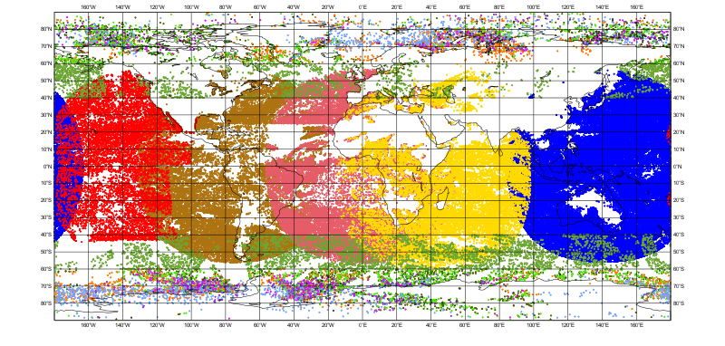
All AMVs used - one cycle 00Z 7th March 2019
Metop A Metop B Dual Metop A/B, B/C GOES-15 Himawari-8 GOES-16 Met-8 Met-11 AQUA NOAA-15 NOAA-18 NOAA-19 SNPP

Slide 23
Operational use
AMVs from 5 geo and 8 polar orbiting
Example of data reduction: typical 12 hr window, Meteosat-11 AMVs
  ~500 000 AMVs available
  15-20% remain after blacklisting
  5-10% used in assimilation
Single-layer observation operator (to convert between model and observed quantities)
Situation dependent observation errors
    [Total u/v error]² = [Tracking error]² + [Error in u/v due to error in height]²

Slide 24
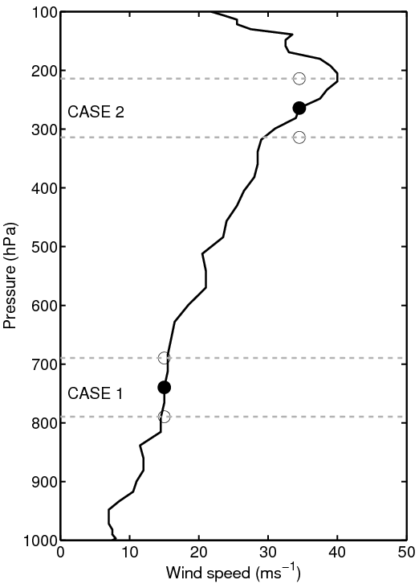
Impact of height assignment errors
Example: ± 50 hPa error in height assignment
CASE 1: Wind speed varies little with height , ±0.5 m/s error in wind speed.
CASE 2: Wind shear in vertical, error up to 7 m/s.

Slide 25
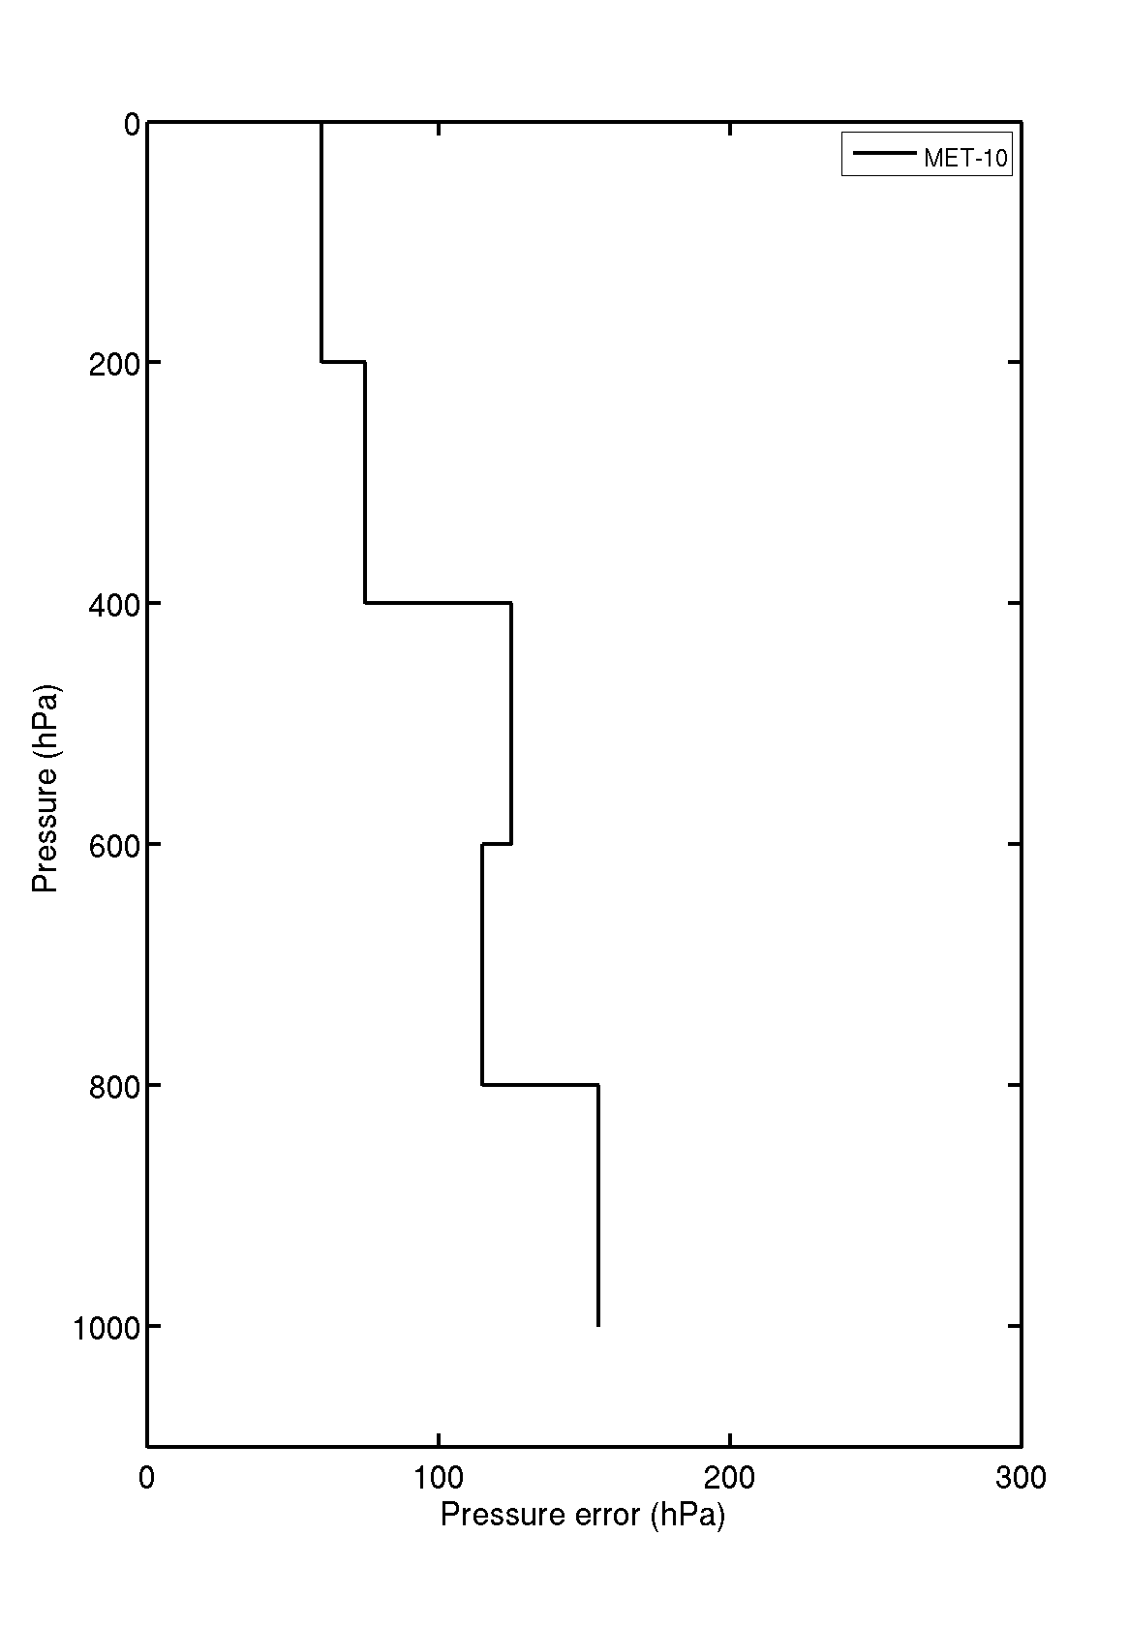
Situation dependent observation errors: error in height
Assumes Gaussian distribution of height error
Estimate error in height assignment using:
Apply Gaussian weights to model wind shear about assigned height to estimate error in speed
Standard deviation (AMV pressure - model pressure minimising vector diff (observed – model) wind)
Height assignment error (hPa) for Meteosat-10
Calculate separately for u and v components

Slide 26
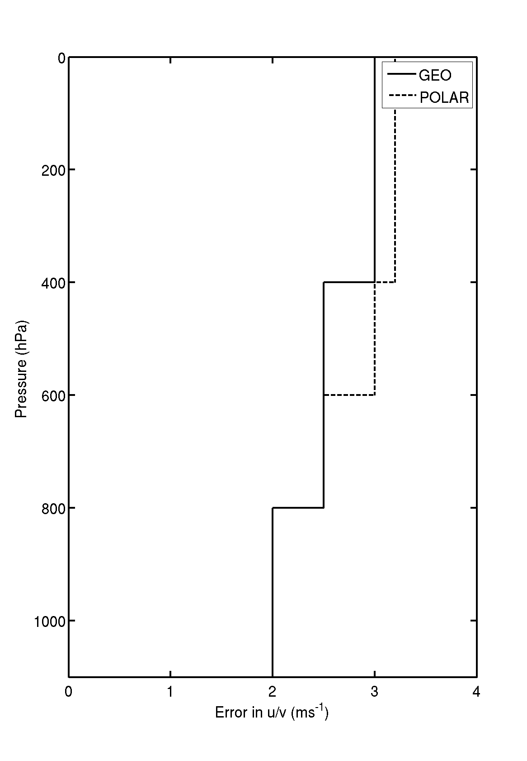
Situation dependent observation errors: tracking error
    [Total u/v error]² = [Tracking error]² + [Error in u/v due to error in height]²
Estimated using root mean square vector difference between AMV and first guess where height error is small
Likely to be an overestimate
Same values used across geostationary
Small variations across polar
Tracking error (m/s)
Forsythe M, Saunders R, 2008: AMV errors: A new approach in NWP. Proceedings of the 9th international winds workshop.

Slide 27
Situation dependent observation errors
2
2
(
+
)
sqrt
Tracking error (m/s)
Height error

Slide 28
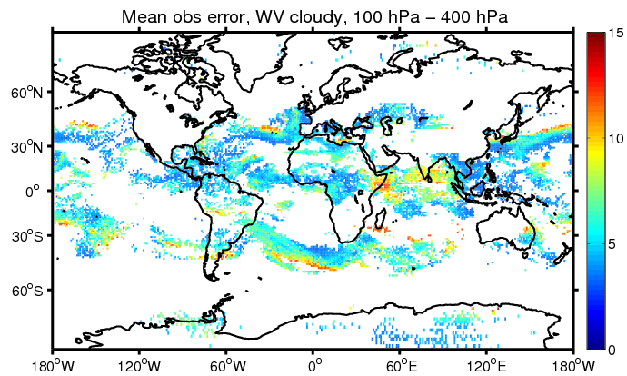
Situation dependent observation errors
Total observation error (m/s)
Example: cloudy WV, high levels
=

Slide 29
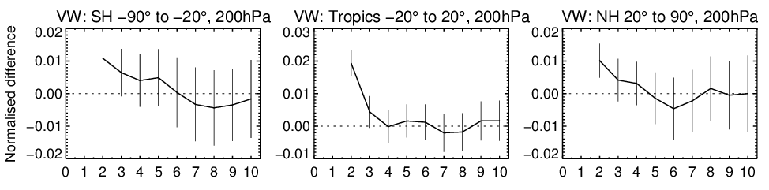
AMV forecast impacts
Ctrl (no AMVs) – Expt (with AMVs)
AMVs good
AMVs bad
Generally +ve for 2-3 days
Neutral at longer ranges
AMV denial experiments (8 months, summer 2016, winter 2017/2018)

Slide 30
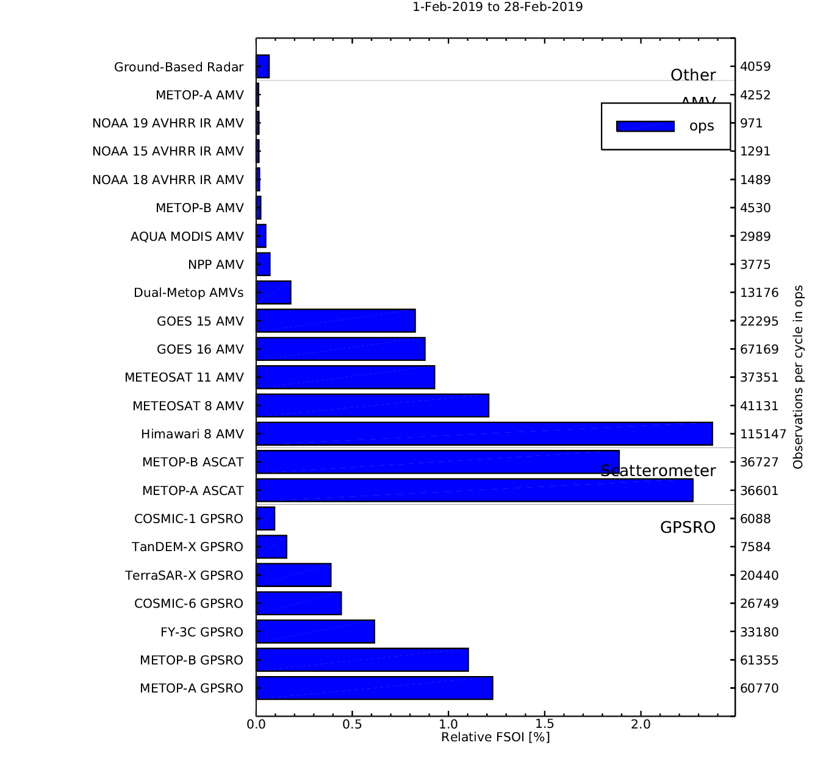
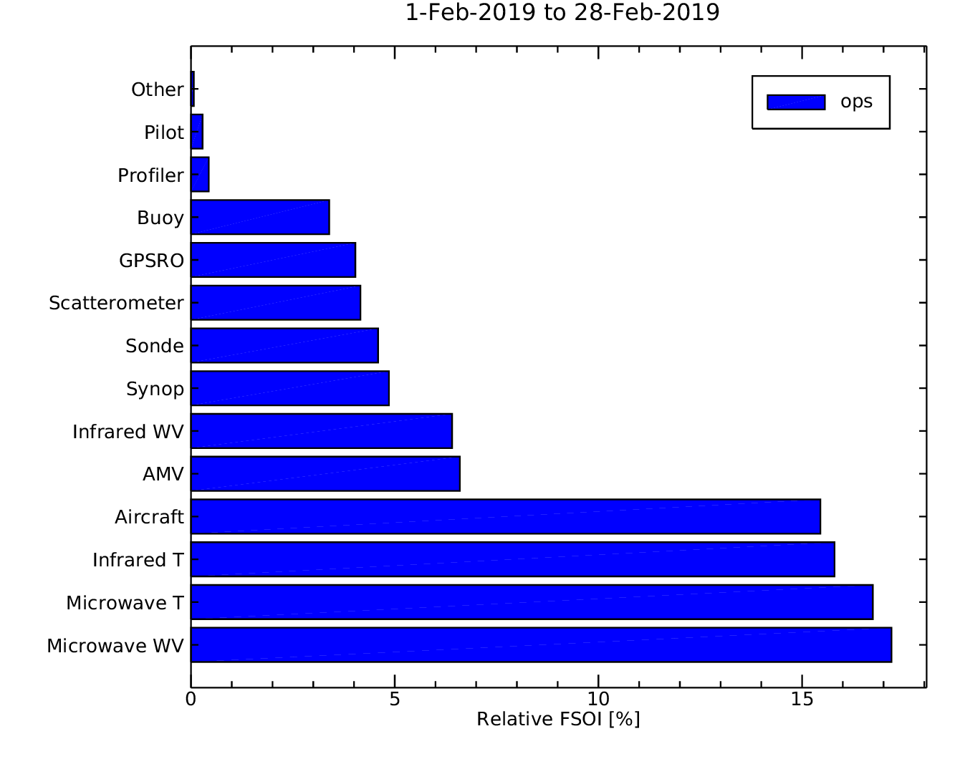
Forecast system performance
Feb 2019
Polar
No. of observations per cycle
Geo
Measures reduction in 24hr forecast error due to each source
Forecast Sensitivity to Observations (%)

Slide 31
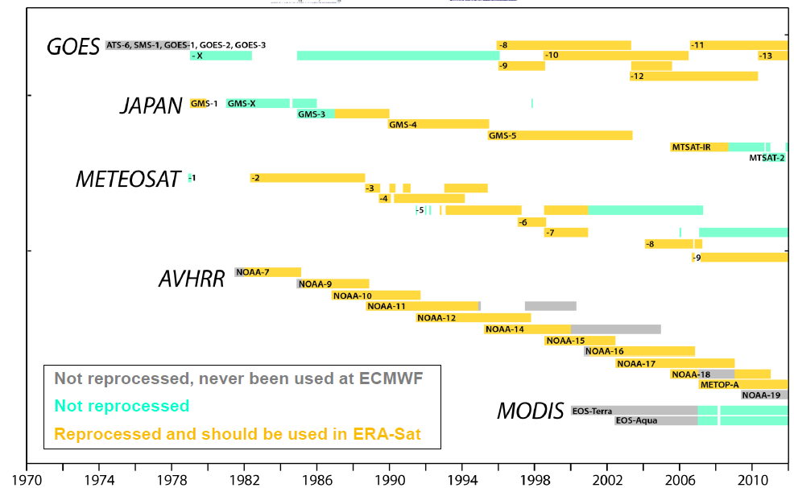
AMVs for Reanalysis
Reprocess and improve AMV data for reanalysis
Coverage and quality much improved
More impact in earlier period as observing system sparser
Figure from Carole Peubey

Slide 32
Assumptions and challenges
Tracked feature exactly follows speed and direction of local wind
  But some clouds don’t move with the local wind
Representing wind field at specific time, height and location
Detected motion represents cloud top or base
  But clouds have depth, using images over finite time etc.
Errors are uncorrelated
  But clouds are not randomly distributed in air flow -> can get nearby AMVs affected by same errors
Notes:
For correlation we thin and inflate observation errors but too much thinning removes valuable mesoscale information
Which layer in the cloud best controls the motion?
Problems with resolving slow winds at shorter time intervals.
Handling of multi layer cloud
More situation dependent and cloud specific background error formulations

Slide 33
Contents
Atmospheric Motion Vectors
What, when, where and why
How are AMVs derived?
How do we use them at ECMWF?
Wind indirectly from radiances
Introduction to clear sky/all sky radiances
Humidity tracing with radiances
Summary and future challenges
Introducing Aeolus

Slide 34
4D-Var tracing:
Changing wind fields by direct assimilation of radiances

Slide 35
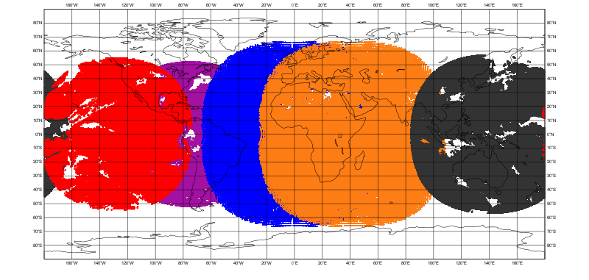
Introducing radiances from geostationary satellites
2 types:
  Clear Sky Radiances (CSR) – GOES-15, GOES-16
  All Sky Radiances (ASR) – Met-8/11 and Himawari-8
  Combines CSR and totally overcast scenes
GOES-15 GOES-16 Met-11 Met-8 Himawari-8
GOES-16 every 15 mins, others hourly data
Area averaged e.g. 48x48km for Met-11

Slide 36
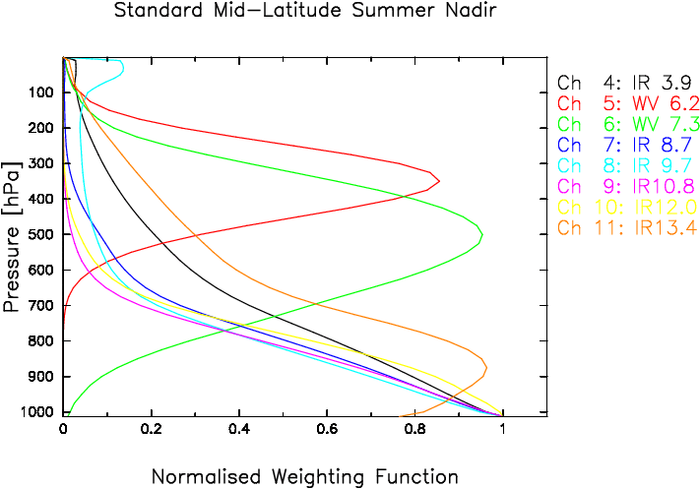
Use of GEO radiances at ECMWF
Select channels peaking in water vapour absorption band
Peak in weighting function mid-upper troposphere
  -> complementary to height of AMVs
Similar to AMVs apply
  Blacklisting
  Thinning
  First guess check
Apply bias correction
Meteosat-9/10 SEVIRI
WV
Notes:
Differently from AMVs, also apply bias correction

Slide 37
Blacklisting and thinning
Geographical
  Satellite zenith angle > 60˚
  Over high terrain (1500m)
Satellite specific rejections
Cloud contamination
  Threshold for number of clear pixels in CSR (land)
  Window channel has large departures (2K) from model (sea)
Thinning
  1˚x1˚
  30 mins

Slide 38
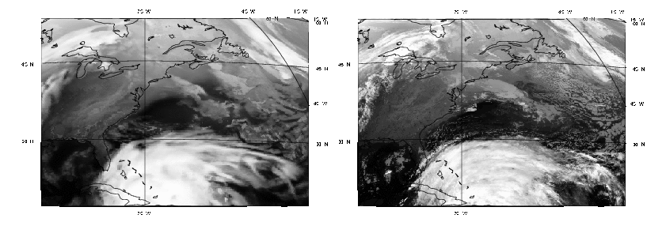
First guess check
H(x_{b}); H =Obs. operator
CSR Observations (y)
(Observation error)
Notes:
Hurricane sandy
Simulated image and observations
GOES-13 IR image

Slide 39
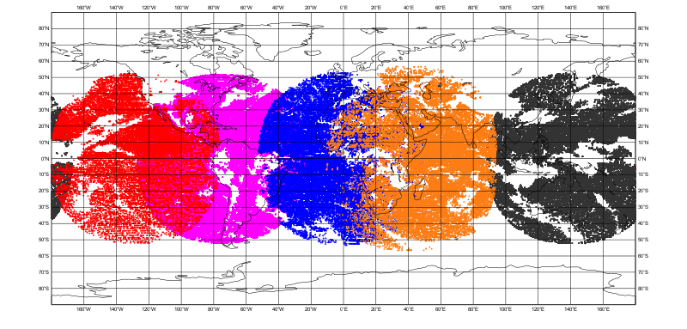
CSR/ASR sample coverage: active
Example typical 12-hour data window (00Z 9th Mar 2017)
    Depending on satellite, ~ 600 000 – 3,000,000 CSR/ASRs available
    ~2-4% used in the assimilation
GOES-15 GOES-16 Met-11 Met-8 Himawari-8
Notes:
after blacklisting, first guess check, thinning, VarQC

Slide 40
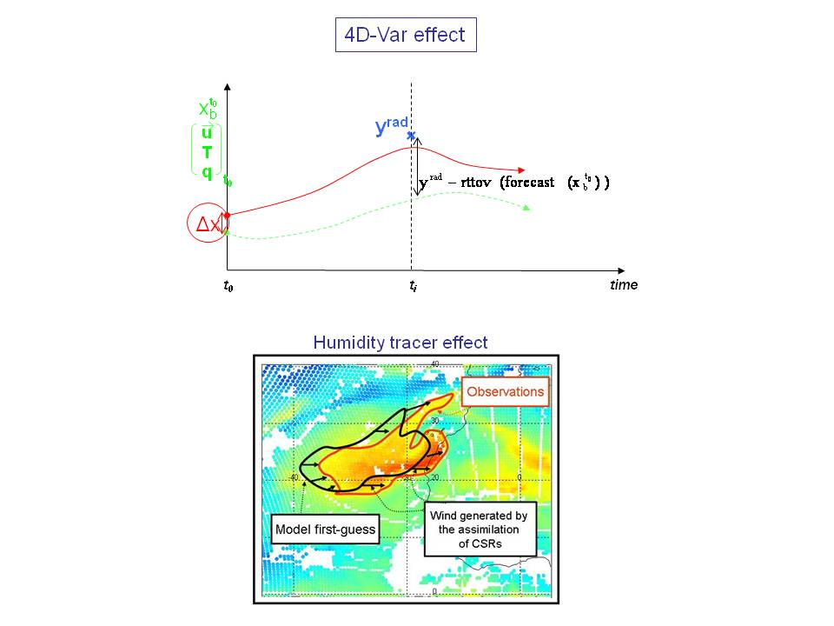
How do the radiances affect the wind field?
In 4D-Var fitting time series of model states to observations
To fit time/spatial evolution of humidity (also potential to use ozone) in radiance data:
  Create constituents locally OR
  Advect constituents to/from other areas i.e. changing the wind field 4D-Var tracing/humidity tracer effect/tracer advection effect
Radiance observation
Evolution of state with observations considered
Diff (obs – forecast value in obs space)
Increment to model state
Evolution of background only

Slide 41
Humidity tracer effect
Adjust wind field in initial conditions
-> better agreement between observations and moving humidity structure over 4D-Var time window
Model governing equations
Assimilate humidity sensitive radiances
Generates humidity increments
Generates wind and temperature increments
Physical parameterisations

Slide 42
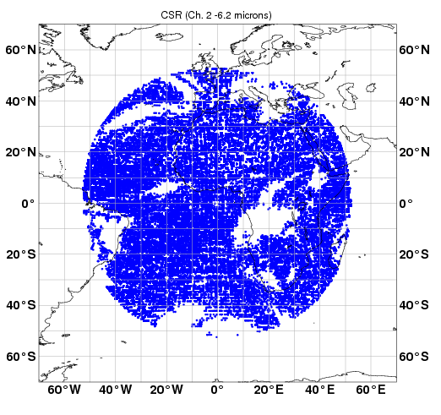
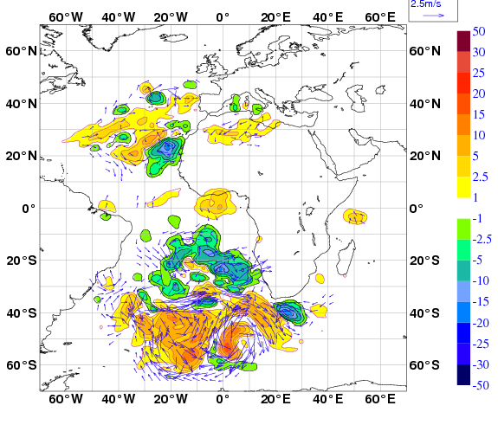
4D-Var tracing vs. AMVs
Radiance observations
RH and VW increments 300hPa
Still ‘tracking’ feature but assimilation system has extra constraints
Due to averaging/thinning tracing better for broad scale motions

Slide 43
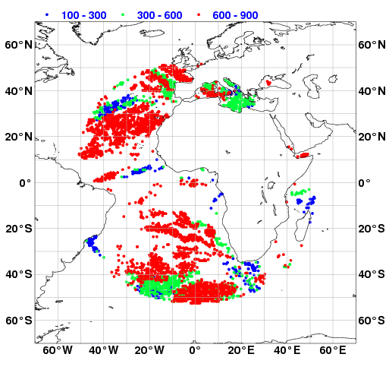
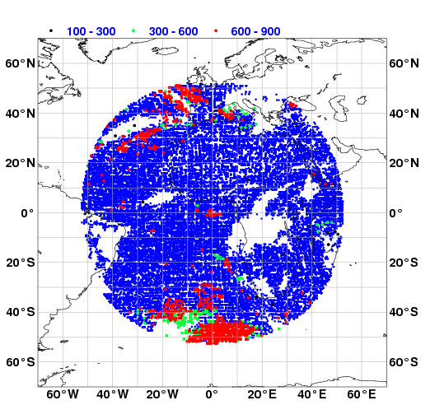
A closer look at the impacts
Control: no satellite obs, conventional only, 12 hr 4D-Var
Experiments using Meteosat-9 only:
  CSR
  ASR: CSR + Cloudy radiances only (“Overcast”) – sea only
  AMVs
Met-9 CSR
Met-9 Overcast
Met-9 ASR
Notes:
Where do we see the influence of CSR, ASR or AMVs?

Slide 44
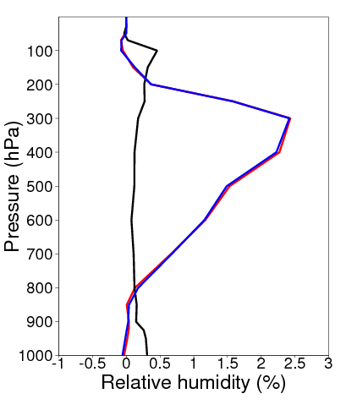
Impact on analysis: humidity increments from radiances
No significant AMV impact
Humidity changes for overcast radiances only above cloud top
Peak sensitivity of water vapour channel
Large vertical extent
CSR
CSR+OV
AMVs
Diff (expt – ctrl) RMS humidity increments

Slide 45
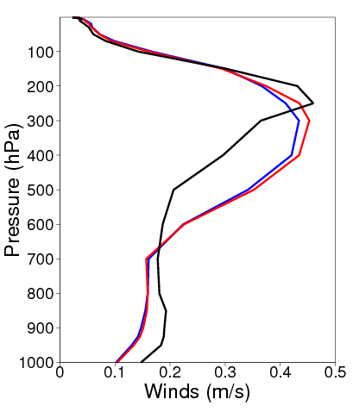
Impact on analysis: wind increments from AMVs and radiances
4D-Var tracing fits CSR by advecting deep layer of humidity…
…leading to deep layer changes to wind field
Overcast radiances add wind information at similar height to AMV
CSR
CSR+OV
AMVs
Diff (expt – ctrl) RMS humidity increments
Diff (expt – ctrl) RMS wind increments

Slide 46
Impact on analysis: wind increments from AMVs and radiances
Largest AMV impacts at high and low levels
CSR
CSR+OV
AMVs
Diff (expt – ctrl) RMS humidity increments
Diff (expt – ctrl) RMS wind increments

Slide 47
Wind analysis scores
Root mean square analysis error for cycle j
Analysis values at grid point from operations
Use ECMWF operational analysis as ‘truth’
0%: no improvement over baseline
100%: no error with respect to high resolution operational analysis
No. of grid points in Meteosat disc area
Analysis values at grid point
Sum over all cycles
Using experiment analysis
Using control (‘base’) analysis
Notes:
Wind analysis error
Put in each experiment CSR, OV, ASR, AMV.
Score is average over m assimilation cycles and normalising by mean vector error of base.
There is a limit due to the resolution difference between operations and experiments.

Slide 48
Wind analysis scores
AMV impact larger at high/low pressure
Complementary to radiances
CSR/ASR best results around peak in water vapour weight function
Wind analysis score (%)
Positive impacts throughout troposphere
ASR similar to CSR, better in SH
Notes:
All have positive impact throughout atmosphere

Slide 49
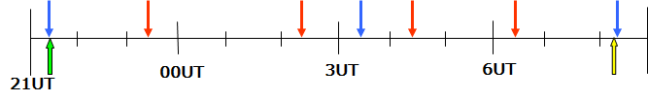

Frequency of assimilated images
How does the timing and frequency of the CSR images matter?
      12 images
      6 images
      3 images
      1 single image at the beginning of the window
      1 single image at the end of the window

Slide 50
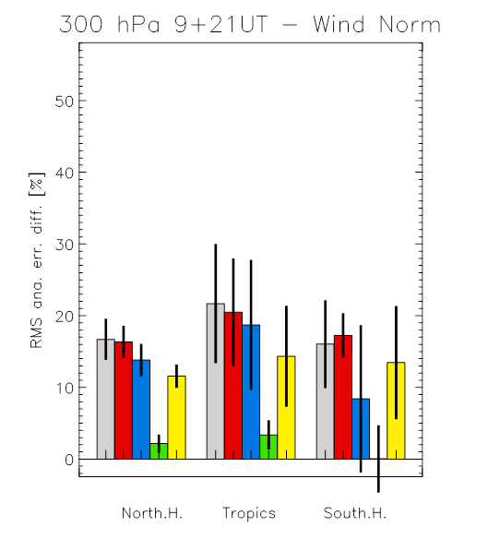
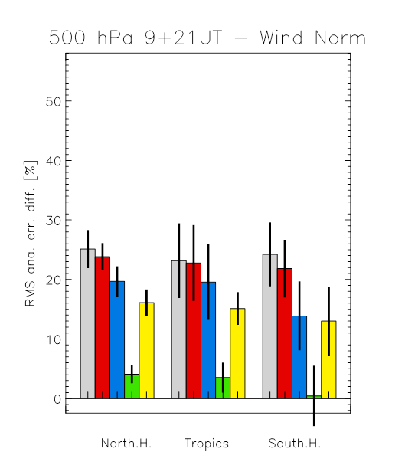

Frequency of assimilated images
300hPa
500hPa
Image at end of window scores better than at beginning of window
Highest frequency provides most impact

Slide 51
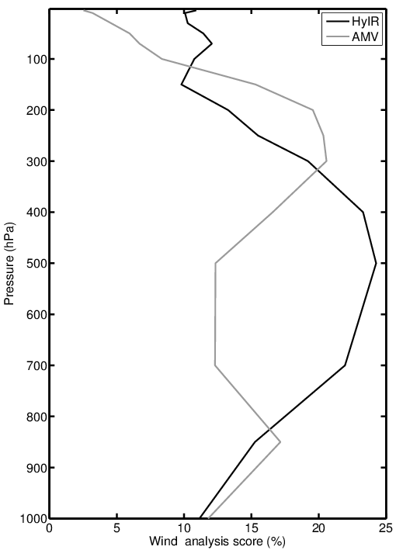
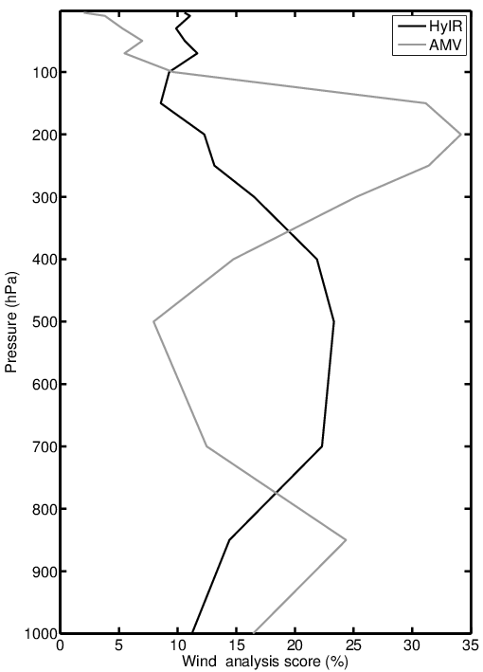
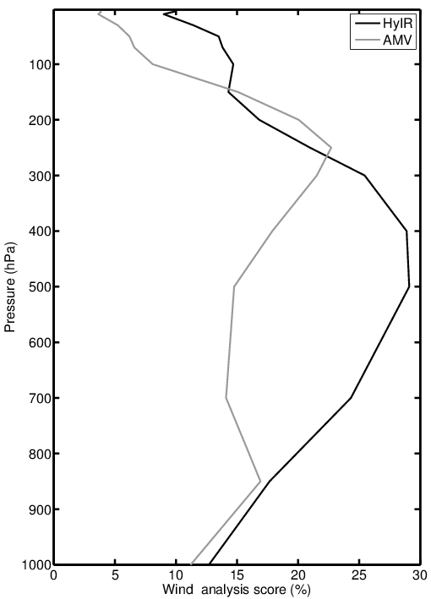
4D-tracing from polar orbiting satellites:
Wind analysis scores from hyperspectral IR
NH
Majority of wind impact from small number of water vapour channels
Tropics
SH
AMV
Wind fields improved by IR in broad band in mid-troposphere
HyIR
Pressure (hPa)
Wind analysis score (%)
Combination of multiple satellites (IASI x 2, AIRS, CrIS) improve spatial/temporal sampling
Improvement

Slide 52
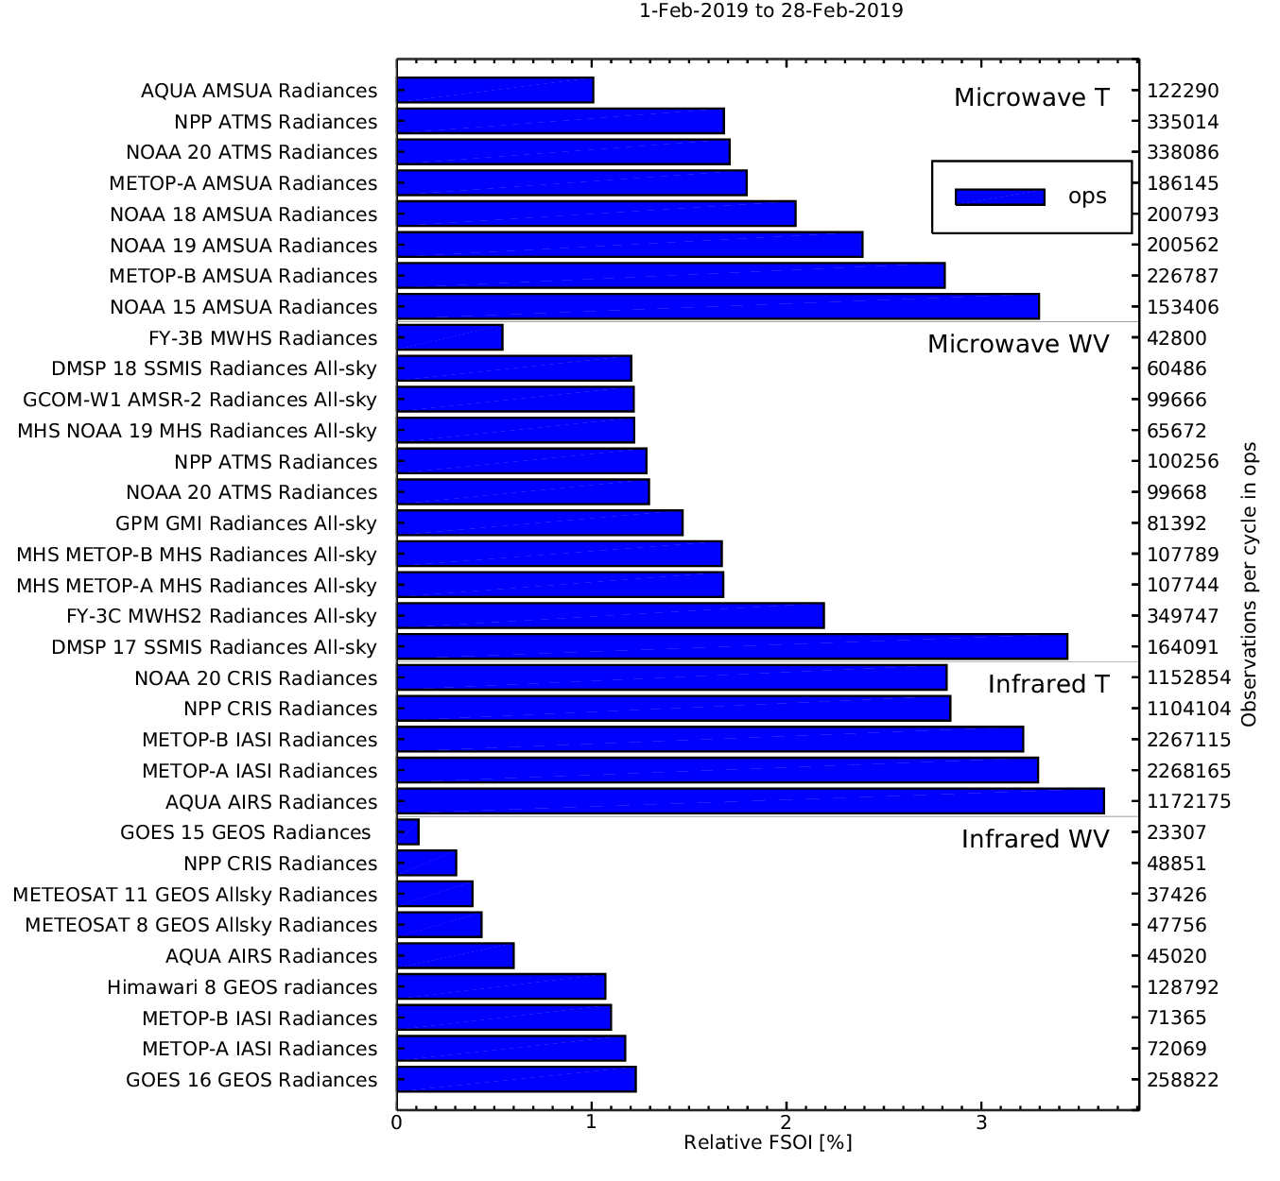
Forecast system performance
GOES-15 has 1 WV channel
Feb 2019
Met-8/10 have 2 WV channels
No. of observations per cycle
GOES-16/Himawari-8 have 3 WV channels
Measures reduction in 24hr forecast error due to each source
Forecast Sensitivity to Observations (%)

Slide 53
Summary and a look to the future

Slide 54
Summary: AMVs
?
Initial corrections
Quality control
?
Early use of satellite observations but lots of improvements
Most impact in low and high troposphere
Complicated and correlated errors
Positive impact on forecast

Slide 55
Summary: 4D-Var tracing
Complementary to AMVs
Good for broad scale motion
Timing and frequency of image matters
NWP models need information on the wind field – AMVs and CSR/ASR will continue to provide good quality observations with good coverage

Slide 56
Future challenges – new generation of imagers
Increases in spatial resolution
  E.g. Himawari-8 and GOES-16: 32x32km box for CSR
  Better cloud detection?
Increases in temporal resolution
  E.g. GOES-16 – full disk in 10 mins
  Constrain error growth in 4D-Var?
Hyperspectral instrument in geostationary orbit
  “3D winds” tracking temp/humidity/ozone profiles
  Higher sampling from radiances
Notes:
Better resolution could mean more pixels entirely cloudy or clear -> more ASR.
We haven’t saturated yet with benefit from more images. But be careful of correlated errors in AMVs.

Slide 57
Contents
Atmospheric Motion Vectors
What, when, where and why
How are AMVs derived?
How do we use them at ECMWF?
Wind indirectly from radiances
Introduction to clear sky/all sky radiances
Humidity tracing with radiances
Summary and future challenges
Introducing Aeolus

Slide 58
Aeolus Doppler wind lidar
Measures Doppler frequency shift of backscattered light
Scatters from:
  air molecules (clear air) – Rayleigh scattering
  particles (cloud/aerosol) – Mie scattering
Wind = average molecule/particle movement in volume of air
Measures line of sight speed
Polar orbiting satellite (320km)
Launched August 2018

Slide 59
Features of Aeolus winds
Advantages
High accuracy possible
Measurement closely linked with wind
Vertical profile – not just single layer estimate
Disadvantages
No transmission through thick clouds
Complex technology
Line of sight rather than vector wind
Limited horizontal sampling
Example of Aeolus vertical sampling
30 km ~10 hPa
16 km
16 km
Mie
Rayleigh
0 km
0 km
WGS84
Notes:
For Aeolus we want to measure the ground return signal because this provides a zero-wind reference, hence we aim to have the first range-bin intersecting orography; however this is not always possible.
"Aeolus only measures line of sight wind, not vector". However experiments have shown a LOS wind can give ~70% impact of vector wind in real assimilation experiments with conventional wind data.
"Limited sampling" to "Limited sampling in the horizontal - lidar 'curtain'". The vertical sampling is very good.

Slide 60
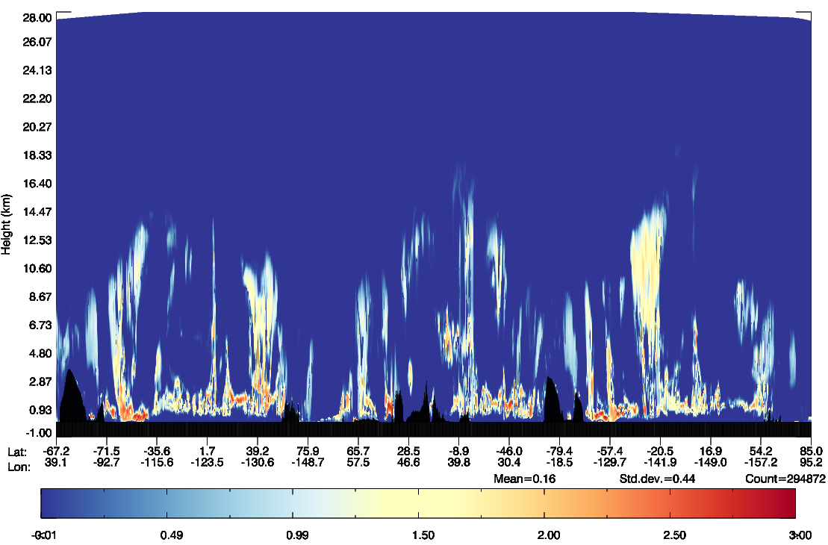
Rayleigh and Mie winds are complimentary
ECMWF model cloud

Slide 61
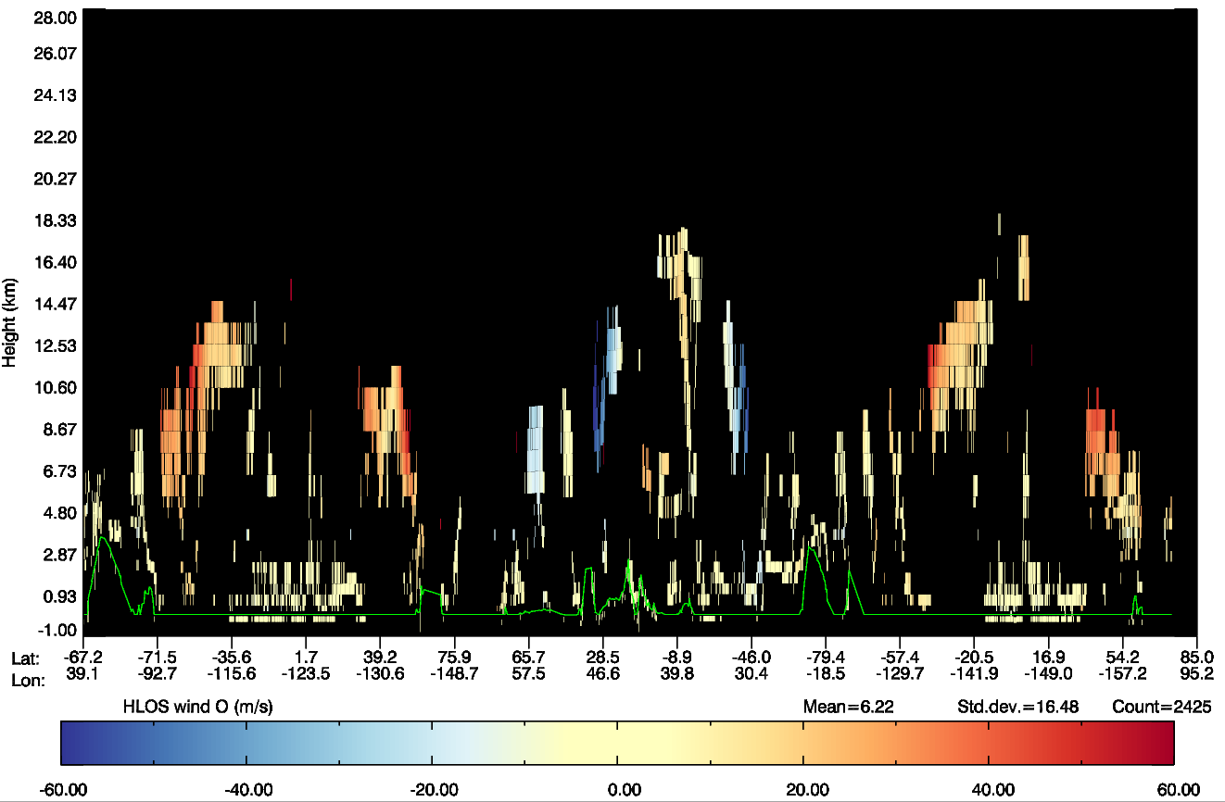
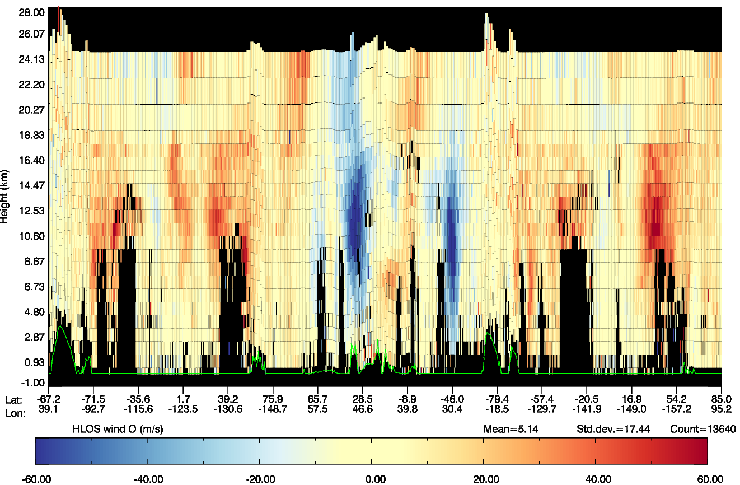
Rayleigh and Mie winds are complimentary
Mie-cloudy HLOS winds
Rayleigh-clear HLOS winds
~5.5 times more Rayleigh than Mie winds
Extinction below optically thick clouds

Slide 62
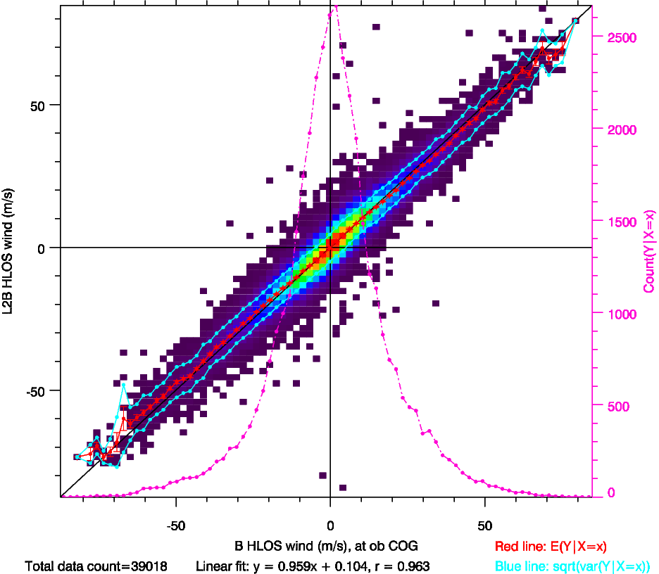
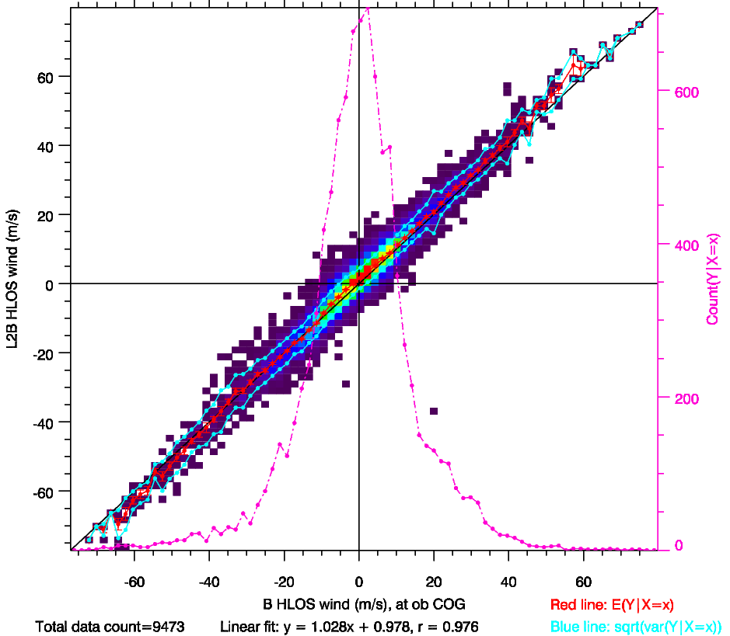
Aeolus HLOS winds compare very well with ECMWF’s model winds
Rayleigh-clear HLOS winds
Mie-cloudy HLOS winds

Slide 63
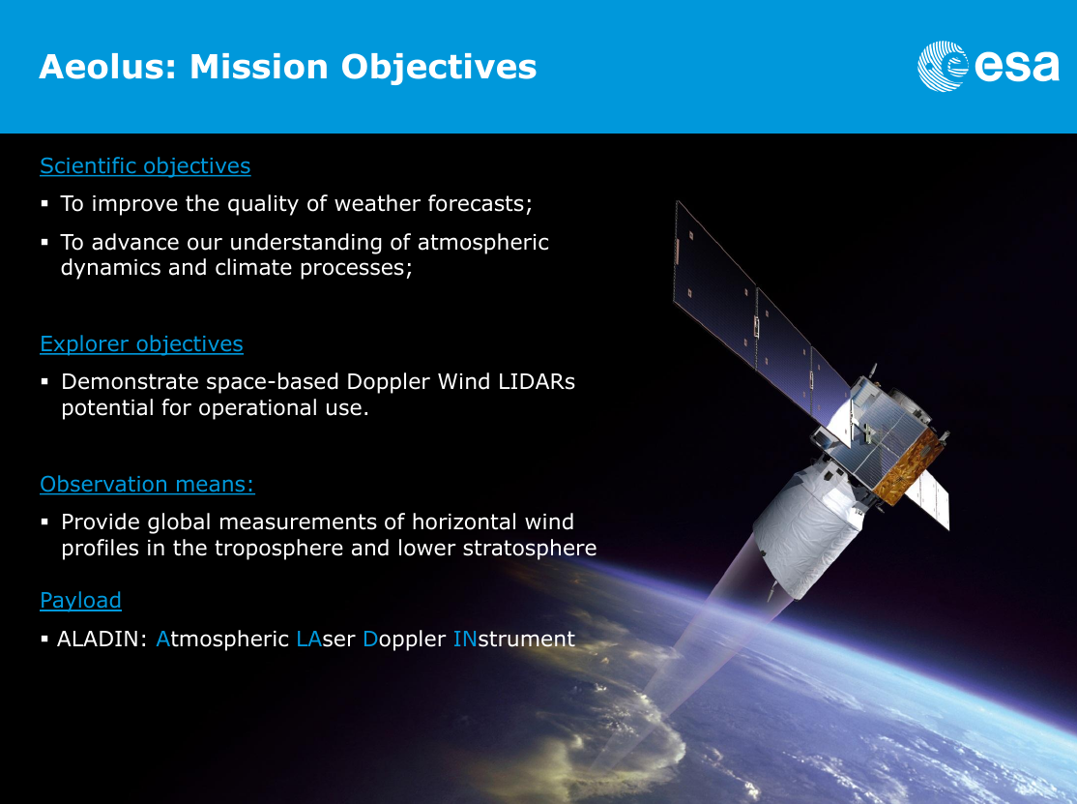

Slide 64
Thank you for listening!
Any questions?

Slide 65
Further information

Slide 66
History of AMVs
1960
1970s
Tetsuya “Ted” Fujita uses first images from polar orbiting TIROS
1966
ATS evolves into GOES -> routine tracking of clouds
Geostationary imager ATS-1
Fujita pioneers much of the work through 1960s and 1970s
1979
Improving all the time!
1978
More automation
More satellites
Quality indicators
Using polar orbiting satellites
Early cloud motion vector production peaks during study of global circulation
First Meteosat with water vapour channels

Slide 67

Pattern matching: how are the features tracked for AMVs?
Commonly based on cross-correlation statistics
N_{T} boxes
j
Covariance between target and search counts
N_{T} boxes
n
i
m
Coefficient for box at location (i, j)
Standard deviation of target area counts
Standard deviation of search area counts
x
Notes:
Determine the cross-correlation between the reference and test images for all possible shifts. i,j is an offset at which to calculate the coefficient each time.
Other methods are available e.g. Euclidean distance which uses a summed squared distance coefficient where the minimum of the surface gives the best match.
Bias and normalisation are also important to include in the calculation e.g. from local additive biases for changes in search area local means.

Slide 68
Pattern matching: how are the features tracked for AMVs?
Commonly based on cross-correlation statistics
Calculate r_{ij} linking pixel count values for each pixel in target and search area
Maximum in the correlation surface = best match
Carried out in spatial or Fourier domains
N_{T} boxes
Pixel counts in target area at (m,n)
Pixel counts in search area at (i+m, j+n)
Mean target area counts
j
Covariance between target and search counts
Mean search area counts
N_{T} boxes
n
i
m
Coefficient for box at location (i, j)
Standard deviation of target area counts
Standard deviation of search area counts
Notes:
Calculates cross-correlation coefficient linking pixel count values for each pixel in target and search area
Determine the cross-correlation between the reference and test images for all possible shifts. i,j is an offset at which to calculate the coefficient each time.
Other methods are available e.g. Euclidean distance which uses a summed squared distance coefficient where the minimum of the surface gives the best match.
Bias and normalisation are also important to include in the calculation e.g. from local additive biases for changes in search area local means.

Slide 69

AMV height assignment methods
Equivalent black-body temperature: comparing measured brightness temps (BTs) to forecast temp profiles. Best agreement = height
Carbon dioxide slicing:
Diff (cloudy – clear) actual radiances CO₂
Diff (cloudy – clear) actual radiances IR window
Diff (cloudy at varying cloud pressure – clear) estimated radiances CO₂
Diff (cloudy at varying cloud pressure – clear) estimated radiances IR window
Cloud fraction x cloud emissivity
  Details e.g. in Nieman et. al, 1993: A Comparison of Several Techniques to assign heights to cloud tracers. J. Appl. Meteor. 1559-1568
Notes:
Equivalent black-body temperature (EBBT) - based on comparing measured brightness temperatures to forecast temperature profiles. Level providing best agreement is chosen for the observation height. Method works best for opaque clouds and often assigns the observation too low for semitransparent and small clouds (Nieman et al. 1993)
Carbon dioxide slicing - combines infrared longwave-window channel data with carbon dioxide absorption channel data and then uses the ratio of the difference between the true cloud affected radiance and the estimate of the cloud-free radiance for the two different spectral channels. Effective for high level and some mid-level clouds but fail when the difference between the observed and clear radiances is less than the instrument noise in any of the channels. Typical situations when the methods fail are low clouds, or very thin cirrus clouds. The method has difficulties in multilayer cloud situations - in this case the observation height is assigned somewhere between the cloud layers.
Water vapour intercept - Uses water vapour and IR channels and height is found using the ratio described above with same success/difficulties.
Cloud base techniques - histogram of brightness temp is derived in the target area. Cloud base temp is estimated using Hermite polynomials fitted to the histograms. The obtained cloud base temp is compared with forecast temperature to determine the cloud base height. The cloud base height assignment method is used for low level clouds only.
(Hermite polynomials H_n(x) are set of orthogonal polynomials over the domain (-infinity, infinity) with weighting function e^(-x^2))

Slide 70
Height assignment methods
Equivalent black-body temperature: comparing measured brightness temps (BTs) to forecast temp profiles. Best agreement = height
Carbon dioxide slicing:
Water vapour intercept: uses same method as CO₂ slicing with water vapour and IR channels
Diff (cloudy – clear) actual radiances CO₂
Diff (cloudy – clear) actual radiances IR window
Diff (cloudy at varying cloud pressure – clear) estimated radiances CO₂
Diff (cloudy at varying cloud pressure – clear) estimated radiances IR window
Cloud fraction x cloud emissivity
  Details e.g. in Nieman et. al, 1993: A Comparison of Several Techniques to assign heights to cloud tracers. J. Appl. Meteor. 1559-1568
Notes:
Equivalent black-body temperature (EBBT) - based on comparing measured brightness temperatures to forecast temperature profiles. Level providing best agreement is chosen for the observation height. Method works best for opaque clouds and often assigns the observation too low for semitransparent and small clouds (Nieman et al. 1993)
Carbon dioxide slicing - combines infrared longwave-window channel data with carbon dioxide absorption channel data and then uses the ratio of the difference between the true cloud affected radiance and the estimate of the cloud-free radiance for the two different spectral channels. Effective for high level and some mid-level clouds but fail when the difference between the observed and clear radiances is less than the instrument noise in any of the channels. Typical situations when the methods fail are low clouds, or very thin cirrus clouds. The method has difficulties in multilayer cloud situations - in this case the observation height is assigned somewhere between the cloud layers.
Water vapour intercept - Uses water vapour and IR channels and height is found using the ratio described above with same success/difficulties.
Cloud base techniques - histogram of brightness temp is derived in the target area. Cloud base temp is estimated using Hermite polynomials fitted to the histograms. The obtained cloud base temp is compared with forecast temperature to determine the cloud base height. The cloud base height assignment method is used for low level clouds only.
(Hermite polynomials H_n(x) are set of orthogonal polynomials over the domain (-infinity, infinity) with weighting function e^(-x^2))

Slide 71
Height assignment methods cont.
Cloud base techniques: histogram of BTs for target area. Cloud base temp estimated from histograms and compared with forecast temp to get best cloud base height
Optimal Cloud Analysis: uses a 1-D optimal estimation approach to get cloud parameters and tests for multi-layer cloud situations
All have assumptions affecting accuracy
Errors in short range NWP
Errors in radiative transfer
Error in height assignment dominant source of error for AMVs
Notes:
the uncertainty comes from
both the methods and the assumption of trying to assign the cloud motion
to a representative height ("somewhere" in the cloud)

Slide 72
Situation dependent observation errors: equation for error in height
Diff wind component (model level – at observation location)
Height error
Weight per model level, i
Diff pressure (model level at obs location – assigned pressure)
Layer thickness
Error in height assignment estimated by standard deviation (AMV pressure - model pressure minimising vector diff (observed – model) wind)
Height assignment error (hPa) for Meteosat-10
Calculate separately for u and v components

