Slide 1
ECMWF/EUMETSAT NWP-SAF Satellite data assimilation Training Course
March 2019

Slide 2
Practical Exercises with RTTOV

Slide 3
Practical Session with RTTOV….Getting started….
1) Open a linux window on your machine:
2) To run the RTTOV GUI type:
rttovgui
3) Select “Open profile” from File menu
trxxxxx/RTTOV_GUI /background_profile.h5
4) View the profile you have selected:
Select “profile editor window” from the Windows drop down menu:
5) Select “load coefficients”: (from Rttov drop down menu)
trxxxxx/RTTOV_GUI/rtcoef_metop_1_amsua.dat
trxxxxx/RTTOV_GUI/rtcoef_metop_1_iasi.dat
6) Select “options editor window” from the Windows drop down menu:
Activate all trace gasses and ozone (hit APPLY)
7) Run the RTTOV!
select “Run RTTOV Direct” from the Rttov drop down menu

Slide 4
Variations: (editing the input profile…)
1) Select “profile editor window” from the Windows drop down menu:
2) Select the variable you wish to change
Use the Tabs on the upper right panel (T,Q,O3 etc..)
3) Select “change profile values” from Edit drop down menu
Scale the variable or apply an offset
4) Select “Apply change” from the File drop down menu:
Otherwise your change will not be saved!
5) Select “Run RTTOV direct” from Rttov drop down menu
6) Select “run_02 minus run_01” from “Pseudo run” tab of radiance viewer window

Slide 5
Practical Exercises with 1DVAR

Slide 6
How does the 1DVAR simulator work ?
Define a background profile Xb
Define a background error covariance B
Define a set of observations (instrument/channels) Y
Define an observation error covariance R
Define a true profile Xt
Simulate observed radiances Y from Xt (adding noise consistent with assumed R)
Compute H (RT model) applied to Xb

Slide 7
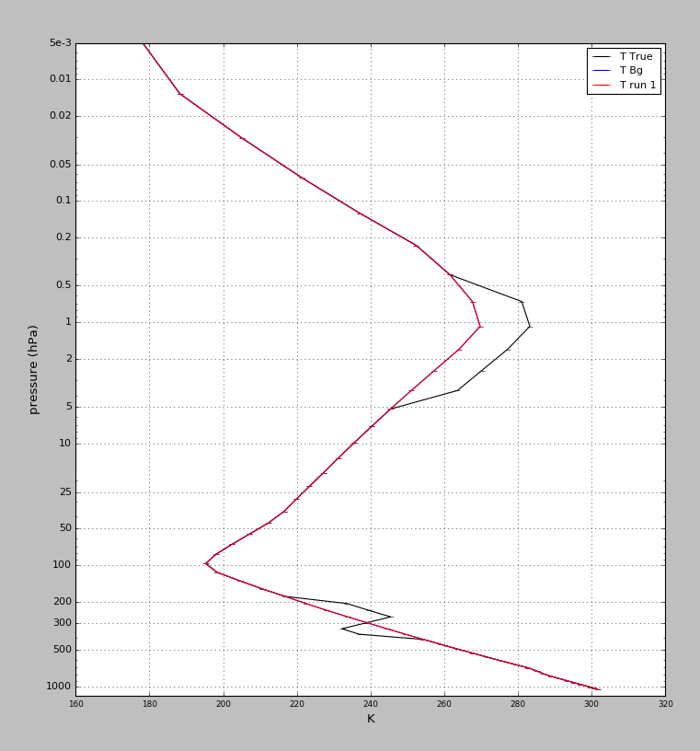
The Background and True profile
Can we push the background profile towards the truth using radiances ?

Slide 8
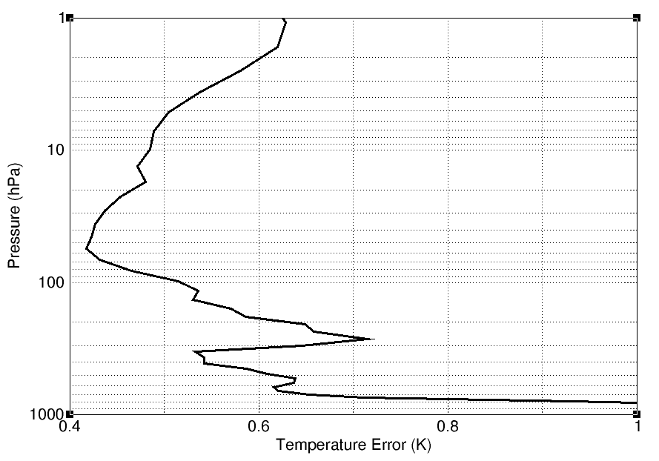
Assumed Background Errors (T)

Slide 9
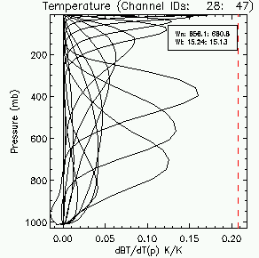
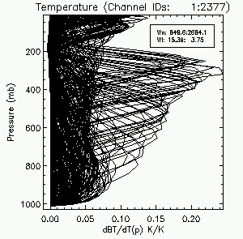
Weighting functions for AMSUA and IASI channels

Slide 10
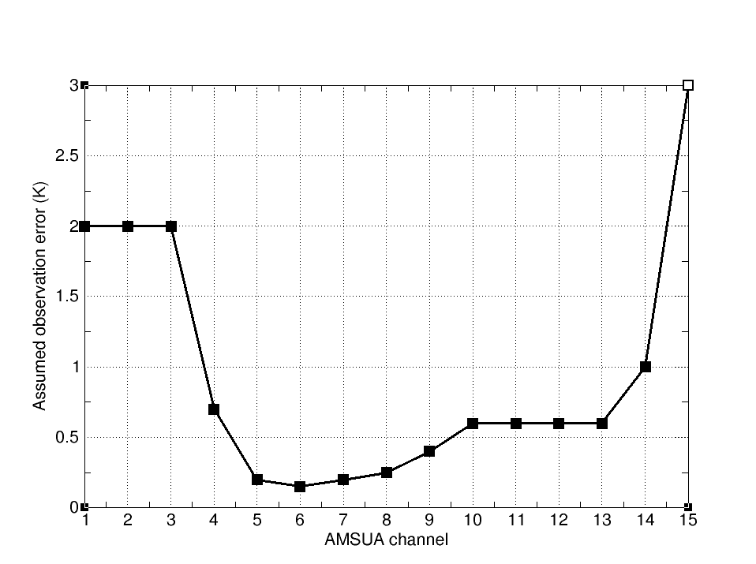
Assumed Observation error for AMSUA channels

Slide 11
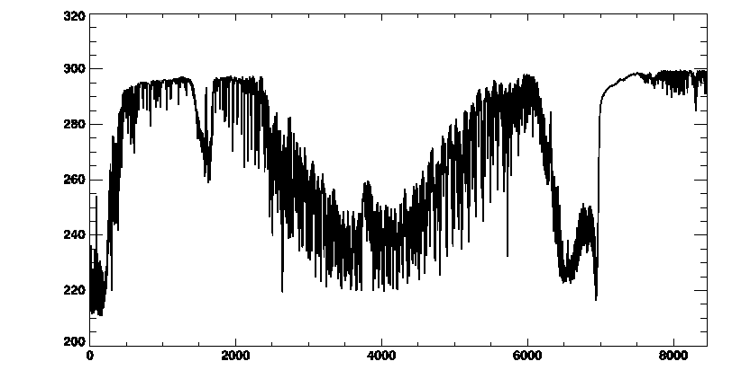
Assumed Observation error for IASI
1.0 K
2.0K
0.4K
15 um
6.4 um
4.2um
3.7 um

Slide 12
Practical Session with 1DVAR …using AMSUA
1) Open a linux window on your machine:
2) To run the RTTOV GUI type: rttovgui
3) Select “Open profile” from File menu: trxxxxx/RTTOV_GUI /background_profile.h5
4) Select “load coefficients”: (from Rttov drop down menu)
trxxxxx/RTTOV_GUI/rtcoef_metop_1_amsua.dat
6) Select “configure 1Dvar” from the 1Dvar drop down menu:
7) Select “Open a True Profile” : trxxxxx/RTTOV_GUI/true_profile_option4.h5
8) Select “RUN 1DVAR” …what do we notice about radiance differences/adjustment ?
9) select “Run RTTOV K” from the Rttov drop down menu (for KP=6 and KP=14)
So why is the profile adjustment so weak ?

Slide 13
Variations:
V1) Increase the background errors:
Slide “Assumed Background Error Scaling” from 10 to 100
Select “RUN 1DVAR” …what do we notice about the adjustment ?
V2) Decrease the observation errors:
Slide “Assumed Observation Error Scaling” from 10 to 1
Select “RUN 1DVAR” …what do we notice about the adjustment ?
Why can we not correct the feature in the troposphere ?
…What about using IASI ?

Slide 14
Quit rttovgui:
Select quit from File drop down menu

Slide 15
Practical Session with 1DVAR …using IASI
1) Open a linux window on your machine:
2) To run the RTTOV GUI type: rttovgui
3) Select “Open profile” from File menu: trxxxxx/RTTOV_GUI /background_profile.h5
4) Select “load coefficients”: (from Rttov drop down menu)
trxxxxx/RTTOV_GUI/rtcoef_metop_1_iasi.dat
5) select “Select Channels” from the Rttov drop down menu (slide thinning factor = 10)
6) Select “configure 1Dvar” from the 1Dvar drop down menu:
7) Select “Open a True Profile” : trxxxxx/RTTOV_GUI/true_profile_option4.h5
8) Select “RUN 1DVAR” …what do we notice about radiance differences/adjustment ?

Slide 16
Variations:
V1) Increase the background errors:
Slide “Assumed Background Error Scaling” from 10 to 100
Select “RUN 1DVAR” …what do we notice about the adjustment ?
V2) Decrease the observation errors:
Slide “Assumed Observation Error Scaling” from 10 to 1
Select “RUN 1DVAR” …what do we notice about the adjustment ?

