Slide 1
Observational bias correction in data assimilation and satellite data monitoring
Niels Bormann, with material from
Hans Hersbach, Dick Dee, and Mohamed Dahoui
NWP SAF Training Course
Use of satellite data
22 March 2019

Slide 2
Everyone knows that models are biased.
Not everyone knows that most observations (or their observation operators) are biased as well.
So… where is the bias term in this equation?
model background constraint
observational constraint
Bias: mean(y-h(x)) (can be situation-dependent)

Slide 3
Outline
Introduction
  Biases in models, observations, and observation operators
Variational analysis and correction of observation bias
  The need for an adaptive system
  Variational bias correction (VarBC)
Limitations of VarBC

Slide 4
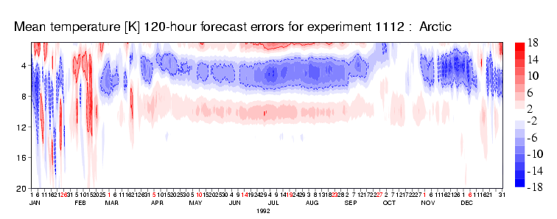
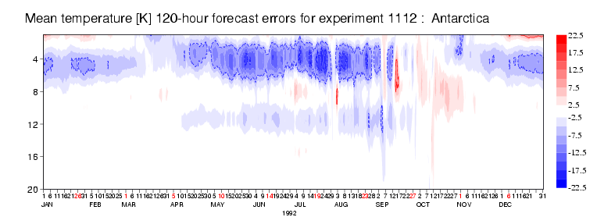
Model bias:
Seasonal variation in upper-stratospheric model errors
T255L60 model used for the ERA-Interim reanalysis
0.1hPa
(65km)
Arctic
Summer: Radiation, ozone?
40hPa
(22km)
0.1hPa
(65km)
Antarctic
40hPa
(22km)
Winter: Gravity-wave drag?

Slide 5
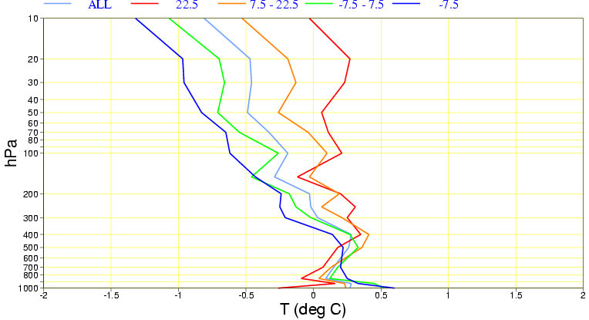
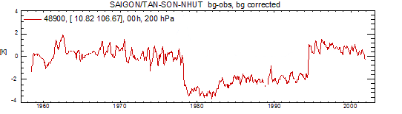
Observation bias:
Radiosonde temperature observations
Daytime warm bias due
to radiative heating of
the temperature sensor
(depends on solar elevation
and equipment type)
Mean temperature anomalies
for different solar elevations
Bias changes due to change of equipment
observed – ERA-40 background
at Saigon (200 hPa, 0 UTC)

Slide 6
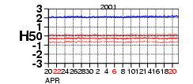
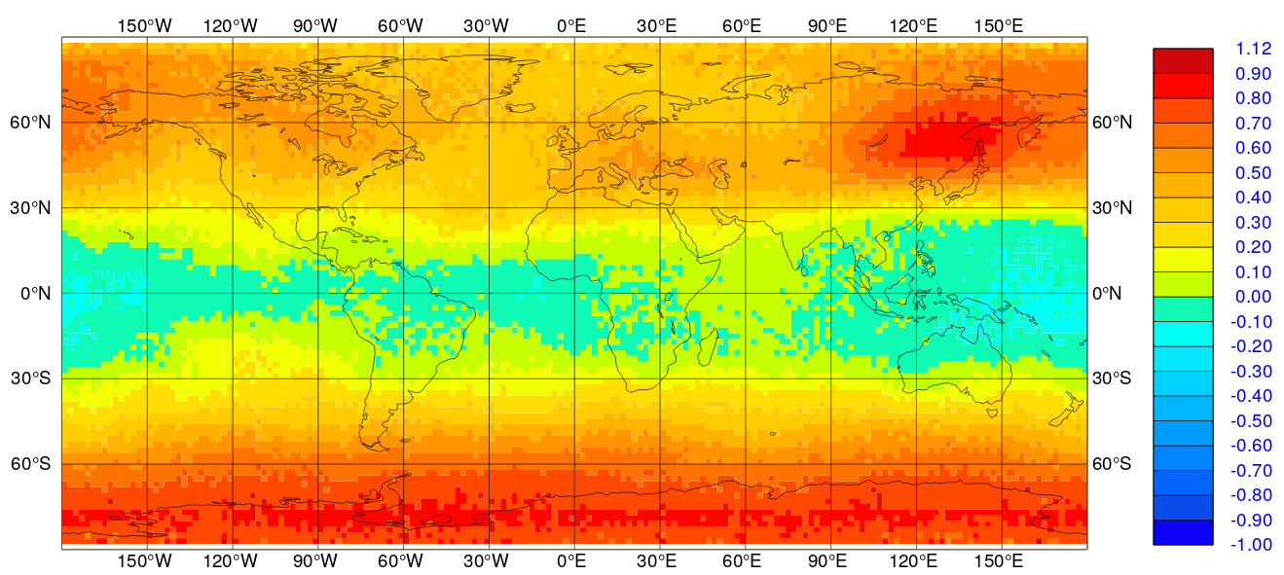
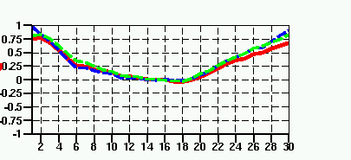
Biases seen with satellite radiances
Monitoring the background departures (averaged in time and/or space):
Constant bias (NOAA-14 HIRS ch 5)
Diurnal bias variation in a geostationary satellite
Obs-B bias [K]
Air-mass dependent bias (AMSU-A ch 8)
Bias depending on scan position
(AMSU-A ch 7) NH Trop SH
1.0
Obs-B bias [K]
0.0
high zenith angle
nadir
high zenith angle
-1.0

Slide 7
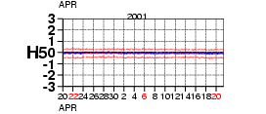
Observation and observation operator bias:
Satellite radiances – sources of bias
Monitoring the background departures (averaged in time and/or space):
HIRS channel 5 (peaking around
600hPa) on NOAA-14 satellite has
+2.0K radiance bias against FG.
Obs-FG bias [K]
Same channel on NOAA-16 satellite has
no radiance bias against FG.
Obs-FG bias [K]
NOAA-14 channel 5 has an instrument bias.

Slide 8
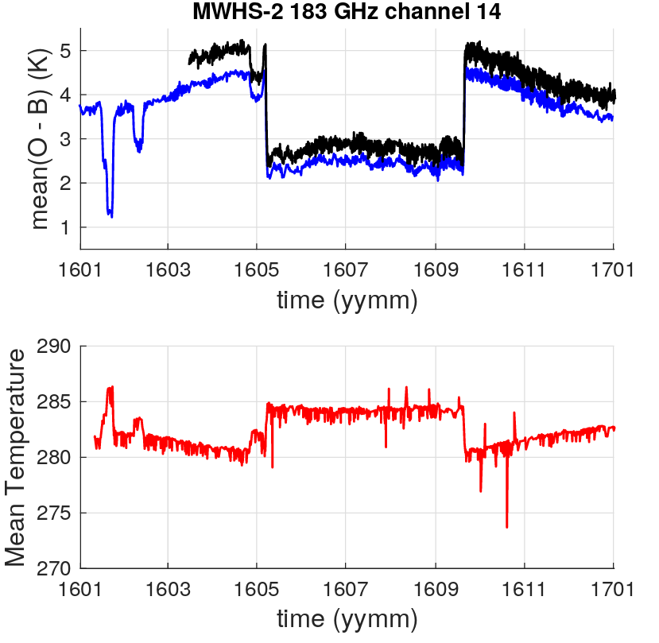
Observation and observation operator bias:
Satellite radiances – sources of bias
A time-varying bias, apparently dependent on the temperature of the satellite instrument:

Slide 9
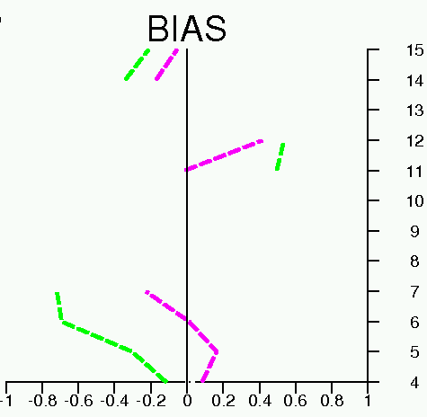
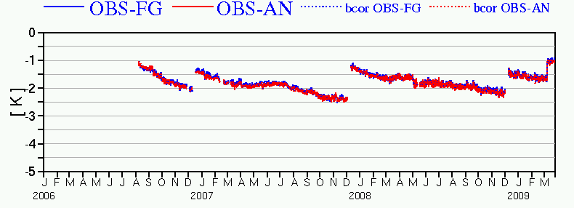
Observation and observation operator bias:
Satellite radiances – sources of bias
Different spectroscopy in the radiative transfer model can lead to different bias, e.g. for HIRS:
Obs-FG bias [K]
Other common causes for biases in radiative transfer:
Bias in assumed concentrations of atmospheric gases (e.g., CO₂, aerosols)
Neglected effects (e.g., clouds)
Incorrect spectral response function
….
Channel number
Old spectroscopy
New spectroscopy
Drift in bias due to ice-build up on sensor:
METEOSAT-9, 13.4µm channel:
Obs –FG Bias
Sensor decontamination

Slide 10
Outline
Introduction
  Biases in models, observations, and observation operators
Variational analysis and correction of observation bias
  The need for an adaptive system
  The variational bias correction scheme: VarBC
Limitations of VarBC

Slide 11
The need for an adequate bias model
Prerequisite for any bias correction is a good model for the bias (b(x,β)):
Ideally, guided by the physical origins of the bias.
In practice, bias models are derived empirically from observation monitoring after careful diagnosis of the bias.
Constant bias (HIRS channel 5)
Diurnal bias variation in a geostationary satellite
Obs-FG bias [K]
Air-mass dependent bias (AMSU-A ch 8)
Bias depending on scan
position (AMSU-A ch 7)
1.0
Obs-FG bias [K]
0.0
high zenith angle
nadir
high zenith angle
-1.0

Slide 12
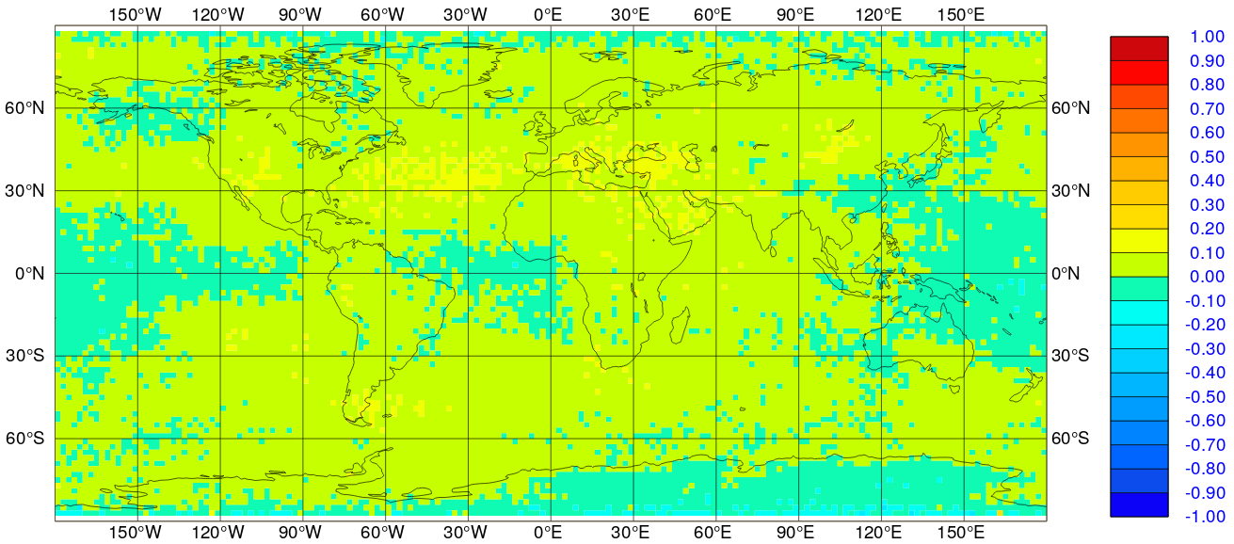
The need for an adequate bias model
Prerequisite for any bias correction is a good model for the bias (b(x,β)):
For instance, a linear model with some predictors p₁, p₂, … p_{n}, and free parameters β₀, β₁, β_{2,} … β_{n} : b(x,β) = β₀ + β₁ p₁ + β₂ p₂ + … + β_{n} p_{n}
Avoid models with too many free parameters.
1.0
Mean o-b before bias correction
0.0
After bias correction
-1.0
1.0
Example uses a linear bias model with a constant β₀ and four layer thicknesses as predictors (1000-300hPa, 200-50hPa, 50-5hPa,10-1hPa thickness) + a model for scan-bias
0.0
-1.0

Slide 13
Satellite radiance bias correction at ECMWF, prior to 2006
Scan bias and air-mass dependent bias for each satellite/sensor/channel were estimated off-line from background departures, and stored in files (Harris and Kelly 2001)
Error model for brightness temperature data:
where
Bias model
Predictors, for instance:
  1000-300 hPa thickness
  200-50 hPa thickness
  surface skin temperature
  total precipitable water
Average the background departures:
Bias coefficients
Periodically estimate scan bias and predictor coefficients:
  typically 2 weeks of background departures
  2-step regression procedure
  careful masking and data selection

Slide 14
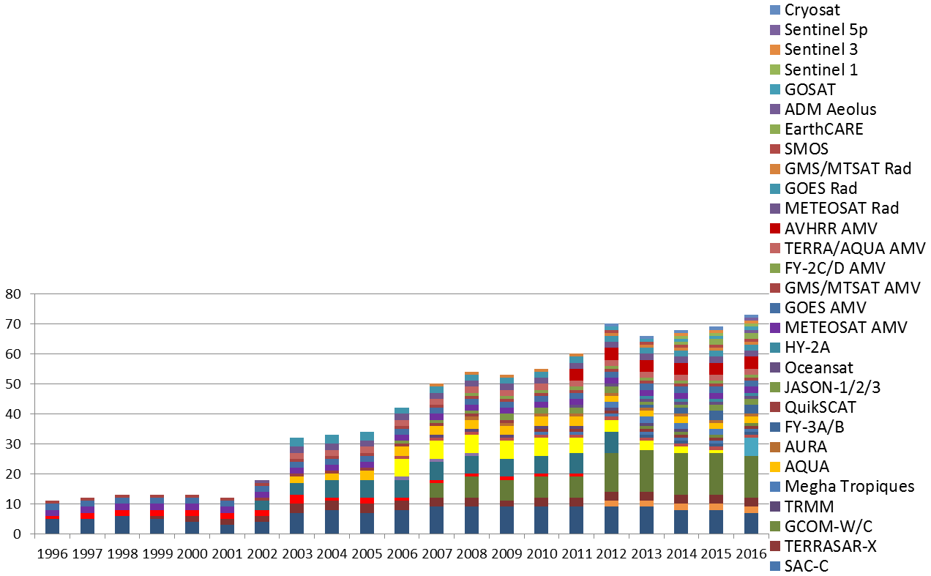
The need for an adaptive bias correction system
The observing system is increasingly complex and constantly changing
It is dominated by satellite radiance data:
  biases are flow-dependent, and may change with time
  they are different for different sensors
  they are different for different channels
How can we manage the bias corrections for all these different components?
This requires a consistent approach and a flexible, automated system

Slide 15
The Variational Bias Correction scheme:
The general idea
The bias in a given instrument/channel (bias group) is described by (a few) bias parameters:
typically, these apply to functions of air-mass and scan-position (the predictors)
These parameters can be estimated in a variational analysis along with the model state
(Derber and Wu, 1998 at NCEP, USA)
The original problem:
J_{b}: background constraint
J_{o}: observation constraint
The modified problem: Control vector becomes [x, β]
J_{b}: background constraint for x
J_{β}: background constraint for β
A model for the observation bias
Parameter estimates
from previous analysis
J_{o}: bias-corrected observation constraint

Slide 16
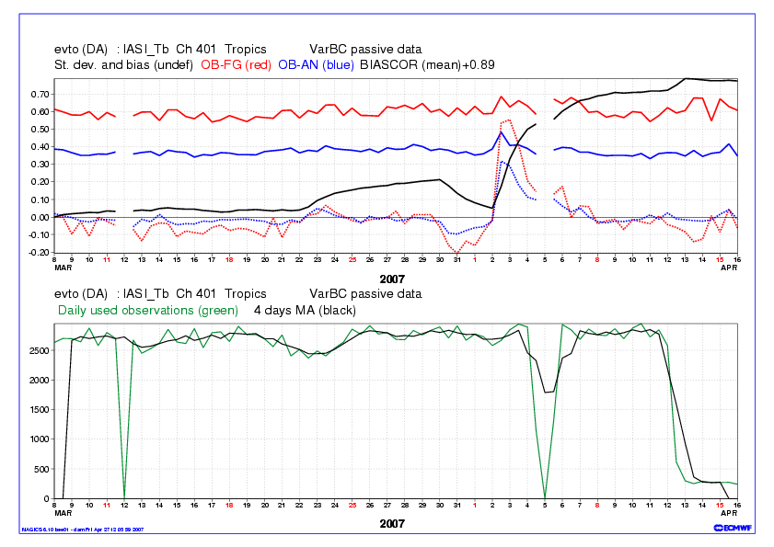
Example 1:
Spinning up new instruments – IASI on MetOp A
IASI is an interferometer with 8461 channels
Initially unstable – data gaps, preprocessing changes

Slide 17
Example 2:
NOAA-9 MSU channel 3 bias corrections (cosmic storm)
200 hPa temperature departures from radiosonde observations
Variational bias correction smoothly handles the abrupt change in bias:
    initially QC rejects most data from this channel
    the variational analysis adjusts the bias estimates
    bias-corrected data are gradually allowed back in
    no shock to the system!

Slide 18
Bias correction use at ECMWF
Current VarBC bias ‘classes’ in the ECMWF operational system:
Radiances
Ozone
Aircraft data
Ground-based radar precipitation
Other automated bias corrections, but outside 4D-Var:
Surface pressure
Radiosonde temperature and humidity
Soil moisture (in SEKF surface analysis)

Slide 19
Outline
Introduction
  Biases in models, observations, and observation operators
  Implications for data assimilation
Variational analysis and correction of observation bias
  The need for an adaptive system
  Variational bias correction (VarBC)
Limitations of VarBC

Slide 20
Limitations of VarBC:
Interaction with model bias
VarBC introduces extra degrees of freedom in the variational analysis, to help improve the fit to the (bias-corrected) observations:
It works well (even if the model is biased) when the analysis is strongly constrained by observations:
model
abundant observations
It does not work as well when there are large model biases and observation biases are poorly constrained (e.g., few anchoring observations; many bias-corrected observations with similar characteristics):
model
observations
VarBC is not designed to correct model biases: Need for a weak-constraint 4D-Var

Slide 21
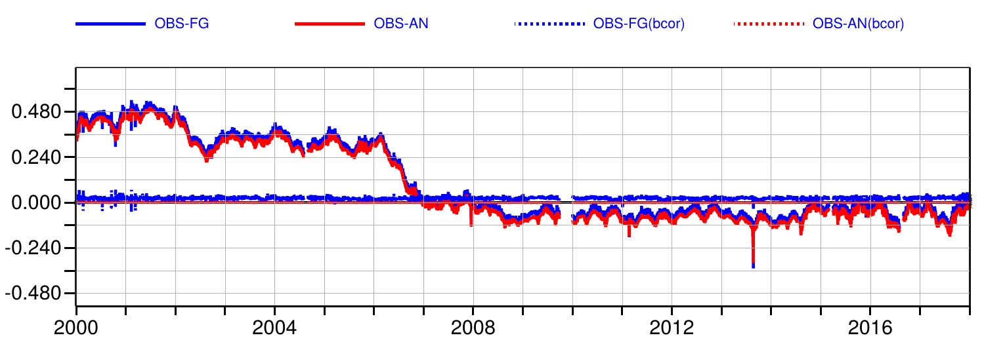
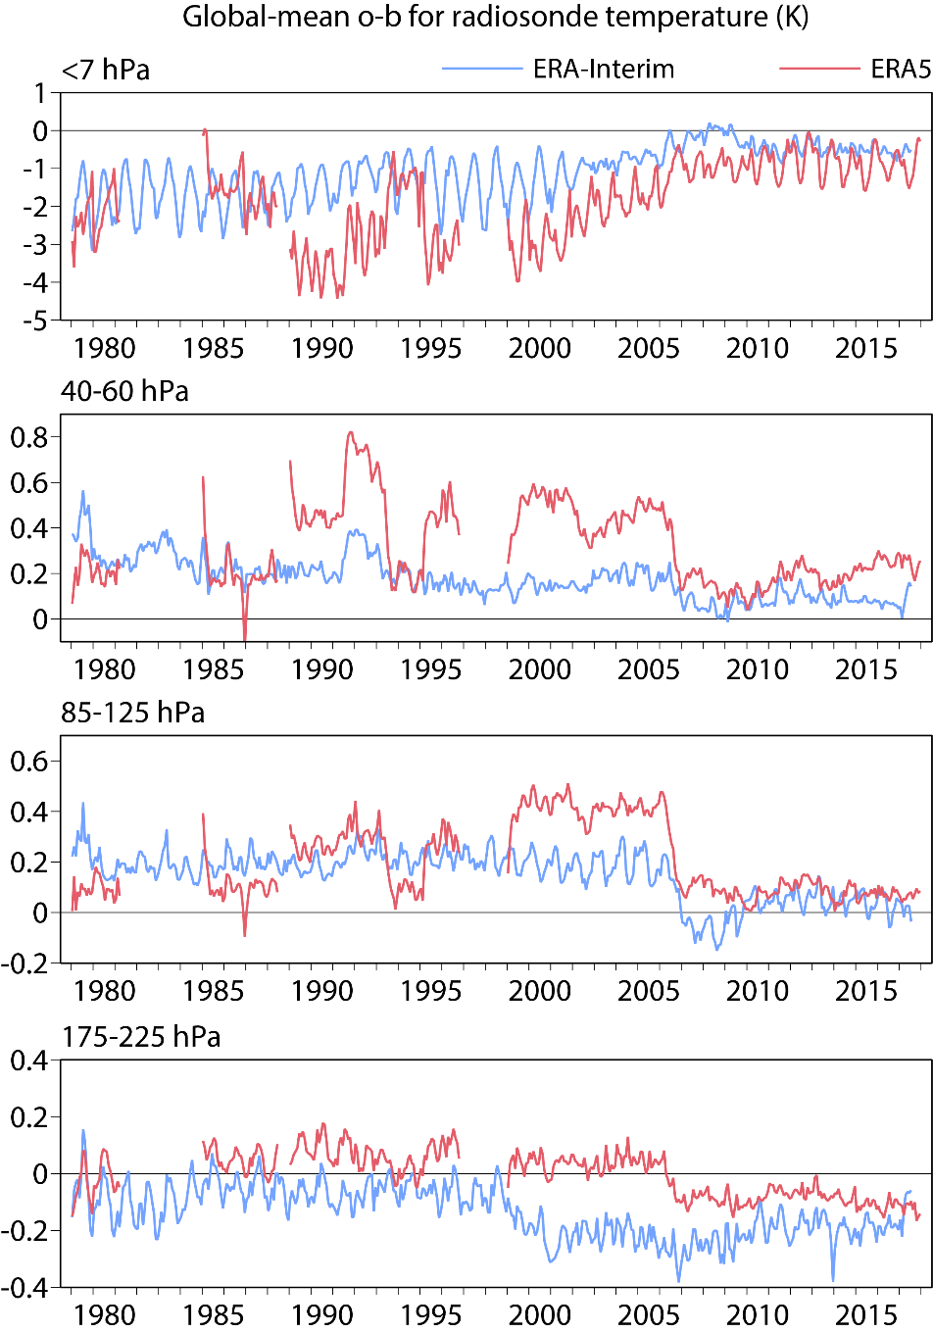
Limitations of VarBC:
Interaction with model bias and the role of anchor observations
Global mean NOAA-15 AMSU-A channel 9 bias in ERA-5
Example: Stratospheric temperature biases
Model biases affect the bias correction in the absence of sufficient anchor observations.
GPS-RO provides a good anchor from mid-2006.
The solution of the bias correction is also affected by other aspects, including the background error covariance.
Increased availability of GPS-RO data
Global mean sonde temperature bias 85-125 hPa
GPS-RO data provides a bias anchor in ERA-Interim and ERA-5

Slide 22
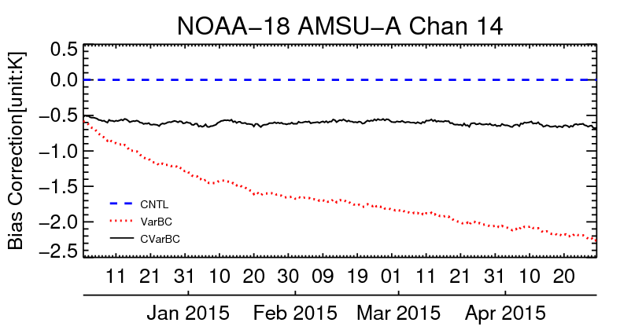
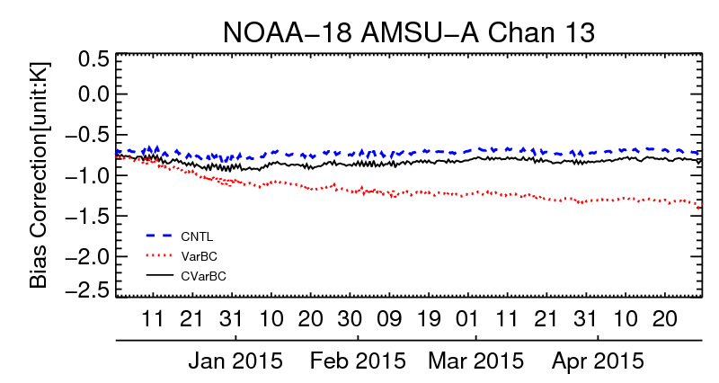
Limitations of VarBC:
Interaction with model bias: selecting an anchor
Example: Upper stratospheric temperature biases
Unrealistic drift in the bias corrections due to model bias (red line)
Additional anchoring is imposed through assimilating AMSU-A channel 14 without a bias correction (blue line)
Other anchoring: selected ozone-sensitive IR channels
(channel sensitive to temperature around 1-5 hPa)
Anchor 14
VarBC 14
(channel sensitive to temperature around 2-10 hPa)
Anchor 14
VarBC 14

Slide 23
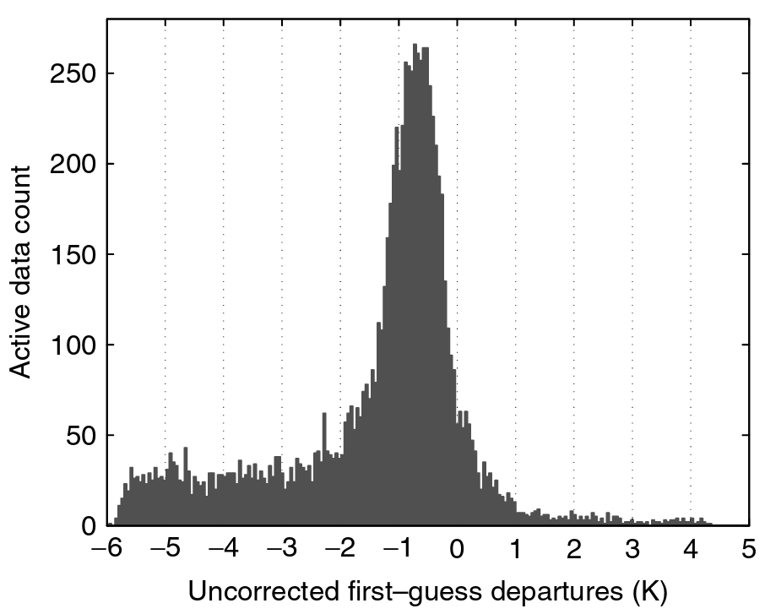
Limitations of VarBC:
Other pit-falls: Removing the signal
Avoid bias correction models with too many predictors, to avoid correcting for situation-dependent background errors/biases to be incorrectly removed.
Beware of interaction between VarBC and departure-based quality control and asymmetric distributions:
  Can lead to unwanted drifts in the population after QC
Histogram of IR window channel departures with cold cloud tail

Slide 24
Summary of bias correction part
Biases are everywhere:
Most observations cannot be usefully assimilated without bias adjustments
Manual estimation of biases in satellite data is practically impossible
Bias estimates can be updated automatically during data assimilation
Variational bias correction works best in situations where:
  there is sufficient redundancy in the data; or
  there are no large model biases
Challenges:
How to develop good bias models for observations
How to separate observation bias from model bias

Slide 25
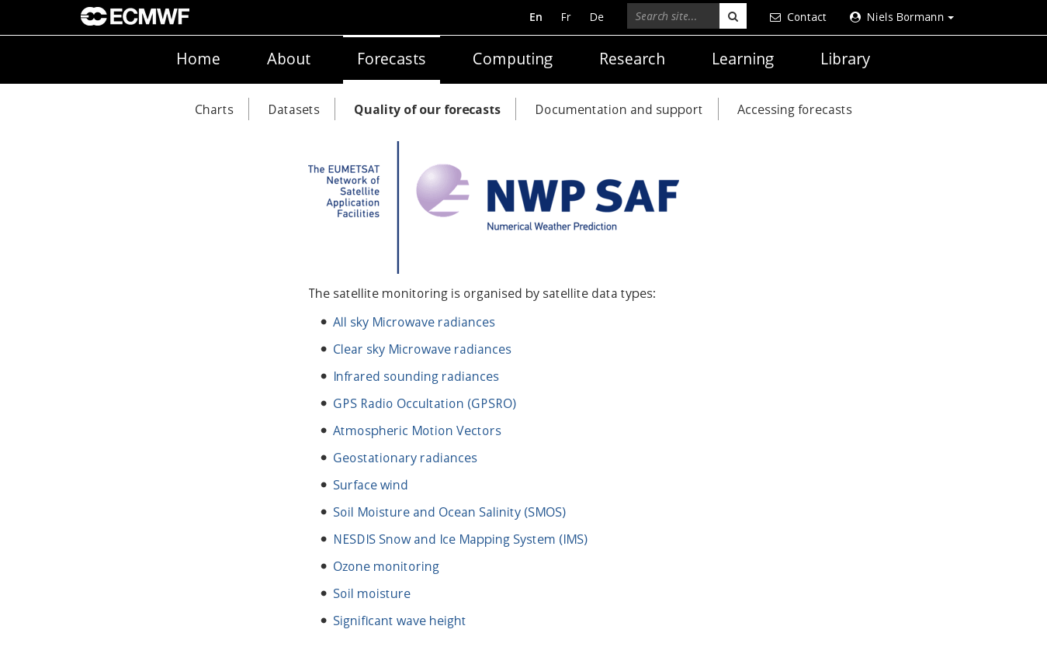
ECMWF satellite data monitoring
https://www.ecmwf.int/en/forecasts/quality-our-forecasts/monitoring-observing-system#Satellite

Slide 26
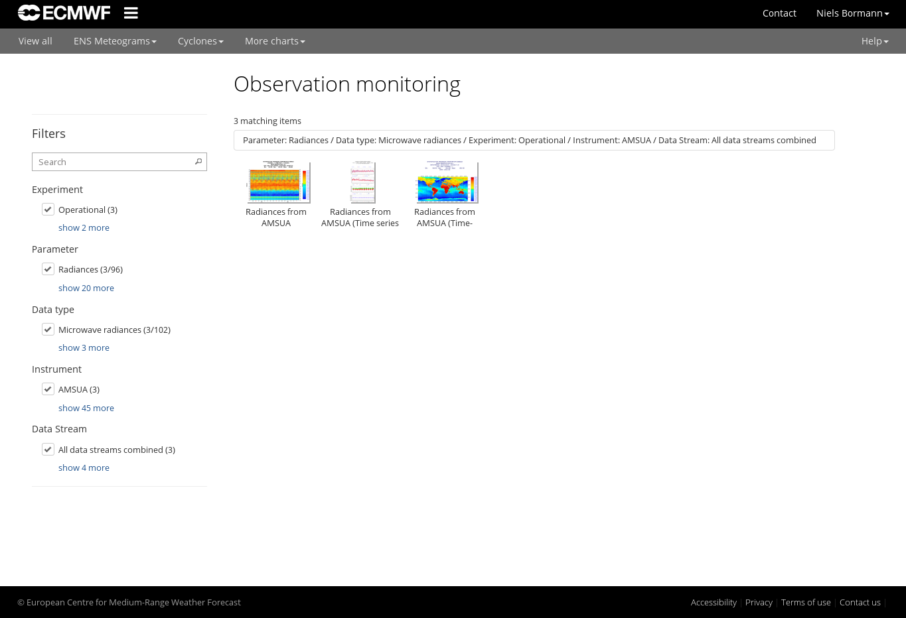
ECMWF satellite data monitoring
Main types of plots available:
Geographical maps
Time-series
Hovmoeller plots
Scan-dependent statistics
etc

Slide 27
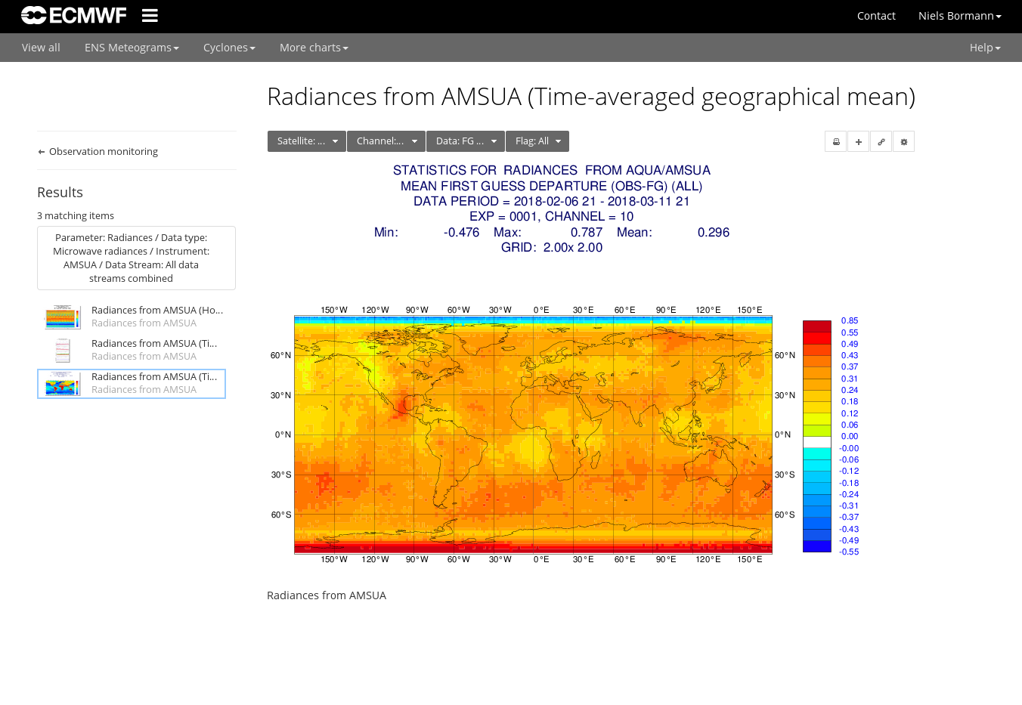
ECMWF satellite data monitoring

Slide 28
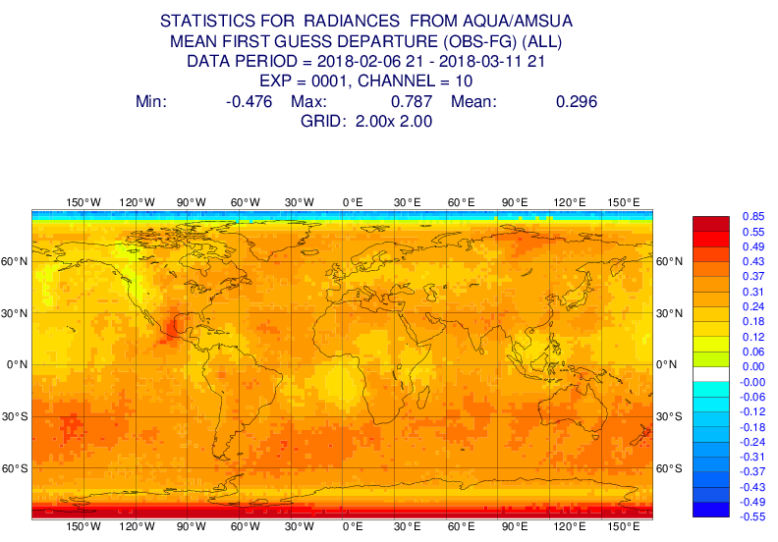
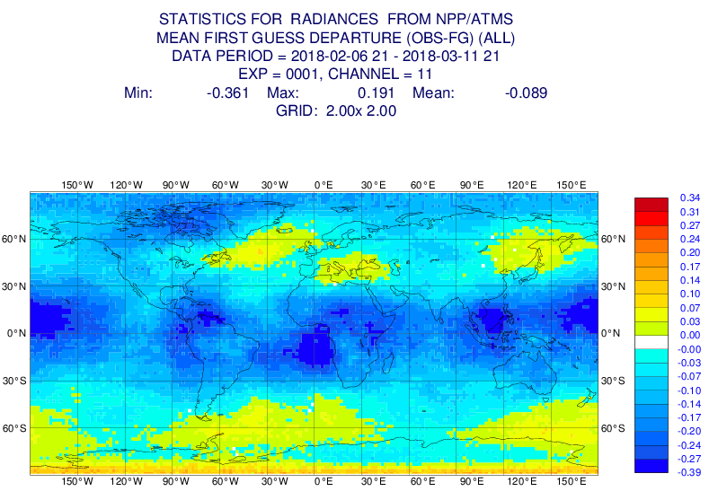
Mean background departures before bias correction for two similar channels on different satellites

Slide 29
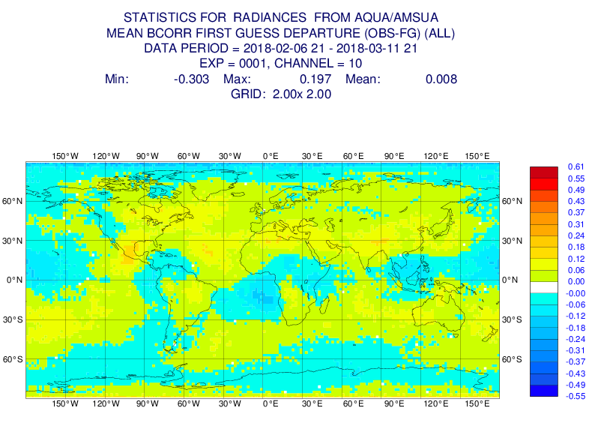
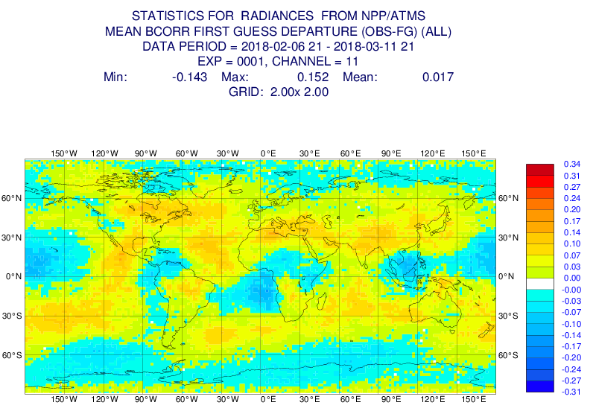
Mean background departures after bias correction for two similar channels on different satellites

Slide 30
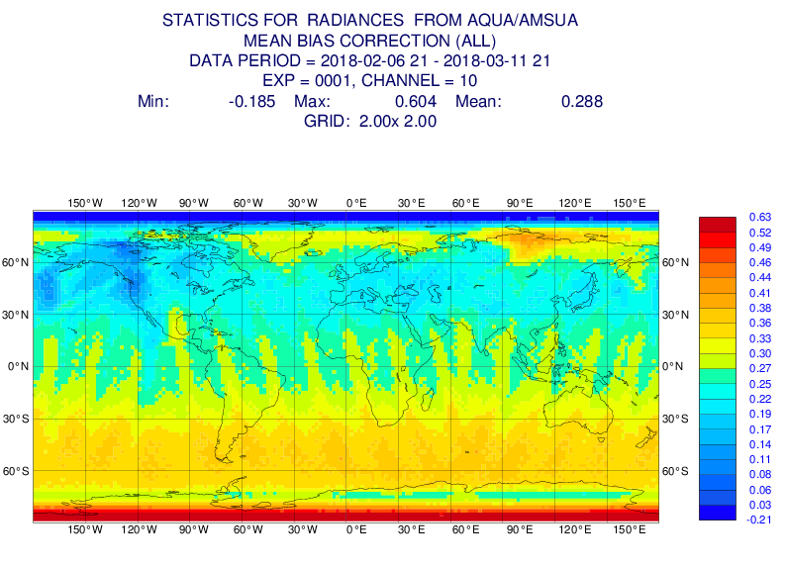
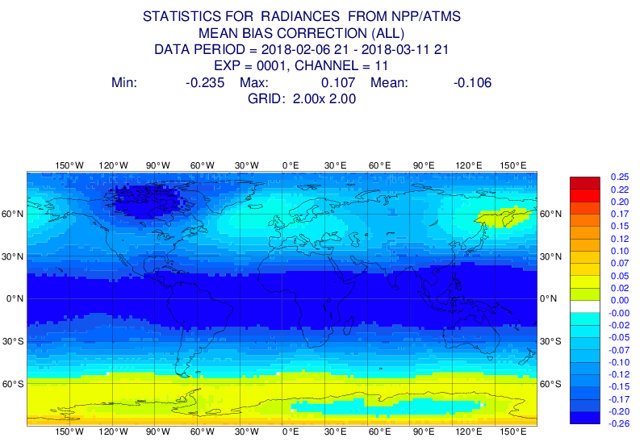
Mean bias corrections for two similar channels on different satellites

Slide 31
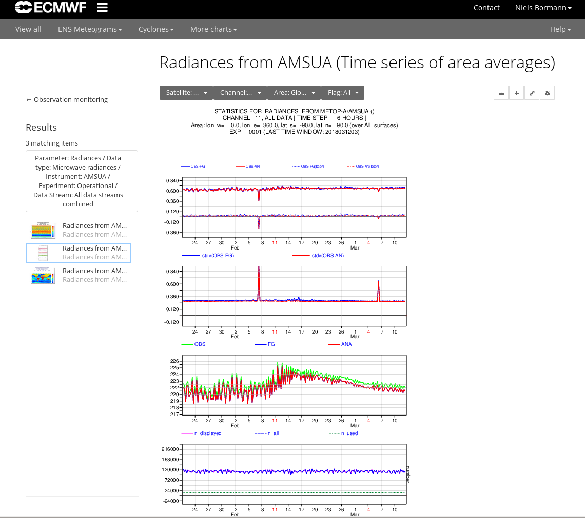
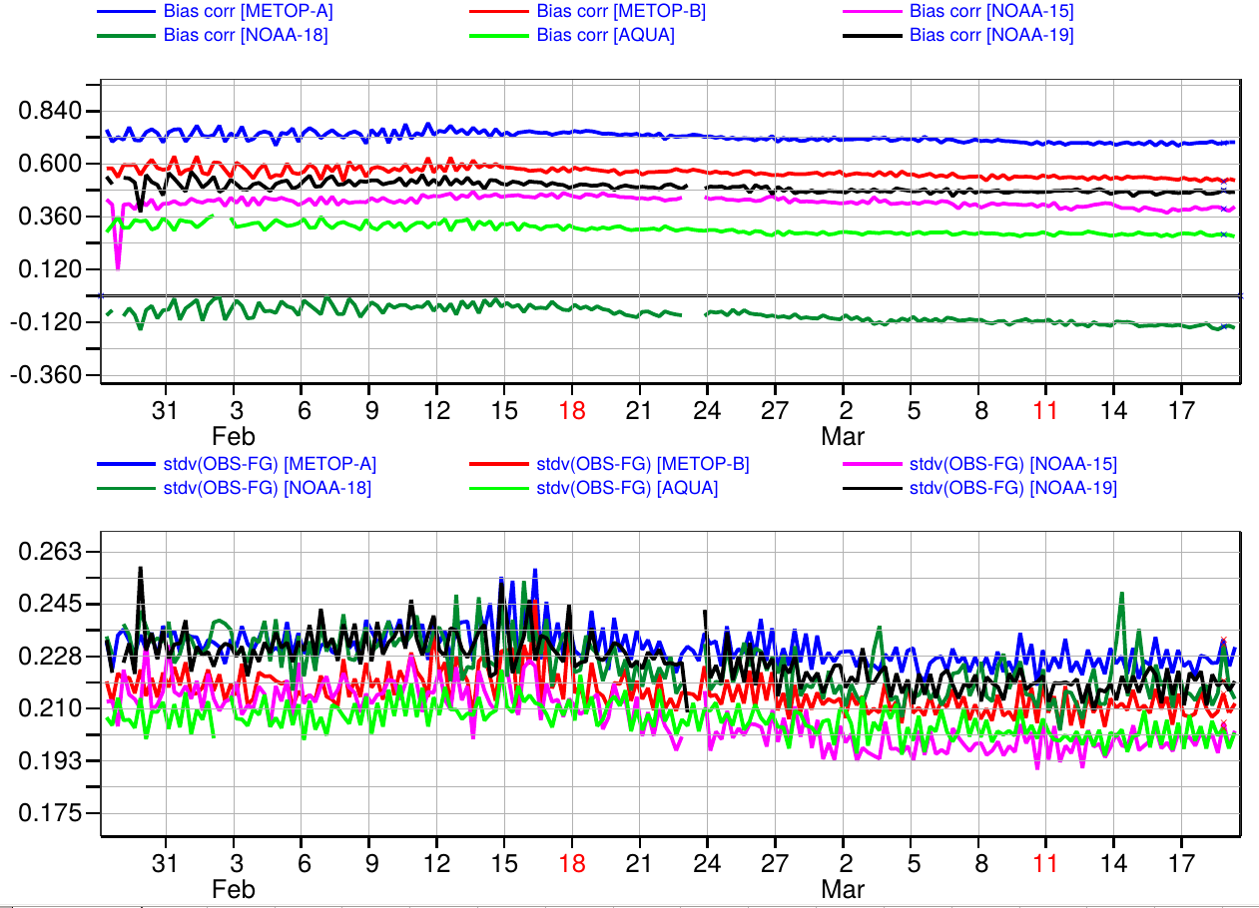
Channel 10, global statistics for used data

Slide 32
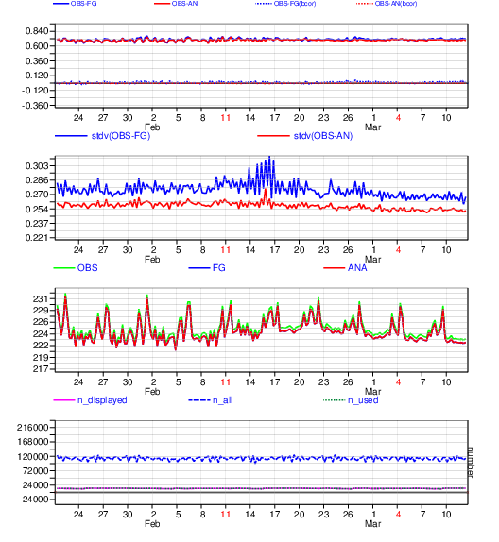
Compare with statistics for used data:
Poor data successfully removed by quality control in sample of used data

Slide 33
The need for an automatic alert system to detect anomalies

Slide 34
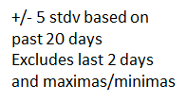
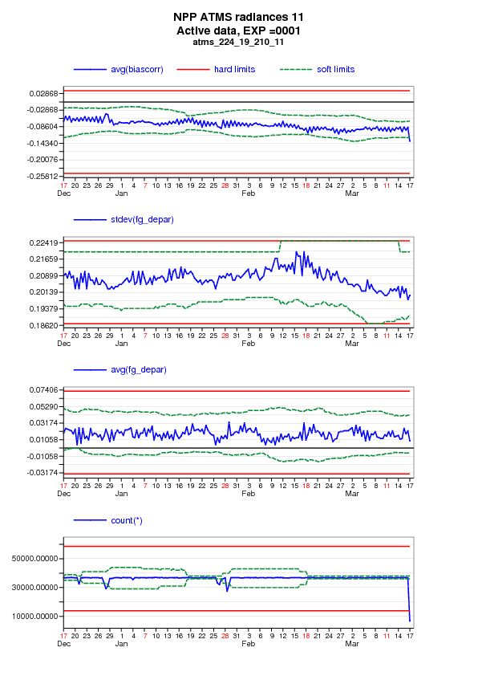
Feedback info (ODB)
ECMWF’s automated alert system
Past Statistics
Per Data type, channel
Current Statistics
Per Data type, channel
Set and adjusted manually
Hard limits
Detect slow drifts
Soft limits
Detect sudden changes
Anomaly detection
Various observation quantities
Ignore facility
Warning message
Web
E-mail
See also
http://apps.ecmwf.int/satellite-alerts/current/

Slide 35
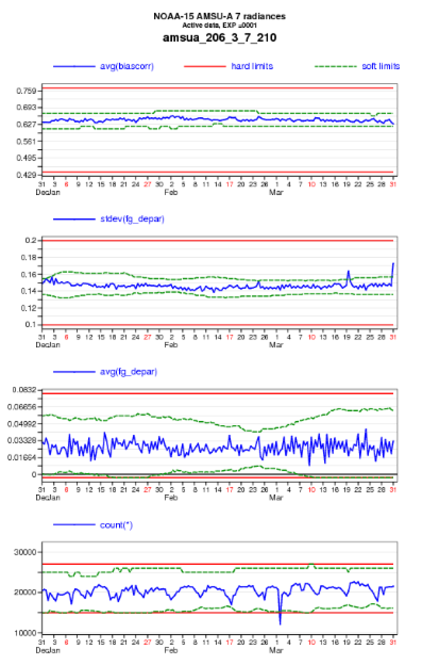
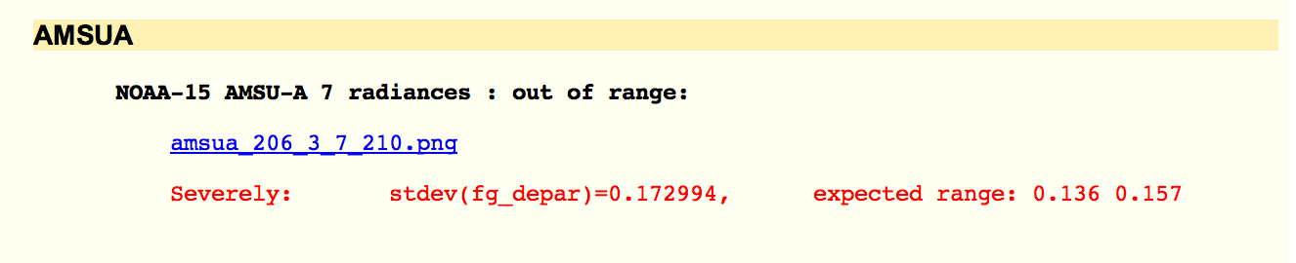
An example of an instrument noise problem…
See also
http://apps.ecmwf.int/satellite-alerts/current/

Slide 36
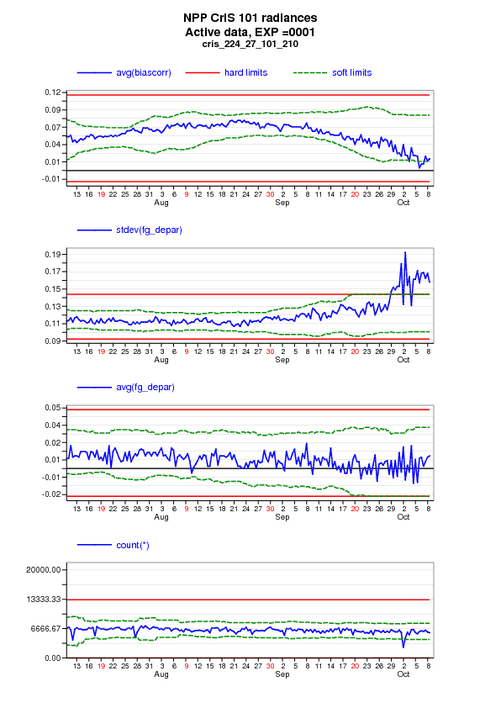
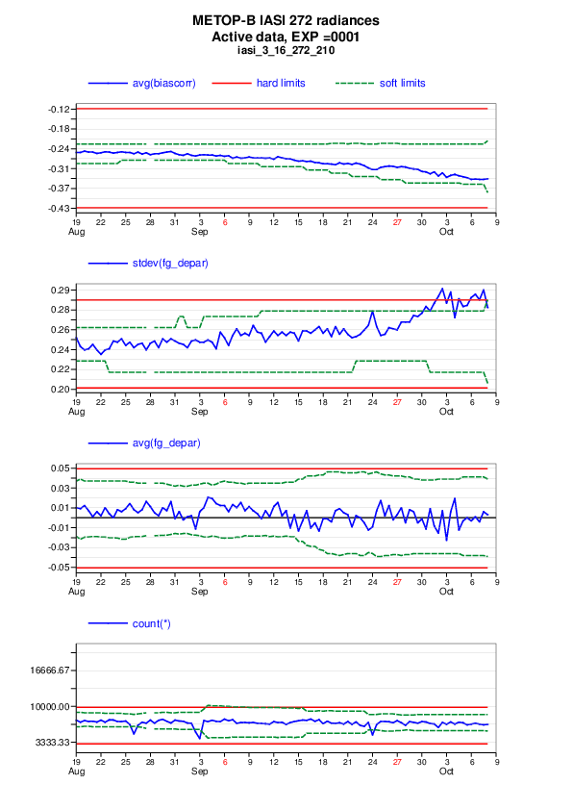
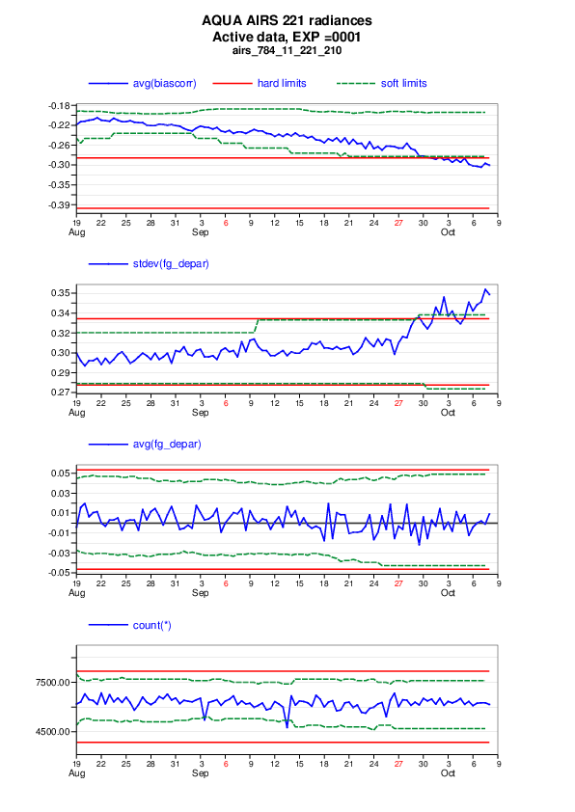
A different example of an alert…

Slide 37
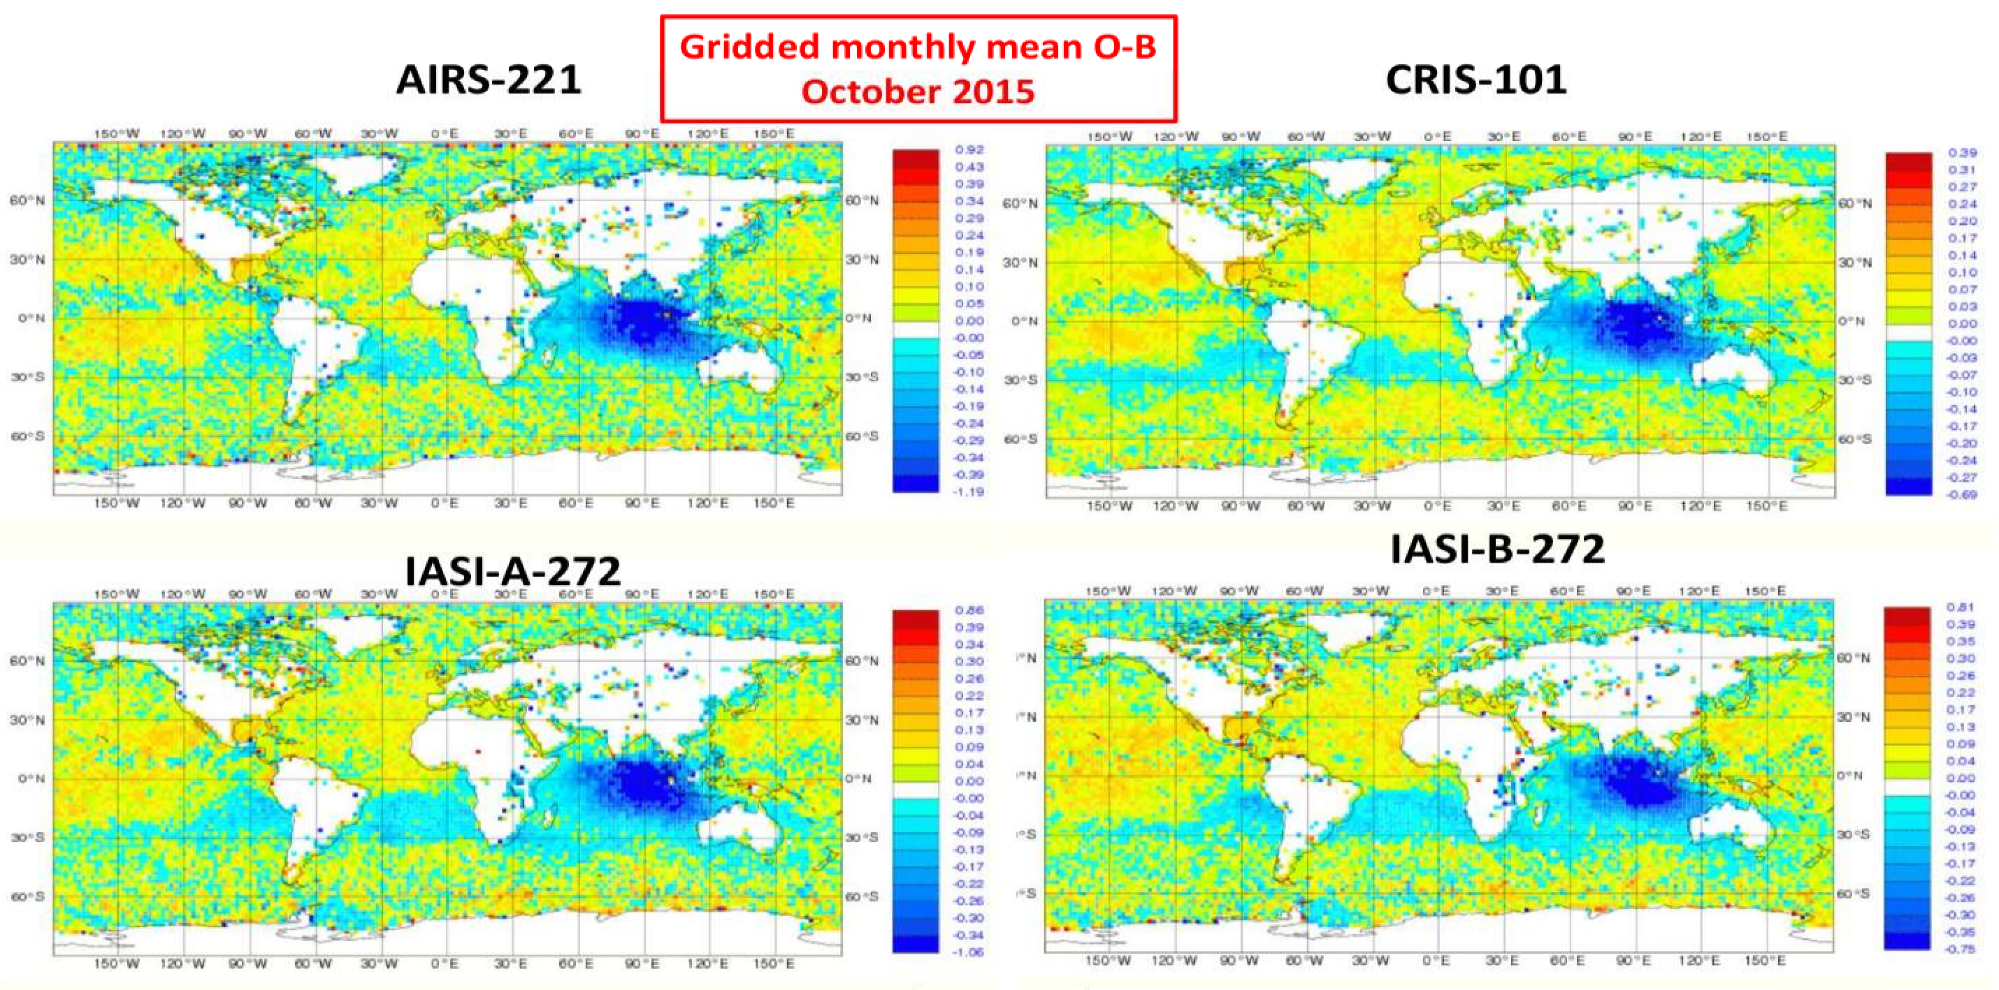
Alerts triggered by local bias signal in several IR channels around 712.5 cm⁻¹

Slide 38
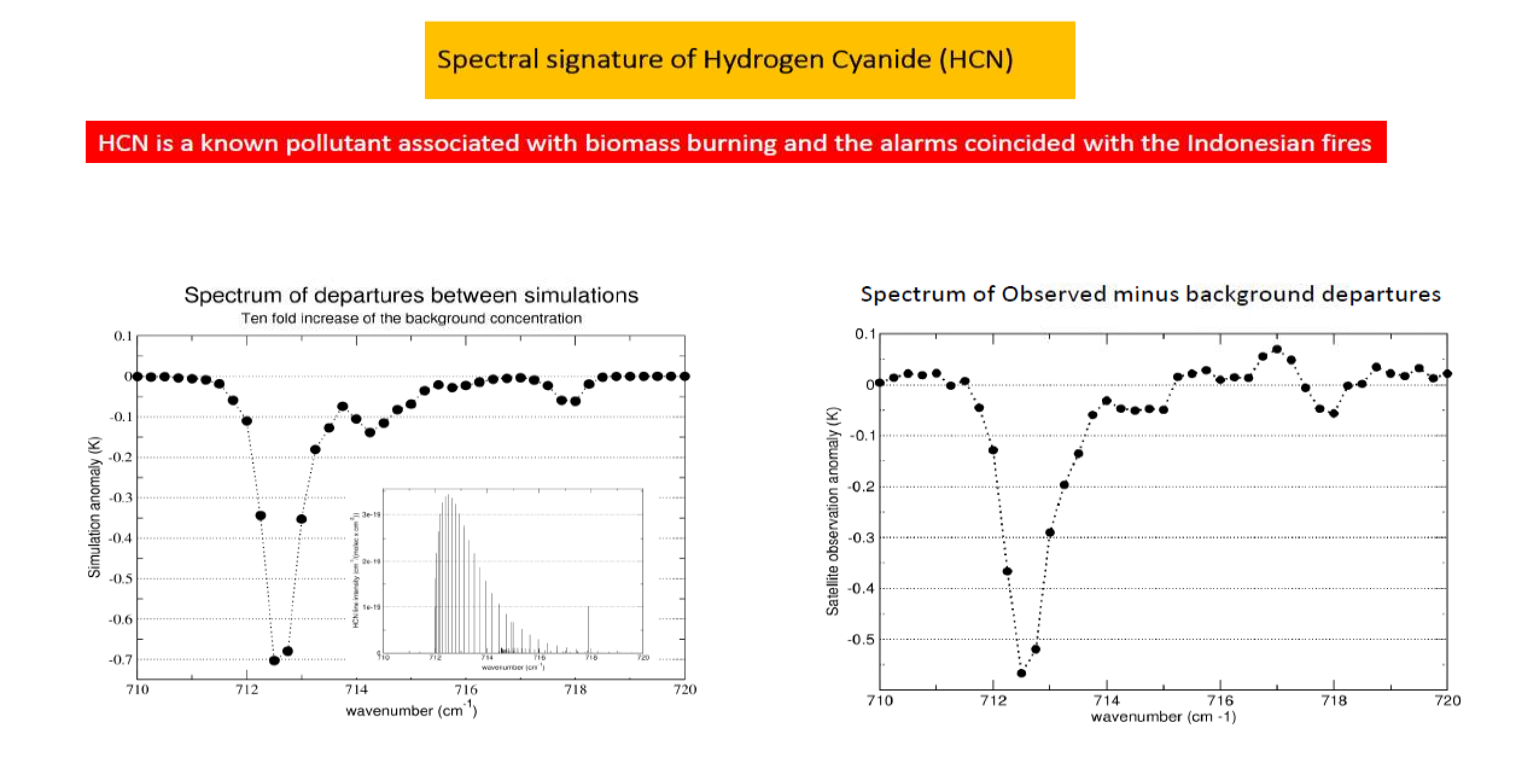
After some detective work….:
Local bias due to strongly increased levels of HCN over the Indian Ocean
→ Subsequently addressed through quality control

Slide 39
Summary on data monitoring
Monitoring of departure statistics is an essential aspect of data assimilation to
  Diagnose “health” of the assimilation system
  Diagnose model or observation biases
  Characterise the quality of observations in the context of the wider observing system (→ contribution to satellite cal/val)
  Characterise performance of bias correction schemes
  Respond to sudden anomalies in observations
  Etc.

Slide 40
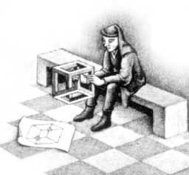
Additional information
Harris and Kelly, 2001: A satellite radiance-bias correction scheme for data assimilation. Q. J. R. Meteorol. Soc., 127, 1453-1468
Derber and Wu, 1998: The use of TOVS cloud-cleared radiances in the NCEP SSI analysis system. Mon. Wea. Rev., 126, 2287-2299
Dee, 2005: Bias and data assimilation. Q. J. R. Meteorol. Soc., 131, 3323-3343
Auligné, T. , McNally, A. P. and Dee, D. P., 2007: Adaptive bias correction for satellite data in a numerical weather prediction system. Q.J.R. Meteorol. Soc., 133: 631-642
Auligné, T. and McNally, A. P., 2007: Interaction between bias correction and quality control. Q.J.R. Meteorol. Soc.. 133: 643-653
Dee and Uppala, 2009: Variational bias correction of satellite radiance data in the ERA-Interim reanalysis. Q. J. R. Meteorol. Soc., 135, 1830-1841
Han and Bormann, 2016: Constrained adaptive bias correction for satellite radiance assimilation in the ECMWF 4D-Var system. ECMWF Technical Memorandum 783.
Feel free to contact me with questions:
Niels.Bormann@ecmwf.int

