Slide 1
Time stepping schemes for atmospheric modelling
by Michail Diamantakis (room 2107; ext. 2402)
michail.diamantakis@ecmwf.int

Slide 2
Atmospheric model (equation) formulations
Hydrostatic approximation
The very fast vertically propagating sound waves are filtered ⇒ no stability problems associated with very large acoustic CFL numbers in the vertical
Not accurate for high resolutions where convection is resolved by the model dynamics explicitly (see Inna’s lectures)
Anelastic approximation
sound waves filtered but unlike hydrostatic it has a prognostic equation for vertical motion
Non-hydrostatic (NH) equation model
Most accurate description. Best for resolutions that can resolve convection explicitly

Slide 3
What motions time-stepping should resolve?
  Rossby waves & slow gravity waves must be resolved and transported accurately – important for good weather predictions
  Fast acoustic waves carry little energy and are not important for weather but for stability reasons they may limit severely timestep
    To avoid such timestep restrictions, ideally an unconditionally stable numerical scheme is needed which may damp acoustic waves while is not damping other meteorologically important waves
  Very high orders of accuracy in time-stepping are not necessary:
    In any model, errors from other model components such as parametrizations are usually large enough to make use of very high integration order not a practical option. Often order 2-3 is sufficient (also depends on space discretization order)

Slide 4
Scalability: an important requirement
CPU clock-speeds have stagnated - even decreasing (to reduce energy consumption)
  More parallelism is the only way to achieve same time-to-solution when model resolution increases
Operational NWP solvers must scale well on very large number of cores ( >O(10⁴) )
Regular lat/lon grid global models are not practical at 1km scales:
  If explicit timestepping is used: meridian convergence at poles ⇒ extremely high resolution which limits severely ∆t
  If implicit: grid anisotropy near poles leads to poor convergence of elliptic solvers + high communication cost
Global spectral transform models with reduced Gaussian grids at 1km: may not scale well mainly due to high communication cost

Slide 5
Eulerian methods for numerical weather prediction (NWP) and climate
Mass conservation:
When the equation model is formulated in flux (conservation) form Eulerian time stepping together with some appropriate space discretization e.g. Finite Volume, Discontinuous Galerkin FEM is both locally and globally mass conserving
In explicit Eulerian conservative transport schemes the advective CFL must be < 1 for stability (unlike semi-Lagrangian semi-implicit which can run at CFL>1)
On quasi-uniform and unstructured meshes
Explicit methods: highly scalable (compact stencils without need for global communication) but need to use very short timestep
Implicit schemes: scalability depends strongly on elliptic solver (Müller & Scheichl QJRMS 2013)

Slide 6
Common time stepping schemes in NWP
Schemes currently used in atmospheric modelling
  Semi-Lagrangian, semi-implicit: unconditionally stable
  Flux-form Eulerian transport with semi-implicit timestepping for fast forcing term integration
  Split-explicit: “improved efficiency” explicit schemes
  HEVI: Horizontally Explicit / Vertically Implicit
    suitable for NH models as they use an implicit & unconditionally stable scheme in the vertical where highest CFL numbers occur
  IMEX: implicit-explicit Runge-Kutta schemes
    Implicit in the fast process, explicit in the slow.

Slide 7




MPDATA: positive definite conservative advection
Smolarkiewicz & Margolin (1998)
Upstream approximation of flux eqn:
MPDATA steps
Compute 1st order upstream approximation from etc
Subtract estimate of error to obtain 2nd order accuracy
where
Pseudo-velocity

Slide 8
A simple test model: 1d gravity wave equations
Fluid mean depth
Linearized:
Perturbation from
mean depth
Analytic solution of the form:
with a phase speed:

Slide 9
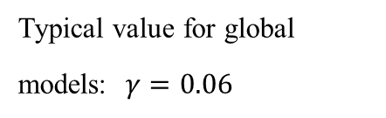
Explicit Leapfrog time stepping on 1D GW eqn
Three-time-level explicit Leapfrog scheme
Leapfrog on a general problem:
Leapfrog on 1D GW equations:
Neutral (no damping) + 2nd order BUT
phase + dispersion errors + computational mode
Von Neuman stability:
Solution is a combination of a physical and a “parasitical” computational mode
which can be damped by use of a time filter, e.g. Asselin filter
Typical value for global models: $γ=0.06$

Slide 10
A note on staggering
The prognostic variables can be
  On the same location on the grid, i.e. collocated
  In between (half way) each other, i.e. staggered
    Improved accuracy + dispersion properties
    On explicit techniques staggering results into a more restrictive timestep e.g.: instead of
x x x x x x x
  x o x o x o x o x o x o x

Slide 11
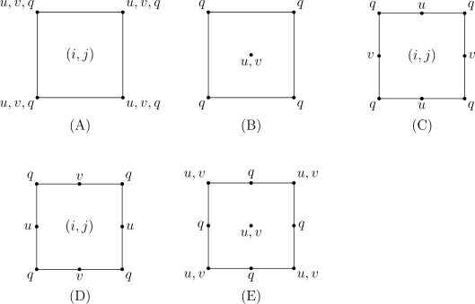
Different Arakawa horizontally staggered grids
“A benefit of C-grid is that it captures well the propagation of inertio-gravity waves and hence the process of geostrophic adjustment”
Arakawa and Lamb 1977
q: geopotential or pressure
(vertical staggering options: see Lorenz and Charney-Philips)
Fig source: Wikipedia By Rpnl ocn - Own work, CC BY-SA 4.0, https://commons.wikimedia.org/w/index.php?curid=47077493

Slide 12
Enhancing stability: forward-backward integration
• Forward-backward scheme: a predictor-corrector type scheme The predictor and the corrector are applied on separate equations.
forward
backward (pseudo-implicit)
Fwd-Bwd versus Leapfrog:
1. Wider stability region allowing twice as big timestep compared with leapfrog
2. Remains neutral (no damping)
3. Two-time-level scheme ⇒ no computational mode

Slide 13
Runge-Kutta RK3 scheme
• Runge-Kutta Wicker & Skamarock (MWR 2002) RK3 scheme:
- three-stage, two-time-level (2nd order) scheme from the RK family
A high order FD scheme is desirable option for estimating derivatives
Compared with leapfrog almost doubles (1.62) Δt when 3rd order spatial discretization used
In WRF this is used in combination with time-splitting …

Slide 14
Splitting the time integration: the motivation
In an atmospheric model we have motions with multiple time-scales: fast and slow changing processes co-exist
Explicit techniques are only conditionally stable and that imposes use of small timesteps for fast propagating waves or when the solution changes rapidly in general
If ∆t is the longest permissible timestep for integrating the slow process then ∆t will be too long for stable integration of the fast process
  A solution is to split the integration:
    integrate slow changing process with ∆t
    integrate fast changing process with a fraction of it i.e. ∆t/n

Slide 15
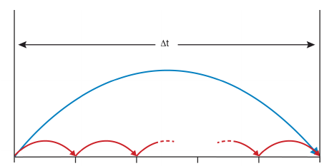
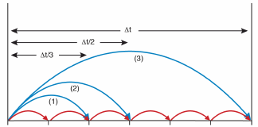
Split-explicit example in a diagram
Split-explicit Euler
Split-explicit RK3
1-cycle/per stage i: slow process integrated with Δt, each stage approximates solution at t+c_{i} Δt where, c_{i}=1/3,1/2,1 the RK3 coefficient
1-cycle: slow process integrated with Δt
n-cycles: fast process integrated with Δt/n
(Diagram courtesy of S.J. Lock, ECMWF Seminar proceedings 2013, HEVI time-stepping for NWP and climate models)

Slide 16
Split-explicit forward Euler integration
Fast forcing term
Slow forcing term
Fast term updated
Slow term kept constant (stored)
1*S + n_{s}*F evaluations
versus FW-Euler
n_{s} *S+ n_{s} *F evaluations

Slide 17
Split-explicit RK3 integration
S term is evaluated only once per stage and added at each sub-cycle

Slide 18
Leapfrog (3TL) split-explicit fw-bw example
fast/forward
slow/leapfrog
e.g.
backward
leapfrog
fast F terms updated
Slow terms kept constant

Slide 19
HEVI schemes
NH models: presence of sound waves poses a severe limit to timestep due to their high propagation speed. CFL in the vertical is much larger due to the vertical resolution being at the order of few meters only!
A solution is: Horizontally Explicit, Vertically Implicit schemes
Explicit scheme (or split explicit) in the horizontal where CFL is not as large as in the vertical due to coarser resolution
Unconditionally stable implicit scheme for the vertical to deal with high acoustic CFL numbers

Slide 20
Some HEVI / split-explicit models
ICON (Germany): global NWP and climate model
  forward-backward explicit time-stepping (no splitting) in the horizontal + vertically implicit (Crank-Nicolson)
EU-COSMO: operational NH LAM
  [Leapfrog (old model), RK3 (new model)] + split-explicit in the horizontal + Crank-Nicolson in the vertical
NICAM: cloud resolving NH global model (Japan)
  Split-explicit forward-backward in the horizontal + implicit in vertical
WRF, MPAS (USA): LAM, Global research & operational
  Split-explicit RK3 + vertically implicit

Slide 21
Drawbacks of the split-explicit approach
In deep global NH models O(100km) there is no much benefit from split-explicit approach in the horizontal
  Stratospheric polar jet velocities not far from speed of sound advective CFL number almost as big as acoustic CFL number
    Practically this means that all processes are fast and therefore horizontal splitting will not bring any efficiency benefit
  Splitting needs damping for stabilization
Alternatives:
  Implicit Explicit (IMEX) RK (unconditionally stable implicit scheme for fast processes and cheap explicit for slow)
  IMEX has very general form: HEVI can be written as IMEX

Slide 22
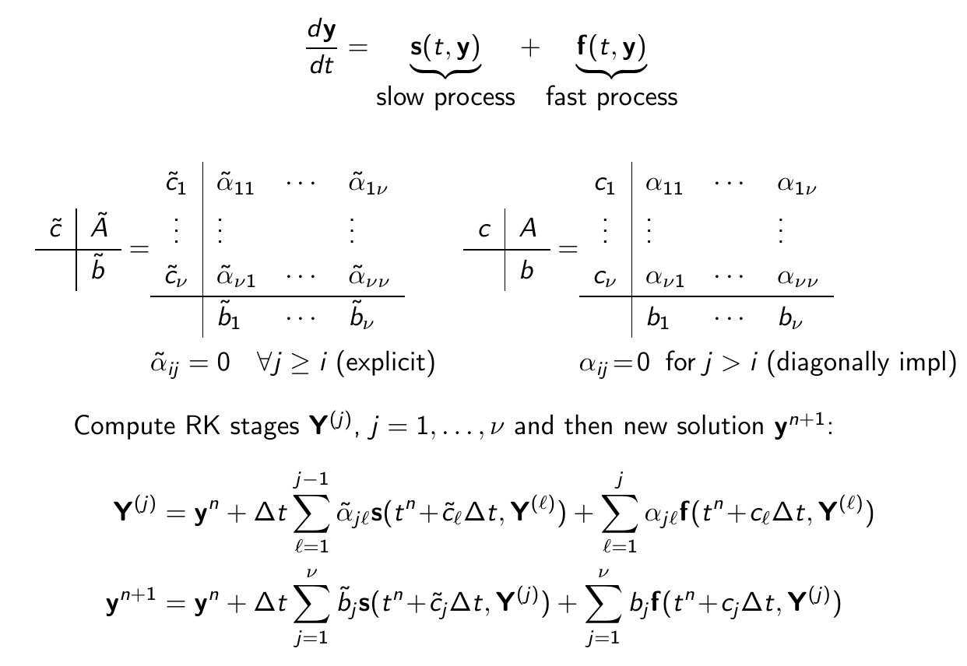
IMEX: Blending explicit with implicit

Slide 23
Some useful theoretical properties
A-stable method: unconditionally stable method for all damping & oscillatory linear problems and consequently for linear constant coefficient systems
  Explicit methods cannot be A-stable (stability functions are polynomials rather than rational functions)
L-Stability: A-stable + rapid decay for stiff problems at long timesteps i.e. for the above linear equation
Strong Stability Preserving: SSP is a desirable property for a hyperbolic PDE . A scheme is SSP if for a given space discretization which is Total Variation Diminishing (TVD) when combined with forward Euler time discretization, it preserves the TVD property for some norm and timestep i.e.

Slide 24
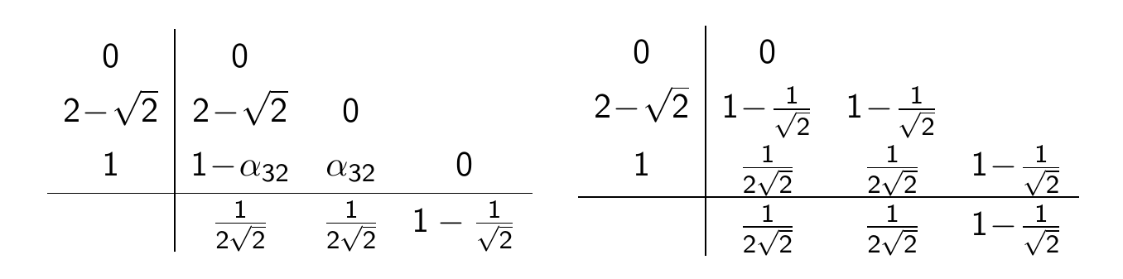
Example of IMEX – ARK2(2,3,2)
Giraldo et al SIAM J.Sci.Comp., 2013 option in NUMA NH US Navy model
2nd order + L-Stable, overall very accurate and stable (Weller et al JCP 2013)

Slide 25
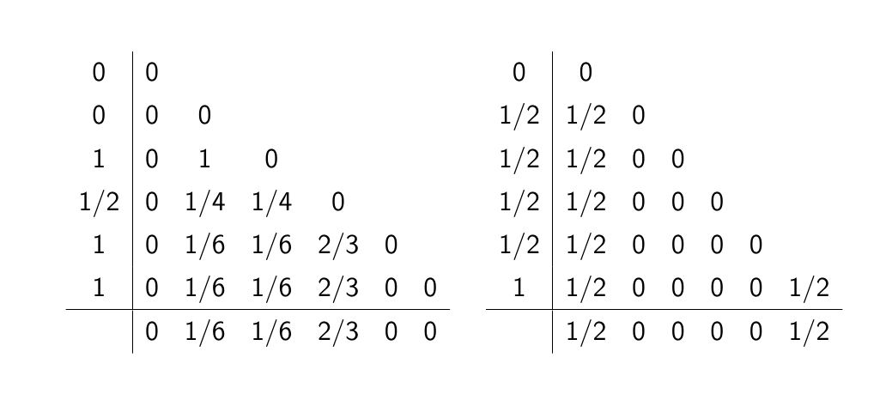
Example of IMEX
2nd order Ulrich & Jablonowski (MWR, 2012) ‘Strang carryover’ UJ3(1,3,2) scheme
Explicit part SSP and 3rd order, overall accuracy 2nd order
Only final stage Y₆ is implicit

Slide 26
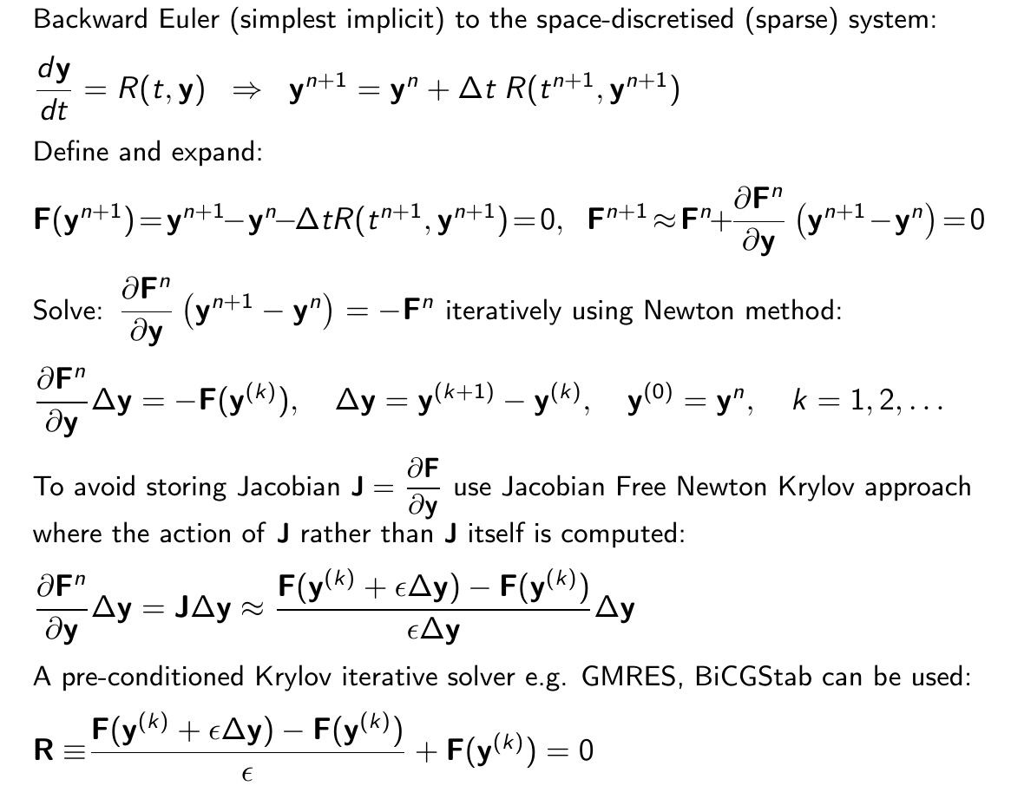
The JFNK approach for solving a 3D implicit system

Slide 27
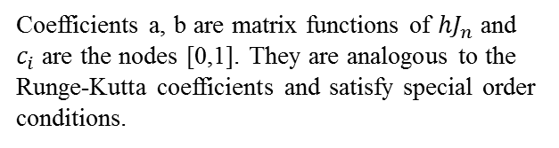
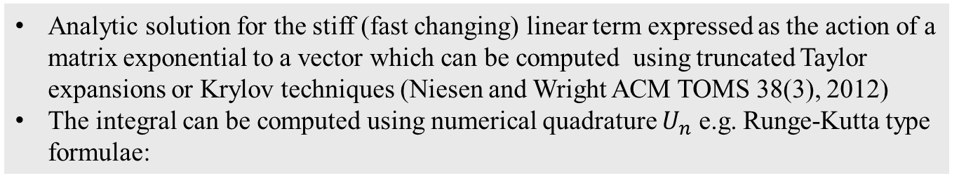
An emerging technique: exponential integrators
Linearise the right hand side F of a nonlinear ODE system around a numerical solution $U_{n}$:
$J_{n}$ is the Jacobian, N$(U)$ the nonlinear residual. After multiplying with an integrating factor $e^{−J_{n}t}$ and few algebraic manipulations
Analytic solution for the stiff (fast changing) linear term expressed as the action of a matrix exponential to a vector which can be computed using truncated Taylor expansions or Krylov techniques (Niesen and Wright ACM TOMS 38(3), 2012)
The integral can be computed using numerical quadrature $U_{n}$ e.g. Runge-Kutta type formulae:
Coefficients a, b are matrix functions of ${hJ}_{n}$ and $c_{i}$ are the nodes [0,1]. They are analogous to the Runge-Kutta coefficients and satisfy special order conditions.
Further reading: Luan et al, JCP Vol 376, Jan 2019, p 817-837

Slide 28
Overview
There are many choices of numerical techniques
What to choose depends on the problem you solve (mathematical formulation, resolution, domain) and the computer architecture you apply your algorithm
Nowadays mainly due to hardware requirements and interest in developing very high resolution systems there is considerable research & development activity in scalable compact stencil Eulerian techniques which are also suited for developing dynamical cores with formal conservation properties

Slide 29
Some references
Dale Durran’s book: “Numerical methods for Wave Equations in Geophysical Fluid Dynamics” (1999)
Lauritzen et al book: Numerical Techniques for Global Atmospheric Models, Springer 2011
Mengaldo et al, Archives of Comp. Meth. in Eng. (2018): Current and Emerging Time-Integration Strategies in Global NWP
Wicker & Skamarock (MWR 2001): “Time-Splitting Methods for Elastic Models Using Forward Time Schemes”

Slide 30
Thank you for your attention!

